Slide 1
Unit-II

Slide 2
Topics
INHERITANCE AND POLYMORPHISM: Basic concepts, Types of inheritance, Member access rules, Usage of this and Super key word, Method Overloading, Method overriding, Abstract classes, Dynamic method dispatch, Usage of final keyword.
PACKAGES AND INTERFACES: Defining package, Access protection, importing packages, Defining and Implementing interfaces, and Extending interfaces

Slide 3
Types of inheritance

Slide 4
What is Inheritance ?:
The process of acquiring properties and behaviors from one class to another class is called Inheritance.
Properties : variables
Behaviours : methods

Slide 5
The main purpose of the inheritance is code extensibility whenever we are extending automatically the code is reused.
By using extends keyword we are achieving inheritance concept.
Inheritance is also known as is-a relationship means two classes are belongs to the same hierarchy.

Slide 6
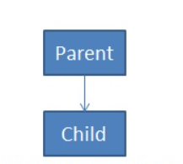
In inheritance one class giving the properties and behavior and another class is taking the properties and behavior.
In the inheritance the person who is giving the properties is called parent ,The person who is taking the properties is called child.

Slide 7
Types of Inheritance:
Single Inheritance
Multilevel Inheritance
Hierarchical Inheritance
Hybrid Inheritance
Multiple Inheritance

Slide 8
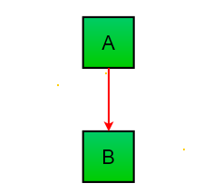
Single inheritance
In single inheritance, subclasses inherit the features of one superclass.
class A serves as a base class for the derived class B.

Slide 9

Multilevel Inheritance
In Multilevel Inheritance, a derived class will be inheriting a base class and as well as the derived class also act as the base class to other class.
Ex:

Slide 10
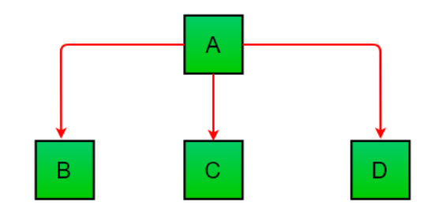
Hierarchical Inheritance
In Hierarchical Inheritance, one class serves as a superclass for more than one sub class.
Ex:

Slide 11
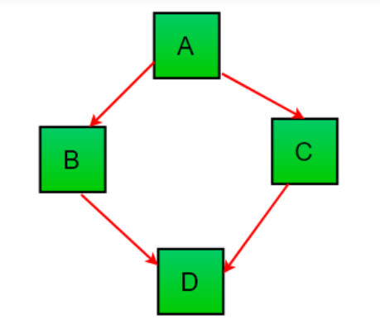
Hybrid Inheritance
It is a mix of two or more of the above types of inheritance.
Since java doesn’t support multiple inheritance with classes, the hybrid inheritance is also not possible with classes.

Slide 12
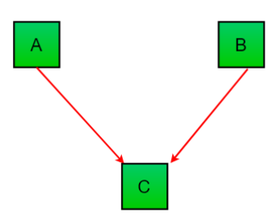
Multiple Inheritance
In Multiple inheritance ,one class can have more than one parent class and inherit features from all parent classes.
Java does not support multiple inheritance with classes.

Slide 13
Object class
Every class in the java programming is a child class of Object.
The base class for all java classes is Object class.
The default package in the java programming is java.lang package.

Slide 14
Ex:
class Test
{
}
====>The above class declaration is equal to below one
class Test extends Object
{
}

Slide 15
Member access rules

Slide 16
Member access rules
public:
Members with the public access modifier are accessible from anywhere, both within the class hierarchy and from outside the class.
Public members of a superclass are inherited and can be accessed in the subclass.
protected:
Members with the protected access modifier are accessible within the same package and by subclasses, even if they are in a different package.
Protected members of a superclass are inherited by the subclass.

Slide 17
default:
If no access modifier is specified (default access), members are accessible within the same package but not outside of it.
Default members of a superclass are inherited by the subclass if they are in the same package.
private:
Members with the private access modifier are only accessible within the class where they are declared.
Private members of a superclass are not inherited by the subclass

Slide 18
this and super key word

Slide 19
this Keyword

Slide 20
this
In Java, the "this" keyword is a reference to the current object(instance) of the class in which it is used.
It can be used to refer to instance variables and instance methods of the current object within that object's scope.
Here are a few common use cases for the "this" keyword in Java:
Accessing instance variables
Calling another constructor in the same class
Passing this for current object as an argument

Slide 21
Accessing instance variables using this
We can use "this" to distinguish between instance variables and method parameters or local variables when they have the same name.
Ex:
class Student { String name; String mobile; Student(String name,String mobile) { this.name=name; this.mobile=mobile; } }

Slide 22
Calling another constructor in the same class using this
When a class has multiple constructors, you can use "this" to call another constructor from the same class. This is useful for constructor overloading and code reuse.
class Employee
{ private int value; public Employee() { this(0); // Calls the parameterized constructor with an initial value of 0 } public Employee(int value) { this.value = value; } }

Slide 23
Passing this for current object as an argument
"this" can be used to pass the current object as an argument to a method or another constructor.
Ex:
public class Test { int i=10; public static void main(String[] args) { Test t=new Test(); t.m1(); } public void m1() { System.out.println("m1- method is calling.."); m2(this); } public void m2(Test t) { int i=100; System.out.println("Local var i="+i); System.out.println("Instance var i="+t.i); } }

Slide 24
super Keyword

Slide 25
super is a keyword in Java which is used to
Call the Super class variable
Call the super class methods
Call the super class constructor
The most common use of the super keyword is to eliminate the confusion and ambiguity between super classes and subclasses that have methods , Variables with the same name.

Slide 26
Calling Super class variable:
If the child class and parent class has same data members (Variables). In that case there is a possibility of ambiguity for the JVM.
To avoid above ambiguity we should use super keyword inside child class

Slide 27
Example:
class Parent { int X=100; int Y=200; } class Child extends Parent { int X=300; int Y=400; public void add() { System.out.println("Parent class value ="+(super.X+super.Y)); System.out.println("Child class value ="+(X+Y)); } } class SuperDemo { public static void main(String[] args) { Child c=new Child(); c.add(); } }

Slide 28
Calling super class methods
If the child class and parent class has same data method names. In that case there is a possibility of ambiguity for the JVM.
To avoid above ambiguity we should use super keyword inside child class

Slide 29
Calling super class methods:
class Parent { int X=100; int Y=200; public int add() { return X+Y; } } class Child extends Parent { int X=300; int Y=400; public int add() { return X+Y; } public void printResult() { System.out.println("Parent class vlaue:"+super.add());//Super method to call a method System.out.println("Child class vlaue:"+add()); } } class Test { public static void main(String[] args) { Child c=new Child(); c.printResult(); } }

Slide 30
Calling the super class constructor
super() method is used to call Super class(Parent class) constructor.
super() method call must be inside constructor only. No other method is allowed to call.
super() must be first statement of the constructor.
Both this(), super() methods must be call inside the Constructor. But at a time only one is allowed to call either this() or super().

Slide 31
super() method is used to call Super class(Parent class) constructor.
public class Parent { public Parent() { System.out.println("Parent class constructor:"); } } class Child extends Parent { public Child() { super();//calling parent class constructor } public static void main(String[] args) { Child c=new Child(); } }

Slide 32
super() must be first statement of the constructor.
class Child extends Parent { public Child() { System.out.println("Hello.."); super(); } public static void main(String[] args) { Child c=new Child(); } }

Slide 33
super() method call must be inside constructor only. No other method is allowed to call.
class Child extends Parent { public Child() { }
public void m1()
{
super();
}
public static void main(String[] args) { Child c=new Child(); } }

Slide 34
Both this(), super() methods must be call inside the Constructor. But at a time only one is allowed to call either this() or super().
class Child extends Parent { public Child() { this(); super(); } public static void main(String[] args) { Child c=new Child(); } }

Slide 35
Polymorphism

Slide 36
Polymorphism?
Poly=Many
Morph=forms
Polymorphism means "many forms", Performing single task in many ways.

Slide 37
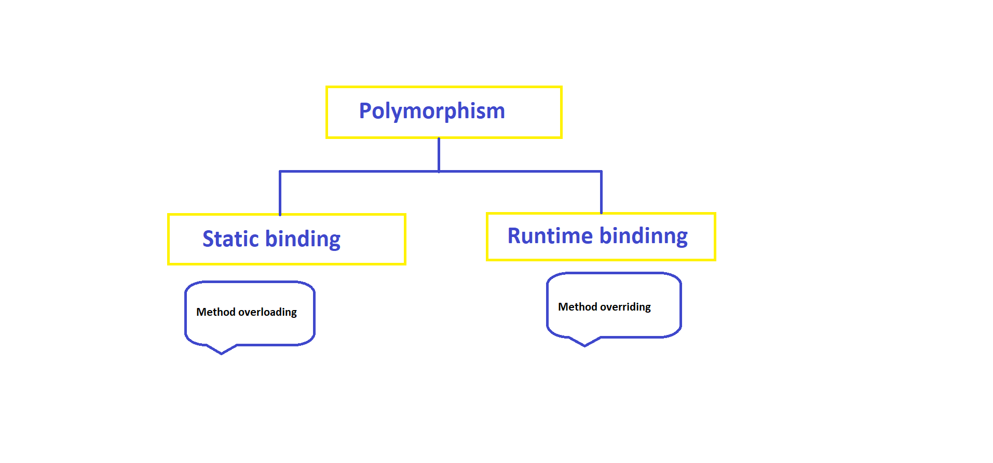

Slide 38
Method Overloading

Slide 39
Method overloading:
It is a process of rewriting a method with different signatures within the same class is called Method overloading.
Two methods are said to be overloaded methods if and only if two methods are having same name but different argument list.
Method overloading can be done in one class.
We can overload any number of methods

Slide 40
The compiler does not consider return type when differentiating methods, so you cannot declare two methods with the same signature even if they have a different return type.
Method resolution takes care by the Compiler.
This process also called Compile time polymorphism (or) Static binding (or) Early binding.

Slide 41
Ex:
public class MethodOverloading { public int getSum(int a,int b)
{ return a+b; }
public float getSum(float a,float b)
{ return a+b; } }

Slide 42
Method overriding

Slide 43
Method overriding:
Rewriting a parent class method in child class is called Method overriding.
Overriding concept is possible if and only if two classes should be in Parent – Child relationship.
In Method overriding JVM is the responsible for Method resolution based on object type.
This process also called as Dynamic binding (or) Late binding (or) Dynamic polymorphism.

Slide 44
Rules for overriding
In method overriding method name and method signature should be same.
Return type: Must be same (optionally covariant type )
Modifier : Method scope should not decrease
Scope order as follows : public>protected>default>private
Possible cases:
public → public
protected → protected, public
default → default, protected, public
private → (Private methods are can not be override)

Slide 45
Static methods: For static Methods overriding concept is not applicable. But Method hiding is possible.
In Method hiding compiler is the responsible for method resolution.
Ex: Method hiding
class Parent { public static void m1() { System.out.println("Parent class method"); } } class Child extends Parent { public static void m1() { System.out.println("Child class method"); } }

Slide 46
final Methods: final Methods cannot be overridden..
final → final ,Non final (Overriding is not possible)
Non final → final (Overriding is possible)

Slide 47
Dynamic method dispatch

Slide 48
Dynamic method dispatch

Slide 49
Usage of final keyword

Slide 50
final is a keyword or modifier applicable to
variables (for all instance, Static and local variables).
methods
classes

Slide 51
final Variables:
If a variable is declared with final keyword, its value can’t be modified, and we can make a variable as a constant.
We must initialize a final variable, otherwise compiler will generates compile-time error.
As per Java documentation final variables naming convention should be in all uppercase, use underscore to separate words.
Ex: public static final double PI=3.141592653589793

Slide 52
Initializing a final variable :
There are three ways to initialize a final variable :
You can initialize a final variable when it is declared. This approach is the most common
A blank final variable can be initialized inside instance block or inside constructor. If you have more than one constructor in your class then it must be initialized in all of them, otherwise compile time error will be thrown.
A blank final static variable can be initialized inside static block.

Slide 53
Ex:
public class FinalVariable { public final double PI=3.141592653589793;//Final Variable initialization at declaration public final int I; public final int J; public static final int DATABASE_VERSION; FinalVariable() { I=10;// Final Variable initialization inside constructor block } { J=20;// Final Variable initialization inside instance block } static { DATABASE_VERSION=2;// Final Variable initialization
inside static block }
}

Slide 54
final Class
When a class is declared with final keyword, it is called a final class.
If a class is declared as final, then we cannot inherit that class i.e., we cannot create any child class for that final class.
Ex: You can not create child class to the String class . Because String is the final class.

Slide 55
Ex:
final class Parent { } class Child extends Parent { //Child class is not possible //Compile time error }

Slide 56
Every method present inside a final class is always final by default but every variable present inside the final class need not be final.
Example:
final class Demo { int a=10; void m1() { System.out.println("m1 method is final"); System.out.println(a=a+1); } public static void main(String[] args) { Demo d=new Demo(); d.m1(); } }

Slide 57
final methods
If a method is declared with final keyword, it is called a final method. A final method cannot be overridden.
If you want to restrict implementation of a method then you can declare it as final.
For example in Object class we can override some methods like equals(), toString() but you cant override method like wait(), notify(), notifyAll() because these methods are declared as final.

Slide 58
Eample:
class Parent { public void m1() { System.out.println("Parent class method ... m1()"); }
public final void m2() { System.out.println("It is method -2"); } }
class Child extends Parent { public void m1() { System.out.println("Hello this is child class method..m1()"); }
public void m2() { //Compile thime error } }

Slide 59
Note:
The main advantage of final modifier is ,We can achieve security as no one can be allowed to change our implementation.
But the main disadvantage of final keyword is we are missing key benefits of Oops like inheritance and polymorphism.
Hence if you have specific requirement you can use but it never recommended to use final modifier.

Slide 60
Abstract classes

Slide 61
Abstraction

Slide 62
What is Abstraction?
In Object-oriented programming, abstraction is a process of hiding the internal implementation details from the user, only the essential functionality will be provided to the user.
Abstraction can be achieved with either abstract classes or interfaces

Slide 63
Normal methods vs Abstract Methods
Normal methods:
Normal method contains declaration as well as method definition
Ex: public void method()
{
---------
--------body;
---------
}

Slide 64
Abstract methods:
The method which is having declaration but not definition such type of methods are called abstract methods.
Every abstract method should end with “;”.
The child classes are responsible to provide implementation for parent class abstract methods.
Ex: abstract void method(); //abstract method
Note: The methods marked abstract end in a semicolon rather than curly braces.

Slide 65
Normal classes vs Abstract classes
Normal classes:
Normal class is a java class contains only normal methods.
Ex: class Test { void m1() { -- } void m2() { -- } }

Slide 66
Abstract class:
If a class contains at least one abstract method then it is a abstract class.
To specify the particular class is abstract and particular method is abstract method to the compiler use abstract modifier.
It is not possible to create an object to the Abstract class. Because it contains the unimplemented methods.
For any class if we don’t want instantiation then we have to declare that class as abstract i.e., for abstract classes instantiation (creation of object) is not possible.

Slide 67
Ex:
abstract class Test { abstract public void m1(); public void m2() { } }

Slide 68
Abstract method (all) implementation should be done in Child class.
Ex:
abstract class Parent { abstract public void m1(); }
class Demo extends Parent { public void m1() { System.out.println("Method m1() implementation"); } }

Slide 69
Even though class does not contain any abstract method still we can declare the class as abstract.
Abstract class contain zero or more number of abstract methods.
For abstract classes it is not possible to create an object

Slide 70
Ex:
abstract class Test { void m1() { System.out.println("m1-method"); } void m2() { System.out.println("m2-method"); } public static void main(String[] args) { //Compile time Error t.m1(); } };
Test t=new Test()

Slide 71
Interfaces

Slide 72
Interface is also one type of class and It contains only abstract methods.
All interface methods are implicitly public and abstract. In other words, you do not need to actually type the public or abstract modifiers in the method declaration, but the method is still always public and abstract.
For the every interface compiler will generates .class files
Each and every interface by default abstract hence it is not possible to create an object.
Interfaces not alternative for abstract class it is extension for abstract classes.

Slide 73
Interface contains only abstract methods means unimplemented methods.
Interface also called 100% Abstract class.
Interfaces giving the information about the functionalities or Services And it will hide the information about internal implementation.
To provide implementation for abstract methods we have to use implements Keyword
For the interfaces also inheritance concept is applicable.

Slide 74
By using interface keyword we can declare interfaces in Java
Syntax:
interface Interface_Name
{
--
}
Ex: interface Demo
{
void m1();
}

Slide 75
abstract interface InterfaceDemo
{
public abstract void m1();
public abstract void m2();
public abstract void m3();
}
Ex:
interface InterfaceDemo
{
void m1();
void m2();
void m3();
}

Slide 76
Every variable in Interface by default public static final
interface InterfaceDemo
{
int i=10;
}
public static final int i=10;

Slide 77
interface InterfaceDemo1 { public void method1(); public void method2(); } interface InterfaceDemo2 extends InterfaceDemo1 { public void method3(); public void method4(); } class Demo implements InterfaceDemo2 { @Override public void method1() { System.out.println("InterfaceDemo1- method1() implementation"); } @Override public void method2() { System.out.println("InterfaceDemo2- method2() implementation"); } @Override public void method3() { System.out.println("InterfaceDemo3- method3() implementation"); } @Override public void method4() { System.out.println("InterfaceDemo4- method4() implementation"); } }
Interfaces with inheritance

Slide 78
interface InterfaceDemo1 { public void method1(); } interface InterfaceDemo2 { public void method2(); public void method3(); } class Demo implements InterfaceDemo1,InterfaceDemo2 { @Override public void method1() { System.out.println("InterfaceDemo1- method1() implementation"); } @Override public void method2() { System.out.println("InterfaceDemo2- method2() implementation"); } @Override public void method3() { System.out.println("InterfaceDemo3- method3() implementation"); } }
Multiple inheritance
with respect to Interfaces

Slide 79
Packages

Slide 80
Access control

Slide 81
Access modifiers:
The access modifiers in Java talks about the accessibility or scope of a Variables ,Methods, Constructor, or Class.
Depends on our requirements we can change the access level.
In Java we have 4 types of access modifiers:
private
Default(No access modifier)
protected
public

Slide 82
private:
Private modifier is applicable to methods , constructor and data members(Variables).
private members are accessible only within the class in which they are declared. Out side of the class we cannot access.
We cannot declare class with private modifier. But it is possible to declare for inner class.
private modifier having less scope to comparative other access modifiers i.e, more restrictive.

Slide 83
default modifier(No modifier):
If we are not specifying any access modifier for a class , method or data member ,It is said to be having the default access modifier by default.
The data members, class or methods which are not declared using any access modifiers i.e. having default access modifier are accessible only within the same package.
default modifier having more scope than private and less scope than protected and public modifiers.

Slide 84
protected:
The methods or data members declared as protected are accessible within same package or sub classes in different package.
protected modifier having more scope than default, private modifiers and less scope than public modifier.

Slide 85
public:
The public access modifier has the more scope among all other access modifiers.
Classes, methods or data members which are declared as public are accessible from every where in the program.
There is no restriction on the scope of a public data members.

Slide 86
Scope order:
public > protected > default > private

Slide 87
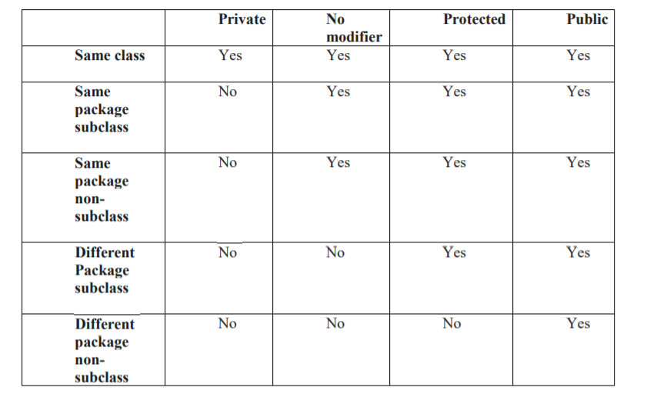

Slide 88
Packages

Slide 89
Information regarding packages:
The package contains group of related classes , interfaces, sub packages.
The package is an encapsulation mechanism it is binding the related classes and interfaces.
We can declare a package with the help of package keyword.
Package is nothing but physical directory (folder) structure and it is providing clear-cut separation between the project modules.
Whenever we are dividing the project into the packages(modules) the shareability of the project will be increased.

Slide 90
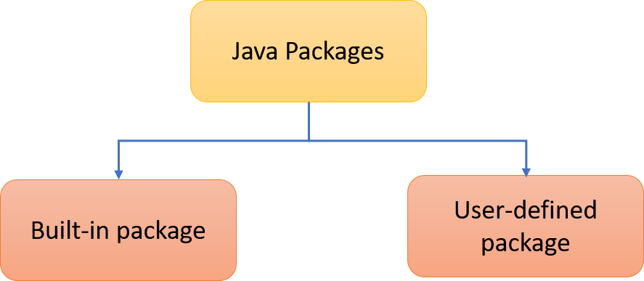
Syntax:
package package_name;
Ex: package com.mlrit;
Packages are divided into two types
Predefined packages
User defined packages

Slide 91
Predefined packages:
Java predefined packages contains all predefined classes and interfaces.
Ex:
java.lang ,
Java.io,
Java.awt ,
Java.util
Java.net.. etc.

Slide 92
Java.lang:
The most commonly required classes and interfaces to write a sample program is encapsulated into a separate package is called java.lang package.
It is a default package , No need to import this package.
Ex: String(class)
StringBuffer(class)
Object(class)
Runnable(interface)
Cloneable(nterface)

Slide 93
Java.io :
The classes which are used to perform the input output operations that are present in the java.io packages.
Ex:
FileInputStream(class)
FileOutputStream(class)
FileWriter(class)
FileReader(class)
Serializable(Inteface)

Slide 94
java.net :
The classes which are required for connection establishment in the network that classes are present in the java.net package.
Ex:
HttpURLConnection
Socket
URL
ServerSocket
InetAddress
SocketOptions (Interface)

Slide 95
Java.util
Contains the collections framework, legacy collection classes, event model, date and time facilities, internationalization, and miscellaneous utility classes.
Ex:
Calender
Date
Scanner
Arrays
ArrayList
Collection<E> (Interface)
Iterator<E> (Interface)
.. etc

Slide 96
java.sql
Provides the API for accessing and processing data stored in a data source (usually a relational database) using the JavaTM programming language.
Ex:
Date
DriverManager
Blob (Interface)

Slide 97
java.awt:
The classes which are used to prepare graphical user interface those classes are present in the java.awt package.
Ex: Button (class)
Checkbox(class)
Choice (Class)
List (class)
ActiveEvent (Interface)

Slide 98
User defined packages:
The packages which are defined by the user are called user defined packages.
In the single source file it is possible to take the only one package. If we are trying to take two packages at that time compiler raise a compilation error.
In the source file it is possible to take single package statement.
While taking package name we have to follow some coding standards.

Slide 99
Rules to follow while writing package:
The package name is must reflect with your organization name and package name is reverse of the organization domain name.
Domain name: www.example.com
Package name: package com.example;

Slide 100
The package must be the first statement of the source file and it is possible to declare at most one package within the source file .
The import statement must be in between the package and class statement. And it is possible to declare any number of import statements within the source file.
The class declaration must be after package and import statement and it is possible to declare any number of class within the source file.

Slide 101
It is possible to declare at most one public class.
It is possible to declare any number of non-public classes.
The package and import statements are applicable for all the classes present in the source file.
It is possible to declare comments at beginning and ending of any line of declaration it is possible to declare any number of comments within the source file.

Slide 102
Advantages of Packages:
Java package is used to categorize the classes and interfaces so that they can be easily maintained.
Java package removes naming collision or naming conflicts.
Packages provide reusability of code .
Java package provides access protection.

Slide 103
Path and Class Path:
Path and Classpath both are operating system level environment variables.
Path is used define where the system can find the executables (.exe) or bin files.
Classpath is used to specify the location .class files.

Slide 104
Static import
Static import allows you to access the static member of a class directly without using the fully qualified name.
Example:
import static java.lang.Math.*; class Test { public static void main(String[] args) { System.out.println(sqrt(16)); System.out.println(min(20,30)); } }

