Slide 1

OBJECT ORIENTED PROGRAMMING THROUGH JAVA

Slide 2

L12 - CONSTRUCTORS

Slide 3


Slide 4
Constructors in Java
In Java, a constructor is a block of codes similar to the method. It is called when an instance of the class is created.
At the time of calling constructor, memory for the object is allocated in the memory.
It is a special type of method which is used to initialize the object.
Every time an object is created using the new() keyword, at least one constructor is called.

Slide 5
Rules for creating Java constructor:-
There are two rules defined for the constructor.
Constructor name must be the same as its class name
A Constructor must have no explicit return type
A Java constructor cannot be abstract, static, final, and synchronized

Slide 6
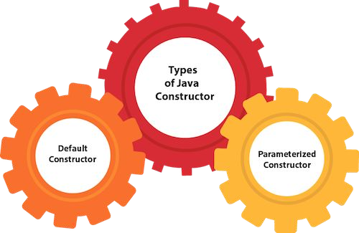

Slide 7
Java Default Constructor
A constructor is called "Default Constructor" when it doesn't have any parameter.
Syntax of default constructor:
<class_name>()
{ }

Slide 8
public class Bike1
{
Bike1()
{
System.out.println("Bike is created");
}
public static void main(String args[])
{
Bike1 b=new Bike1();
}
}
Bike is created

Slide 9
Java Parameterized Constructor
A constructor which has a specific number of parameters is called a parameterized constructor.
Why use the parameterized constructor?
The parameterized constructor is used to provide different values to distinct objects.
However, you can provide the same values also.

Slide 10
class Rectangle
{
int area, length, breadth;
// Parameterized constructor Rectangle(int l, int b)
{
length = l; breadth = b;
}
void getArea()
{
area = length * breadth; System.out.println("Area of rectangle : " + area);
}
}

Slide 11
public class FindArea
{
public static void main(String[] args)
{
Rectangle rs = new Rectangle(10, 20);
rs.getArea();
}
}

Slide 12
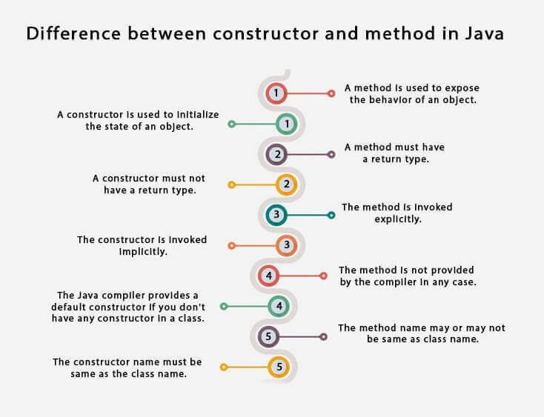

Slide 13
Next….
STATIC BLOCK,STATIC DATA & STATIC METHOD
Notes:
In Slide Show mode, click the arrow to enter the PowerPoint Getting Started Center.

Slide 14


