Slide 1

OBJECT ORIENTED PROGRAMMING THROUGH JAVA

Slide 2

L15- STATIC KEYWORD

Slide 3


Slide 4

STATIC KEYWORD
The static can be:
Static Variables
Static Methods
Static Blocks Of Code.

Slide 5
STATIC VARIABLE
Static variables are class variables. A single copy of variable is created and shared among all objects at class level
Static variables are essentially global variables.
All instances of the class share the same static variable initialized only once at the start of the execution.
It is a variable which belongs to the class and not to object(instance ).
Static variables are initialized only once, at the start of the execution. These variables will be initialized first, before the initialization of any instance variables.
A static variable can be accessed directly by the class name and doesn’t need any object

Slide 6
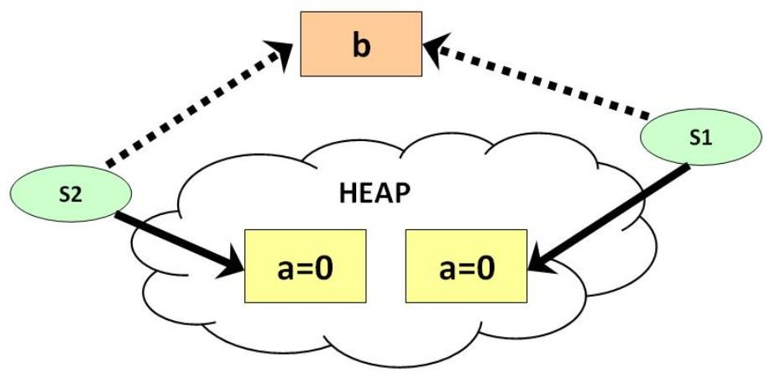
STATIC VARIABLE
class Test
public static void main(String[] args)
{
int a ;
{
static int b;
Test s1=new Test();
Test() {
s1.show();
a++;
Test s2=new Test();
b++;
s2.show();
}
}
void show()
{
System.out.println(a+” “+b);
}

Slide 7
STATIC BLOCK
Java supports a special block, called static block (also called static clause) which can be used for static initializations of a class. This code inside static block is executed only once: the first time the class is loaded into memory.
class Test {
static int i;
int j;
static {
i = 10;
System.out.println("static block called ");}
Test(){
System.out.println("Constructor called");
}
}
class Main {
public static void main(String args[]) {
// Although we have two objects, static block is executed only once.
Test t1 = new Test();
Test t2 = new Test();
}
}

Slide 8
STATIC BLOCK
class Test
{
// static variable
static int a = 10;
static int b;
// static block
static {
System.out.println("Static block initialized."); b = a * 4;
}
public static void main(String[] args)
{
System.out.println("from main");
System.out.println("Value of a : "+a); System.out.println("Value of b : "+b);
}
}

Slide 9
STATIC BLOCK
Static block
The static blocks are executed at the time of class loading.
The static blocks are executed before running the main () method.
The static blocks don't have any name in its prototype.
If we want any logic that needs to be executed at the time of class loading that logic needs to placed inside the static block so that it will be executed at the time of class loading.
Syntax
static {
//some statements
}

Slide 10
STATIC METHOD
When a method is declared with static keyword, it is known as static method. The most common example of a static method is main( ) method.
A static method can call only other static methods and cannot call a non-static method from it.
A static method can be accessed directly by the class name and doesn’t need any object
A static method cannot refer to "this" or "super" keywords in anyway

Slide 11
STATIC METHOD
class Test
public static void main(String[] args)
{
{
int a ;
Test t=new Test();
static int b;
t.show();
Test.show1();
}
}
void show(){
System.out.println("Value of a : "+a);
}
static void show1(){ System.out.println("Value of b : "+b); }

Slide 12

Next….
STRINGS
Notes:
In Slide Show mode, click the arrow to enter the PowerPoint Getting Started Center.

Slide 13


