Slide 1


OBJECT ORIENTED PROGRAMMING THROUGH JAVA

Slide 2

L8-ARRAYS

Slide 3


Slide 4
ARRAYS:-
In this digital world, storing information is a very crucial task to do as a programmer. Every little piece of information needs to be saved in the memory location for future use.
Instead of storing hundreds of values in different hundreds of variables, using an array, we can store all these values in just a single variable. To use that data frequently, we must assign a name, which is done by variable.
An array is a homogenous non-primitive data type used to save multiple elements (having the same data type) in a particular variable.
Arrays in Java can hold primitive data types (Integer, Character, Float, etc.) and non-primitive data types(Object). The values of primitive data types are stored in a memory location, whereas in the case of objects, it's stored in heap memory.

Slide 5

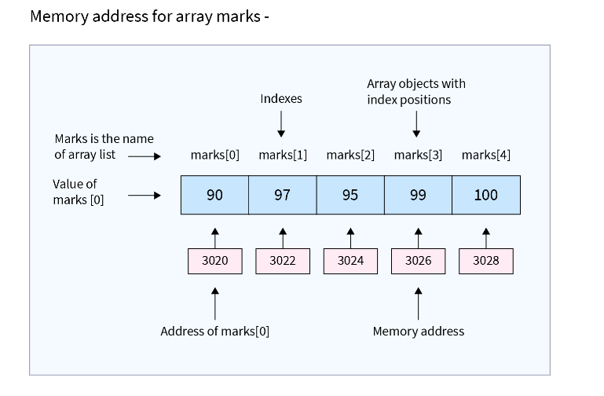

Slide 6
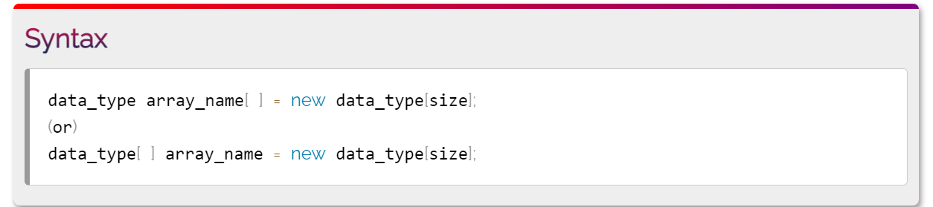
How to Create and Initialize Array in Java:-
In every program, to use an array, we need to create it before it is used. We require two things to create an array in Java - data type and length.
The new keyword is crucial to creating an array. Without using it, we cannot make array reference variables.

Slide 7
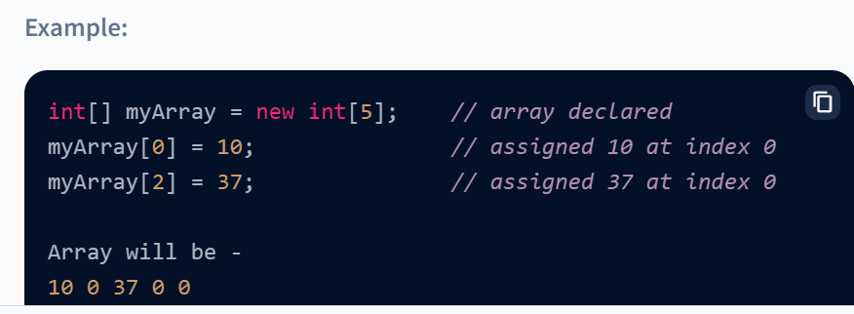
We can Initialize Arrays in Java in two Different ways –
1.Initialize using index - Once an array is created successfully, we can assign the value to any specific element using its index. Un-assigned elements automatically take the default value of the array's data type. In this case, 0 for the integer data type. On the other hand, if we try to enter more values than the size of the array, it will raise an ArrayIndexOutOfBoundsException.

Slide 8
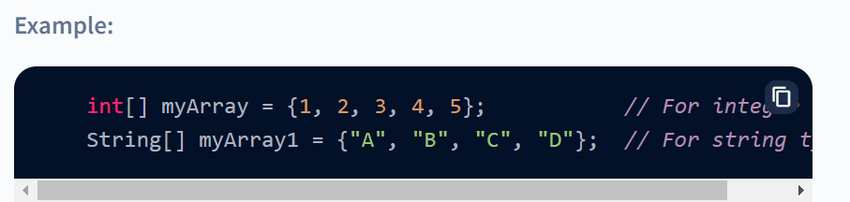
Initialize while declaring - We can also initialize the whole array while declaring it just by using curly brackets {}. The string must be in quotes, whereas int, float, etc., do not require that.

Slide 9
Looping Through Array Elements:-
For performing any operation or displaying any elements, we used an index. But by using an index, we can only implement one operation at a time. If we are required to modify all elements in an array, we must write an operation for each index.
To overcome this situation, we have a looping feature in Java that follows the principle write once and execute multiple times.
There are two ways to loop through the array elements.
1.Using for Loop - In this way of looping through the array elements, we need the array's length first. This can be done by java in-built property length. If we start the for loop from 0, then the total iteration will be the array's length - 1, and if we start the for loop from 1, then the total iteration will be the length of an array.

Slide 10
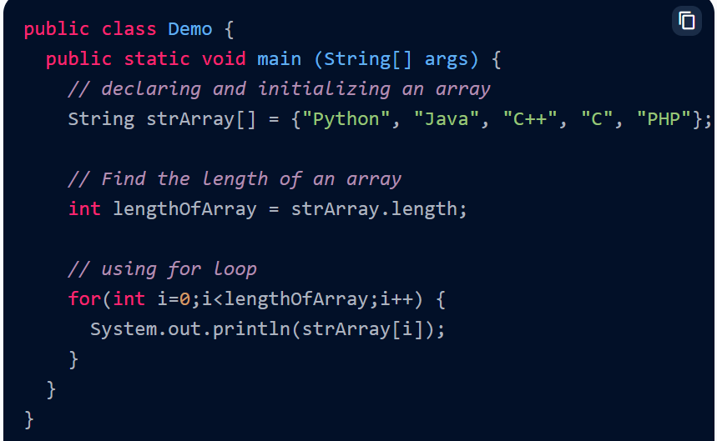

Slide 11
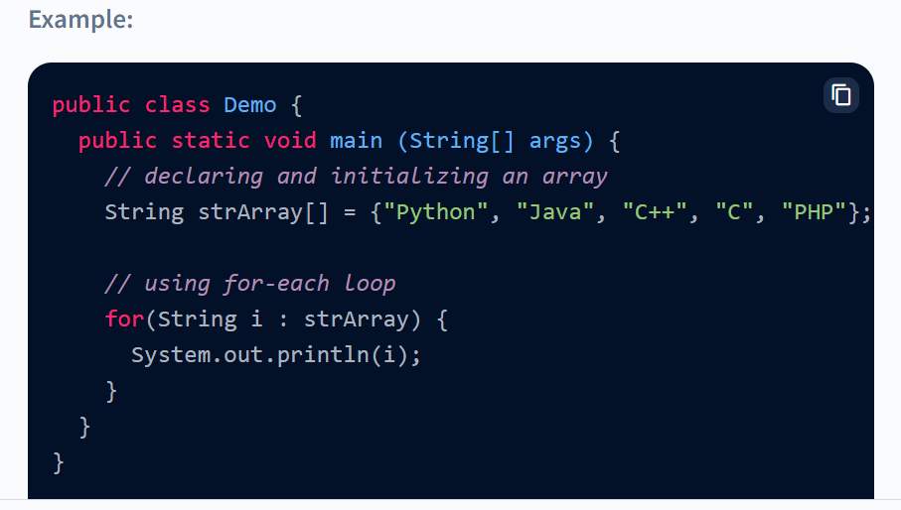
2.Using for-each loop - In this way, we use a for loop, but we do not need the length of the array. The for-each method is much easier to loop through the array element than looping for-loop. While using the for-each loop, we need to define a variable of the same type as the data type of the defined array. If not done, the compiler will throw compile time error saying- incompatible types:

Slide 12
Types of Array in Java:-
In Java, there are two types of arrays:
Single-Dimensional Array
Multi-Dimensional Array
Single Dimensional Array:-
An array that has only one subscript or one dimension is known as a single-dimensional array. It is just a list of the same data type variables.

Slide 13
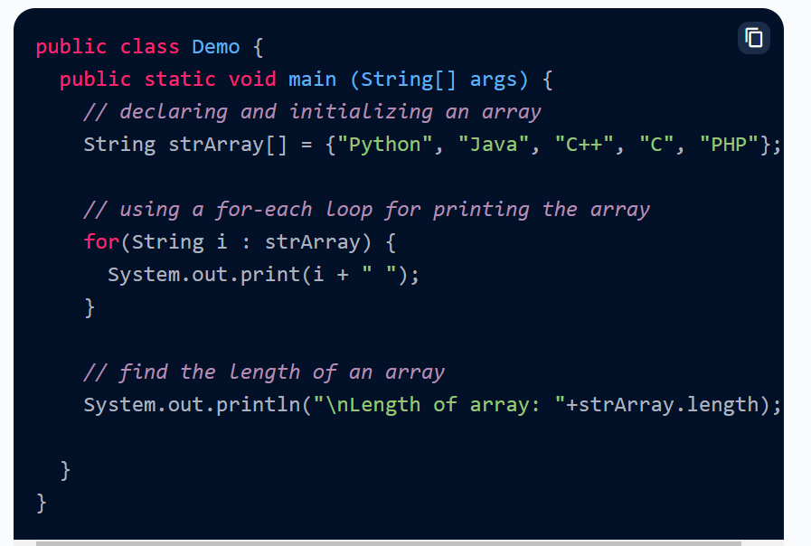

Slide 14
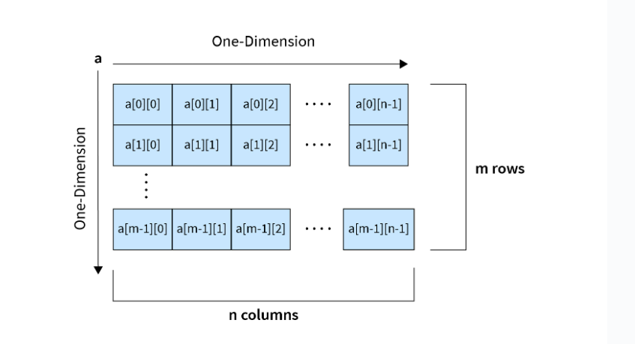
2.Multi-Dimensional Array:-
A multi-dimensional array is very much similar to a single dimensional array. It can have multiple rows and multiple columns unlike single dimensional array, which can have only one row index.
It represent data into tabular form in which data is stored into row and columns.

Slide 15
Multidimensional array can be a 2D array, a 3D array, a 4D array, where D stands for Dimension. But the higher the dimension, the more difficult it is to access and store elements.
Two-Dimensional Array or 2D Array.:-
Many computer games, like simulation games, strategy games, or first-person conflict games, involve objects that occupy a two-dimensional space. Applications for such positional games use a two-dimensional array for representing objects using indices, say i and j, that refer to the cells in the array. The first index refers to a row number, and the second index refers to a column number. In Java, a two-dimensional array is nothing but a table or matrix with columns and rows. It is the simplest multi-dimensional array.
A two-dimensional array can be declared as follows:
DataType[][] arrayName; (OR) DataType arrayName[][];

Slide 16

Initialization:
arrayName = new DataType[length 1][length 2];
Accessing Elements of Two-Dimensional Arrays
Elements of a Two-dimensional array can be accessed using row numbers and column numbers.
arrayName[row_number][column_number];
Printing elements of two-dimensional Arrays
for (int i = 0; i < arrayName.length; i++) {
for (int j = 0; j < arrayName[i].length; j++) {
System.out.print(arrayName[i][j] + " ");
}
}

Slide 17
Three-Dimensional Array or 3D Array.:-
An array is a complex form of a multidimensional array. A three-dimensional array adds an extra dimension and exponentially increases the size of a two-dimensional array. Effectively it is an array containing multiple two-dimensional arrays, with each element addressed by three indices, the first one for a two-dimensional array` and the rest two for the rows and the columns.
Syntax to declare a three-dimensional array:
DataType[][][] arrayName;
Initialization:
arrayName = new DataType[length 1][length 2][length 3];

Slide 18

Next….
OPERATORS
Notes:
In Slide Show mode, click the arrow to enter the PowerPoint Getting Started Center.

Slide 19



