Slide 1
Unit-III

Slide 2
IO Streams

Slide 3
Stream?
A stream is a sequence of data.
In Java, Stream is a channel or a path along which data flows between source and destination.
Java brings various Streams with its I/O package that helps the user to perform all the input-output operations.
A stream can represent many different kinds of sources and destinations, including disk files, devices, other programs, and memory arrays.
Streams support many different kinds of data, including simple bytes, primitive data types, localized characters, and objects.

Slide 4
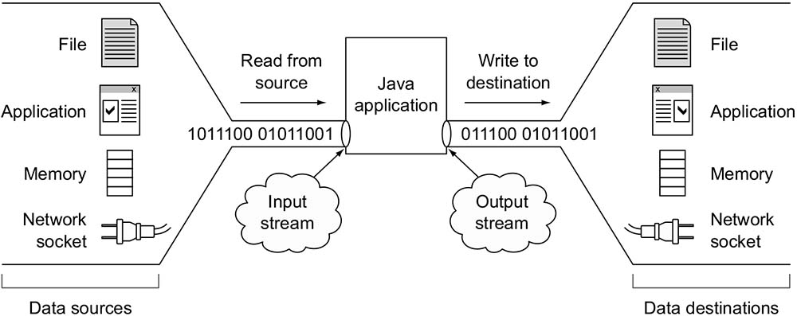

Slide 5
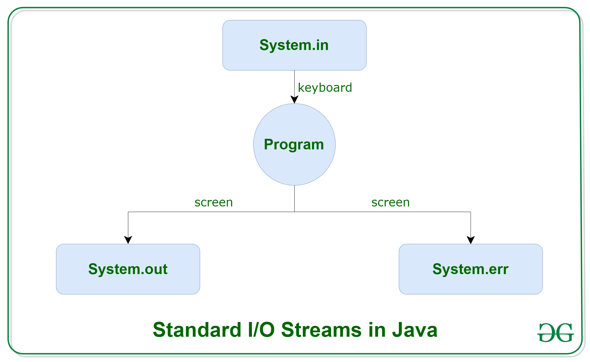
Standard(Default) IO Streams in Java
There are three standard IO Streams in Java
System.in
System.out
System.err

Slide 6
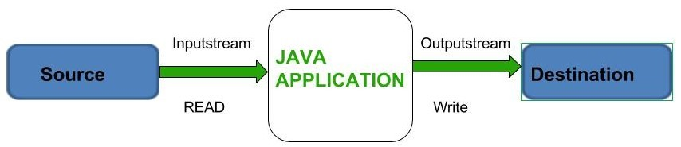
Types of Streams
Depending on the type of operations, streams can be divided into two primary classes.
InputStream
OutputStream

Slide 7
InputStream
These streams are used to read data that must be taken as an input from a source array or file or any peripheral device.
The Java InputStream class is the base class (superclass) of all input streams in the Java IO API.
Each subclass of InputStream typically has a very specific use, but can be used as an InputStream.
Example:
FileInputStream,
BufferedInputStream,
ByteArrayInputStream etc.

Slide 8
OutputStream
These streams are used to write data as outputs into an array or file or any output peripheral device.
The Java OutputStream class is the base class (superclass) of all output streams in the Java IO API.
Each subclass of OutputStream typically has a very specific use, but can be used as an OutputStream
Example:
FileOutputStream,
BufferedOutputStream,
ByteArrayOutputStream etc.

Slide 9
Types of Streams(Based on file types)
Based on file types Streams can be divided into two primary classes
ByteStream
CharacterStream

Slide 10
ByteStreams:
Programs use byte streams to perform input and output of (8-bit) bytes.
All byte stream classes are descended from InputStream and OutputStream.

Slide 11
CharacterInputStream:
Java Character streams are used to perform input and output for 16-bit Unicode.

Slide 12
 | Byte Based |  | Character Based
 | Input | Output | Input | Output
Basic | InputStream | OutputStream | Reader InputStreamReader | Writer OutputStreamWriter
Arrays | ByteArrayInputStream | ByteArrayOutputStream | CharArrayReader | CharArrayWriter
Files | FileInputStream RandomAccessFile | FileOutputStream RandomAccessFile | FileReader | FileWriter
Pipes | PipedInputStream | PipedOutputStream | PipedReader | PipedWriter
Buffering | BufferedInputStream | BufferedOutputStream | BufferedReader | BufferedWriter
Filtering | FilterInputStream | FilterOutputStream | FilterReader | FilterWriter
Parsing | PushbackInputStream StreamTokenizer |  | PushbackReader LineNumberReader
Strings |  |  | StringReader | StringWriter
Data | DataInputStream | DataOutputStream
Data - Formatted |  | PrintStream |  | PrintWriter
Objects | ObjectInputStream | ObjectOutputStream
Utilities | SequenceInputStream

Slide 13
File Handling
File handling in Java implies reading data from the file and writing data to a file.
The File class from the java.io package, allows us to work with different formats of files.
In order to use the File class, you need to create an object of the class and specify the filename or directory name.
Ex:
// Import the File class
import java.io.File;
// Specify the filename
File obj = new File(“sample.txt");

Slide 14
File and Directory
A file is a named location that can be used to store related information.
Ex: main.java is a Java file that contains information about the Java program.
A directory is a collection of files and subdirectories. A directory inside a directory is known as subdirectory.

Slide 15
File handling methods
Method | Type | Description
canRead() | Boolean | It tests whether the file is readable or not
canWrite() | Boolean | It tests whether the file is writable or not
createNewFile() | Boolean | This method creates an empty file
delete() | Boolean | Deletes a file
exists() | Boolean | It tests whether the file exists
getName() | String | Returns the name of the file
getAbsolutePath() | String | Returns the absolute pathname of the file
length() | Long | Returns the size of the file in bytes
list() | String[] | Returns an array of the files in the directory
mkdir() | Boolean | Creates a directory

Slide 16
Example: Creating a File
import java.io.IOException; public class FileDemo { public static void main(String[] args) { File f=new File("sample.txt"); if(f.exists()) { System.out.println("File already existed.."); } else { try { f.createNewFile(); System.out.println("File created successfully.."); } catch (IOException e) { e.printStackTrace(); } } } }

Slide 17
Example: No of Files and Directories in a Directory
import java.io.File; public class Ex2 { public static void main(String[] args) { File f1=new File("."); String[] list=f1.list(); int count=0; for (String name:list) { count++; File f2=new File(name); if(f2.isFile()) { System.out.println("File :"+name); } else if (f2.isDirectory()) { System.out.println("Directory:"+name); } } System.out.println("No of files and dir :"+count); } }

Slide 18
Example: File Information
import java.io.File; import java.util.Scanner; public class Ex3 { public static void main(String[] args) { System.out.println("Enter your file name"); Scanner scr=new Scanner(System.in); String fname=scr.next(); File f=new File(fname); if(f.exists()) { System.out.println("Size of the file :"+f.length()); System.out.println("Absolute path :"+f.getAbsolutePath()); if(f.canRead()) System.out.println(f.getName()+": Is readable file"); else System.out.println(f.getName()+": Is not readable file"); if(f.canWrite()) System.out.println(f.getName()+": Is writeable file"); else System.out.println(f.getName()+": Is not writeable file"); if(f.canExecute()) System.out.println(fname+": Is Executable file"); else System.out.println(fname+": Is not Executable file"); } else { System.out.println("No such file existed.."); } } }

Slide 19
Example: Deleting Specified File
import java.io.File; import java.util.Scanner; public class Ex4 { public static void main(String[] args) { System.out.println("Enter your file name"); Scanner scr=new Scanner(System.in); String fname=scr.next(); File f=new File(fname); if(f.exists()) { if(f.delete()) { System.out.println(f.getName()+" is deleted successfully.."); } else { System.out.println(f.getName()+" is not deleted.."); } } else { System.out.println("No such file existed.."); } } }

Slide 20
Exception Handling

Slide 21
What is an Exception?
It is an unexpected unwanted event which disturbs entire execution flow of the program.
Ex:
SleepingException
TirePuncharedException
PowerCutException
ArithmaticException
Exception also called as runtime error.

Slide 22
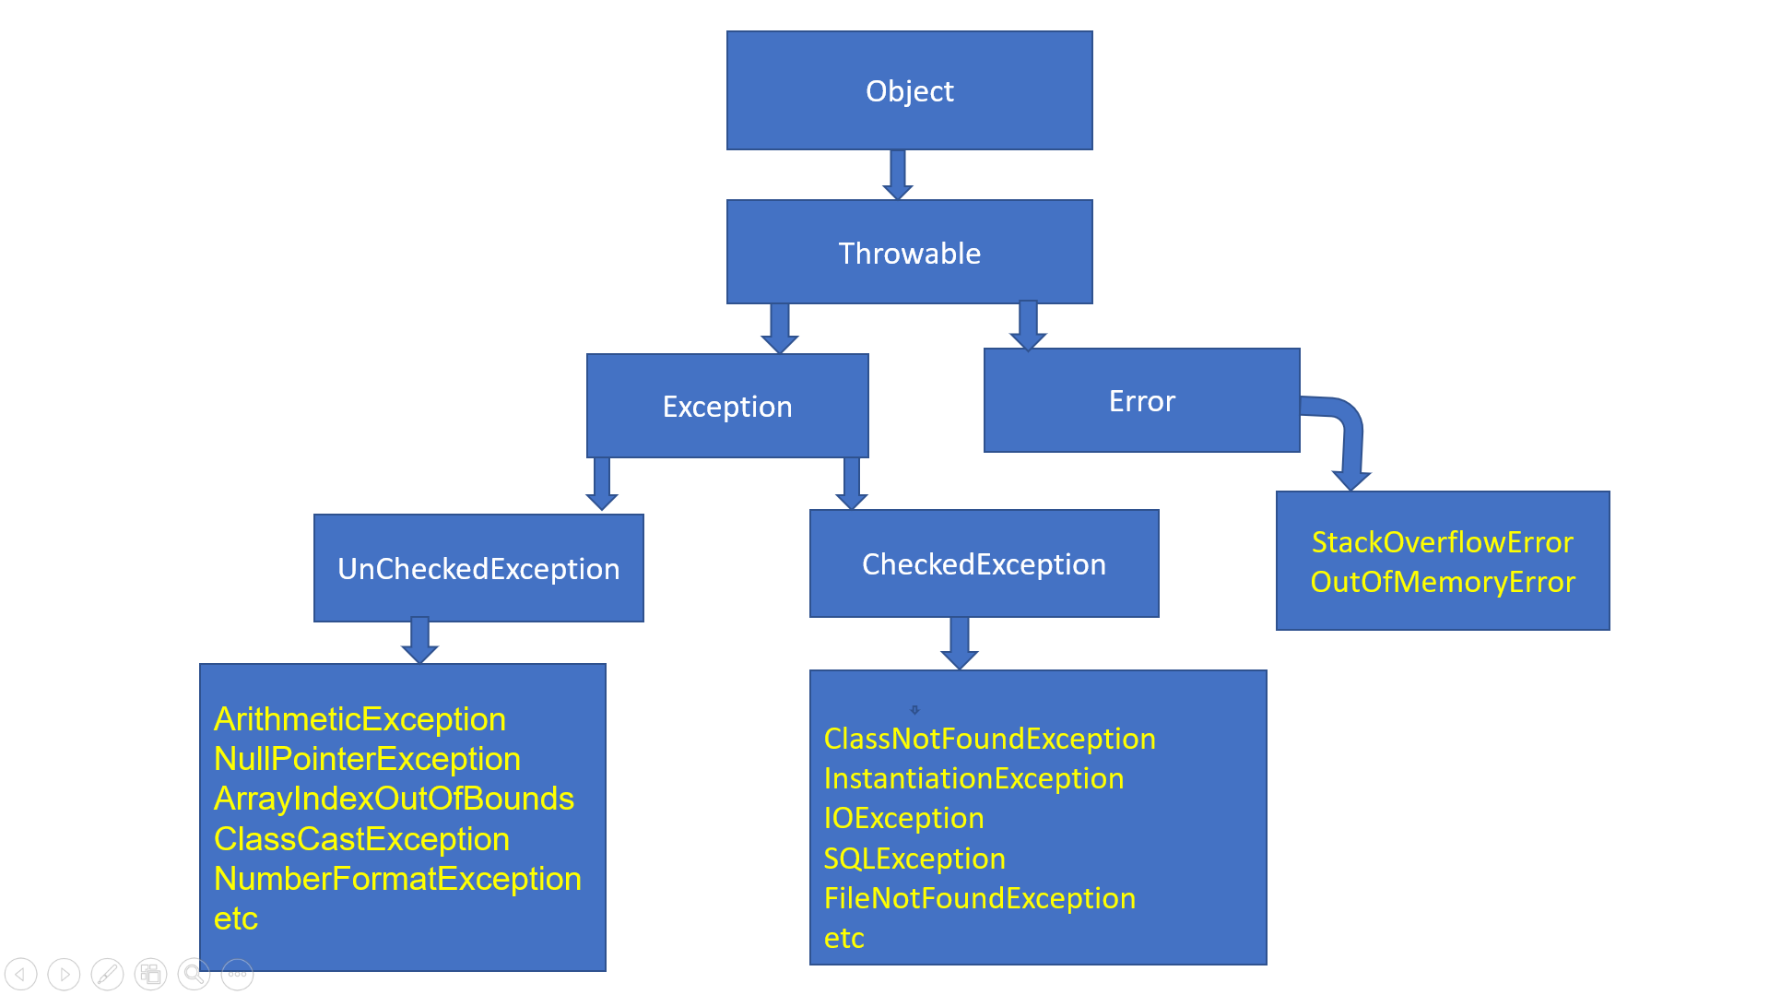
Exceptions Hierarchy

Slide 23
All exceptions and errors are sub classes of class Throwable.
Throwable class having two child classes.
Error
Exceptions
Both Error and Exceptions are present in java.lang package.

Slide 24
Error
Error is an event caused by lack of System resources.
These are exceptional conditions that are external to the application, and that the application usually cannot anticipate .
Which cannot get recovered by any handling techniques.
It surely cause termination of the program abnormally.
Errors belong to unchecked type and mostly occur at runtime.
Ex:
OutOfMemoryError
StackOverFlowError

Slide 25
Exception:
An exception is an event, which occurs during the execution of a program, that disrupts the normal flow of the program's instructions.
These are recoverable by using programing techniques.
Exceptions are divided into two types
UnCheckedExceptions (RuntimeExceptions)
CheckedExceptions (CompileTimeExceptions)

Slide 26
UnChecked Exceptions
Also called as Runtime Exceptions
Compiler does not check this type of Exceptions
This type of programs are not connected to External resources(like files, printers, scanner).
Exception handling is optional i.e, If we handle the exceptions program terminates normally, If not it leads to abnormal termination.

Slide 27
Exception | Description
ArithmeticException | Arithmetic error, such as divide-by-zero.
ArrayIndexOutOfBoundsException | Array index is out-of-bounds.(out of range)
InputMismatchException | If we are giving input is not matched for storing input.
ClassCastException | If the conversion is Invalid.
IllegalArgumentException | Illegal argument used to invoke a method.
IllegalThreadStateException | Requested operation not compatible with current thread state.
IndexOutOfBoundsException | Some type of index is out-of-bounds.
NegativeArraySizeException | Array created with a negative size.
NullPointerException | Invalid use of a null reference.
NumberFormatException | Invalid conversion of a string to a numeric format.
StringIndexOutOfBoundsException | Attempt to index outside the bounds of a string.

Slide 28
Examples for UnChecked Exceptions:
i) ArrayIndexOutOfBoundException:
int a[]={10,20,30}
System.out.println(a[3]); // Array index out of bound exception
ii) NumberFormatException:
String s=“ten”
int i=Integer.parseInt(s);
System.out.println(i); // Number Format Exception

Slide 29
iii) Arithmetic Exception:
System.out.println(100/0);
iv)NullPointerException:
String s=null;
System.out.println(s); // Null Pointer Exception

Slide 30
v) IllegalArgumentException
public class Ex1 { public static void main(String[] args) { for (int i=0;i<10;i++) { System.out.println("Hello"); try { Thread.sleep(-10); } catch (InterruptedException e) { e.printStackTrace(); } } } }

Slide 31
Checked Exceptions
The Exceptions which are checked by the compiler at compilation time for the proper execution of the program at runtime is called Checked Exceptions.
Also called compile time exceptions.
External resources (like files , printers , scanners) may connected to the programs.
Exception handling is mandatory for this type of Exceptions . If not handled even .class file wont generate.

Slide 32
Exception | Description
ClassNotFoundException | If the loaded class is not available
CloneNotSupportedException | Attempt to clone an object that does not implement the Cloneable interface.
IllegalAccessException | Access to a class is denied.
InstantiationException | Attempt to create an object of an abstract class or interface.
InterruptedException | One thread has been interrupted by another thread.
NoSuchFieldException | A requested field does not exist.
NoSuchMethodException | If the requested method is not available.

Slide 33
Exception handling?
Exception handling means it is not repairing an exception we are providing alternative way to continue rest of the program normally.
The program must be graceful termination.
There are two types of Exception handling techniques.
Default Exception Handling
Customized Exception Handling

Slide 34
Default Exception Handling
When ever an exception raised in the method in which it is raised is responsible for the preparation of exception object by including the following information.
Name of Exception.
Description.
Location of Exception.
After preparation of Exception Object, The method handovers the object to the JVM.
JVM will check for Exception handling code in that method

Slide 35
If the method doesn’t contain any exception handling code then JVM terminates that method abnormally and removes corresponding entry from the stack.
This process will be continued until main() method.
If the main method also doesn’t contain any exception handling code then JVM terminates main method abnormally.
Just before terminating the program JVM handovers the responsibilities of exception handling to default exception handler.
Default exception handler prints the error in the following format.
Name of Exception
Description stackTrace

Slide 36

Ex:
class Test { public static void main(String[] args) { doStuff(); } public static void doStuff() { doMoreStuff(); } public static void doMoreStuff() { System.out.println(10/0); } }

Slide 37
Exception Handling:
Providing alternative way to execute rest of the program normally.
Exception Handling is normal Execution of the program or graceful termination of the program at runtime.
Exception class present in java.lang package.
We can handle the exceptions in two ways.
By using try-catch blocks
By using throws keyword.

Slide 38
In Java we have 5 key words to handle the Exceptions:-
try
catch
finally
throw
throws

Slide 39
Exception handling by using try-catch block:
In Exception Handling try block contains risky code of the program and catch block contains handling code of the program.
Catch block code is a alternative code for Exceptional code. If the exception is raised the alternative code is executed fine then rest of the code is executed normally.
Syntax:
try
{
Risky code;
}
Catch(ExceptionName reference_variable)
{
Alternative code if Exception raised;
}

Slide 40
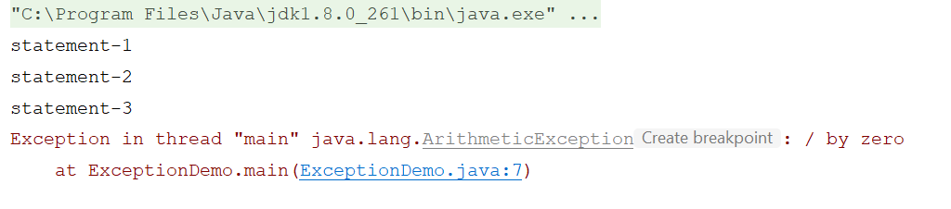
Without try-catch
class ExceptionDemo { public static void main(String[] args) { System.out.println("statement-1"); System.out.println("statement-2"); System.out.println("statement-3"); System.out.println(10/0); System.out.println("statement-4"); System.out.println("statement-5"); } }

Slide 41
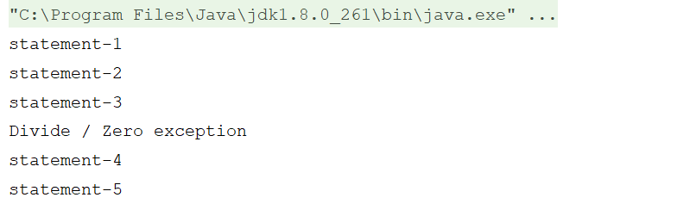
With try-catch
class ExceptionDemo { public static void main(String[] args) { System.out.println("statement-1"); System.out.println("statement-2"); System.out.println("statement-3"); try { System.out.println(10/0); } catch (ArithmeticException e) { System.out.println("Divide / Zero exception"); } System.out.println("statement-4"); System.out.println("statement-5"); output: } }

Slide 42
Multiple catch() blocks:
A try block can be followed by one or more catch blocks.
Each catch block must contain a different exception handler. So, if you have to perform different tasks at the occurrence of different exceptions.
At a time only one exception occurs and at a time only one catch block is executed.
All catch blocks must be ordered from most specific to most general, i.e. catch for ArithmeticException must come before catch for Exception.

Slide 43
Syntax:
try{
}
catch(Exception1 e)
{
}
catch(Exception2 e)
{
}
.
.
etc

Slide 44
finally:
It is never recommended to write clean up code in try block. Because try block may execute or may not execute.
And never recommended to use catch block for clean up code , because if there is no exception catch block wont execute.
The finally keyword is used in association with a try/catch block and guarantees that a section of code will be executed, even if an exception is thrown.
The finally block always executes when the try block exits. This ensures that the finally block is executed even if an unexpected exception occurs.

Slide 45
Putting cleanup code in a finally block is always a good practice, even when no exceptions are anticipated.
Important: The finally block is a key tool for preventing resource leaks

Slide 46
Possible combinations (try-catch()-finally())
Try-catch() ➔ Allowed
Try-finally() ➔ Allowed
Try-catch-finally() ➔ Allowed
Try-finally()-catch()➔ Not allowed
Catch()-finally() ➔ Not allowed

Slide 47
throw:
The main purpose of the throw keyword is to creation of Exception object explicitly either for predefined or user defined .
Throw keyword works like a try block. The difference is try block is automatically find the situation and creates a Exception object implicitly. Whereas throw keyword creates a Exception object explicitly.
throw keyword must call within the method.
By using throw keyword we can throw only one Exception object at a time.

Slide 48
Example:
if (withdrawal>balance)
{
throw new InsufficientFunds("No funds..");
}

Slide 49
Creating user defined Exceptions
In Exception Handling user can defined their own Exceptions.
To create user defined Exceptions we need to create a child class to RuntimeException class or Exception class.
Each and every Exception contains two constructors
default constructor
parameterized constructor
Naming convention: Every user defined exception name must be suffix of Exception
Ex:
InsufficientFundsException

Slide 50
Example:
public static void checkBalance(double withdrawal)
{
double balance=1234567.50;
if (withdrawal>balance)
{
throw new InsufficientFunds("No funds..");
}
else
{
balance= balance-withdrawal;
System.out.println("You're A/C balance : "+balance);
}
}
}
class InsufficientFunds extends RuntimeException
{
InsufficientFunds(String str)
{
super(str);
}
}

Slide 51
throws:
If any Checked Exception raised in a program that must be handle by try-catch or throws keyword.
Ex:
class ExceptionDemo
{
public static void main(String[] args)
{
Thread.sleep(100); // Checked Exception
}
}

Slide 52
Handling Exception with try-catch:
Ex:
public static void main(String[] args) { try { Thread.sleep(100); } catch (InterruptedException e) { e.printStackTrace(); } }

Slide 53
Handling Exception with throws keyword:
Ex:
public static void main(String[] args) throws InterruptedException { Thread.sleep(100); }
The main objective of the throws keyword is to delegate responsibilities to the caller method about Exception handling.
throws keyword bypass the Exception but it doesn’t prevent abnormal termination.

Slide 54
By using throws keyword we can throw multiple Exceptions at a time.
We can use throws keyword in Method declaration.
throws keyword is applicable only Throwable objects but not Normal objects.
throws keyword is required only for checked exception and usage of throws keyword for unchecked exception is meaningless.

Slide 55
Differences b/w throw and throws
No. | throw | throws
1) | Java throw keyword is used to explicitly throw an exception. | Java throws keyword is used to declare an exception.
2) | Checked exception cannot be propagated using throw only. | Checked exception can be propagated with throws.
3) | Throw is followed by an instance. | Throws is followed by class.
4) | Throw is used within the method. | Throws is used with the method signature.
5) | You cannot throw multiple exceptions. | You can declare multiple exceptions e.g. public void method()throws IOException,SQLException.

