Slide 1
Bluestock Mutual Fund
Analytics Capstone Project
End-to-End MF Analytics | June 2026
Divya Madiraju | Bluestock Fintech MJ28

Slide 2
Problem Statement & Objectives
• India's MF industry manages Rs.67+ lakh crore AUM across 1,900+ schemes — data is fragmented
• Retail investors lack tools to compare risk-adjusted performance across fund categories
• No unified platform exists to track NAV trends, SIP growth, and investor demographics together
• Objective: Build end-to-end analytics covering ETL, EDA, performance metrics, and dashboard
• Scope: 40 fund schemes, Jan 2022 – Dec 2025, 32,778 investor transactions
40
46,000
32,778
7
Fund Schemes
NAV Records
Transactions
Deliverables

Slide 3
Data Sources & Architecture
• 10 CSV datasets from AMFI India covering NAV, AUM, SIP, transactions, holdings
• Live NAV API: mfapi.in — fetched for 5 key schemes (HDFC, SBI, ICICI, Axis, Kotak)
• SQLite star schema: dim_fund, dim_date, fact_nav, fact_transactions, fact_performance
• ETL pipeline: Extract → Clean → Validate → Load → Verify row counts
• Tools: Python 3.14, Pandas, NumPy, SQLite, SQLAlchemy, Pathlib

Slide 4
ETL Pipeline Architecture
EXTRACT
TRANSFORM
LOAD
ANALYSE
Raw CSVs + mfapi.in
Clean, validate, standardise
SQLite star schema
EDA + Performance + VaR
Common Mistakes Avoided:
✓ ffill() applied after reindexing NAV to full date range (weekends/holidays handled)
✓ CAGR annualised using 252 trading days, not calendar days
✓ Pathlib.Path used throughout — no hard-coded file paths
✓ *.db added to .gitignore — only schema.sql committed

Slide 5
EDA Highlights — Industry Overview
• Total industry AUM peaked at Rs.391.76 lakh crore — SBI MF leads with highest AUM
• SIP inflows grew from Rs.11,000 Cr (Jan 2022) to record highs by Dec 2025
• Industry folios doubled: 13.26 Cr (Jan 2022) to 26.12 Cr (Dec 2025)
• Equity category dominates net inflows; debt funds see March outflows (tax-related)
• Geographic reach: Punjab, Tamil Nadu, Madhya Pradesh lead in transaction volumes
15+ Charts Generated | EDA_Analysis.ipynb

Slide 6
EDA Highlights — Fund Analytics
• Small-cap funds: highest 1Y returns (21-25%) but highest NAV volatility
• Debt funds (Liquid/Gilt): highest Sharpe ratios due to low volatility
• NAV correlation matrix: equity funds show 0.85+ pairwise correlation
• Financial services dominates portfolio holdings — HHI concentration risk flagged
• Direct plans consistently outperform regular plans on 1Y returns (expense ratio effect)

Slide 7
Performance Metrics — Scorecard
Composite Score = 30% CAGR + 25% Sharpe + 20% Alpha + 15% Expense + 10% Drawdown
Rank
Fund Name
Score
3Y CAGR
Sharpe
1
ICICI Pru Midcap Fund - Regular - Growth
84.5
30.4%
1.18
2
Axis Midcap Fund - Regular - Growth
80.8
33.6%
1.00
3
HDFC Mid-Cap Opportunities Fund - Regular - G
80.5
31.1%
1.09
4
Mirae Asset Large Cap Fund - Regular - Growth
80.0
32.6%
1.45
5
Kotak Flexicap Fund - Regular - Growth
78.2
28.4%
1.31

Slide 8
Performance Metrics — Risk Analysis
• Historical VaR (95%): Small-cap funds show -2.5% to -3.5% daily VaR
• CVaR (Expected Shortfall): Worst 5% days average -3.8% for high-risk funds
• Alpha: Top equity funds generate 15-29% annualised excess return vs Nifty 100
• Beta: Equity funds 0.85-1.15 (market-like); debt funds near 0 (uncorrelated)
• Maximum Drawdown: Small-cap funds saw -18% to -21% peak-to-trough drawdowns
• Rolling Sharpe: Dipped below 0 during 2024 corrections, recovered by 2025

Slide 9
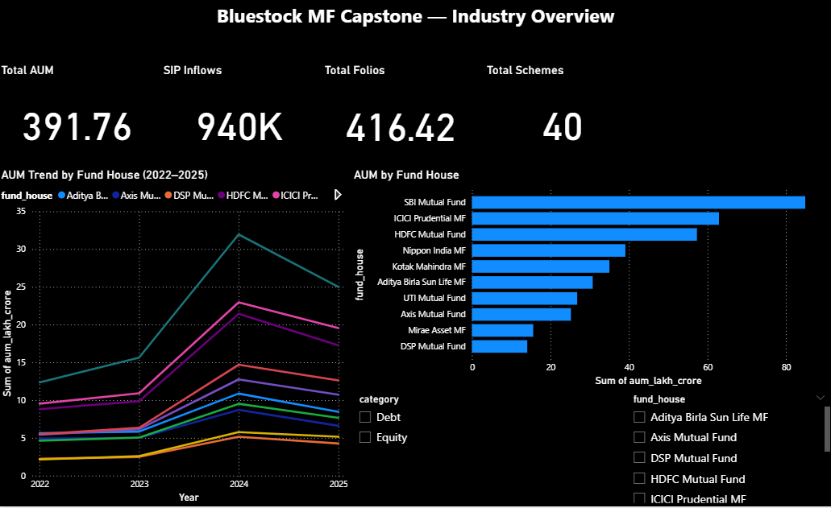
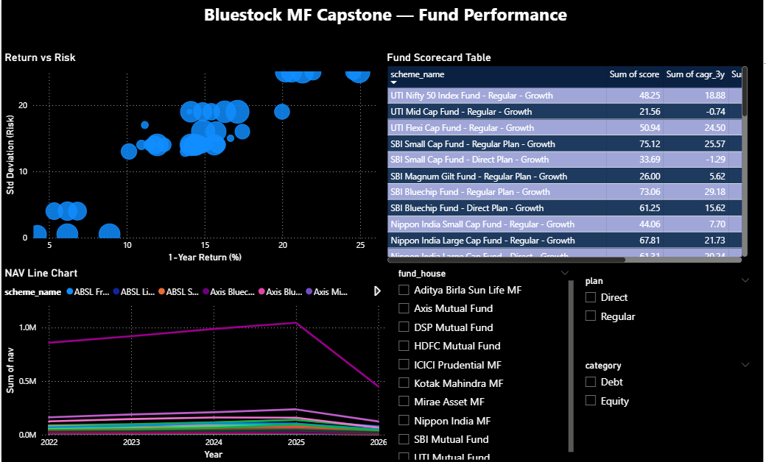
Interactive Dashboard — Page 1 & 2

Slide 10
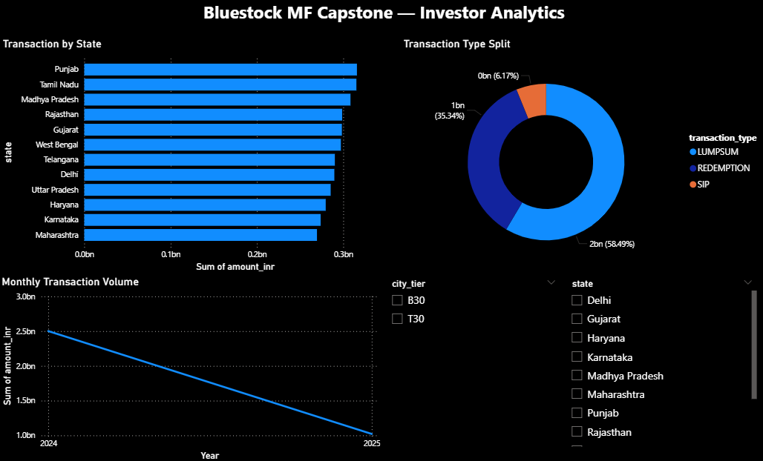
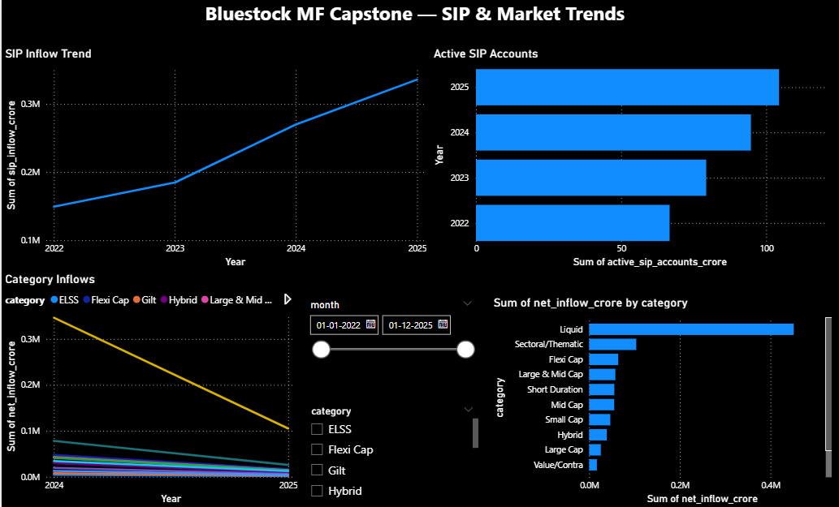
Interactive Dashboard — Page 3 & 4

Slide 11
Key Findings & Recommendations
• SBI MF leads AUM — distribution through bank branches is the key competitive moat
• Small-cap funds deliver best long-term CAGR but require 5+ year investment horizon
• SIP discipline is strong — 80%+ investors maintain monthly cadence (gap < 35 days)
• Direct plans outperform regular plans consistently — cost matters in mutual funds
• Equity fund correlation >0.85 — true diversification requires multi-asset allocation
• 2024 cohort investors contribute highest avg SIP amounts — newer investors are more informed

Slide 12
Thank You
Bluestock Mutual Fund Analytics Capstone
GitHub: github.com/Divya-Madiraju/bluestock_mf_capstone
Divya Madiraju | divyamadiraju2006 | June 2026

