Slide 1


Analysis of College Donations
Divya Maiya
University of Massachusetts Amherst

Slide 2
Purpose
Provide insights into the distribution and trends of donations
Gain a deeper understanding of donors' preferences and potential areas for further engagement.

Slide 3

Importance of Donations
Advance Educational Mission
Support Scholarships and programs
Improve facilities and infrastructure
Understanding the patterns and trends in donations allows us to enhance our fundraising strategies, strengthen relationships with donors, and align our efforts with their interests.

Slide 4

Scope of Analysis
Conducted an extensive analysis using data from the CollegeDonations.xls file, containing information on donation gifts to various colleges.
Analysis covers multiple dimensions:
geographic locations
types of colleges
academic majors of donors
graduation years of donors
types of colleges receiving the most donations
trend of donations over the years

Slide 5

Distribution of Donations by Geographic Locations
Geographic distribution of donations provides valuable insights into the regions that contribute most significantly to our fundraising efforts.
Data was analyzed to identify the geographic locations associated with the highest donation amounts.
Analysis encompasses a wide range of geographic regions, including states and cities all over the United States

Slide 6

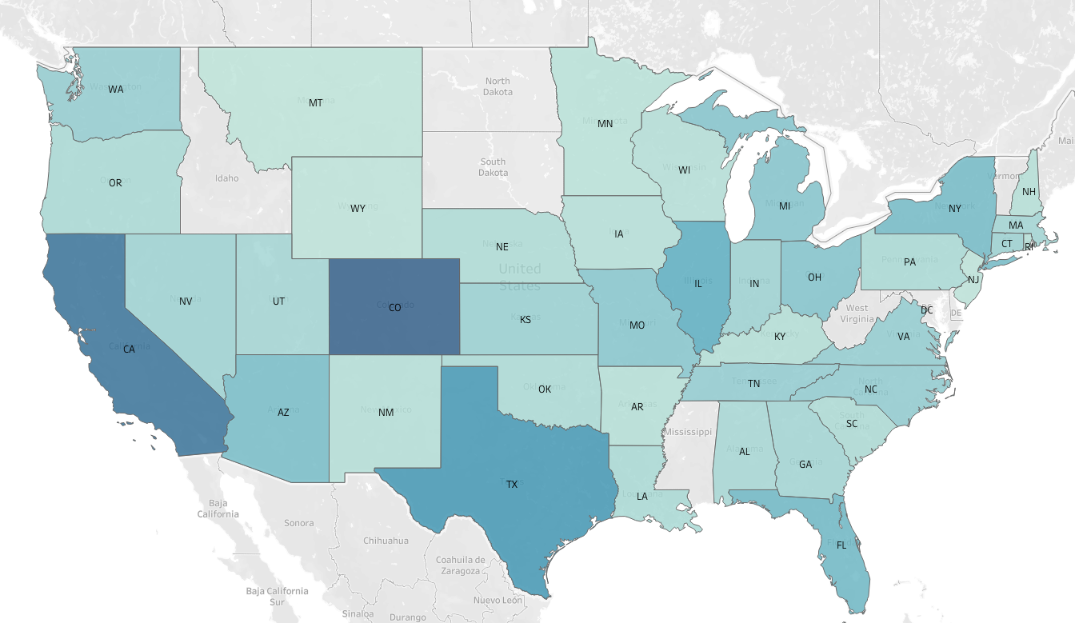
Distribution of Donations by States
Key Observation: Donors belong to 40 different states across the United States.
States with Donation over $1M: Arizona, California, Colorado, Florida, Illinois, New York, Texas
Likely Reasons: High Economic Prosperity and High Population Density of states in questions

Slide 7
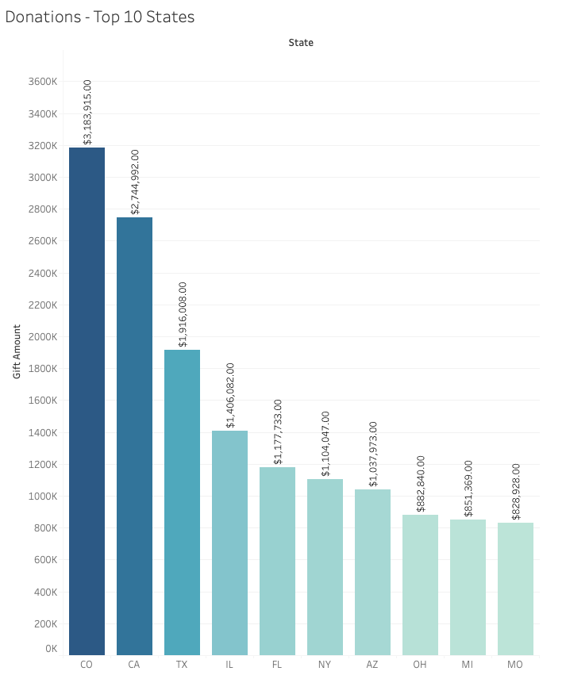
Distribution of Donations by States
Highest Contributor: Colorado, 3.1 million dollars
Conclusion: This significant donation amount indicates a strong support for education and research initiatives from donors
Likely Reasons:
Education-Focused Culture of Colorado
Philanthropic Traditions
Positive Economic Conditions
Recommendations: Engaging alumni from Colorado through targeted outreach and events can foster a sense of pride and connection, encouraging them to continue supporting the institution financially.

Slide 8
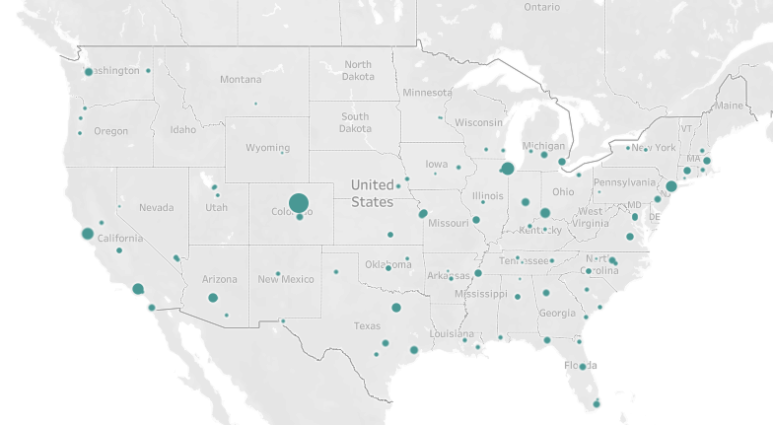
Distribution of Donations by Cities
Key Observation: Donors belong to 95 different cities across the United States.
Cities with Donation over $1M: Denver, Chicago and San Francisco
Recommendations: Engaging alumni from these cities through targeted outreach and events can foster a sense of pride and connection, encouraging them to continue supporting the institution financially.

Slide 9
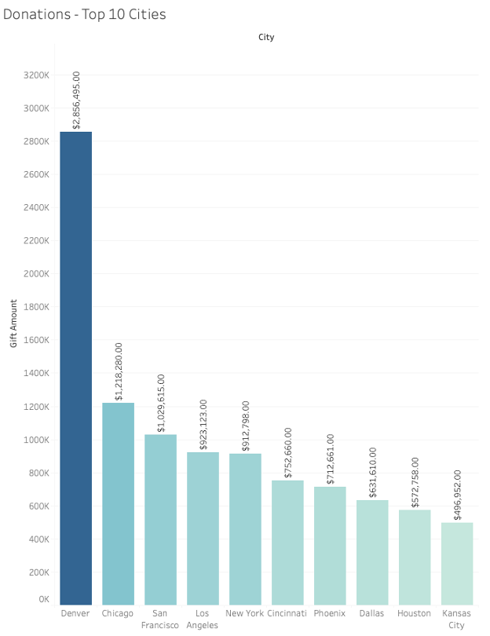
Distribution of Donations by Cities
Highest Contributor: Denver, 2.8 million dollars.
Likely Reason: Concentration of high net worth individuals and philanthropic organizations in the area
Observation: Analyzing the state-wise and city-wise distribution we can see over 50% of the contribution for each state can be attributed to its capital city.

Slide 10
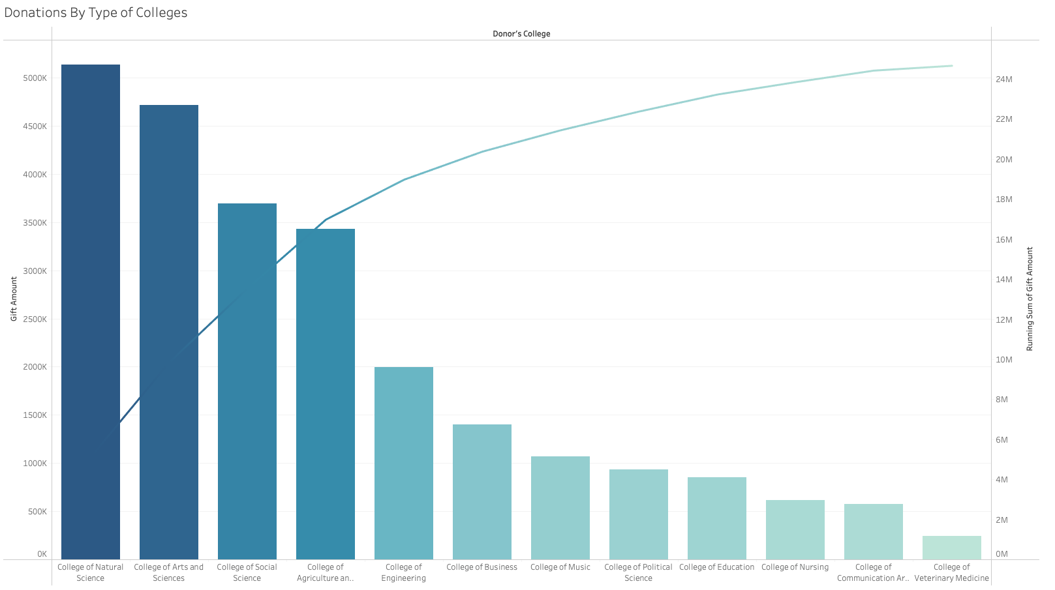
Distribution of Donations by Type of Colleges
Highest Contributor: College of Natural Science
Key Observations:
Most of the top donors belong to STEM
Pareto principle: Significant portion of the donations comes from a small number of college types, in our case first two
Likely Reasons: STEM fields often offer lucrative career opportunities, with individuals in these fields achieving high levels of professional success and financial stability.
Recommendations: Establish scholarships and research opportunities that specifically benefit students STEM fields. Highlight the impact of donations on supporting the education, research, and professional development thereby attracting more donations from individuals passionate about these fields.

Slide 11
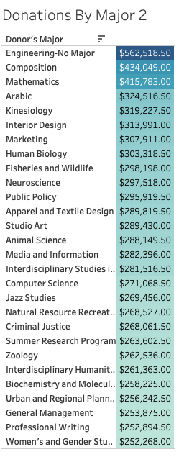
Distribution of Donations by Academic Majors
*
Highest Contributors: Engineering (No Major), Composition, Mathematics, Kinesiology
Key Observation: Most of the top donors belong to majors in the STEM field
Likely Reasons:
Can be attributed to the recognition of the importance and impact of these disciplines.
Donors likely have personal connections, appreciation, and a desire to support education and advancement in their respective fields
*For the purpose of this analysis we only considered major’s that had donations over 250k

Slide 12
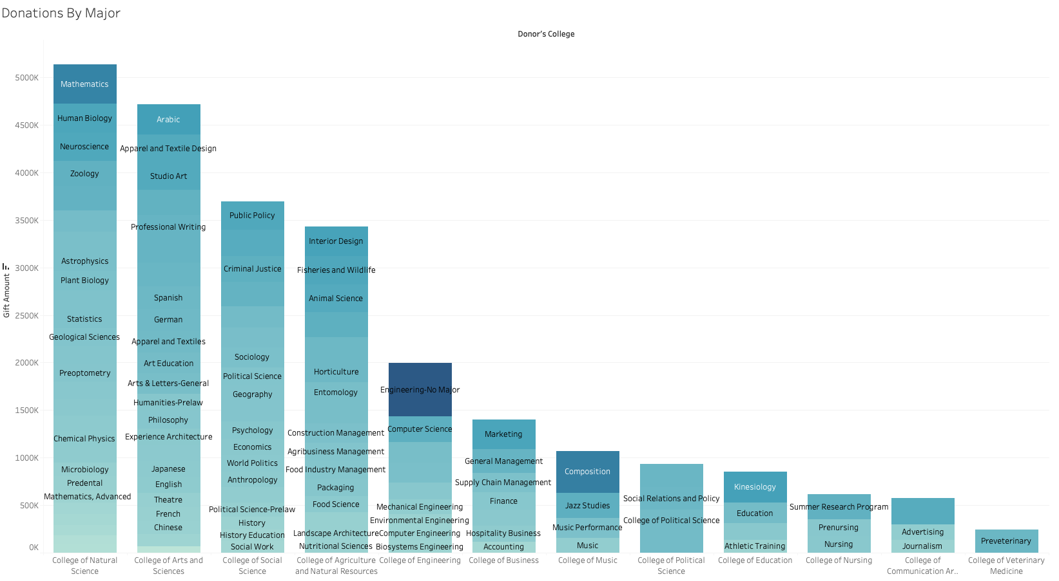
Distribution of Donations by Academic Majors - College wise
Key Observation: Although Engineering majors make the highest donation contributions, the College of Engineering ranks lower in terms of the total amount received compared to other colleges.
Recommendations: While individual donors from Engineering backgrounds are generous, there may be opportunities to increase overall support and engagement for the College of Engineering as an institution.

Slide 13
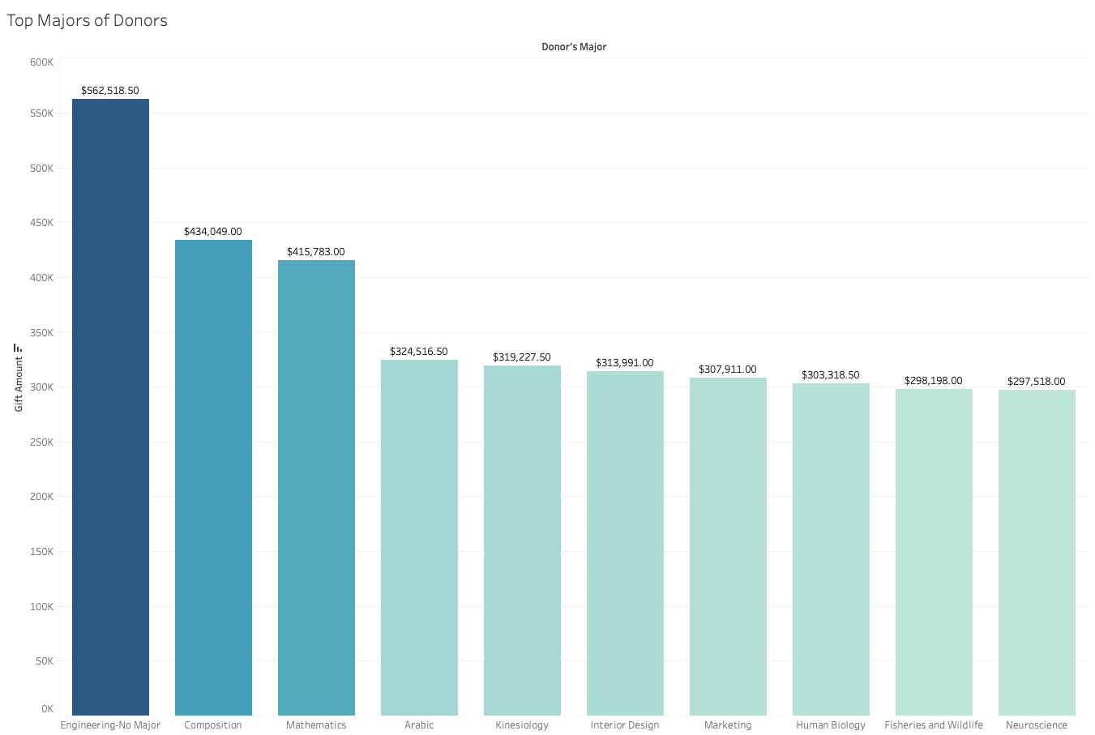
Top Majors of the Donors
Highest Contributor: Engineering (No Major)
Key Observation: While Engineering has a donation of over 560k, other majors are quite low
Recommendations:
Alumni Outreach: Strengthen efforts to engage and connect with alumni from these majors through targeted outreach.
Industry Partnerships: Foster partnerships with companies and organizations relevant to majors like Interior Design, Marketing, and Neuroscience.

Slide 14
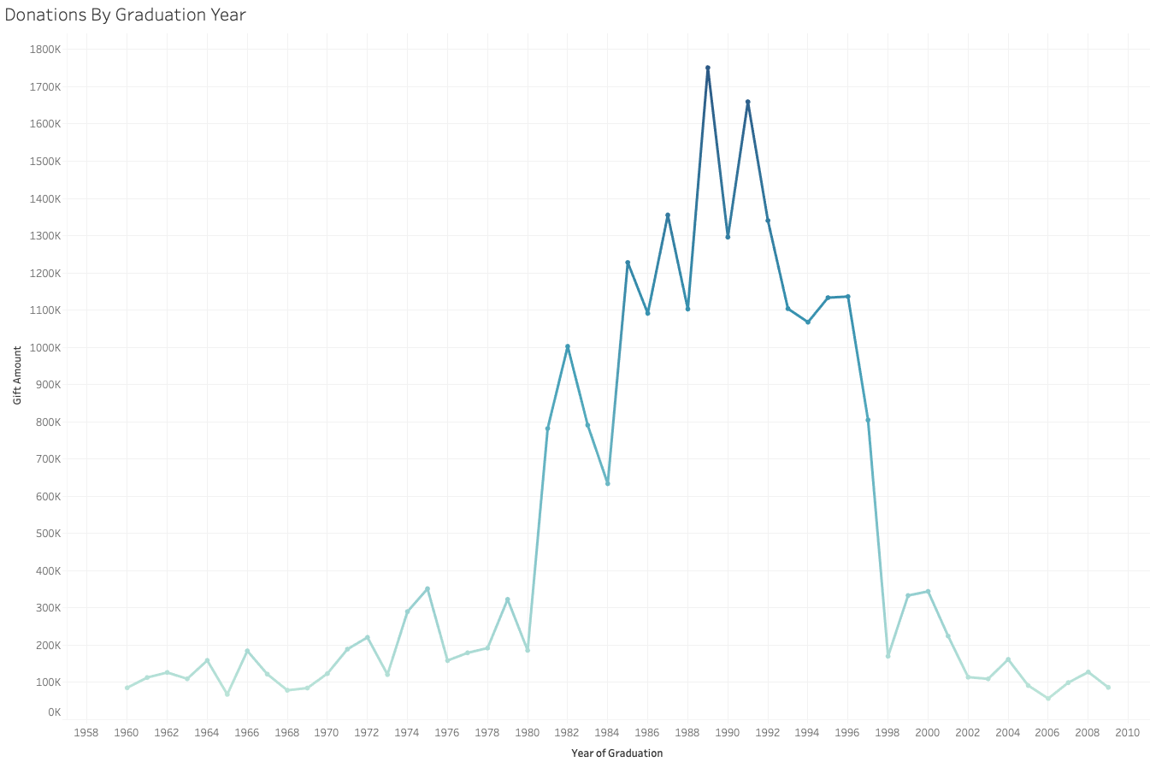
Distribution of donations by graduation years
Highest Contributor: Donors graduating between the years of 1985 to 1996
Lowest Contributor: Donors who graduated after 2002
Likely Reasons:
Highest donors likely have a stronger emotional connection and affinity towards their alma mater
Highest donors have had more time to establish their careers and accumulate wealth compared to those who graduated after 2002.
Recommendations: Cultivating a culture of philanthropy among students by encouraging participation in fundraising campaigns, promoting the impact of donations, and educating students about the importance of giving back.

Slide 15
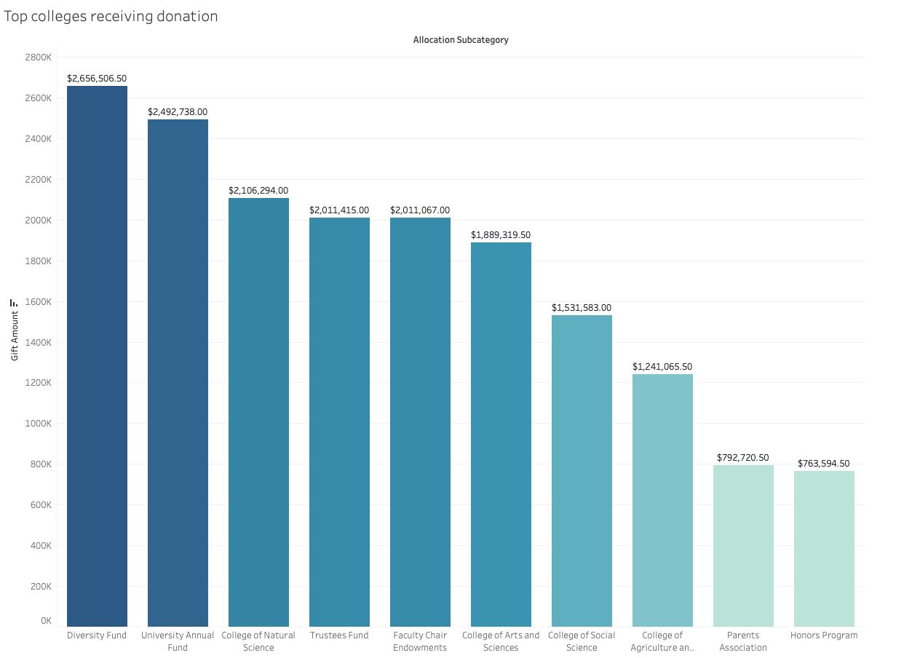
Top Colleges that Received the Most Donations
Highest Receivers: Diversity Fund, University Annual Fund, College of Natural Science
Likely Reasons:
Diversity Fund's focus on promoting diversity and creating a more inclusive campus environment may resonate with donors who value equality and want to contribute to the institution's efforts in this area.
The College of Natural Science may attract donors who have a keen interest in scientific research, innovation, and advancements in scientific fields.
Recommendations: Donor Recognition and Stewardship, Showcase Success Stories, Tailored Fundraising Campaigns

Slide 16
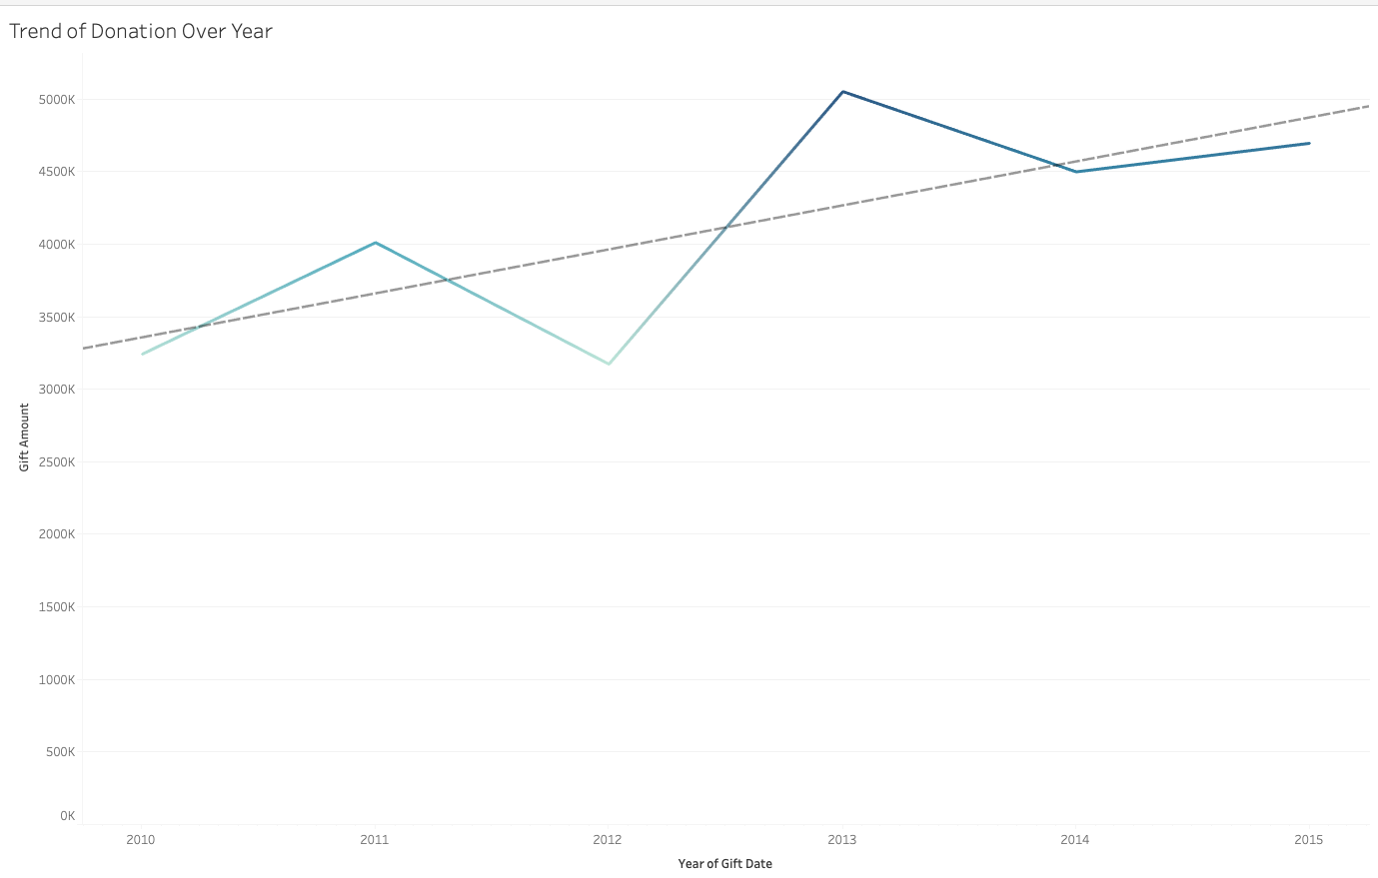
Trend of Donations Over Years
Highest Contribution: 2013
Trend: Generally positive trajectory, with slight fluctuations
Conclusion: Overall, the trend of donations over the years likely suggests a mix of factors influencing the donation amounts, including fundraising efforts, donor engagement strategies, economic conditions, and specific events or campaigns.
Open questions and Recommendations: What was the strategy employed in 2013 that led to peak donations? Reuse this strategy.

Slide 17
Summary
The analysis of donation distributions revealed key insights into various aspects:
Donations were concentrated in Denver, with the highest contribution exceeding USD2.8M.
STEM-related colleges, particularly Engineering, received the highest donations, while majors like Interior Design and Marketing received comparatively lower contributions.
Donors graduating between 1985 to 1996 made the highest contributions, and STEM majors were prominent among the top donors.
The Diversity Fund, University Annual Fund, and College of Natural Science were the top recipients of donations.
The trend of donations over the years showed fluctuations, with a peak in 2013.
These findings provide helped us discuss some opportunities and methods to increase donations.

