Slide 1


K.RAMAKRISHNAN COLLEGE OF TECHNOLOGY
(AUTONOMOUS), TRICHY.
STOCK MANAGEMENT SYSTEM
PRESENTED
DIVYA P
2303811710422035
SUPERVISOR
Mr. M. Saravanan, M.E.,
AP/CSE.

Slide 2
PRESENTATION OVERVIEW
Objective
Project Introduction
Problem Statement
Methodologies (Programming concepts relevant to problem statement)
Architecture of the proposed system
List of Modules
Merits
Results and Discussion
Queries

Slide 3
OBJECTIVE
The primary objective of the Stock Management System is to create a reliable, efficient, and user-friendly software solution for managing inventory. This system is designed to automate stock-related tasks, minimize errors, and improve operational efficiency for businesses. The system aims to ensure real-time stock tracking, maintain optimal stock levels, and streamline inventory operations, leading to enhanced productivity and cost savings.

Slide 4
PROJECT INTRODUCTION
The Stock Management System is a Java-based application tailored for businesses to manage and monitor their inventory effectively. The traditional manual methods of stock management are prone to errors, inefficiencies, and delays. This system offers a digital solution by integrating Java’s programming capabilities with database management. It allows businesses to track stock levels, record transactions, and forecast future stock requirements.

Slide 5
PROBLEM STATEMENT
Efficient inventory management is a critical challenge faced by businesses across various industries. Traditional manual methods of stock management are prone to errors, delays, and inefficiencies, leading to issues such as overstocking, stock shortages, and inaccurate record-keeping. These challenges can disrupt the supply chain, result in financial losses, and impact customer satisfaction.

Slide 6
METHODOLOGIES
1.Programming Concepts Used
2.Tools and Frameworks
3.Database Connectivity (JDBC)
4.Exception Handling
5.GUI Development

Slide 7
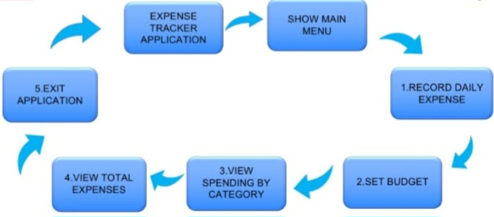
ARCHITECTURE OF THE PROPOSED SYSTEM

Slide 8
LIST OF MODULES
Add stock item Module
view stock item Module
update stock Quantity Module
Delete stock item Module

Slide 9
MERITS
1. Automation and Efficiency: Reduces manual effort by automating inventory management tasks. Improves efficiency in stock tracking and transaction recording. 2. Error Reduction: Minimizes human errors in data entry and stock calculations. 3. Real-Time Data: Provides up-to-date information on stock levels, enabling better decision-making.

Slide 10
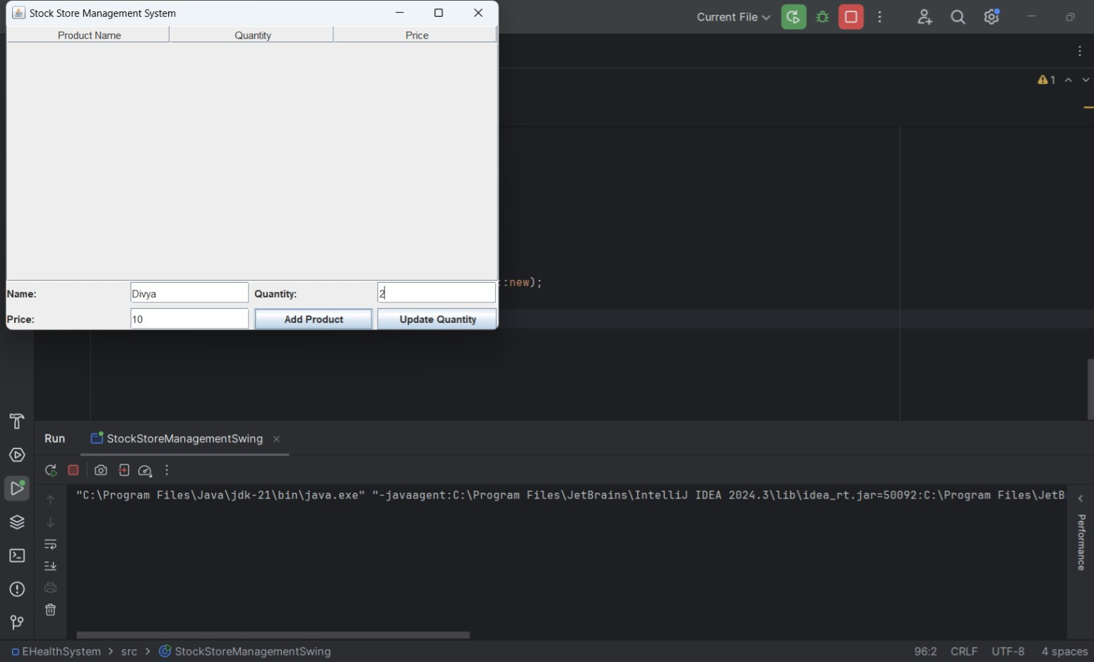
RESULTS AND DISCUSSION

Slide 11
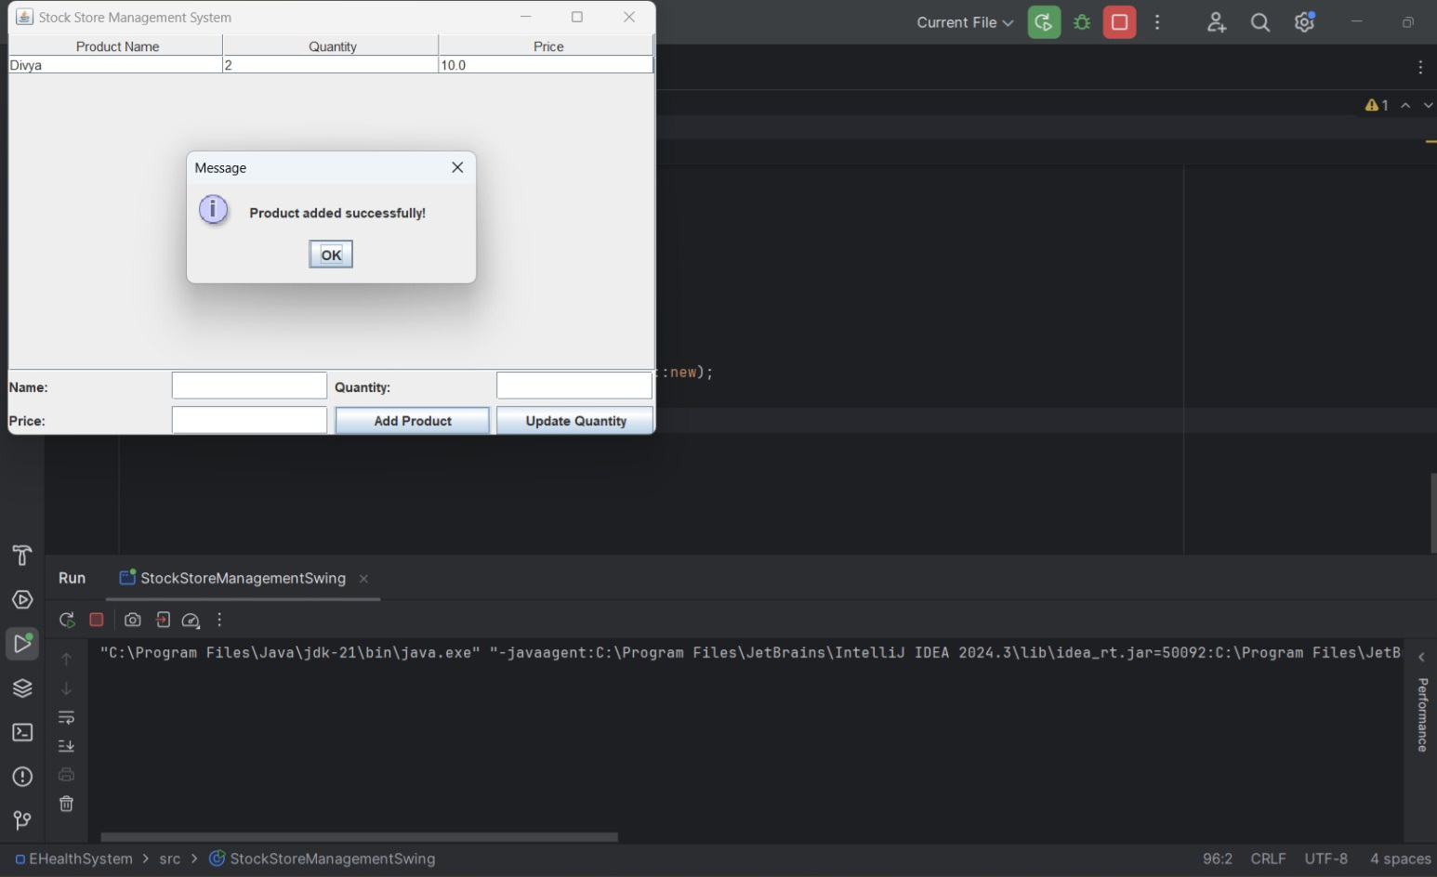

Slide 12
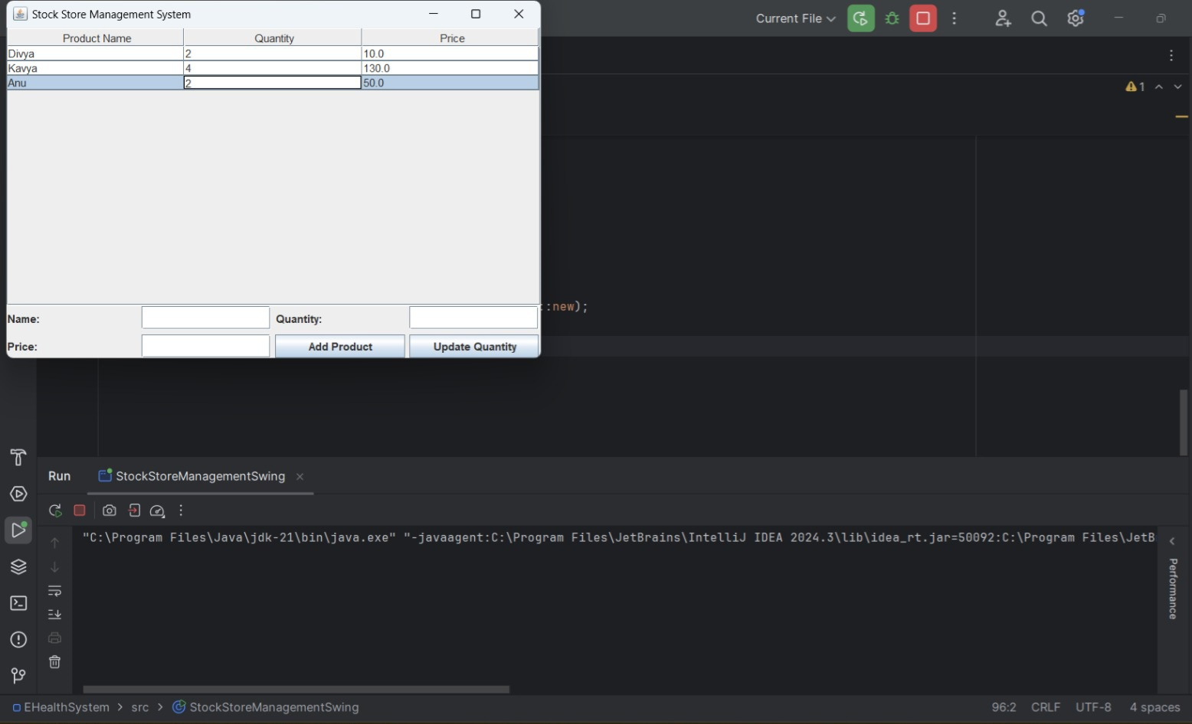

Slide 13
QUERIES ?

