Slide 1
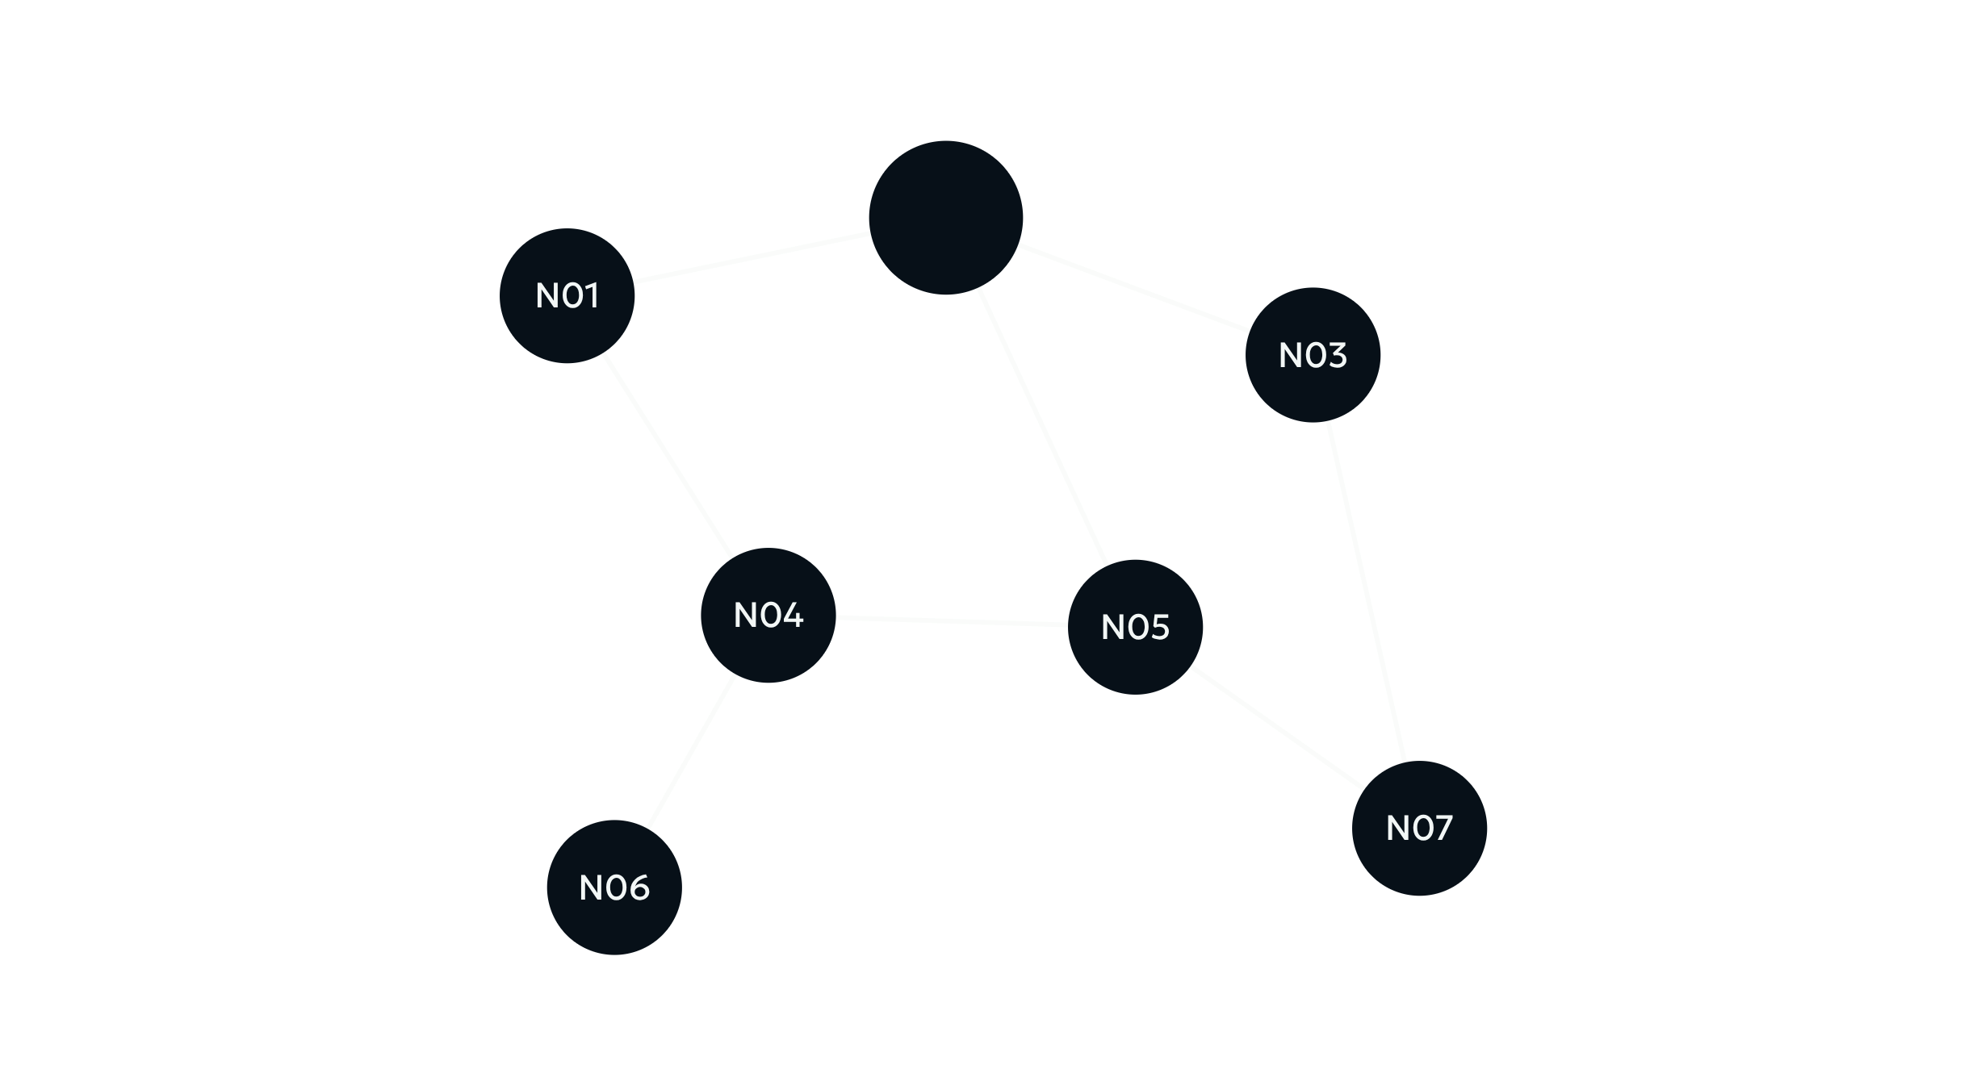
WIRELESS PROTOCOL DEVELOPMENT
TDMA SCHEDULE
PLANNER AND OPTIMIZER
Generate a conflict-free transmission schedule for wireless nodes.
Python · NetworkX · Pytest
Divya S · B.Tech Information Technology

Slide 2

THE SCHEDULING CONSTRAINT
Two-hop interference makes scheduling harder
A TDMA network divides communication time into slots. Direct neighbours cannot share a slot. Nodes within two hops, including nodes that share a common neighbour, also conflict.
Goal: generate a conflict-free schedule with minimum slots.
02

Slide 3
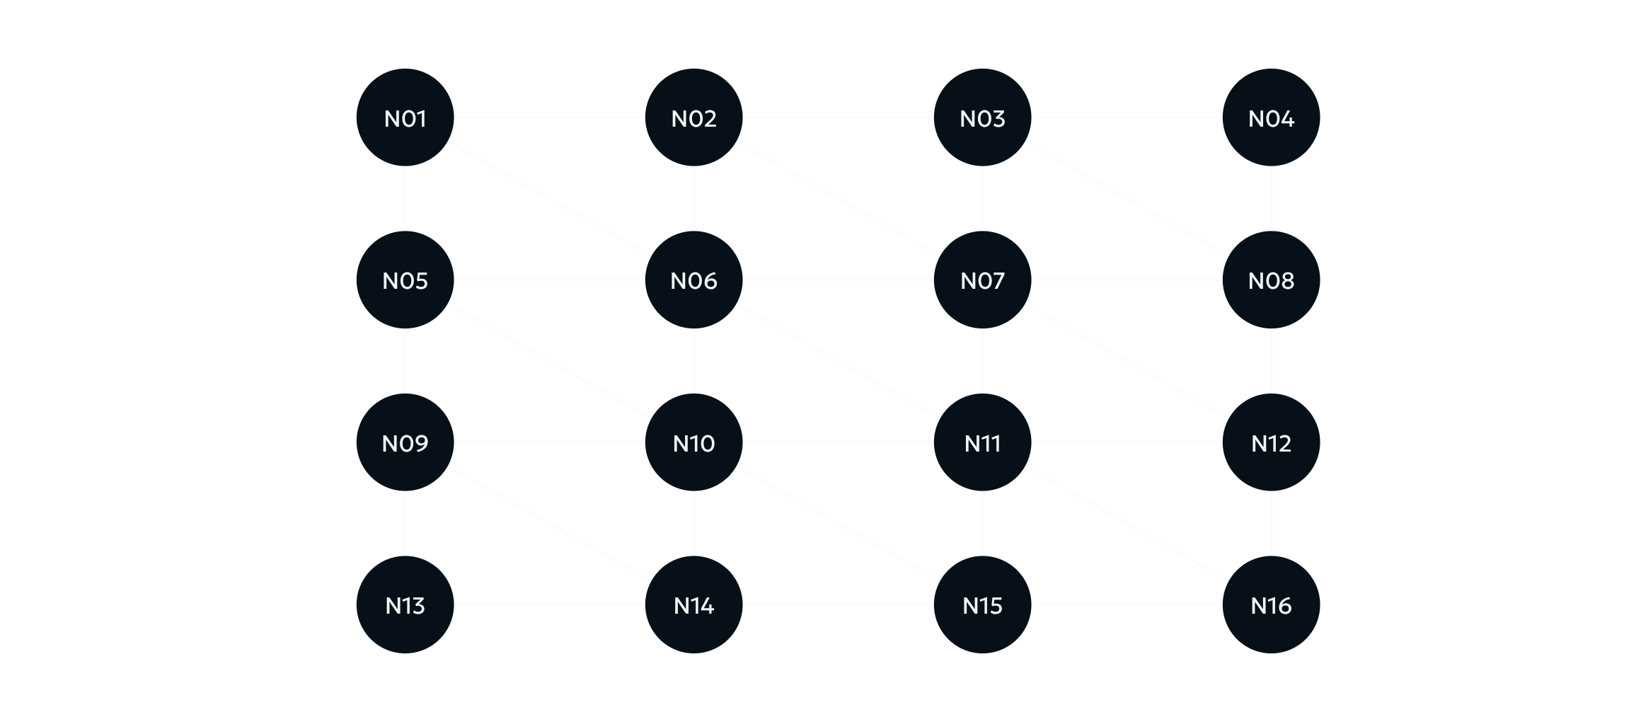
SAMPLE TOPOLOGY · 16 NODES
The sample topology is a 4 × 4 wireless grid
4 × 4
16 wireless nodes
Static (x, y) coordinates
Radio range: 500 meters
Within range → radio-graph link
03

Slide 4
SCHEDULING PIPELINE
The scheduler turns coordinates into validated slots
01
02
03
04
05
Coordinates
Radio graph
Conflict graph
Coloring
Validation
Static (x, y)
Links within 500 m
Direct + two-hop
Allocate slots
Check every conflict
RADIO GRAPH
CONFLICT GRAPH
VALIDATION
Identifies nodes within 500 m.
Captures direct and two-hop conflicts.
Conflicting nodes never share a slot.
04

Slide 5
DISTANCE-2 RULE
Conflict means shortest-path distance ≤ 2
DIRECT CONFLICT
TWO-HOP CONFLICT
A
B
A
C
B
A—B: different TDMA slots.
A—C—B: endpoints conflict.
Rule: conflicting nodes receive different TDMA slots.
05

Slide 6
SEARCHING FOR A COMPACT COLORING
Heuristic coloring searches for a compact schedule
Evaluate highest-degree, lowest-degree, DSATUR-style, and NetworkX largest-first orderings.
01
02
03
04
Conflict graph
Node ordering
Greedy coloring
Slot assignment
Four heuristics
First available
0, 1, 2, …
FOR EACH ORDERING
CANDIDATE SELECTION
Select a node → inspect conflicting slots → assign the first available slot.
Compare total slot counts; keep the best candidate.
06

Slide 7
FINAL MAPPING · 16 NODES
The final mapping uses nine TDMA slots
Nodes share a slot only when they do not conflict in the distance-2 graph.
Node | Slot | Node | Slot
Node_01 | 8 | Node_02 | 5
Node_03 | 4 | Node_04 | 8
Node_05 | 7 | Node_06 | 3
Node_07 | 2 | Node_08 | 7
Node_09 | 6 | Node_10 | 1
Node_11 | 0 | Node_12 | 6
Node_13 | 8 | Node_14 | 5
Node_15 | 4 | Node_16 | 8
NINE-SLOT ASSIGNMENT
S0
S1
S2
N11
N10
N07
S3
S4
S5
N06
N03, N15
N02, N14
S6
S7
S8
N09, N12
N05, N08
N01, N04,
N13, N16
07

Slide 8
EXACT VERIFICATION
Verification confirms a nine-slot minimum
16
42
90
9
0
NODES
RADIO LINKS
CONFLICT PAIRS
TDMA SLOTS
CONFLICTS
8 SLOTS
9 SLOTS
Conclusion
Not possible
Possible · 0 conflicts
9 slots is the minimum for this sample topology.
08

Slide 9
TESTING COMPLETE · INTEGRATION NEXT
Testing is complete; EMANE integration is next
PYTEST
PART 2 · EMANE TDMA MODEL
4
01
Python scheduler
02
Node → Slot mapping
Tests passed
03
Adapter
04
EMANE TDMA model
Generic XML
Coverage: radio-graph construction, distance-2 conflict detection, schedule validation, and schedule-matrix generation.
05
Packet transmission
Slot duration: 1 ms.
Actual packet-level EMANE execution is not claimed yet.
09

Slide 10
IMPLEMENTED · VALIDATED · READY FOR INTEGRATION
A validated nine-slot schedule is ready for integration
ARCHITECTURE PATH
IMPLEMENTED
16 nodes
Conflict analysis
9-slot schedule
Validation ✓
EMANE integration · Future work
Radio graph; distance-2 conflict graph; slot allocation; validation; exact verification; automated testing; EMANE schedule-adapter prototype.
FINAL RESULT
Conflict-free TDMA schedule using 9 slots for the 16-node sample topology.
FUTURE WORK
Complete EMANE setup; connect the schedule to the TDMA event mechanism; verify packet transmission.
10

