Slide 1
Structure of URL

Slide 2
What is URL (Uniform Resource Locator) ?
A URL or Uniform Resource Locator is a Unique identifier that is contained by all the resources available on the internet. It helps users and browsers communicate with servers to access webpages, files, or other resources.
A URL is composed of several parts, each serving a unique purpose.
Let’s break it down the components.

Slide 3
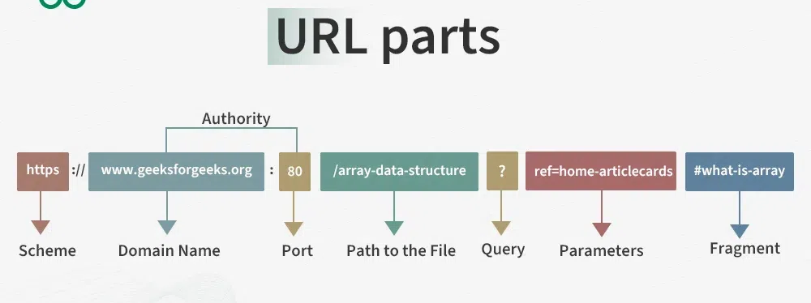
Reference URL:
https://www.example.com:8080/products/shoes?brand=nike&color=red#reviews

Slide 4
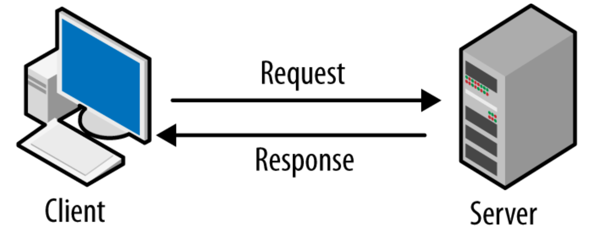

Slide 5
Components of a URL
1. Protocol (or Scheme)
Definition: The protocol specifies how the browser should communicate with the server to fetch the resource.
It uses multiple protocols like HTTP (Hypertext Transfer Protocol), HTTPS Protocol (Secured HTTP), mailto for emails, FTP (File Transfer Protocol) for files, and TELNET to access remote computers.
Examples: http, https, ftp, mailto, etc.
Purpose: Determines whether the connection is secure (e.g., https is secure while http is not).
Example:
https:// in https://www.example.com

Slide 6
2. Domain Name (or Host)
Definition: The domain name identifies the website’s address on the internet. It’s made of three parts:
Subdomain: An optional prefix such as www or blog.
Second-Level Domain (SLD): The main name of the website (e.g., example).
Top-Level Domain (TLD): The suffix such as .com, .org, or .edu.
Example:
In https://www.example.com, the domain name is www.example.com.
example is the SLD.
.com is the TLD

Slide 7
3.Port (Optional)
Definition: The port is the endpoint for communication with the server.kr55r55rrrr
Custom Ports: Shown with a colon (:) after the domain.
Example:
http://example.com:8080 (port 8080 is specified).

Slide 8
4.Path
Definition: The path specifies the location of the resource (e.g., a specific file or webpage) on the server.
Example:
https://example.com/products/shoes
/products/shoes is the path, directing the browser to the “shoes” page within the “products” section.

Slide 9

5. Query String (Optional)
Definition: A query string provides additional data to the server. It starts with a question mark (?) and consists of key-value pairs separated by &.
Structure:
?key1=value1&key2=value2
Example:
https://example.com/search?q=shoes&color=red
Query: ?brand=nike&color=red
brand=nike Searching for nike brand
color=red: Filtering results by color red.

Slide 10
6. Fragment (Optional)
Definition: The fragments appear at the end of a URL starts with a Hashtag(#) symbol.Fragments are used to help browsers scroll directly to a specific part of the page without reloading it.
Example:
https://example.com/page#section2
#section2 refers to a specific section on the page.

Slide 11
Thank You
Presented by Sinduja Reddy

