Slide 1

Comprehensive data analysis of traffic violation data for the City of Denton in 2016
Analysis by:
Divya Yerramsetty
Amruta Mungikar
INFO 5731- Computational methods for Information Systems Spring 2017 Dr. Jiangping Chen

Slide 2
Outline
Purpose of the Project
Data and Data collection
Various aspects of analysis
Packages, functions and modules
Programming Strategies
Output plots
Lessons learnt
References

Slide 3
Purpose of the Project
Conducting Analysis on Traffic violations dataset and drawing out conclusions from the data.
The purpose of analysing data involves:
Finding the no of violations on each day.
Estimate trends of violations during different timings of the day
Finding out the geographical area where the violations are more
Actions taken by the Department
This analysis involves manual Data clean up, key phrase identification, statistical analysis, model building. The results will provide a clear idea about the traffic violations in Denton.

Slide 4
Data and Data collection
The dataset is a CSV file which consists of 1282 traffic violations tickets. These violations were recorded in Denton from the date 11/23/2016 to 12/31/2016.
The Analysis is focussed only on the people from Denton, Texas, taking out the out-of-state people and analysing instate as a separate dataset and also considering the violations that have taken place only in the month of December i.e., from 12/01/2016 to 12/31/2016 . There are 11 different status descriptions of violations which gives us the information about the formal reading which are based on 55 various kinds of traffic violations.

Slide 5
Various Aspects of Analysis
Date-wise violations
Day-wise violations
Time-wise violations
Place-wise violations
Status-wise violations
Speed violations

Slide 6
Packages, Functions, Modules
We used Anaconda 4.3.1 (64 -bit) for this project as it comes with many built-in libraries.
Pandas: It is used to operate table-like structures effectively. It is helpful to analyse huge amount of data.
Matplotlib: : This is a plotting library. To have a visual representation the number of violations date wise, day wise, time wise can be plotted. This module is used to creating plots based on the obtained data from analysis.
Numpy: NumPy is a general-purpose array-processing package.
datetime: In python, the datetime module gives classes for manipulating dates and times in simple and complex ways. While date and time arithmetic is supported, the focus is on efficient attribute extraction for output formatting and manipulation.
Basemap: The matplotlib basemap toolkit is a library for plotting 2D data on maps in Python.

Slide 7
Programming Strategies
In pandas, dataframe is a basic table like structure with the required data. The entire data from the csv is read into pandas dataframe and modified as required.
The column header ‘ct_viol_date’ is modified into separate ‘Date’ and ‘Time’ columns for ease and has been used to sort data for the month of December. With the given original format of ct_viol_date, sorting date and time was not supported. So, the date format and time format has been changed.
The dataframe with the modified date and time was taken and further more sorted according to the city of ‘DENTON’ and dates corresponding only to the month of December.
Plots were made for each type of violation mentioned in the methodology using matplotlib.
Used basemap package to plot the geographical map which represented the Zipcode areas of Denton.

Slide 8
1. Date-wise Violations:
The number of violations based on each date starting from 12/01/2016 to 12/31/2016.
This aspect is analysed by taking total number of violations on each single day.
Function used:
df_date_filtered = df_city_filtered[(df_city_filtered['Date'] >= '2016-12-01') & (df_city_filtered['Date'] <= '2016-12-31')]
dates = (df_date_filtered.Date.unique())
2. Day-wise Violations:
The total number of violations based on seven days of the week.
From this number, we can know about which day in the week usually have more number of traffic violations.
Function used:
df_date_filtered = pd.read_csv("denton_1.csv", parse_dates = [['Date','Time']])
days = df_date_filtered.Date_Time.dt.weekday_name

Slide 9
3.Time-wise Violations:
The number of violations based on the time of 24 hours.
The violations in the entire data is split into 4 main time periods, say morning hours from 06:00 hours to 12:00 hours, mid-day hours from 13:00 hours to 19:00 hours, night hours from 20:00 hours to 23:00 hours and early hours from 00:00 hours to 05:00 hours.
Function used:
df_days_date['Hours'] = df_days_date.Date_Time.dt.hour
4. Place-wise Violations:
The number of violations in Denton from different locations based on pin codes.
This gives us the information that people of which part of the city has made most number of violations across the month.
Function used:
zipcodes = (df_date_filtered.nam_r_zip1.unique())
(zipcodes.sort(axis = -1, kind = 'quicksort', order = None))

Slide 10
5. Status-wise Violations:
There are a total number of 11 different kinds of status descriptions for the traffic violations.
The number of violations for each status description is analysed to know about what status is given more number of times when traffic rules are violated.
Function used:
df_viol = df_date_filtered[['Date','nam_r_city','viol_status','stc_desc']]
viol_status = (df_viol.stc_desc.unique())
6. Speed violations:
There are 6 different kinds of speeding violations mentioned in the data.
The number of each kind of speeding violation would be monitored and the highest number of violations for each kind can be found out.
Function used:
df_speeding = df_speed[(df_speed['cod_desc1'].str.contains("SPEEDING"))]
speed_status = (df_speeding.cod_desc1.unique())

Slide 11
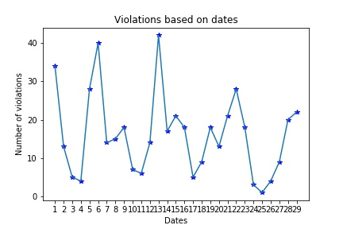
Output plots
Date-wise Violations
Analysis Results:
More number of violations recorded on dates 13th dec, 6th dec and 1st dec with 43, 40 and 34 violations respectively.
Least was recorded on 25th dec, only 1 violation

Slide 12
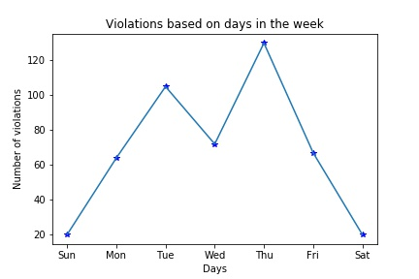
Day-wise Violations
Analysis Results:
The highest number of violations in the month according to the days in the week is recorded on Thursdays with 130 violations.
Least violations are recorded on Saturday and Sunday with 20 violations on each day.

Slide 13
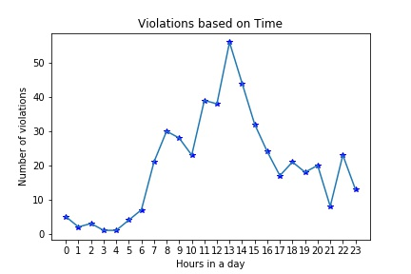
Time-wise Violations
Analysis Results
The maximum number of violation occurred in the Mid-days hours; 1pm being the highest in the month with 56 violations followed by 2pm with 44 violations and 11am 39 violations.
Least number of violations are recorded in the early hours from 2 am to 6am ranging from 2 to 5 violations.

Slide 14
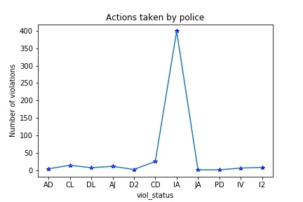
Status wise violations
Analysis Result:
The most repeated status given to violations by the police is INITIAL ARRAIGNMENT. There are 399 cases with the IA Status.
The least number of punishments given by the police are JAIL ARRAIGNMENT and PENDING DISMISSAL.

Slide 15
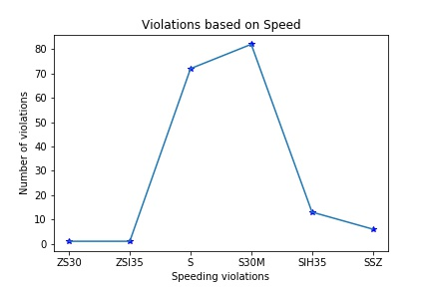
Speed-wise violations
Analysis Result:
The frequently violated speeding violation is the SPEEDING IN 30 MILE HOUR ZONE. There are 82 violations based on this speeding violation condition.
The least speeding violation recorded is CONST ZONE SPEEDING 30 MPH ZN.
(Legend: ZS30-CONST ZONE SPEEDING 30 MPH ZN, ZSI35-CONST ZONE SPEEDING INTERSTATE 35, S-SPEEDING, S30M-SPEEDING IN 30 MILE HOUR ZONE, SIH35-SPEEDING INTERSTATE HWY 35, SSZ- SPEEDING SCHOOL ZONE.)

Slide 16
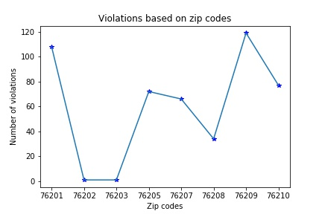
Place-wise Violations
Analysis Result:
The place in Denton which has highest number of violations are from people living in pincode 76209 with a total of 119 violations.
The least number of violations are recorded from the places of people living in pincodes 76202 and 76203 with only 1 violation.

Slide 17
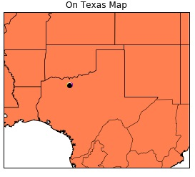
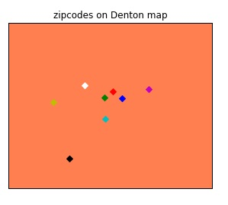
Geographical representation of the Zip codes
This map represents the geographical location of the places from where people who committed violations came from.
Legend:
76201-red
76202- green
76203-blue
76205-cyan
76207-magenta
76208-yellow
76209-white
76210-black

Slide 18
Lessons learnt
The main lesson learnt by doing this project is the usage of pandas package. This package uses dataframe which is a 2D data structure with the required columns. Creating new columns, renaming the column headers, sorting the data based on specific strings or values with conditional logic from dataframes were learnt.
The major challenge encountered while performing this analysis is with the Date time format. Unless the date is filtered we could not proceed further. After series of trials, the date and time format was modified and listed out in separate columns. After this, the csv was sorted based on required city and dates.
Some learnings about matplotlib were incorporated while plotting data. Such as how to give x-axis and y-axis manually. If the X-axis have values as strings and Y-axis has values as integers, first the required data should be listed in arrays and the string values of the X-axis should be listed using ‘my_ticks’ and the values are plotted.

Slide 19
References
https://jeffdelaney.me/blog/useful-snippets-in-pandas/
2. https://www.analyticsvidhya.com/blog/2016/01/12-pandas-techniques-python-data-manipulation/
3. https://dev.socrata.com/blog/2014/11/04/data-visualization-with-python.html
4. http://stackoverflow.com

Slide 20

Thank you

