Slide 1

Title Layout
Subtitle

Slide 2
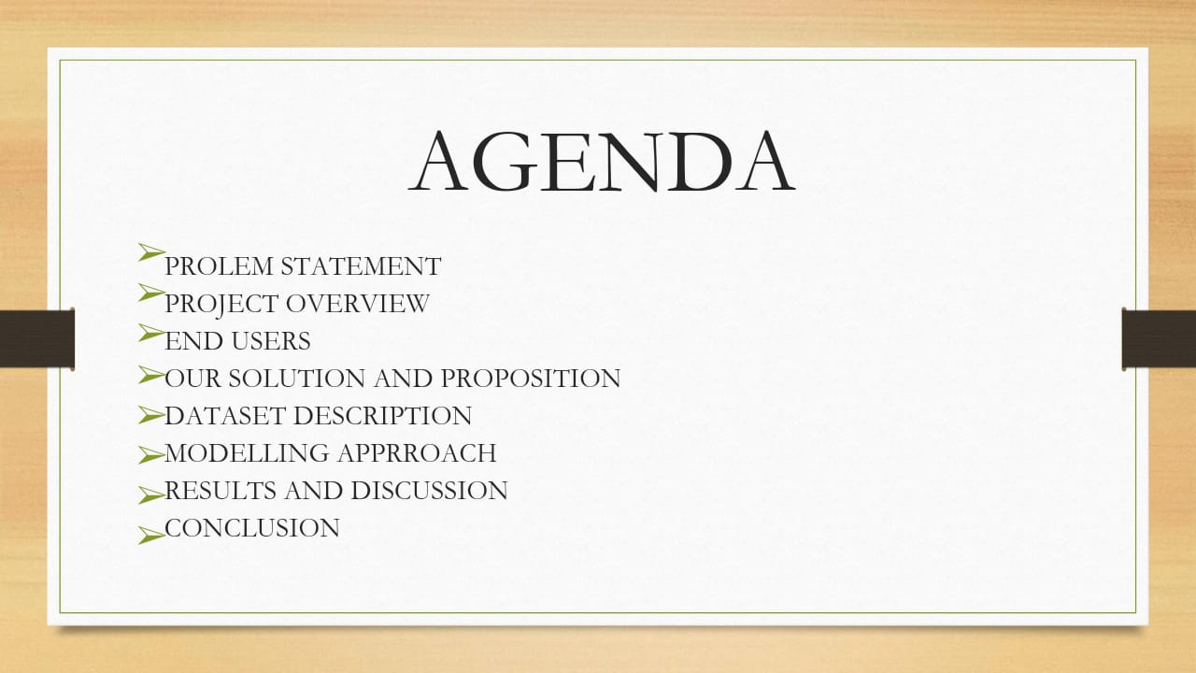
Title and Content Layout with List
Add your first bullet point here
Add your second bullet point here
Add your third bullet point here

Slide 3
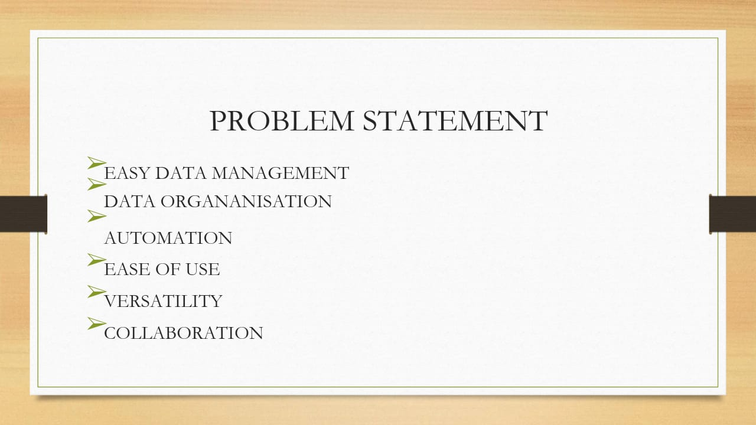
Title and Content Layout with Chart

Slide 4

Title and Content Layout with Table
First bullet point here
Second bullet point here
Third bullet point here
Class | Group 1 | Group 2
Class 1 | 82 | 95
Class 2 | 76 | 88
Class 3 | 84 | 90

Slide 5
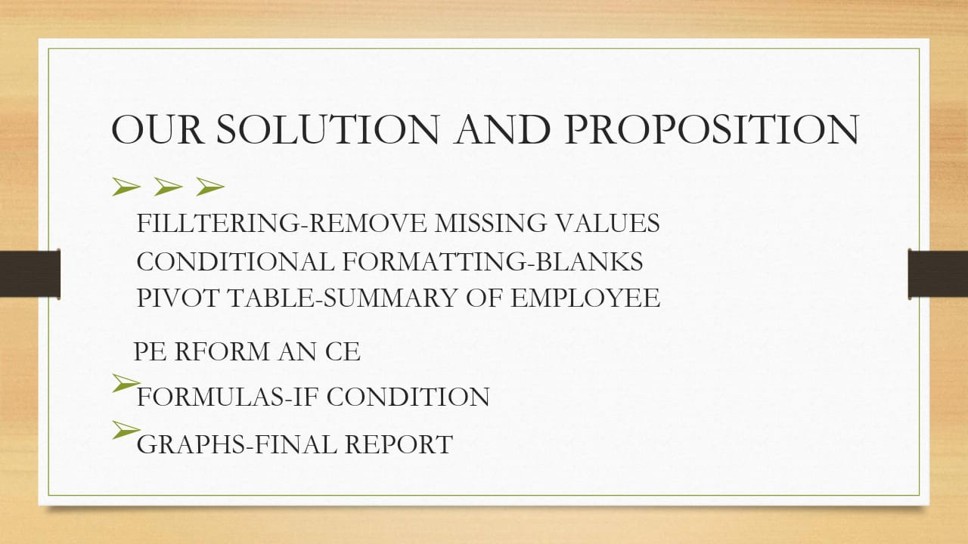
Two Content Layout with SmartArt
First bullet point here
Second bullet point here
Third bullet point here
Step 1 Title
Step 2 Title
Step 3 Title
Step 4 Title

Slide 6
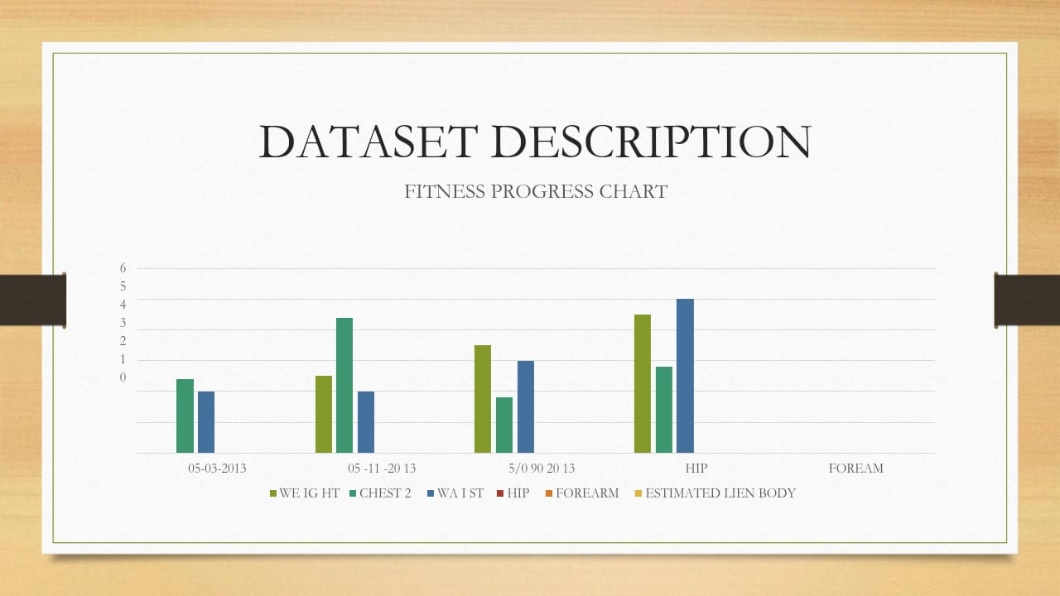
Add a Slide Title - 1

Slide 7
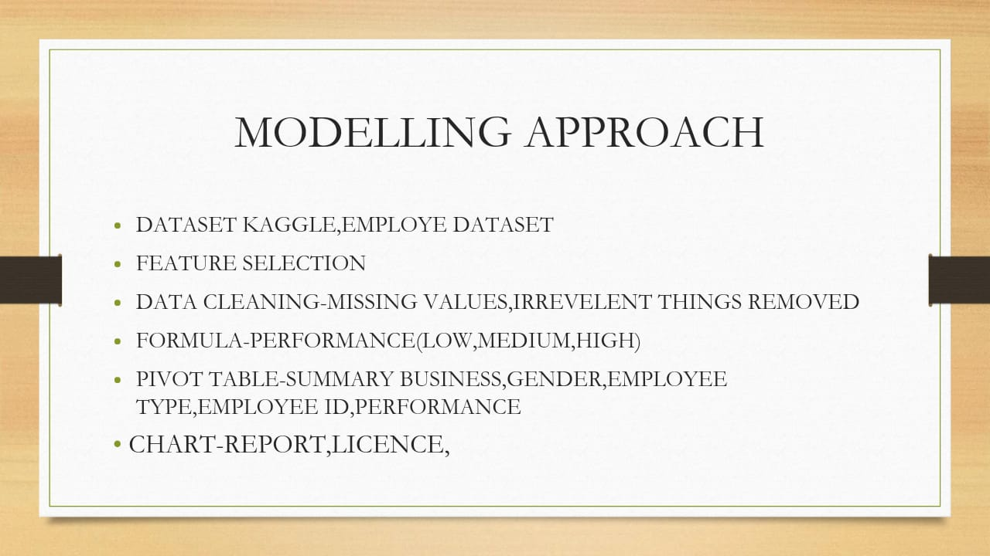
Add a Slide Title - 2

Slide 8
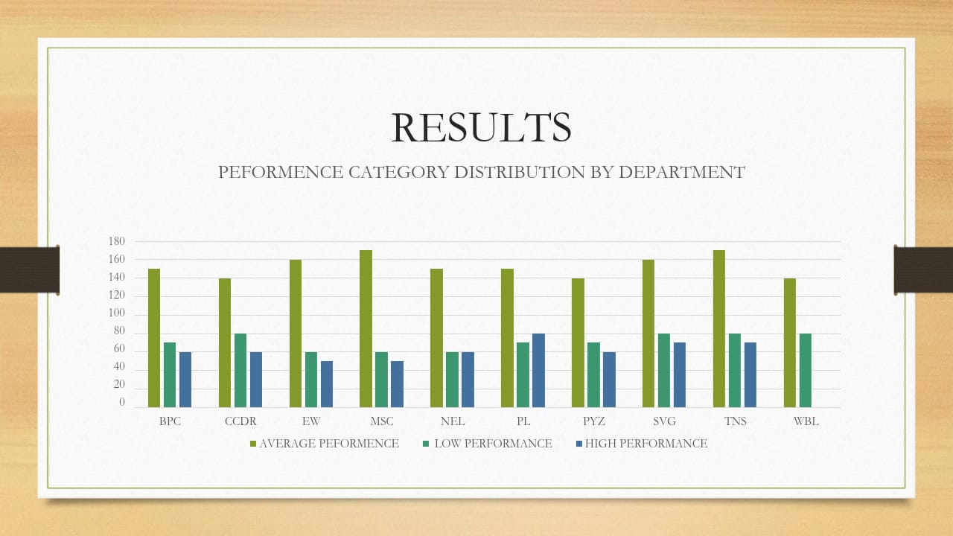
Add a Slide Title - 3

Slide 9


Slide 10

Add a Slide Title - 4

