Slide 1

Rural Health Connect
BATCH:A05
Members:
22BQ1A0522- B.DIVYA SRI LAKSHMI
22BQ1A0523 – K.BHAVANA
22BQ1A0524 – B. KEERTHANA
22BQ1A0525 – B.PRAVALLIKA
22BQ1A0526 – B.RITHWIK RAO
PROJECT GUIDE:
DR. N. LASKHMI PRASANNA
(Associate Professor)

Slide 2
Introduction:
Community Background:
During our visit to Tadikonda village, we found that government hospitals in rural areas face major challenges due to a shortage of senior doctors and delayed treatment for common illnesses.
Why This Project Was Chosen:
We wanted to develop a system that ensures rural citizens receive timely medical support by connecting them digitally with available doctors.
Relevance to Society:
The project strengthens rural healthcare infrastructure through a centralized platform that connects patients, junior doctors, and senior doctors—promoting faster response and improved health outcomes.

Slide 3
Objectives:
Main Goals
Bridge communication between patients and doctors through a helpline and web portal.
Develop a centralized system to store and manage patient health records.
Enable guided diagnosis, treatment, and structured follow-ups.
Implement a case escalation mechanism for critical conditions.
Expected Outcomes
Improved medical accessibility in rural areas.
Faster diagnosis and consultation process.
Better coordination between different levels of doctors.
Organized patient record management and tracking.

Slide 4
Problem Statement:
Rural areas often face severe delays in medical treatment due to a shortage of senior doctors and limited communication between patients and healthcare providers. Villagers struggle to access timely guidance for even minor health issues. To address this, a centralized digital system is needed to connect patients, helper doctors, and specialists, ensuring faster diagnosis, treatment, and data-driven health management.
Issues Identified:
Lack of senior doctors in rural hospitals.
Delay in attending even minor health issues.
Limited medical records and tracking systems.
Absence of quick doctor-patient communication.
Importance of Solving These Issues:
Improving rural healthcare accessibility will reduce treatment delays, enhance medical coordination, and ensure better health outcomes for villagers.

Slide 5
Methodology / Approach
Steps Followed
Conducted community visit to identify rural healthcare challenges and treatment delays.
Defined system roles — Patient, Helper Doctor, Junior Doctor, Senior Doctor, and Admin.
Designed a centralized digital platform for case reporting and healthcare communication.
Developed role-based modules with diagnosis, escalation, and follow-up features.
Integrated and tested the complete workflow for structured case tracking and treatment support.
Tools / Resources Used
• MERN Stack (MongoDB, Express.js, React.js, Node.js)
• Role-Based Access Control (RBAC)
• RESTful API Integration
• Centralized Database for Medical Records

Slide 6
Implementation Plan
S.NO | Activity | Description
1 | Community Visit & Problem Study | Visited Tadikonda village, identified shortage of senior doctors, observed delays in treatment and lack of structured communication.
2 | Requirement Analysis & Role Definition | Identified system users (Patient, Helper Doctor, Junior Doctor, Senior Doctor, Admin) and defined their responsibilities and workflow chain.
3 | System Design & Architecture Planning | Designed role-based healthcare workflow, centralized database structure, case escalation model, and helpline + website reporting system.
4 | Patient & Helpline Module Development | Developed patient registration, complaint submission form, and helper doctor case entry system for villagers without internet access.
5 | Doctor Modules Development | Built Junior Doctor module (diagnosis, prescription, follow-up) and Senior Doctor module (case review, specialist guidance, escalation handling).
6 | Admin Dashboard & Data Management | Implemented centralized medical record storage, case tracking system, doctor assignment monitoring, and overall system control panel.
7 | Integration & Workflow Implementation | Connected all modules to enable real-time case flow from patient → junior doctor → senior doctor with structured follow-up process.
8 | Testing & Validation | Tested case submission, diagnosis flow, escalation process, and simulated rural healthcare scenarios to ensure smooth functioning.

Slide 7
Team Roles
22BQ1A0522 – Patient Interaction Module
22BQ1A0523 – Junior Doctor Module
22BQ1A0524 – Specialist Doctor Module
22BQ1A0525 – Data Analytics & Insights Module
22BQ1A0526 – Admin Dashboard Module

Slide 8
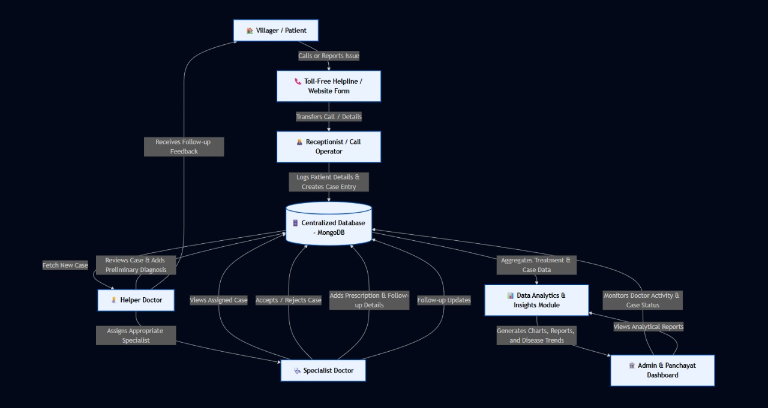

Slide 9
Results / Outcomes
Achievements
• Successfully developed a centralized rural healthcare communication platform.
• Implemented patient case reporting through website and helpline support.
• Developed role-based modules for Helper Doctor, Junior Doctor, and Senior Doctor.
• Enabled diagnosis, prescription upload, and structured follow-up tracking.
• Implemented case escalation system for critical patient conditions.
• Created admin dashboard for centralized record management and monitoring.
Expected Benefits to Community
• Faster reporting of health issues from rural patients.
• Timely diagnosis and medical guidance from doctors.
• Specialist intervention for serious cases through escalation.
• Reduced communication gap between villagers and hospitals.

Slide 10
Before vs After Impact
Before Implementation:
• Manual visit-based consultations.
• Delayed doctor responses.
• No centralized patient records.
• No structured follow-up system.
After Implementation:
• Digital complaint reporting system.
• Faster doctor response and diagnosis.
• Centralized medical record storage.
• Structured escalation and follow-up process.

Slide 11
Challenges Faced
Problems Encountered
• Difficulty in understanding real rural healthcare communication gaps during initial study.
• Designing a simple and user-friendly interface suitable for villagers and non-technical users.
• Structuring a proper workflow between Patient, Junior Doctor, and Senior Doctor.
• Implementing role-based access for multiple healthcare users.
• Ensuring accurate case escalation and follow-up tracking.
Solutions Applied
• Conducted field visits and discussions to understand rural medical needs.
• Designed a minimal, easy-to-use portal interface for accessibility.
• Created a structured healthcare workflow model for case handling.
• Implemented role-based modules for controlled system access.
• Integrated escalation and monitoring features for effective treatment flow.

Slide 12
Learnings & Skills Gained
Technical Skills
• Full-stack development using MERN Stack (MongoDB, Express.js, React.js, Node.js).
• Designing role-based access control systems for multiple users.
• Developing RESTful APIs for secure data communication.
• Managing centralized medical record databases.
Teamwork & Leadership
• Coordinating development across multiple modules (Patient, Doctor, Admin).
• Efficient task allocation based on team strengths.
• Collaborative problem-solving during system integration and testing.
Social Awareness
• Understanding real healthcare challenges in rural communities.
• Recognizing the importance of structured communication in medical systems.
• Realizing how technology can bridge rural–urban healthcare gaps.

Slide 13
Conclusion & Future Scope
Summary
Rural Health Connect is a centralized digital platform that bridges healthcare communication gaps in rural areas. It connects patients, helper doctors, junior doctors, and senior doctors through a structured workflow system. The platform enables efficient case reporting, diagnosis, escalation, and follow-up to ensure timely medical support for villagers.
Future Enhancements
• Integration of multiple rural hospitals for wider doctor availability and case handling.
• Implementation of real-time notification and alert systems for faster response.
• Enhancement of admin analytics dashboard for healthcare monitoring.
• Expansion into a scalable telemedicine support platform.
Acknowledgment
We extend our sincere gratitude to our project guide, VVIT management, community members of Tadikonda village, and all mentors for their continuous guidance and support throughout the development of this project.

Slide 14
Thank You

