Slide 1
Employee Data Analysis using Excel
STUDENT NAME: Divya R
REGISTER NO: 312201324(autumn110312201324)
2D42A57C2587AA4AB594274807624338
DEPARTMENT:B com general
COLLEGE :DRBCCC HINDU college

Slide 2
PROJECT TITLE
Employee Performance Analysis using Excel

Slide 3


AGENDA
Problem Statement
Project Overview
End Users
Our Solution and Proposition
Dataset Description
Modelling Approach
Results and Discussion
Conclusion
3/21/2024 Annual Review

Slide 4

PROBLEM STATEMENT
Performance Analysis: "How does the performance level vary across different business units and job titles? Is there any correlation between certain demographics (e.g., gender, race) and performance levels?"
Employee Retention: "What factors are most predictive of employee turnover, and how do start dates, performance scores, or business units influence employee exit dates?"
Diversity and Inclusion: "What is the distribution of gender, race, and marital status across different performance levels, job functions, and business units?"
Workforce Planning: "How can the organization optimize its workforce by analyzing the distribution of high performers across various business units and job functions?"

Slide 5

PROJECT OVERVIEW
To conduct a comprehensive analysis of employee performance, retention, and diversity metrics to provide actionable insights that can improve organizational efficiency, employee satisfaction, and diversity inclusion within the company
.

Slide 6

WHO ARE THE END USERS?
Human Resources (HR) Department
Management and Leadership Team
Diversity and Inclusion Team
Departmental Managers and Team Leads

Slide 7

OUR SOLUTION AND ITS VALUE PROPOSITION
Data Integration and Cleaning:
Consolidate and clean data from various sources, ensuring consistency and accuracy.
Performance Analytics Dashboard:
Develop an interactive dashboard that allows users to view performance metrics across different business units, job functions, and demographic groups.
Retention Prediction Model:
Build a predictive model to identify employees at risk of leaving the organization.
Diversity and Inclusion Reporting:
Create reports that highlight the distribution of employees across various demographic categories, such as gender, race, and marital status.

Slide 8
Value proposition
Improved Employee Retention:
By identifying the key factors leading to employee turnover, the organization can implement targeted retention strategies, reducing the costs and disruption associated with high turnover rates.
Enhanced Performance Management:
The insights gained from the performance analytics dashboard will help managers identify top performers and areas needing improvement, enabling more effective performance management and employee development.
Increased Organizational Efficiency:
By optimizing workforce allocation based on data-driven insights, the organization can ensure that the right talent is in the right roles, leading to improved overall productivity and efficiency.

Slide 9
Dataset Description
EmpID: Unique identifier for each employee
FirstName: Employee's first name
LastName: Employee's last name
DOB: Date of birth, used to calculate the employee's age
GenderCode: Gender of the employee (e.g., Male, Female)
.RaceDesc: Race or ethnicity of the employee (e.g., Asian, White, Hispanic)
.MaritalDesc: Marital status of the employee (e.g., Single, Married, Divorced).
This dataset is crucial for providing insights that can inform HR strategies, improve organizational effectiveness, and ensure a diverse and inclusive workplace.

Slide 10

THE "WOW" IN OUR SOLUTION
=IFS(Z2>=5,“VERY HIGH ”,Z2>=4,“HIGH”,Z2>=3,“MED”,TRUE, “LOW”) this formula is used for performance level
3/21/2024 Annual Review
10

Slide 11
MODELLING
Cleaning data : Cleaning the data involves transforming the raw data into a format that's easier to work with. For the Excel file you provided, the data appears to be a pivot table with some extraneous information
Header Rows: The first two rows (NaN, Count of Title, etc.) are not part of the main data and can be removed.Blank Rows/Columns: Any rows or columns that are entirely blank or contain non-essential information (like grand totals) should be removed.
11

Slide 12
Modeling
Extract Relevant Data:Row Labels: The row with "Row Labels" indicates the department or category names. This row will be used as the main labels for your data.Column Labels: The columns labeled "HIGH," "LOW," "MED," and "VERY HIGH" represent different categories. These should be used as column headers.Data Rows: The rows following the "Row Labels" contain the actual data you need—counts corresponding to each department/category.
Create a DataFrame: Use the cleaned data to create a DataFrame where:The first column contains the department or category names (from "Row Labels").The subsequent columns contain counts under each category ("HIGH," "LOW," "MED," "VERY HIGH").
. Create a Table:Organize the data into a clean table: The table should have clear column names like "Department" (from Row Labels) and each of the categories (e.g., "HIGH," "LOW," "MED," "VERY HIGH") with their respective counts.

Slide 13
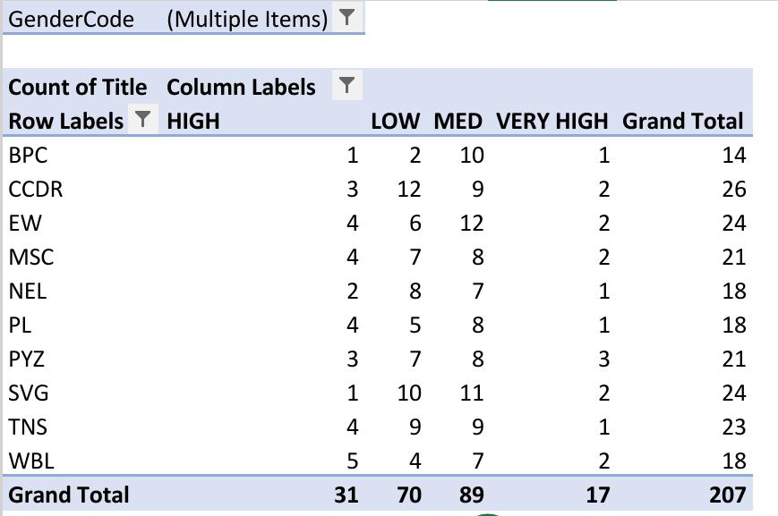
RESULTS
13

Slide 14
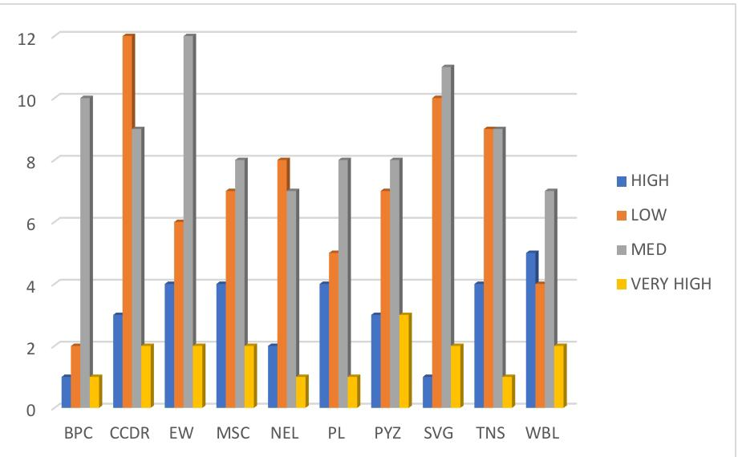

Slide 15
conclusion
The dataset provided is a rich source of information that can be leveraged to drive significant improvements in employee performance, retention, and diversity within the organization.

