Slide 1


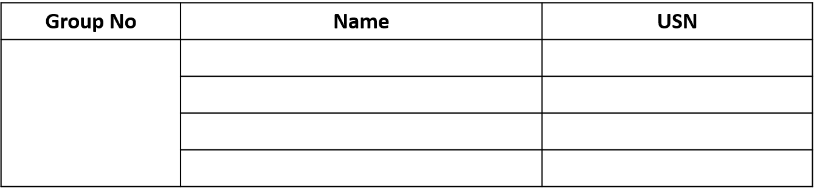
Department of Electronics and Communication Engineering
Acharya Institute of Technology
Soladevanahalli , Bengaluru 560107
Project Synopsis Presentation on
DEVELOPMENT OF UNDERWATER BODY MONITORING SYSTEM FOR MARINE PERSONNEL
Presented by
Bhoomika S Jiroli
1AY20EC014
Bole Swetha
1AY20EC015
24
Divya Dharshini R
1AY20EC027
Madhan Karthick E
1AY20EC042
Under the guidance of
Ms. Nikita Kar Chowdhury
[Assistant Professor]
Department of ECE,
Acharya Institute of Technology
2022-2023
1
1

Slide 2
Table of contents
ABSTRACT
INTRODUCTION
OBJECTIVES
LITERATURE SURVEY
PROPOSED METHODOLOGY
REQUIREMENTS
HARDWARE COMPONENTS
DESIGN AND IMPLIMENTAION
RESULT
OUTCOMES
CONCLUSION

Slide 3
ABSTRACT
Diving into innovation, our system integrates cutting-edge sensors to capture vital biometric data from submerged marine personnel.
With waterproof, non-invasive sensors thoughtfully positioned on their bodies, we unveil the heart rate, body temperature, and oxygen saturation.
The development of this system involves research and testing to optimize sensor accuracy and reliability in underwater conditions.
By this, we are prepared to witness a groundbreaking shift as this remarkable underwater body parameter measuring system takes center stage.
Its ecstatic implementation promises to revolutionize the monitoring and management of marine personnel across diverse sectors: offshore energy, subaquatic construction, exploration, and military operations.
With its proactive nature, it becomes the guardian of health and safety, uplifting the welfare and effectiveness of those embracing the challenging unveiling of excellence in the vast depths.

Slide 4
INTRODUCTION
The notion of this project emphasizes healthcare and the safety of the diver.
The health condition of the diver is critically monitored before going into the ocean with constant monitoring of the body parameters as the descension of the diver takes place.
Health monitoring is the collection of individual health-related physiological parameters and related influence factors through a certain monitoring system.
The bodily parameters of the diver are continuously monitored in the ocean.

Slide 5
OBJECTIVES
The monitoring of bodily parameters reduces expenses and monitors physiological parameters, such as heart rate, body temperature, and blood oxygen on a smartphone.
Monitoring the health of the diver as he descents can ensure the safety of the diver in the entire process.
Its purpose is to identify the diver and detect his/her levels of vigilance through software and alert him/her in cases of drowsiness, distractions, etc. to avert accidents.

Slide 6
LITERATURE SURVEY
a
Xiaohui Wei Yuanyuan Liu Shang Gao Xingwang Wang Hengshan Yue | 17 February 2019 | An RNN Based Delay Guaranteed Monitoring Framework in Underwater Wireless Sensor Networks | Real-time underwater monitoring has been widely applied in many applications of underwater wireless sensor networks (UWSNs).Due to the long acoustic communication delays, real-time data collection in UWSNs is challenging.
Shengmin Xu Yingjiu Li Robert H. Deng Yinghui Zhang Xiangyang Luo Ximeng Liu | 20 August 2019 | Lightweight and Expressive Fine Grained Access Control for Healthcare Internet-of Things | encryption, cloud and edge computing, which provides an efficient, flexible, secure finegrained access control healthcare IoT network without any secure channel and enables data users to enjoy the lightweight decryption.
Chongwei Liu Haojie Li Shuchang Wang | 05 July 2021 | A Dataset and Benchmark of Underwater for Robot Picking | Underwater object detection for robot picking has attracted a lot of interest. However, it is still an unsolved problem due to several challenges. We take steps towards making it more realistic by addressing the following challenges. Training other methods lead to an increase in workload and different researchers divide different datasets.
Authors
Year
Work Presented
Drawbacks/Limitations

Slide 7
PROPOSED METHODOLOGY
Start
Measuring bodily parameters before diving
NO
The diver is not fit to dive
YES
Monitoring the body parameters as the diver descents
Displaying the parameters as they vary

Slide 8
REQUIREMENTS
Node MCU ESP8266 board
MAX30100 pulse oximeter sensor
DS18B20 sensor
DHT22 sensor
Resistor 4.7kΩ
Connecting wire
Breadboards
Arduino IDE

Slide 9
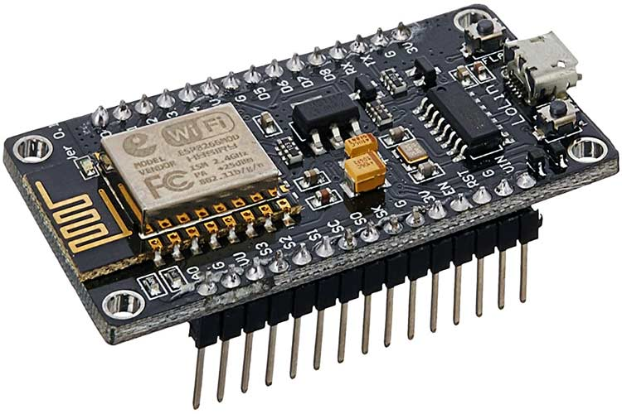
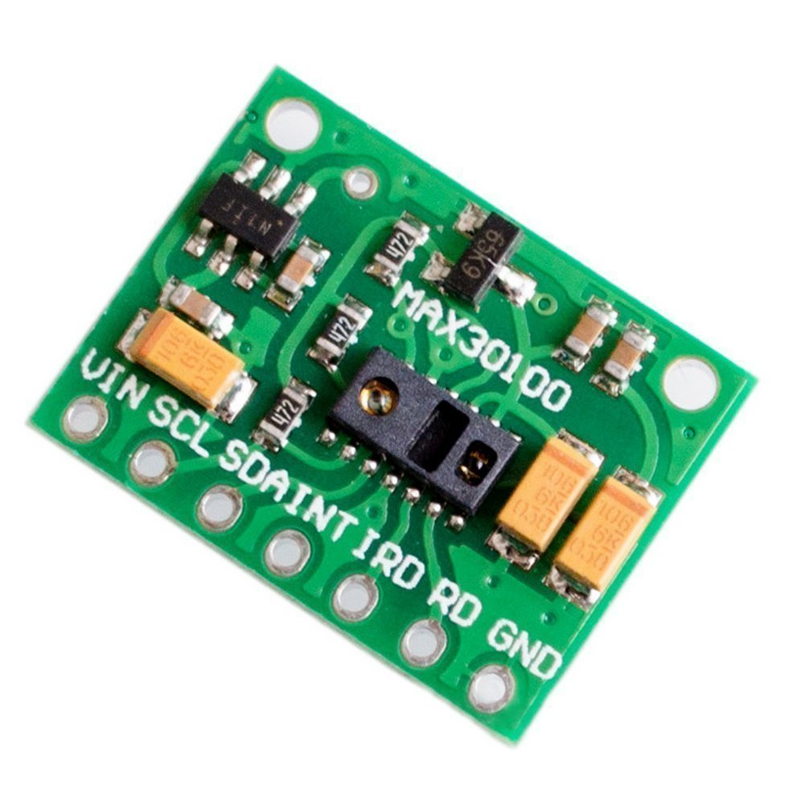
HARDWARE COMPONENTS
Node MCU ESP8266:
1. Node MCU is an open source platform based on
ESP8266 which can connect objects and let data
transfer using the Wi-Fi protocol.
2. In addition, by providing some of the most important
features of microcontrollers such as GPIO, PWM, ADC, and etc.
MAX30100 Pulse Oximeter Sensor:
The MAX30100 is an integrated pulse oximetry and heart-
rate monitor sensor solution. It combines two LEDs, a
photodetector, optimized optics, and low-noise analog
signal processing to detect pulse oximetry and heart-rate signals signals.

Slide 10
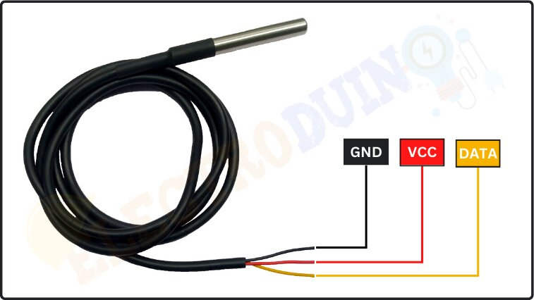
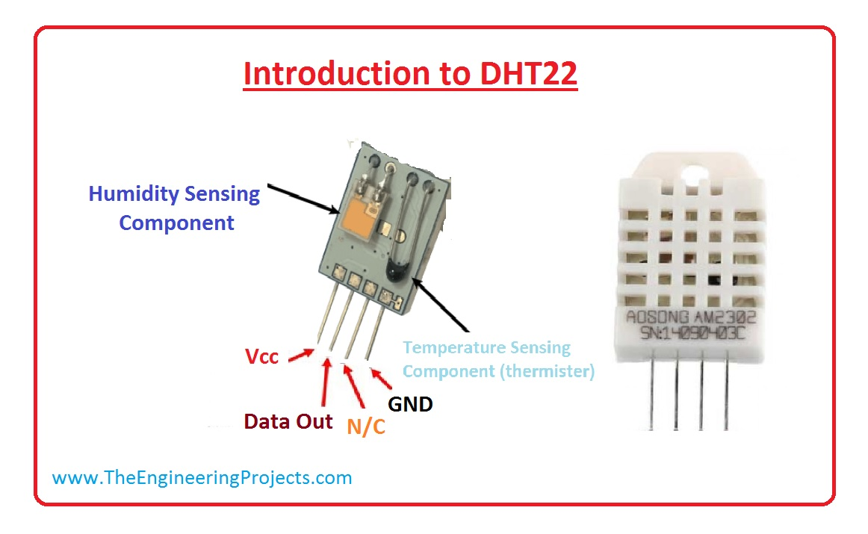
DS18B20 Sensor:
The DS18B20 is one type of temperature sensor and it supplies 9-bit to 12-bit readings of temperature. These values show the temperature of a particular device.
DHT22 Sensor:
The DHT22 is a basic, low-cost digital temperature and humidity sensor. It uses a capacitive humidity sensor and a thermistor to measure the surrounding air and spits out a digital signal on the data pin (no analog input pins needed).

Slide 11
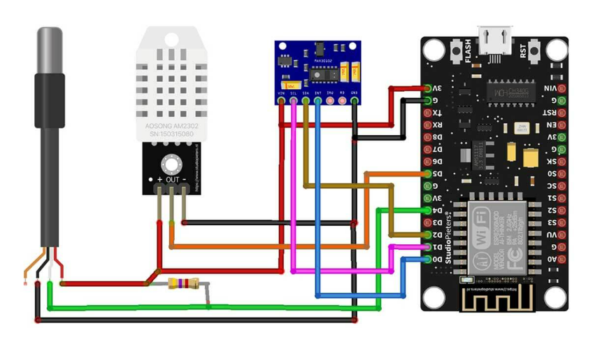
DESIGN AND IMPLEMENTATION

Slide 12
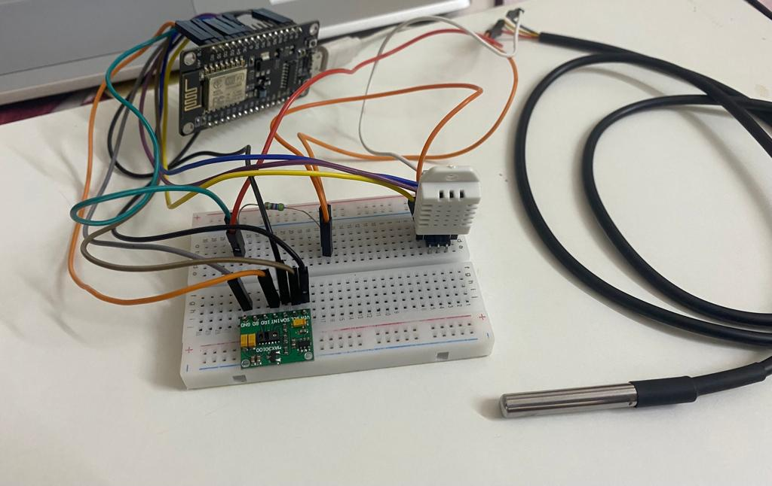
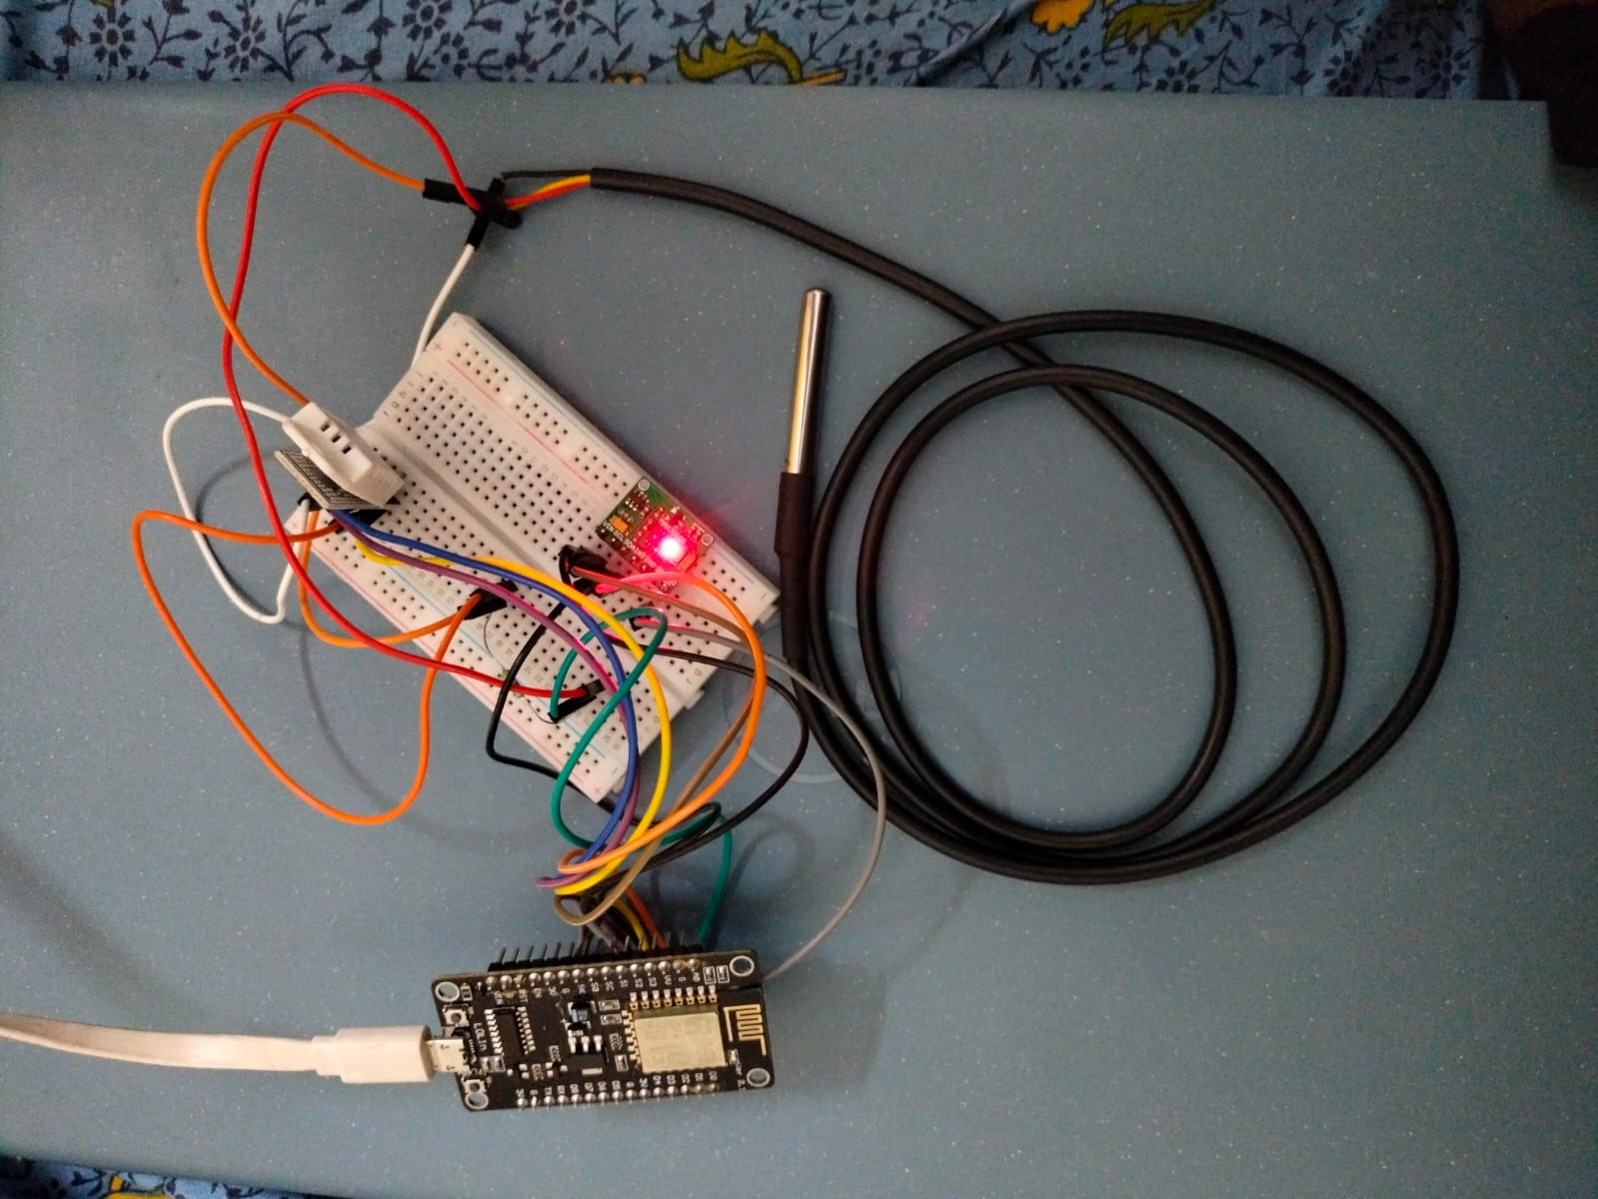

Slide 13
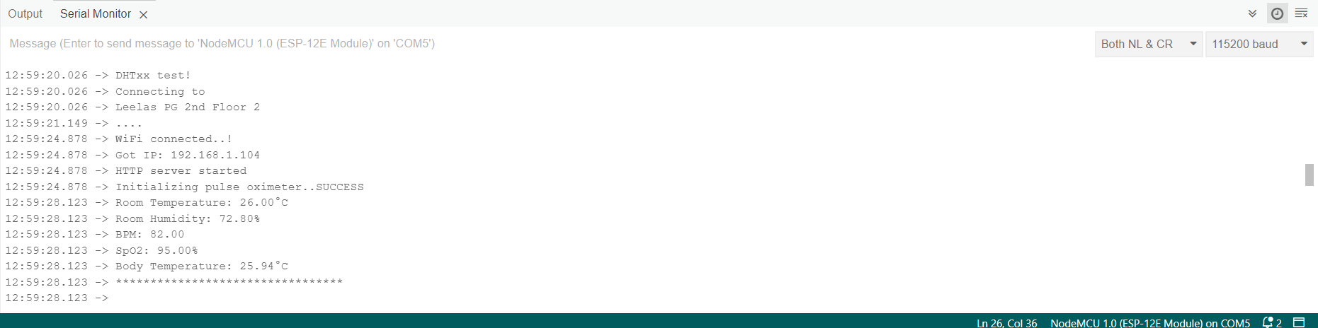
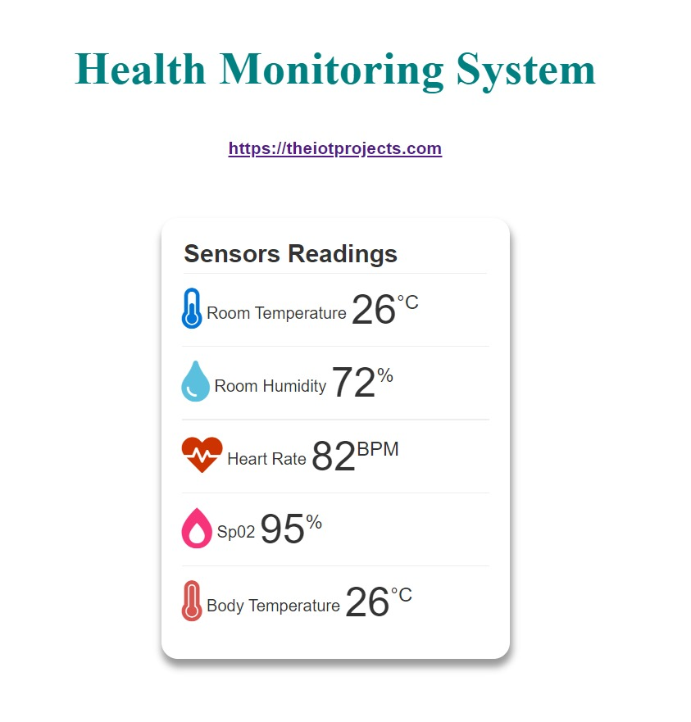
RESULT

Slide 14
OUTCOMES
Preventing the heart attack and high blood pressure of the diver.
Helps to collect real-time health-related data effortlessly.
The body parameters of the diver are monitored continuously.

Slide 15
CONCLUSION
Underwater body monitoring systems have the potential to greatly benefit marine personnel engaged in underwater operations.
Despite their technical limitations and potential disadvantages, these systems offer significant advantages in terms of safety, health management, performance optimization, and early warning capabilities.
By addressing the challenges and mitigating potential negative impacts, underwater body monitoring systems can enhance the overall well-being and effectiveness of marine personnel, contributing to successful and safe underwater missions.

