Slide 1
Customer Churn Prediction Using KNIME
Group 3
Malav Sheth
Divya Umeshkumar
Shadman Sakib

Slide 2
Project Objective
Predict customer churn using the Telco dataset.
Use KNIME for data preprocessing, visualization, and machine learning.
Analyze key factors influencing churn and suggest actionable recommendations.

Slide 3
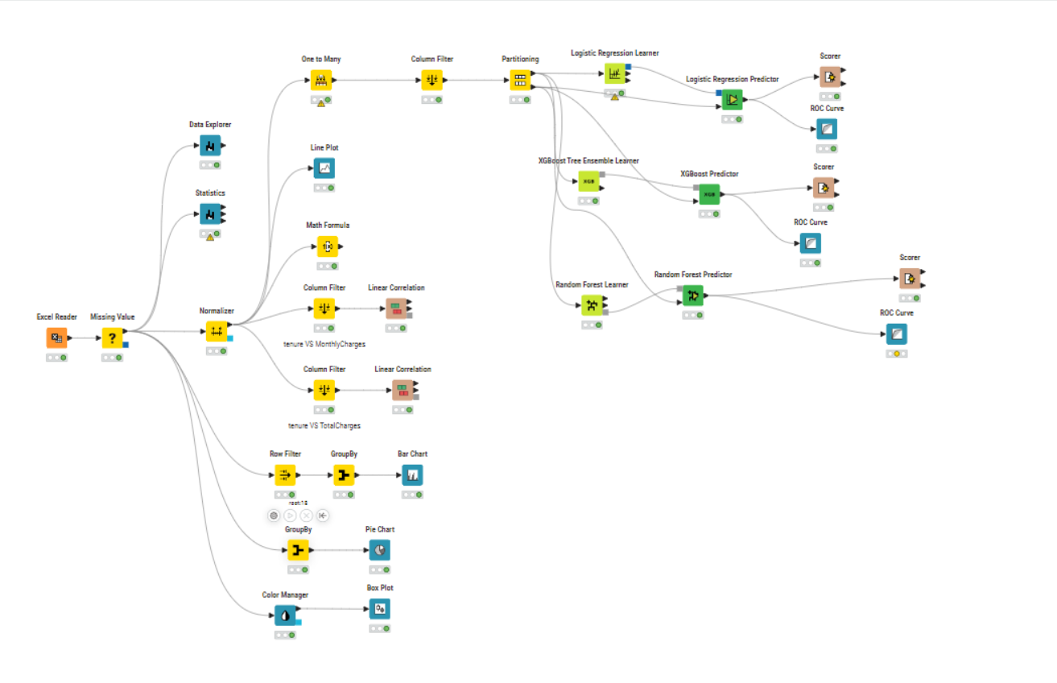
KNIME Workflow

Slide 4
Modeling Summary
Data Split: 70% Train / 30% Test
Models Trained:
- Logistic Regression
- Random Forest
- XGBoost
We used all the models but the highest accuracy was given by Logistic Regression.

Slide 5
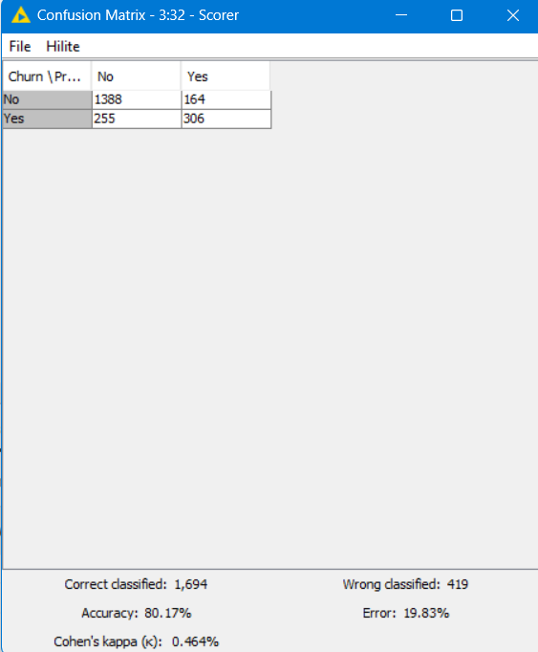
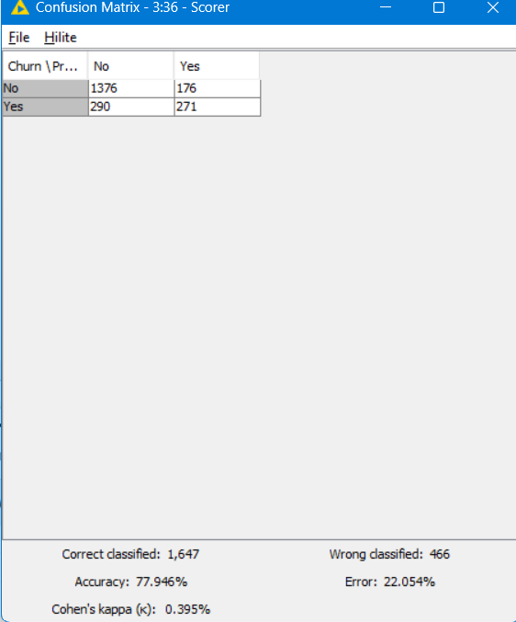
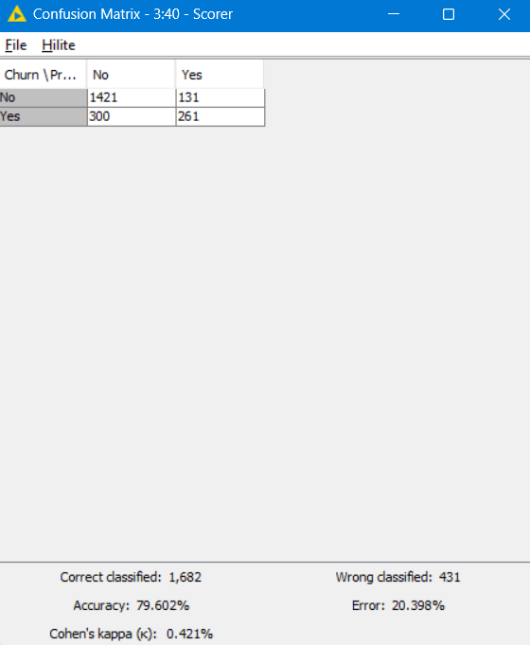
Model Performance Comparison
Model | Accuracy
Logistic Regression | 0.801
Random Forest | 0.779
XGBoost | 0.796

Slide 6
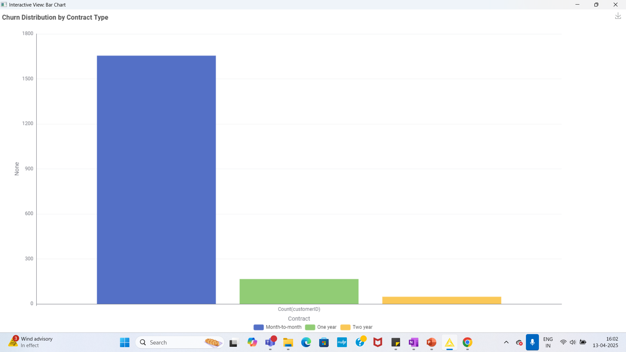
Churn Distribution
What It Shows:
This bar chart illustrates churn counts across different contract types.
Interpretation:
Month-to-month contracts show the highest churn rate, significantly more than 1-year or 2-year contracts.
One-year and two-year contract holders churn less frequently.

Slide 7
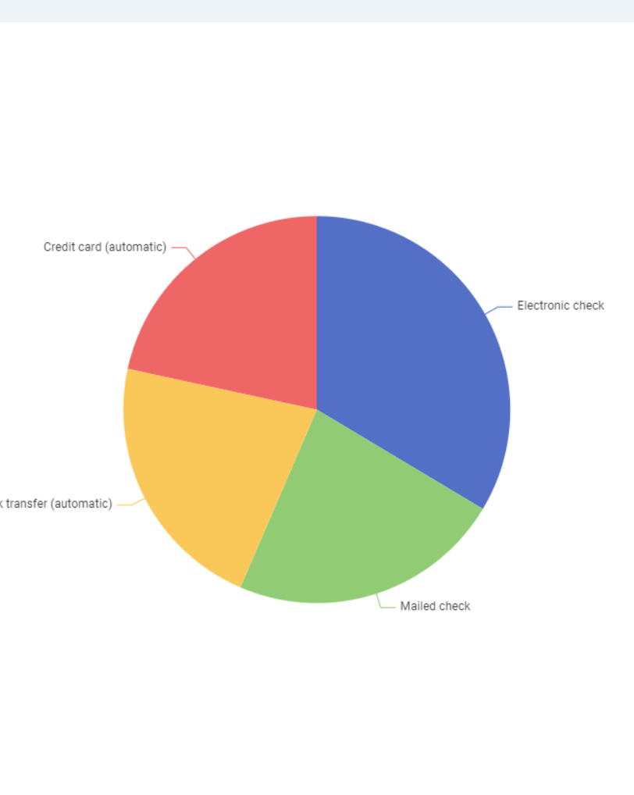
Tenure Distribution by Churn
What It Shows:
This pie chart breaks down the percentage of customers based on their payment method.
Interpretation:
The most commonly used payment method is Electronic Check (Blue).
Other methods such as Mailed Check, Bank Transfer (automatic), and Credit Card (automatic) are also present but less dominant.

Slide 8
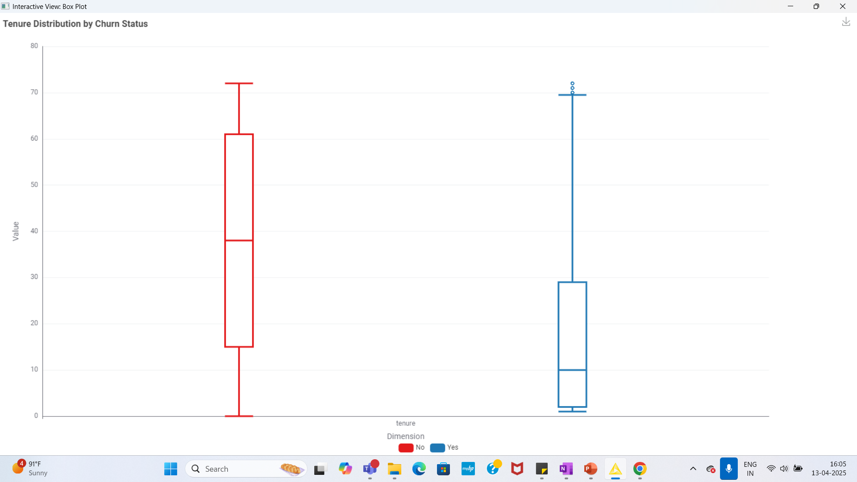
Monthly Charges by Churn
What It Shows:
This box plot compares the tenure (number of months a customer has stayed) between customers who churned (Yes) and those who did not churn (No).
Interpretation:
Red Box (No):
Customers who stayed have a higher median tenure, indicating they’ve been with the company for longer.
Their tenure values are more spread out, suggesting a variety of long-term customers.
Blue Box (Yes):
Churned customers have a lower median tenure.
Most of the churned customers left early in the lifecycle (closer to the start of their tenure).
There are some outliers (dots above the top whisker) who churned after staying for a long time, but they’re rare.

Slide 9
Business Recommendations
Reward long-tenured customers to improve retention.
Proactively reach out to customers with high monthly charges.
Improve support service availability and quality.
Use churn model predictions to design targeted interventions.

