Slide 1
Clinical Decision Making and Pattern Recognition in Health Care
Strategic Opportunities for Cotiviti Presented by Divya Sivani Kona 08/19/2024

Slide 2

Introduction
The integration of Artificial Intelligence (AI) and Machine Learning (ML) is transforming healthcare. AI technologies such as Chain Reasoning, Agentic Generative AI, and Time-Series Anomaly Detection are enhancing clinical decision-making processes, improving patient outcomes, and optimizing operational efficiencies. This presentation explores these AI-driven advancements and their strategic potential for Cotiviti.

Slide 3

Topic Overview
Clinical decision-making and pattern recognition involve utilizing AI technologies to assist healthcare providers. Key concepts include:
Chain Reasoning: AI connects different pieces of information logically to mimic human reasoning.
Agentic Generative AI: AI autonomously generates content or predictions from learned data patterns.
Time-Series Anomaly Detection: Identifies unusual patterns in time-series data, crucial for detecting operational inefficiencies or anomalies.

Slide 4

Relevant Trends
Several trends highlight the growing role of AI in healthcare:
AI-Driven Clinical Decision Support Systems (CDSS): Growing adoption of AI tools to support clinicians in making more accurate decisions.
Time-Series Analysis: Increasingly used for real-time patient monitoring, enabling early detection of complications.
Generative AI: Used for creating personalized treatment plans based on patient-specific data.

Slide 5
Opportunities Threats
The application of AI in healthcare presents significant opportunities: Improved Diagnostic Accuracy: AI can detect complex patterns in data, leading to more accurate diagnoses.
Cost Reduction: Predictive analytics can reduce unnecessary tests and optimize resource allocation.
Operational Efficiency: Time-series analysis can detect inefficiencies in healthcare operations, allowing for timely interventions."
While AI offers many benefits, there are also challenges: Data Privacy and Security: Handling sensitive patient data raises concerns about privacy.
Algorithmic Bias: AI models may reflect biases present in the training data, leading to unequal treatment outcomes.
Integration Challenges: Implementing AI systems into existing healthcare infrastructures can be complex and resource-intensive.

Slide 6

Strategic Recommendations
Cotiviti can capitalize on AI's potential by: Investing in AI-Driven Decision Support Tools: Enhancing payment integrity and risk adjustment through AI tools.
Partnerships with AI Startups: Collaborating with AI innovators to accelerate healthcare analytics capabilities.
Focus on AI-Enabled Fraud Detection: Exploring AI solutions for detecting and preventing healthcare payment fraud."

Slide 7
POC Overview
The Proof of Concept (POC) demonstrates Time-Series Anomaly Detection in healthcare operations: Objective: Identify anomalies in operational data that may indicate issues like billing errors or unusual patient inflows.
Technology: Python-based application using the Isolation Forest algorithm to detect anomalies in time-series data.
Outcome: The POC successfully identifies anomalies, showcasing how AI can enhance operational efficiencies in healthcare.

Slide 8
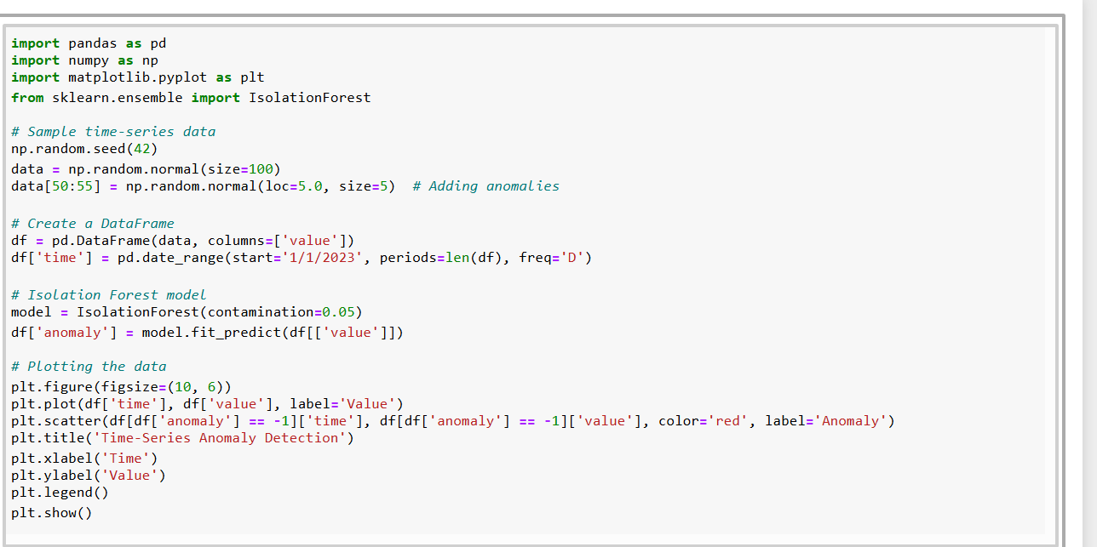
Python script that demonstrates time-series anomaly detection using the Isolation Forest algorithm:

Slide 9
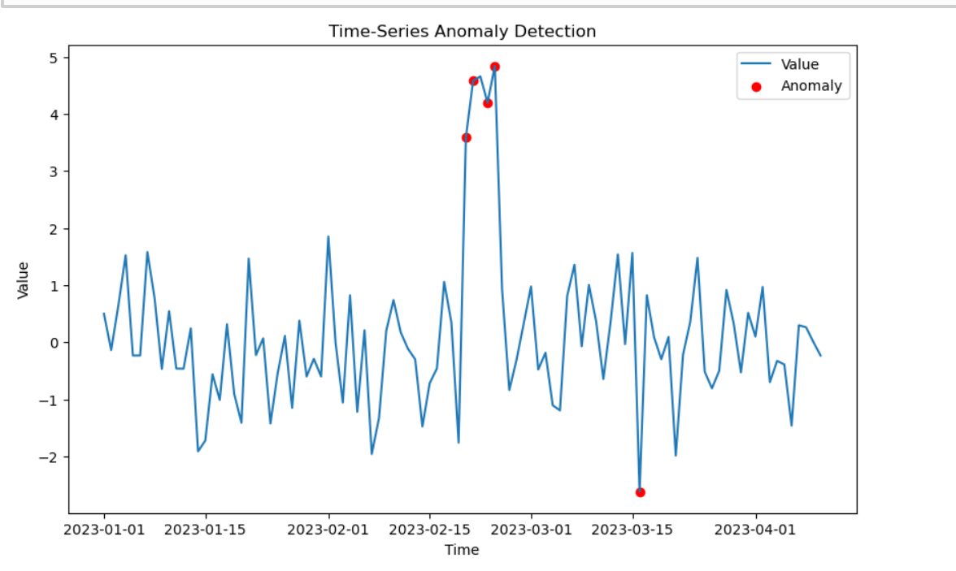
Output

Slide 10

Conclusion
AI and Machine Learning are crucial to the future of healthcare. By investing in AI-driven tools and forming strategic partnerships, Cotiviti can lead the way in healthcare analytics, improving decision-making, operational efficiency, and fraud detection. Embracing these technologies will not only enhance Cotiviti’s capabilities but also contribute significantly to healthcare innovation.

Slide 11

References
Smith, John. Artificial Intelligence in Healthcare: A Comprehensive Review. Springer, 2023
Brown, Michael, and Lisa Green. "Time-Series Analysis in Healthcare: Trends and Applications." Healthcare Analytics Review, vol. 5, no. 2, 2021, pp. 50-63.
Chen, David. "Addressing Bias in AI Models: Ethical Considerations for Healthcare." Journal of Ethics in AI, vol. 7, no. 1, 2023, pp. 30-45.
Anderson, Patricia. "Privacy Concerns in AI-Driven Healthcare: A Legal Perspective." International Journal of Healthcare Law, vol. 12, no. 3, 2022, pp. 76-89.
Williams, Rachel. "Strategic Partnerships in AI: A Case Study on Healthcare Startups." Tech Innovations Journal, vol. 9, no. 6, 2023, pp. 142-155.

Slide 12


