Slide 1



Forest Fire Detection Using Deep learning
Student name : Divya Teja Yeleti
AICTE ID : STU67cf0ba556d0d1741622181
Internship ID : INTERNSHIP_174099535967c57b1f336c3

Slide 2

Learning Objectives
Understand the working principles of Convolutional Neural Networks (CNNs) and their application in image classification tasks.
Train a deep learning model to accurately detect wildfires from forest images using CNN architectures.
Learn effective techniques for preprocessing and structuring image datasets to enhance model performance.
I practiced evaluating model performance using metrics like accuracy, loss, and confusion matrices.
I wanted to get hands-on experience with TensorFlow, Keras, and OpenCV for deep learning and image processing.
My objective included building a prediction system that works on individual images.
I planned to extend the model for real-time fire detection and consider transfer learning for better accuracy.
GOAL

Slide 3
Tool and Technology used
Python – My primary programming language for building and training the model.
Tensor Flow & Keras – Used to design, train, and evaluate the Convolutional Neural Network (CNN).
OpenCV – Helped me handle and process image data efficiently.
NumPy & Pandas – For data manipulation and preprocessing.
Matplotlib & Seaborn – To visualize training results, accuracy trends, and confusion matrices.
Scikit-learn – For model evaluation and performance metrics.
Google Colab/Jupyter Notebook – Used for code development, testing, and visualization in an interactive environment.
Kaggle – Source of the wildfire image dataset and a great platform for research inspiration.
Streamlit (Planned) – For building a web demo of the fire detection system.

Slide 4
Methodology
I began by collecting and organizing the wildfire dataset from Kaggle into training, validation, and test sets.
Then, I preprocessed the images by resizing and normalizing them to prepare for training. I also applied data augmentation techniques to make the model more robust.
I designed a Convolutional Neural Network (CNN) with Conv2D, MaxPooling, Dropout, and Dense layers to extract features and classify the images.
The model was trained on the training set and validated on the validation set to fine-tune hyperparameters and prevent overfitting.
After training, I evaluated the model’s performance on the test set, achieving around 80% accuracy.
I also created a prediction script to test the model on new images and analyze the output.

Slide 5
Problem Statement:
Wildfires pose a serious threat to our environment, wildlife, and human lives, often spreading rapidly before they are detected. I want to build an intelligent system that can automatically detect wildfires from images using deep learning. This system aims to provide early warning by accurately distinguishing between fire and non-fire images, helping in faster response and prevention efforts. The challenge lies in training a reliable model that can handle diverse forest conditions and varying fire appearances, minimizing false alarms and missed detections.

Slide 6
Solution:
To tackle this challenge, I developed a Convolutional Neural Network (CNN)-based image classification model that can accurately detect the presence of wildfire in forest images. Using The Wildfire Dataset from Kaggle, I trained the model to learn complex patterns and visual cues that differentiate fire from non-fire scenes. The architecture includes convolutional, pooling, dropout, and dense layers to ensure robust learning while minimizing overfitting. Once trained, the model can classify unseen images with around 80% accuracy, making it a promising step toward automated wildfire detection. This solution can serve as the foundation for real-time video surveillance, drone-based monitoring, or even mobile-based alert systems in the future.
GITHUB REPOSITORY : https://github.com/Divya3215/Forest-fires-detection-using-Deep-Learnig.git

Slide 7
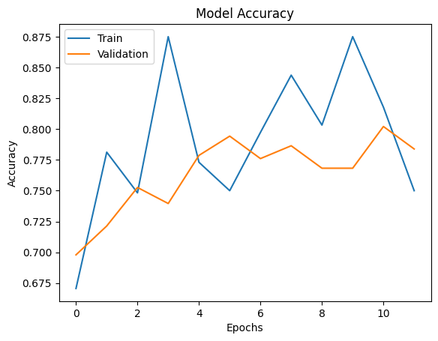
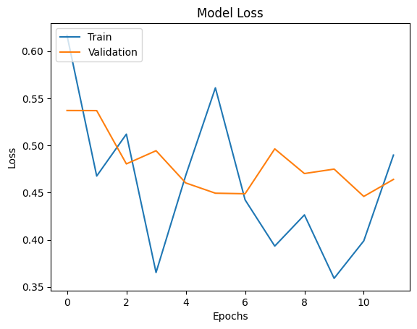
Screenshot of Output:
Graph : Model Accuracy and Loss

Slide 8
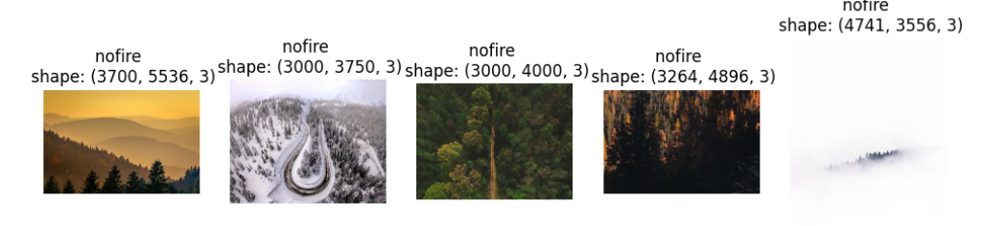
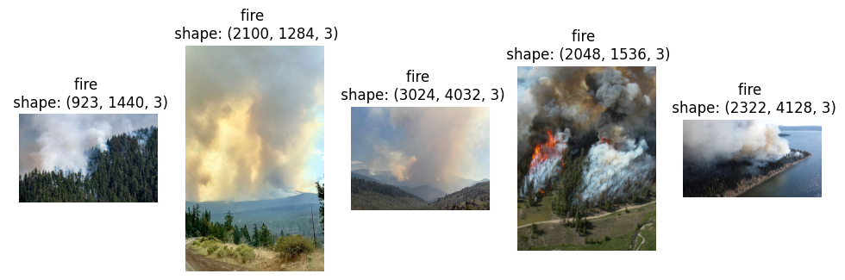
Training data image into two classes nofire and fire

Slide 9
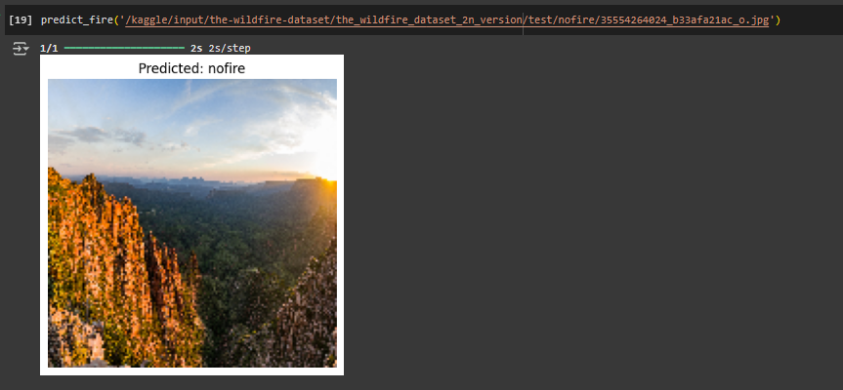
As we give path of image of forest to predict the fire or no fire , it will predict the output .

Slide 10
Conclusion:
Through this project, I explored the power of deep learning in tackling real-world environmental challenges. By training a Convolutional Neural Network on a wildfire image dataset, I was able to create a model that can distinguish between fire and no-fire scenarios with promising accuracy. This journey taught me not just how to build and train models, but also how critical early wildfire detection can be in saving lives and ecosystems. While the current model performs well on test data, I recognize the potential for future improvements — including real-time video analysis, deployment on web platforms, and integration with drones or IoT devices. This project marks a meaningful step in my learning journey and reaffirms my belief in AI as a force for good.

