Slide 1
Smartwatch Data Analysis Project
Name: Divya M
Department: MCA (VTU) Semester:3rd Sem
USN: 1BO23MC032

Slide 2
Outline
Title Name
Outline
Abstract
Problem Statement
Proposed Solution
Short Video
Implementation
Output Screenshots
References

Slide 3
Abstract:
The Smartwatch Data Analysis Project With the rapid adoption of smartwatches and wearable devices, vast amounts of personal health data are generated daily, including information on physical activity, heart rate, sleep patterns, and calories burned. While this data offers significant potential to enhance user well-being, most individuals lack the tools or knowledge to interpret it effectively. This project aims to analyze smartwatch data to uncover valuable health insights, detect early signs of potential health issues, and offer personalized recommendations to optimize user health.
Key objectives include:
Health Monitoring and Wellness Insights:
Personalized Recommendations:
Predictive Analytics for Health Issues:

Slide 4
Problem Statement
With the increasing adoption of smartwatches and wearable fitness devices, a vast amount of personal health data is being generated by users on a daily basis. However, the raw data collected—such as heart rate, steps taken, sleep patterns, and activity levels—remains largely underutilized. Most users do not have the tools or expertise to interpret this data in a meaningful way. Additionally, there is a gap in the ability to automatically detect potential health issues or provide personalized, actionable insights based on this data.
Data Overload
Data Noise
Personalization

Slide 5
Proposed Solution
The goal of the smartwatch data analysis project is to leverage data collected from smartwatches to monitor users' health, detect potential health issues, and provide personalized insights to help users optimize their lifestyle choices. This solution will involve several key steps:
Data Collection:
Data Preprocessing:
Data Analysis:
Machine Learning for Prediction and Personalization
Real-Time Monitoring and Alerts

Slide 6
Implementation
https://github.com/Divya7781/divya81_smartwatch

Slide 7
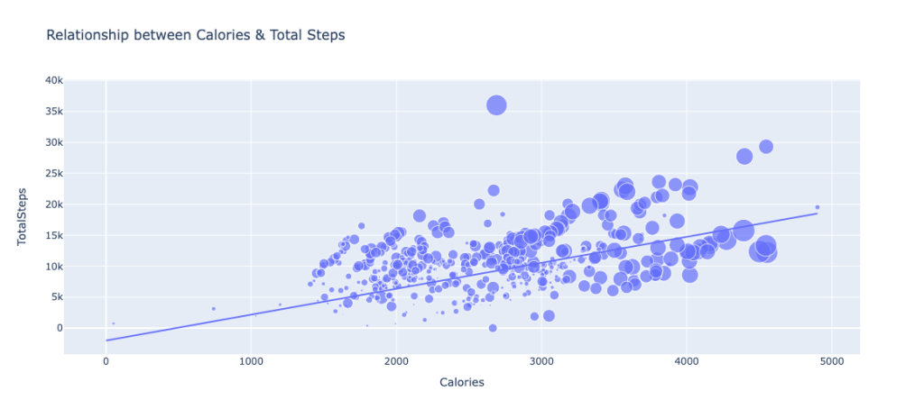
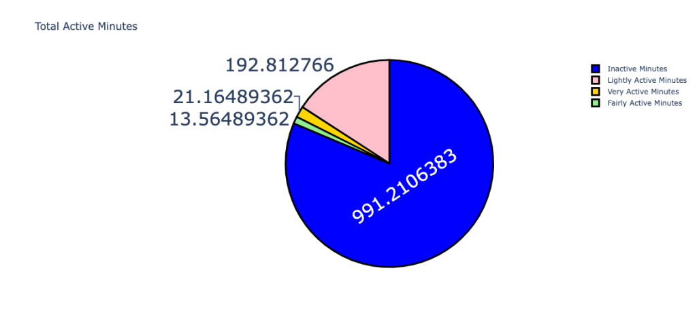
Output

Slide 8
