Slide 1
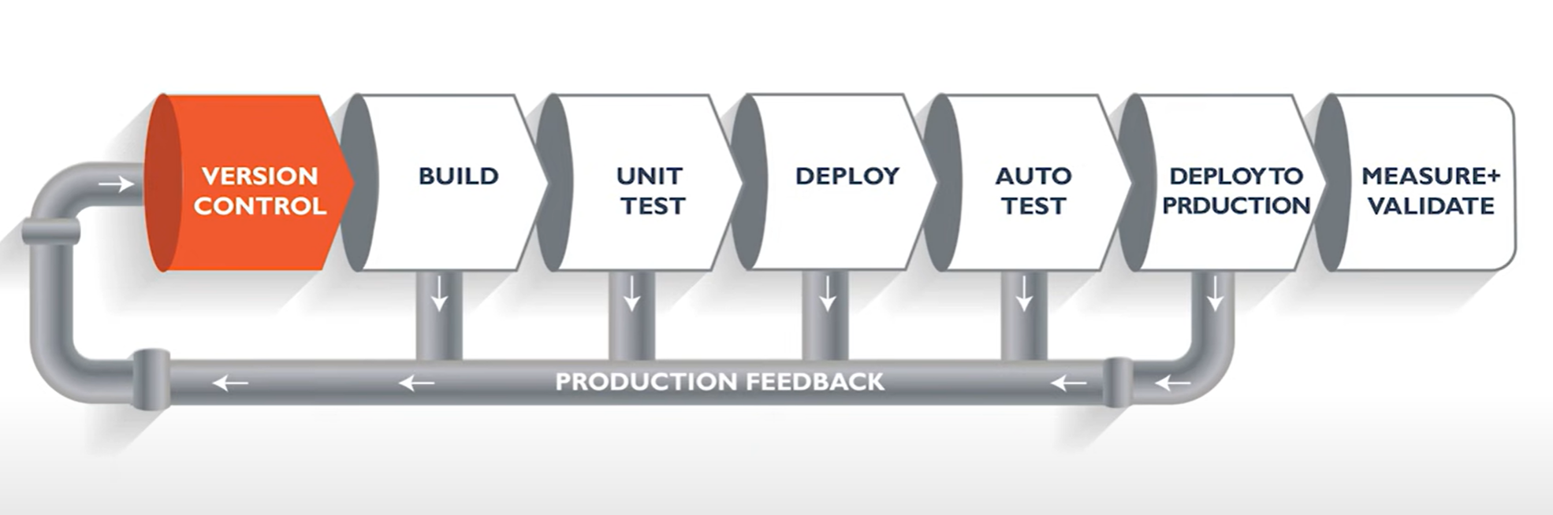
CICD Approach Using Jenkins
CICD Pipeline Stages:
SCM Checkout
Build (Maven Compilation – war/jar files) – NPM for Node .js
Code Quality (SonarQube)
Artifactory (Jfrog / Nexus - To store artifacts)
Deployment ( IBM UCD/Docker/any Deployment Tools in Development)
Approval to deploy in Production
Deployment to Production

Slide 2
CICD Approach Using Jenkins
Continous Integration (CI):
From DevOps perspective, to build CI/CD pipelines, Jenkins would be installed for continuous integration. The tools required for entire integration to deploy a application would be installed through Jenkins plugins. (Git, Maven, JaCoCo, Sonarqube, Nexus, Deployment Tools, Ansible)
The 1st stage of pipeline would be SCM checkout from GitHub. As it is java based application, we use Maven to build and compile the code.Once the code is compiled, war/jar files will be generated and these artifactories would be stored in an repository (say Jfrog/Nexus). Along this to ensure code quality, sonarqube can be used. Jenkins plays these role till here.
Continuous Delivery(CD):
For continuous delivery, we can use any of the deployment tools (UCD/Docker) to deploy the artifacts. The deployment tools would be integrated with jenkins.
Jenkins pipeline would be defined to take the artifacts from jenkins workspace and can be deployed automatically through them.
Continuous Monitoring:
AppDynamics/Prometheus to be used to monitor continuosly (for applications as well as Jenkins)

Slide 3
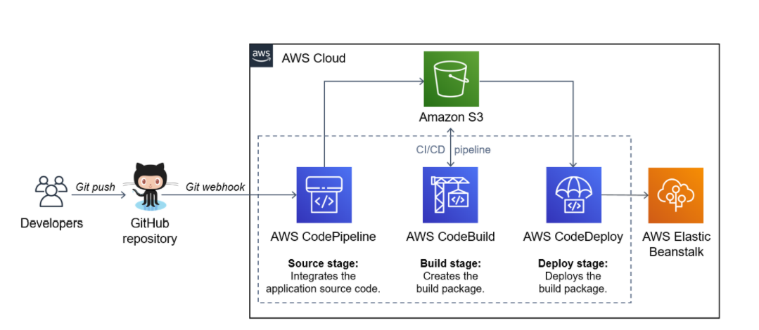
CICD Approach in AWS
CICD Pipeline Stages:
The pipelines can be configured in AWS as well to deploy the applications.
Below are the various services used in AWS to build and deploy an application
AWS CodeCommit (Not mandatory can pull from GitHub as well)
AWS CodeBuild
AWS CodeDeploy
AWS CodePipeline
AWS Lambda
AWS ElasticBeanStalk

