Slide 1

602 Credit Card Applications
Divya Aitipamula - YK91210
Jyothirnayani Gurrala - YR76819

Slide 2
Introduction:
The code aims to automate the process of approving or rejecting credit card applications using machine learning techniques.
A dataset of credit card applications is used, with all attribute names and values anonymized for confidentiality.
The dataset is a mix of different attribute types and contains some missing values, adding complexity to the task.

Slide 3
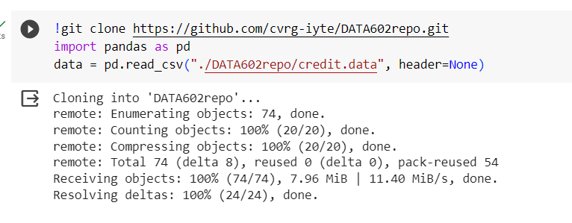
1. Data Loading and Initial Analysis:
The dataset is cloned from a GitHub repository and loaded using Pandas, a popular Python library for data manipulation.

Slide 4
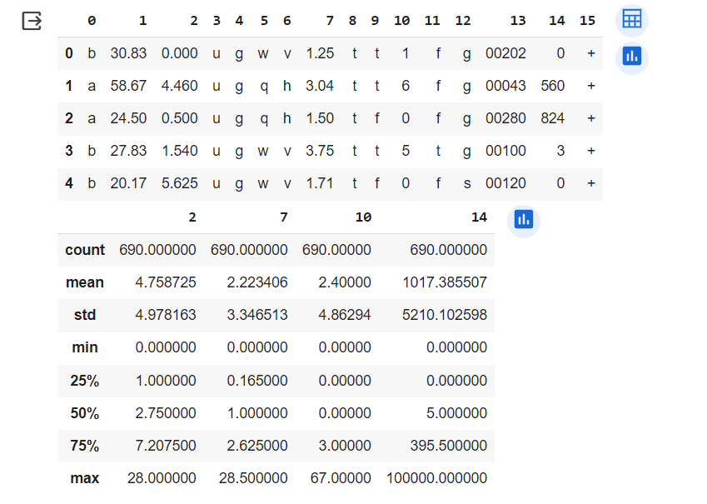
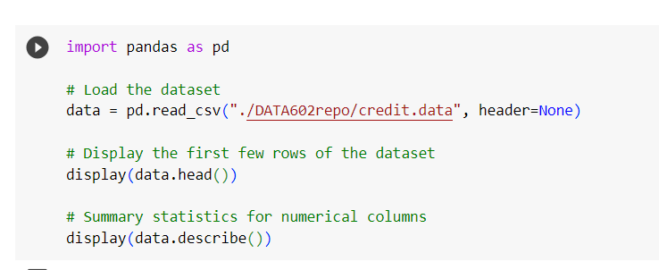
Cont..
The head() function displays the first few rows for an initial understanding of the dataset.
The describe() function provides summary statistics for numerical columns.

Slide 5
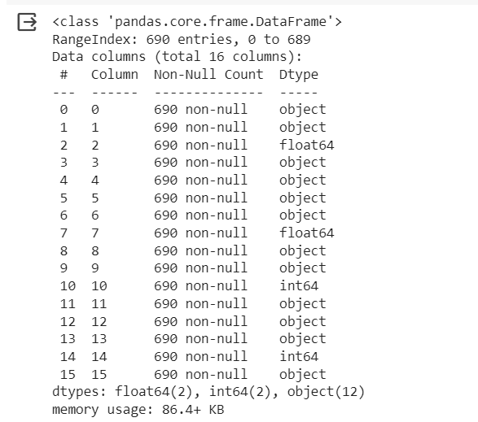
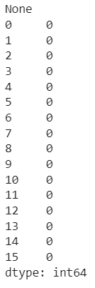
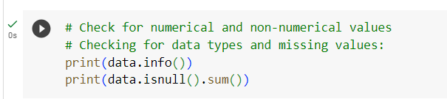
Cont...
The isnull().sum() function checks for missing values in the dataset.
The info() function checks for numerical and non-numerical values in the dataset.

Slide 6
2. Data Preprocessing:
Missing values are handled, although the specific method (dropping or imputing) is not detailed in the provided code.
Non-numerical values are converted to numerical values. This might involve techniques like label encoding or one-hot encoding, but the specific method is not detailed.

Slide 7
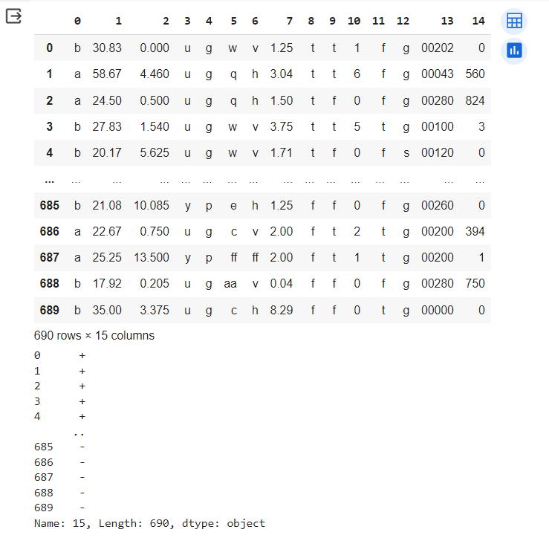
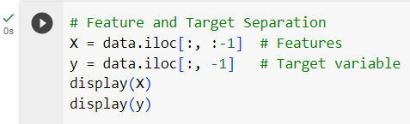
3. Feature and Target Separation:
The dataset is divided into features (X) and the target variable (y), with the target variable being the last column in the dataset.

Slide 8
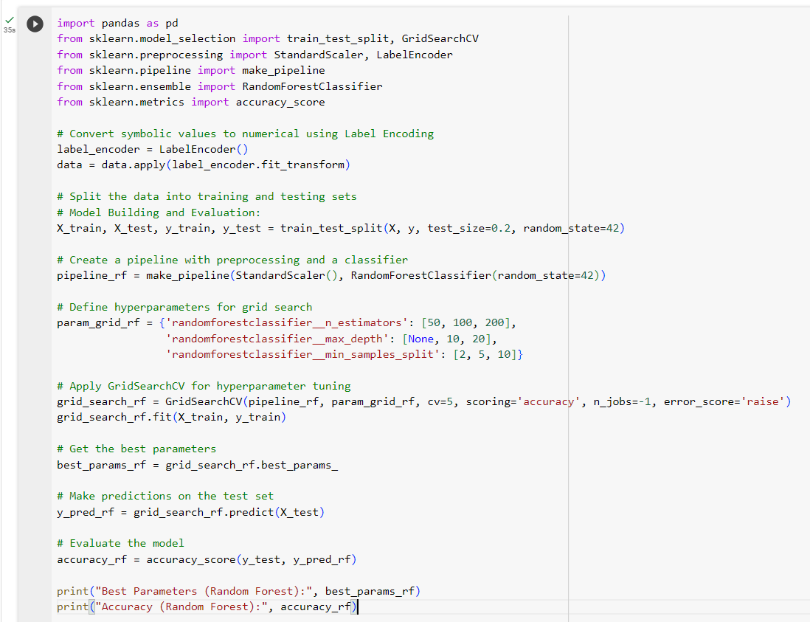
4.Model Building and Evaluation: (a - Random Forest Classifier)
The dataset is split into training and testing sets using train_test_split.
A machine learning pipeline is created using make_pipeline, which includes preprocessing with StandardScaler and a classifier RandomForestClassifier.
GridSearchCV is used for hyperparameter tuning of the Random Forest classifier.

Slide 9
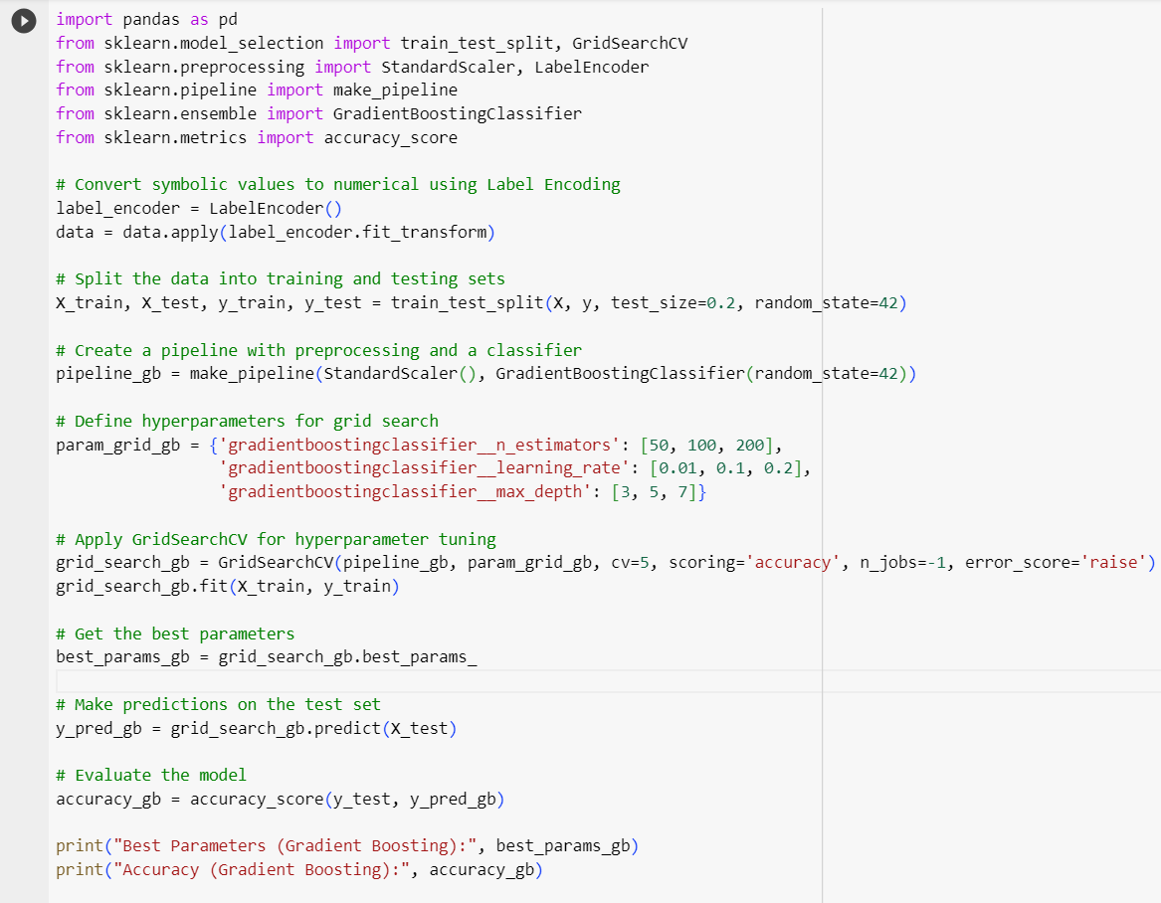
(4b – Gradient Boosting Classifier)
The dataset is split into training and testing sets using train_test_split.
A machine learning pipeline is created using make_pipeline, which includes preprocessing with StandardScaler and a classifier GradientBoostingClassifier.
GridSearchCV is used for hyperparameter tuning of the GradientBoostingClassifier.

Slide 10
Cont…
The model is trained with the training data, and the best parameters are obtained.
Predictions are made on the test set, and the model's accuracy is evaluated using accuracy_score.

Slide 11
Output:
The output includes the number of missing values in each column, the best parameters for the Random Forest model after hyperparameter tuning, and the accuracy score of the model on the test data.
4a)
4b)

Slide 12
Significance:
This process demonstrates how machine learning can effectively automate and optimize decision-making tasks like credit card application processing.
The use of GridSearchCV for hyperparameter tuning ensures that the model is as accurate as possible.
The project highlights the practical application of machine learning techniques in financial services.

Slide 13
Thank you!!

