Slide 1

Mitron Bank
Credit Card Analysis
Code Basics Resume Project challenge #8 -Divya Arji

Slide 2
CONTENTS
01 About Mitron Bank
02 Problem Statement
03 Insights from dashboard
04 Assist for new Credit card line

Slide 3
01
About Mitron Bank Information Given
Mitron Bank is a legacy financial institution
headquartered in Hyderabad
With large number of customers all over the INDIA
Provides services like Deposit accounts, Loans,
Investments, Insurance policies,
Foreign currency exchange, Financial consolation.

Slide 4
02 Problem Statement
Mitron Bank want to introduce a new line of credit cards, aiming to broaden its product offerings and reach in the
financial market.
For the proposal implementation Mitron Bank has provided with sample dataset of 4000 customers across five cities on their online spend and other details .
Tables
a) dim_customers
customer_id,age_group,city,occupation,gender,
marital status, avg_income
b) fact_spent
customer_id,month,category,payment_type,spend

Slide 5
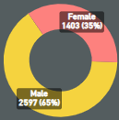

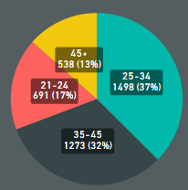
Insights from Dashboard
Bank has 65% of the male customers and 35% of female customer over the five cities
78% of the customer are married and 22 % of the customer are single
37% customers are from age group 25-34,major part of the customers from this group
13% customers are from age group 45+ which is least
number of customers

Slide 6
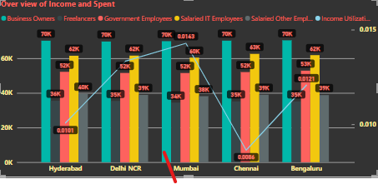
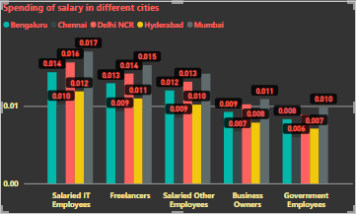
Insights form Dashboard
Income and Utilization:
Income of Business owners is high followed by IT Employees
Freelancers and Other Employees have least income
Government Employees and Business Owners in Chennai spent
less amount of there salary.
On overall occupation people in Chennai and Hyderabad spent less amount of there salary.
Customers living in Mumbai followed by spent more amount of there
salary.
Most of the expenditure are Bills, Groceries and the payment type used is
credit cards and less payment type is Net Banking

Slide 7
Assist for new Credit card line
Partnerships and Rewards:
Consider forming partnerships with merchants, airlines, or other businesses to offer exclusive
discounts and rewards for cardholders.
Develop a compelling rewards program to attract and retain customers, including cashback, travel
benefits, or points systems.
Technology Integration:
Ensure that the credit cards are equipped with modern technology, such as contactless payment options and robust security features.
Develop a user-friendly mobile app for cardholders to manage their accounts, make payments, and track rewards.
Customization and Flexibility:
Provide a range of credit card options with varying interest rates, credit limits, and annual fees to cater to different customer segments.
Offer flexibility in payment terms and options to accommodate diverse financial needs.

Slide 8
Assist for new Credit card line
Marketing and Branding:
Develop a comprehensive marketing strategy to promote the new credit cards. This may
include online and offline channels, social media campaigns, and targeted advertisements.
Emphasize the unique features and benefits of Mitron Bank's credit cards to differentiate them
from competitors.
Regulatory Compliance:
Ensure that the credit cards comply with all relevant financial regulations and industry standards.
Clearly communicate terms and conditions to cardholders, adhering to transparency and fair
practices.
Customer Education:
Provide educational materials to help customers understand the benefits, responsibilities, and
proper use of credit cards.
Offer customer support services to address queries and concerns related to the credit cards.

Slide 9
Assist for new Credit card line
Monitoring and Feedback:
Implement systems to monitor the performance of the credit card program and gather customer feedback.
Use feedback to make necessary adjustments to the credit card offerings and improve customer
satisfaction.
Launch Event:
Consider organizing a launch event to generate buzz around the new credit cards. Invite media,
key stakeholders, and potential customers to build awareness.
Sustainability and Corporate Social Responsibility (CSR):
Integrate sustainability features into the credit card program, such as eco-friendly card materials or carbon offset programs.
Consider incorporating CSR initiatives to contribute positively to the community.

Slide 10
THANK YOU

