Slide 1
AWS Cloud

Slide 2
Agenda
Introduction to Cloud
Why Cloud Computing?
Components of Cloud Computing
Characteristics of Cloud
Cloud Computing Models
Cloud Providers
AWS Pros and Cons
Why Amazon AWS?
AWS Services Categories

Slide 3
Cloud is a model for enabling ubiquitous, convenient on-demand network access to shared pool of configurable computing resources( network, servers, storage, application, services) that can be rapidly provisioned and released with minimal management effort or service provider interaction.
Cloud

Slide 4
Introduction to Cloud
Highly Reliable.
Horizontally Scalable.
Distributed Systems.
Provides services over network.
Resource Pooling
On Demand Self Service
Broad Network Access
Rapid Elasticity
Measured Service

Slide 5
Pay as you use.
Reliability, Scalability
Secure Storage
Highly automated
Easy and Agile Deployment
Device and Location independent
24*7 Support
Why Cloud Computing?

Slide 6
Components of Cloud Computing
Client – Interact with cloud
Distributed servers – servers in different places
Data Centers – Collection of servers

Slide 7
Cost
Agility
Multi-tenancy
Reliability
Duplicability
Security
Elasticity
Virtualization
Flexibility
Automation
Characteristics of Cloud

Slide 8
Cloud Computing Models
Service Models
Deployment Models
IaaS – Infrastructure as a Service
Example, EC2 instance
PaaS – Platform as a Service
Example, tomcat.
SaaS – Software as a Service
Example, Gmail, Facebook, Salesforce.
Private Cloud
Example : Amazon EC2
Public Cloud
Example : Gmail
Community Cloud
Example: Salesforce
Hybrid Cloud
Example: Rackspace, EMC

Slide 9




Cloud Providers

Slide 10
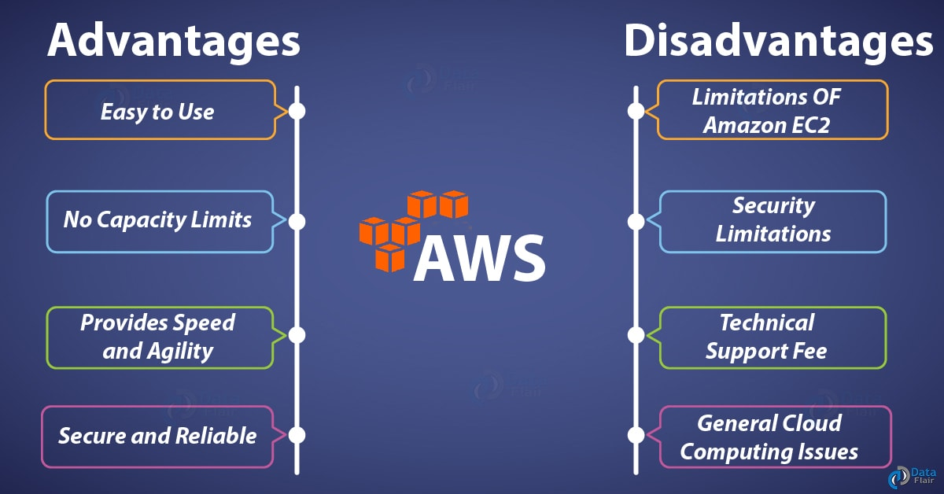
AWS Pros and Cons

Slide 11
Why AWS?
It operates 44 availability zones within 16 geographic regions around the world.
2. While AWS is an extremely useful platform for backups and disaster recovery, it is also extremely reliable.
3. The platform also allows for a high level of customization to meet the needs of individual businesses
4. Amazon’s flexible cloud-computing platform allows users to automate routine tasks and quickly scale capacity up or down as needed.

Slide 12
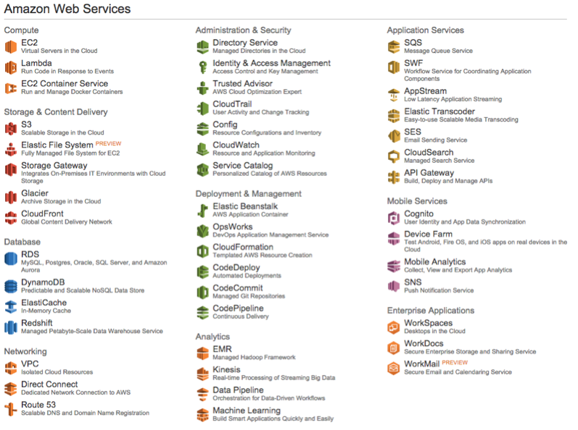
AWS Service Categories

Slide 13


https://docs.aws.amazon.com/index.html?nc2=h_ql_doc#lang/en_us
https://cloudranger.com/10-reasons-to-choose-aws/
https://data-flair.training/blogs/aws-advantages/
https://www.amazonaws.cn/en/products/
Appendix

