Slide 1
AWS Cloud

Slide 2
Agenda
Introduction to Cloud
Why Cloud Computing?
Components of Cloud Computing
Characteristics of Cloud
Cloud Computing Models
Cloud Providers
AWS Pros and Cons
AWS Services Categories
Why Amazon AWS?

Slide 3
Cloud is a pay-per-use model for enabling ubiquitous, convenient on-demand network access to shared pool of configurable computing resources( network, servers, storage, application, services) that can be rapidly provisioned and released with minimal management effort or service provider interaction.
Cloud

Slide 4
Introduction to Cloud
Found by Netflix on August,2008.
Highly Reliable.
Horizontally Scalable.
Distributed Systems.
Provides services over network.
Resource Pooling
On Demand Self Service
Broad Network Access
Rapid Elasticity
Measured Service

Slide 5
Pay as you use.
Reliability, Scalability
Secure Storage
Highly automated
Easy and Agile Deployment
Device and Location independent
24*7 Support
Why Cloud Computing?

Slide 6
Components of Cloud Computing
Client – Interact with cloud
Distributed servers – servers in different places
Data Centers – Collection of servers

Slide 7
Cost
Agility
Multi-tenancy
Reliability
Scalability
Duplicability
Security
Elasticity
Virtualization
Flexibility
Rapidity
Automation
Characteristics of Cloud

Slide 8
Cloud Computing Models
Service Models
Deployment Models
IaaS – Infrastructure as a Service
In this model, Cloud offers you resources such as linux virtual machine. Users are responsible for installing and deploying application.
For Example, ec2 instance.
PaaS – Platform as a Service
In this model, Cloud directly offers you a platform.
For example, tomcat.
SaaS – Software as a Service
In this model, Users directly consume services over internet.
For example, Gmail, Facebook, Salesforce.
Private Cloud
In this type, Infrastructure is completely dedicated to a specific client. Infrastructure can be deployed at cloud providers site, or at client’s own data center. Private Cloud is expensive.
Public Cloud
In this type, Users deploy all infrastructure in cloud where you share certain resources with other customer.
Community Cloud
Community cloud model is a cloud infrastructure shared by a group of organizations of similar industries and backgrounds with similar requirements.
Hybrid Cloud
Hybrid cloud is a combination of two or more models, private cloud, public cloud or community cloud.

Slide 9



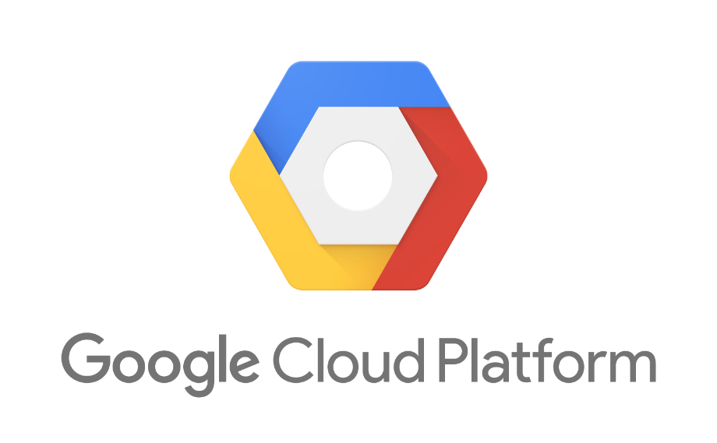
Cloud Providers

Slide 10
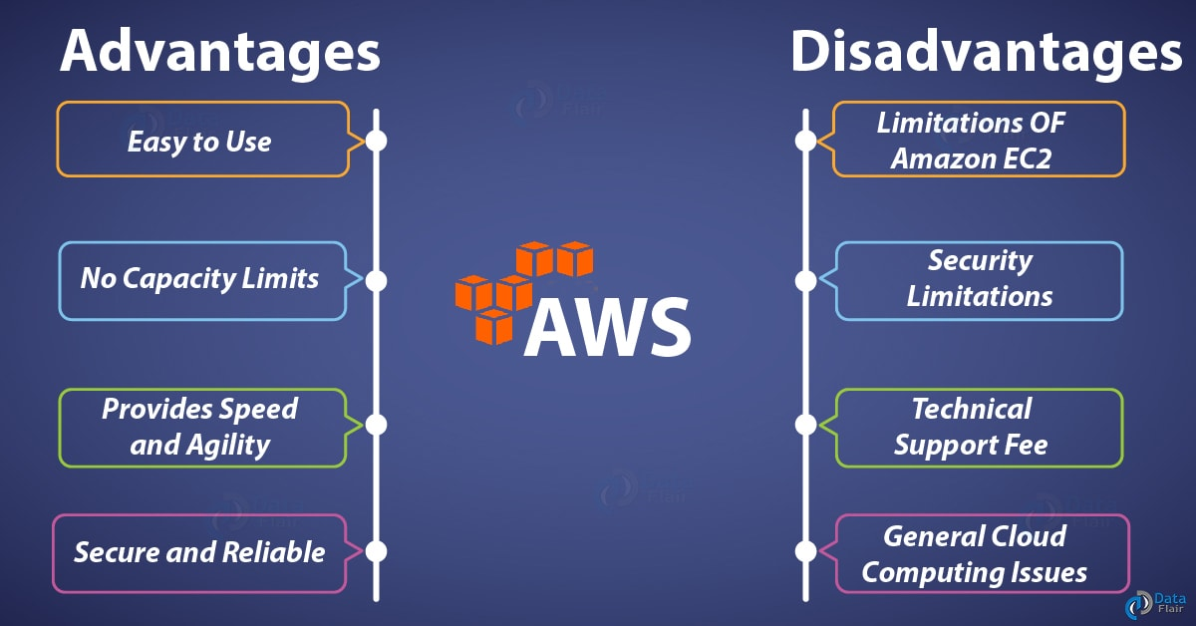
AWS Pros and Cons

Slide 11
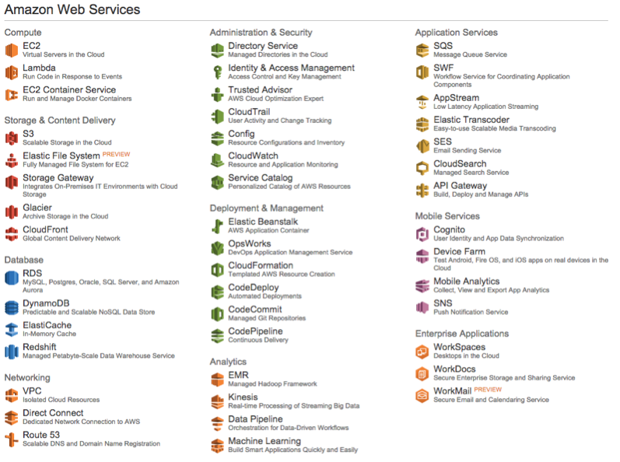
AWS Service Categories

Slide 12
Why AWS?
It operates 44 availability zones within 16 geographic regions around the world.
AWS offers various backup methods including AMIs and EBS snapshots.
While AWS is an extremely useful platform for backups and disaster recovery, it is also extremely reliable.
While AWS is an extremely useful platform for backups and disaster recovery, it is also extremely reliable.
Amazon’s flexible cloud-computing platform allows users to automate routine tasks and quickly scale capacity up or down as needed.

Slide 13


https://docs.aws.amazon.com/index.html?nc2=h_ql_doc#lang/en_us
https://cloudranger.com/10-reasons-to-choose-aws/
https://data-flair.training/blogs/aws-advantages/
https://www.amazonaws.cn/en/products/
Appendix

