Slide 1

Fingerprint Object Analysis And Identification
by
B. Shahid Afridi
Roll No. 194G5A0507
D. Chandrika
Roll No. 184G1A0512
D. Divya
Roll No. 184G1A0514
R. Manish Kumar
Roll No. 184G1A0542
Under the guidance of
Dr. G. Hemanth Kumar Yadav _{M.Tech.,} _{Ph. D}
Associate Professor
Department of Computer Science and Engineering
Srinivasa Ramanujan Institute of Technology
(Affiliated to JNTUA & Approved by AICTE) (Accredited by NAAC with ‘A’ Grade & Accredited by NBA (EEE, ECE & CSE)
Rotarypuram Village, B K Samudram Mandal, Ananthapuramu – 515701.
2021 - 2022

Slide 2
Abstract
Fingerprint images in crime scene are important clues to solve serial cases. Here, we present a complete crime scene fingerprint identification system using Harris Corner and OpenCV. Images are acquired from crime scene using methods ranging from precision photography to complex physical and chemical processing techniques and saved as the database.
The features of preprocessed data are fed into Harris corner as input to train and test the network. The experimental results demonstrated on database using Open CV-Python shows high accuracy of 80% recognition an partial or full fingerprints in the criminal database.

Slide 3

Contents
Introduction
Existing System
Proposed System
Literature Survey
Problem Definition
Requirements
UML Diagrams
Data Flow Diagram
Sample Code
Screenshots
Conclusion
References

Slide 4
Introduction
FINGERPRINTS in the crime scene plays an important role to identify the criminal involved in the crime. Crime scene images (CSI) are images taken from the crime spot.
The fingerprint images are subjected to image pre-processing, image feature extraction and identification analysis.
In order to solve serial cases, we try to build a model that predicts the Criminal person for a particular crime using OpenCV and Harris Corner.

Slide 5
Existing System
A fingerprint is characterized by abundant and strong textural information. The textural properties of a live fingertip surface are dependent upon skin elasticity, pore distribution and perspiration phenomenon.
As a result, the pixels along and around the ridges of a live fingerprint exhibit wide and random variations in gray-level values.
Therefore, texture feature based methods which can capture these variations from fingerprint image properties are expected to perform better.

Slide 6
Proposed System
Segmentation is a process of segmenting a precise or trivial detail of the fingerprints which extract the minutiae marking from the dataset. By applying the image thinning operation region of interest (ROI) is extracted.
The filtered ROI images are given as input to the Harris Corner. The dataset is divided into training and testing sets. Then the model will be trained as per our requisition.
If the fingerprint matches, the system identifies the suspect and gives the output as a person is a crime person or not.

Slide 7
Literature Survey
[Anil K. Jain, and Jianjiang Feng-1]: This paper focuses on Latent fingerprint identification is of critical importance to law enforcement agencies in identifying suspects. The experimental results indicate that singularity, ridge quality map, and ridge flow map are the most effective features in improving the matching accuracy.

Slide 8
Contd…
[Mohammad Mogharen Askarin, KokSheik Wong and Raphael C-W Phan-2]: This paper discusses about fingerprints that are deployed biometric modality due to its ease of acquisition, established use, acceptance and high recognition rate (i.e., robustness). One form of fingerprint is called latent fingerprint. Experiments show that the application of the proposed geometrical compensation method is able to flatten the fingerprint image uncovered from a single directional curved surface and improve its matching score.

Slide 9
Contd…
[Pavithra. R and K.V. Suresh-3]: This paper tells about Latent fingerprint matching has played a critical role in identifying suspects and criminals. Experimental results on two latent fingerprint databases show that the proposed algorithm outperforms the state-of-the-art segmentation and enhancement algorithms and boosts the performance of a state-of-the-art commercial latent matcher.

Slide 10
Problem Definition
Fingerprints are the abrasion impression made by the tip of the human finger. The fingerprints in the crime scene are obtained from the crime spot are converted into digital image form and these images are formed as dataset.
After the image acquisition the pre-processing method was done, for image pre-processing, Otsu enhancement, Image thinning, Minutiae marking, ROI extraction methods are used.
At last step the Python-GUI will use for identify the suspect fingerprint match with the fingerprint in the dataset or not.

Slide 11
Requirements
Hardware Requirements:
Processor : Intel i3 Processor or above
RAM : 8GB
Hard Disk : 128GB
Software Requirements:
Operating System : Windows 7+
Server Side Script : Python 3.8
IDE : PyCharm
Libraries Used : Numpy, SKimage, OpenCV

Slide 12
UML Diagrams
Activity Diagram:
Dataset
Pre-processing
Segmentation
Feature Extraction and Analysis
Post processing
Matched with Database
Yes
Result

Slide 13
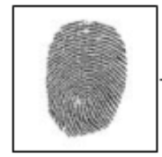
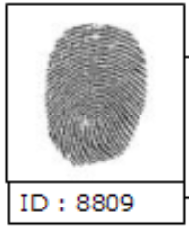
Data Flow Diagram
Fingerprint Object
Feature Extraction
Database
Fingerprint Object
Feature Extraction
Matching
Result

Slide 14
Sample Code
Sample Code of our Project:
def get_descriptors(img):
clahe = cv2.createCLAHE(clipLimit=2.0, tileGridSize=(8,8))
img = clahe.apply(img)
img = image_enhance.image_enhance(img)
img = numpy.array(img, dtype=numpy.uint8)
# Threshold
ret, img = cv2.threshold(img, 127, 255, cv2.THRESH_BINARY_INV | cv2.THRESH_OTSU)
# Normalize to 0 and 1 range
img[img == 255] = 1
#Thinning
skeleton = skeletonize(img)
skeleton = numpy.array(skeleton, dtype=numpy.uint8)
skeleton = removedot(skeleton)

Slide 15
Contd…
# Harris corners
harris_corners = cv2.cornerHarris(img, 3, 3, 0.04)
harris_normalized = cv2.normalize(harris_corners, 0, 255, norm_type=cv2.NORM_MINMAX, dtype=cv2.CV_32FC1)
threshold_harris = 125
# Extract keypoints
keypoints = []
for x in range(0, harris_normalized.shape[0]):
for y in range(0, harris_normalized.shape[1]):
if harris_normalized[x][y] > threshold_harris:
keypoints.append(cv2.KeyPoint(y, x, 1))
# Define descriptor
orb = cv2.ORB_create()
# Compute descriptors
_, des = orb.compute(img, keypoints)
return (keypoints, des);

Slide 16
Contd…
def main():
image_name = sys.argv[1]
img1 = cv2.imread(r"C:\Users\srico\PycharmProjects\FRCD\venv\FingerPrintBasedCrimeDetection/DataBase1/" + image_name, cv2.IMREAD_GRAYSCALE)
kp1, des1 = get_descriptors(img1)
image_name = sys.argv[2]
img2 = cv2.imread(r"C:\Users\srico\PycharmProjects\FRCD\venv\FingerPrintBasedCrimeDetection/DataBase1/" + image_name, cv2.IMREAD_GRAYSCALE)
kp2, des2 = get_descriptors(img2)
# Matching between descriptors
bf = cv2.BFMatcher(cv2.NORM_HAMMING, crossCheck=True)
matches = sorted(bf.match(des1, des2), key= lambda match:match.distance)
# Plot keypoints
img4 = cv2.drawKeypoints(img1, kp1, outImage=None)
img5 = cv2.drawKeypoints(img2, kp2, outImage=None)
f, axarr = plt.subplots(1,2)
axarr[0].imshow(img4)
axarr[1].imshow(img5)

Slide 17
Contd…
plt.show() # Plot matches
img3 = cv2.drawMatches(img1, kp1, img2, kp2, matches, flags=2, outImg=None)
plt.imshow(img3)
plt.show()
# Calculate score
score = 0;
for match in matches:
score += match.distance
score_threshold = 33
if score/len(matches) < score_threshold:
print("Fingerprint matches At the Crime Location")
else:
print("Fingerprint does not match At the Crime Location")
if __name__ == "__main__":
try:
main()
except:
raise

Slide 18
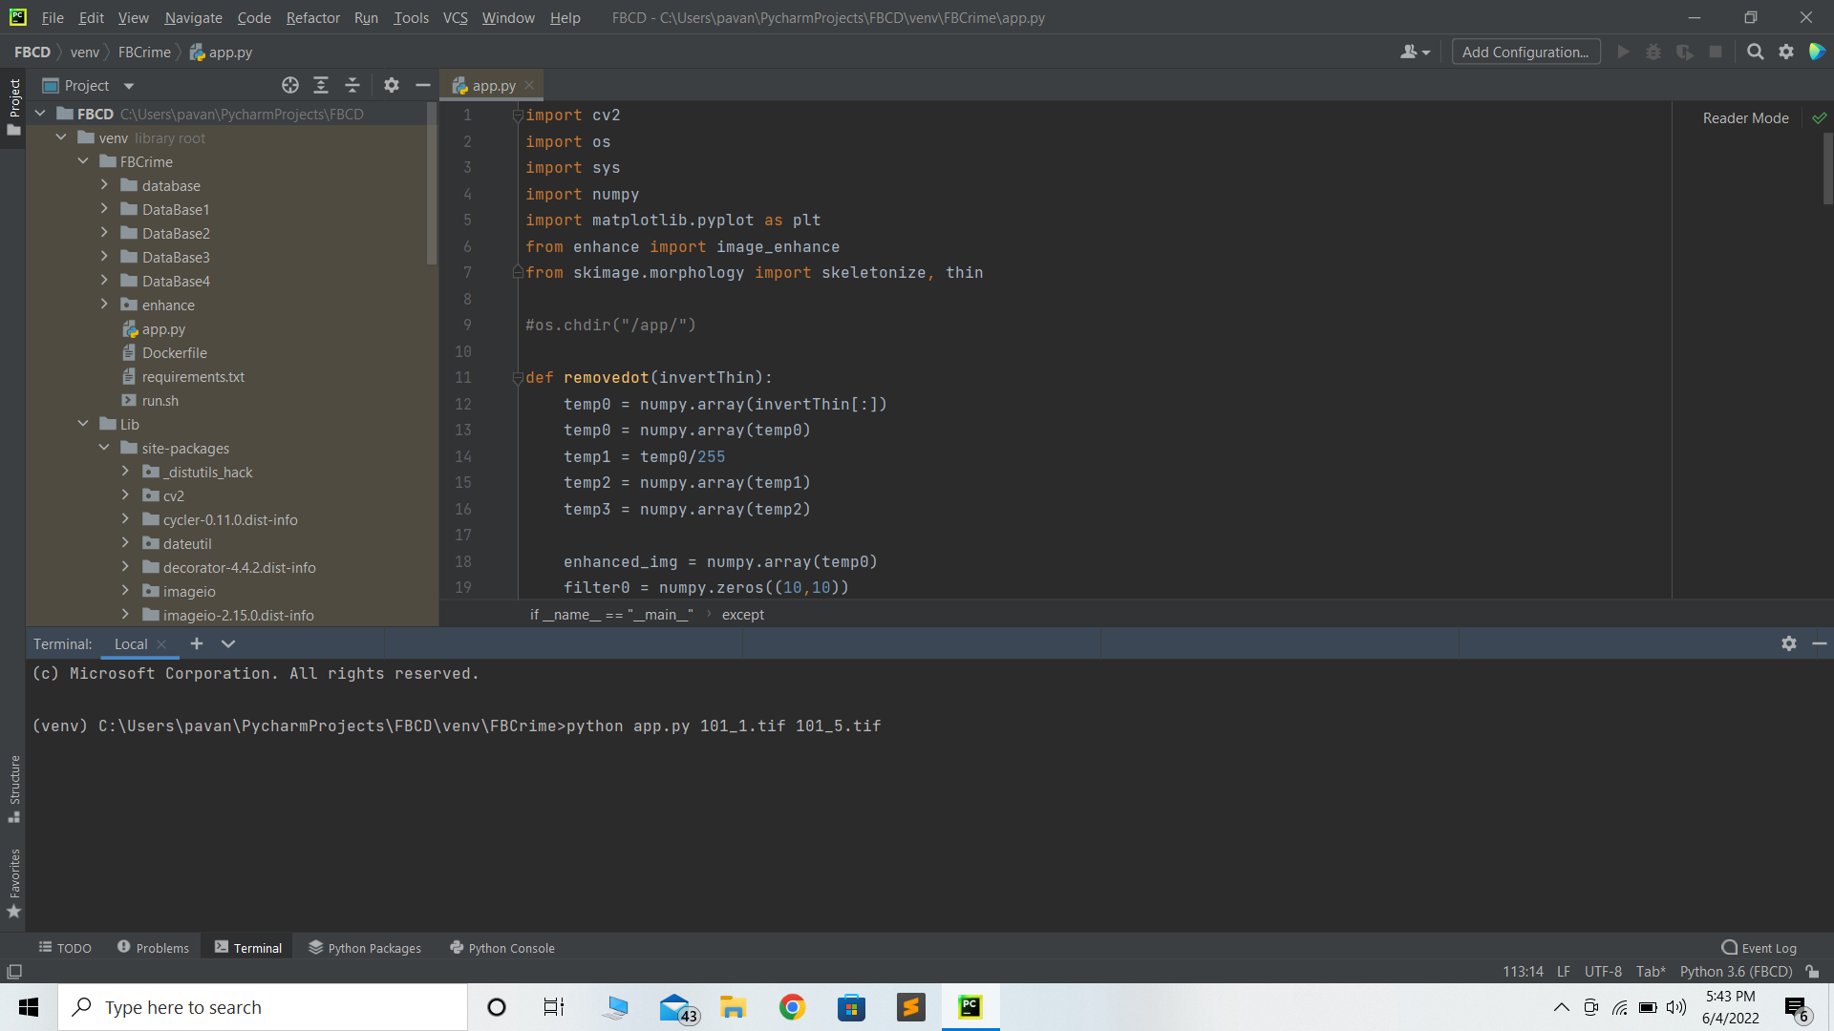
Screenshots
The below screenshot is while using the run command of our project:

Slide 19
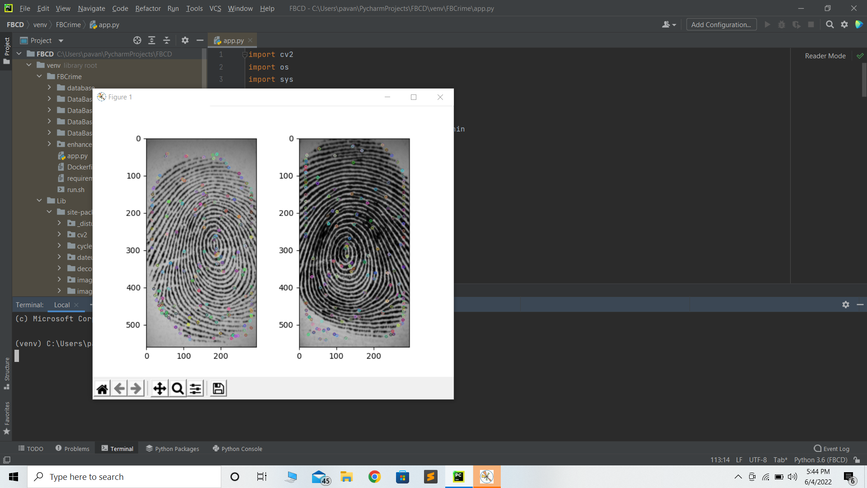
Contd…
The below screenshot is while plotting the keypoints of the fingerprint images:

Slide 20
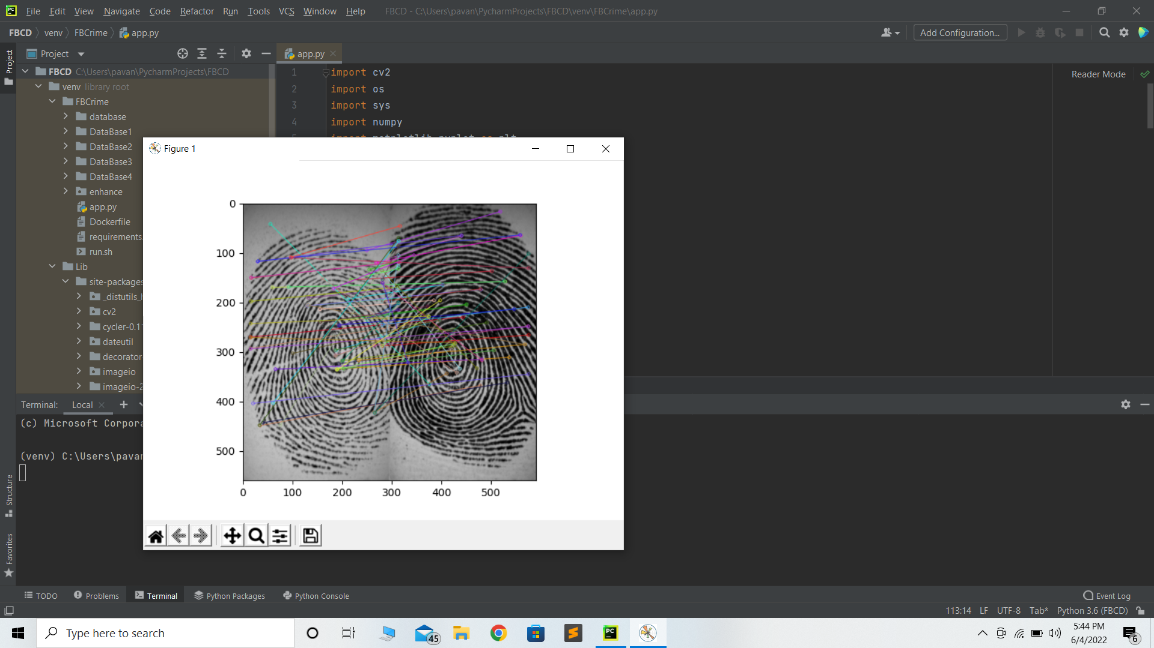
Contd…
The below screenshot is while matching the keypoints between the fingerprint images:

Slide 21
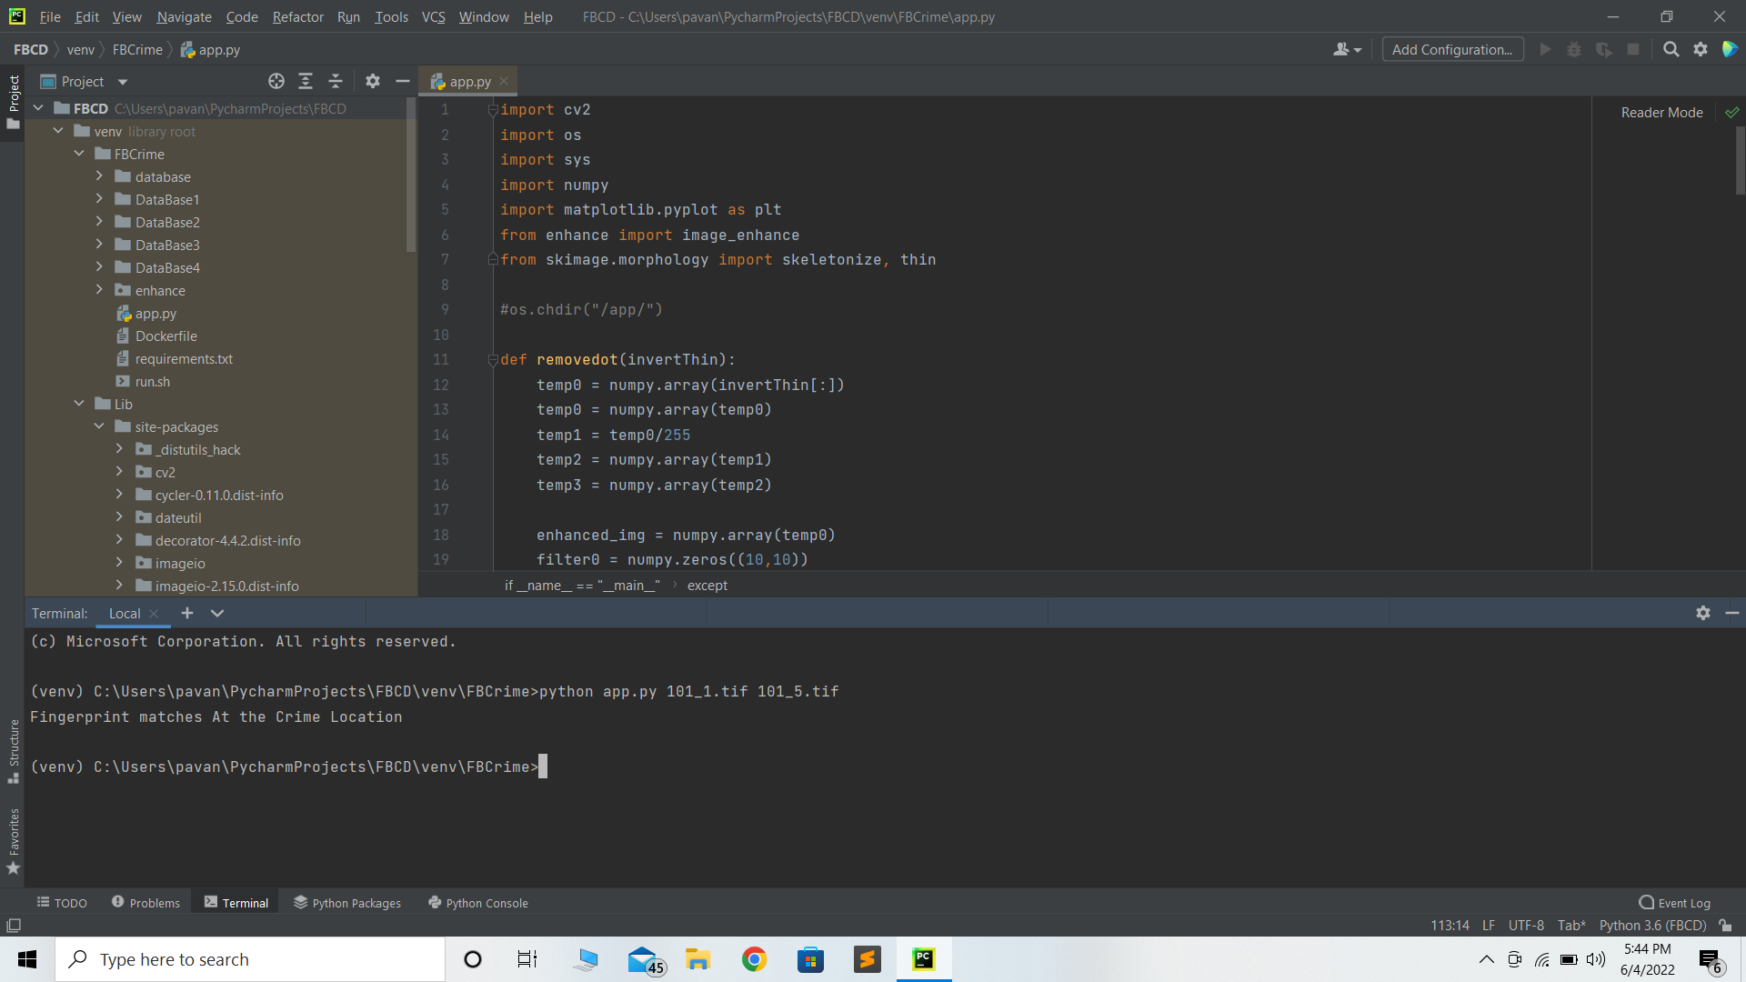
Contd…
The below screenshot is the output of our project:

Slide 22
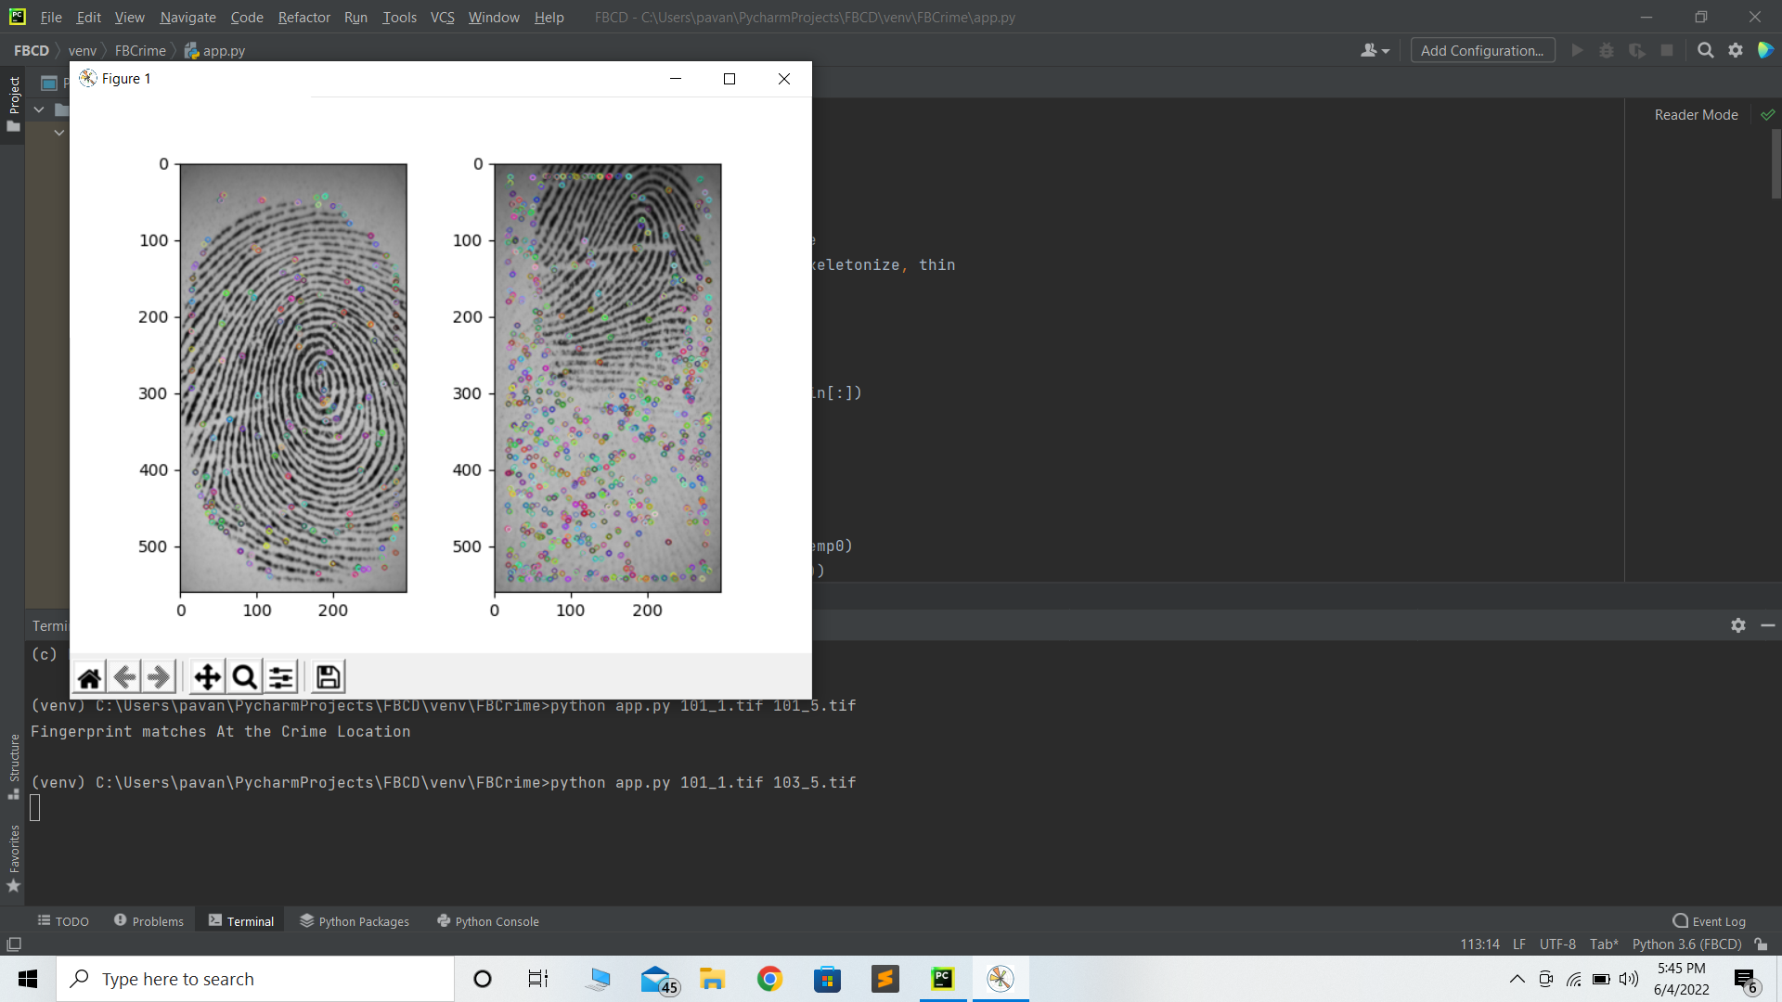
Contd…
The below screenshot of the project shows plotting the keypoints when fingerprint doesn’t match:

Slide 23
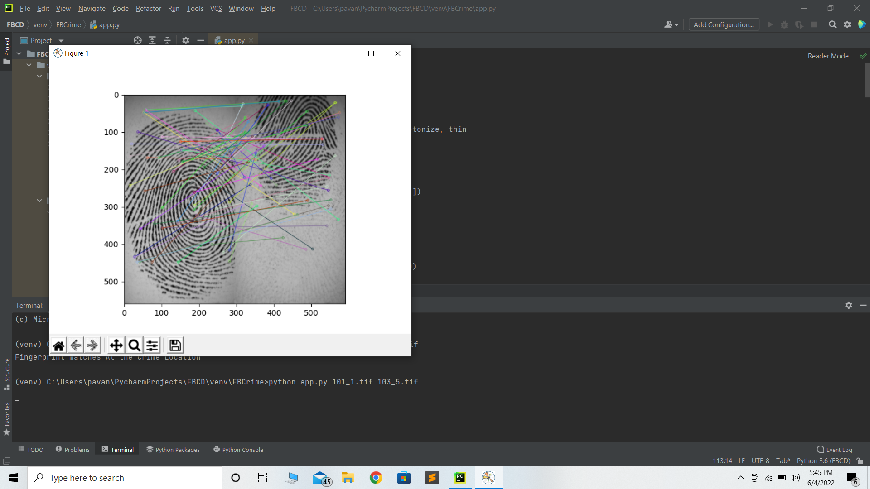
Contd…
The below screenshot of the project shows matching the keypoints when fingerprint doesn’t match:

Slide 24
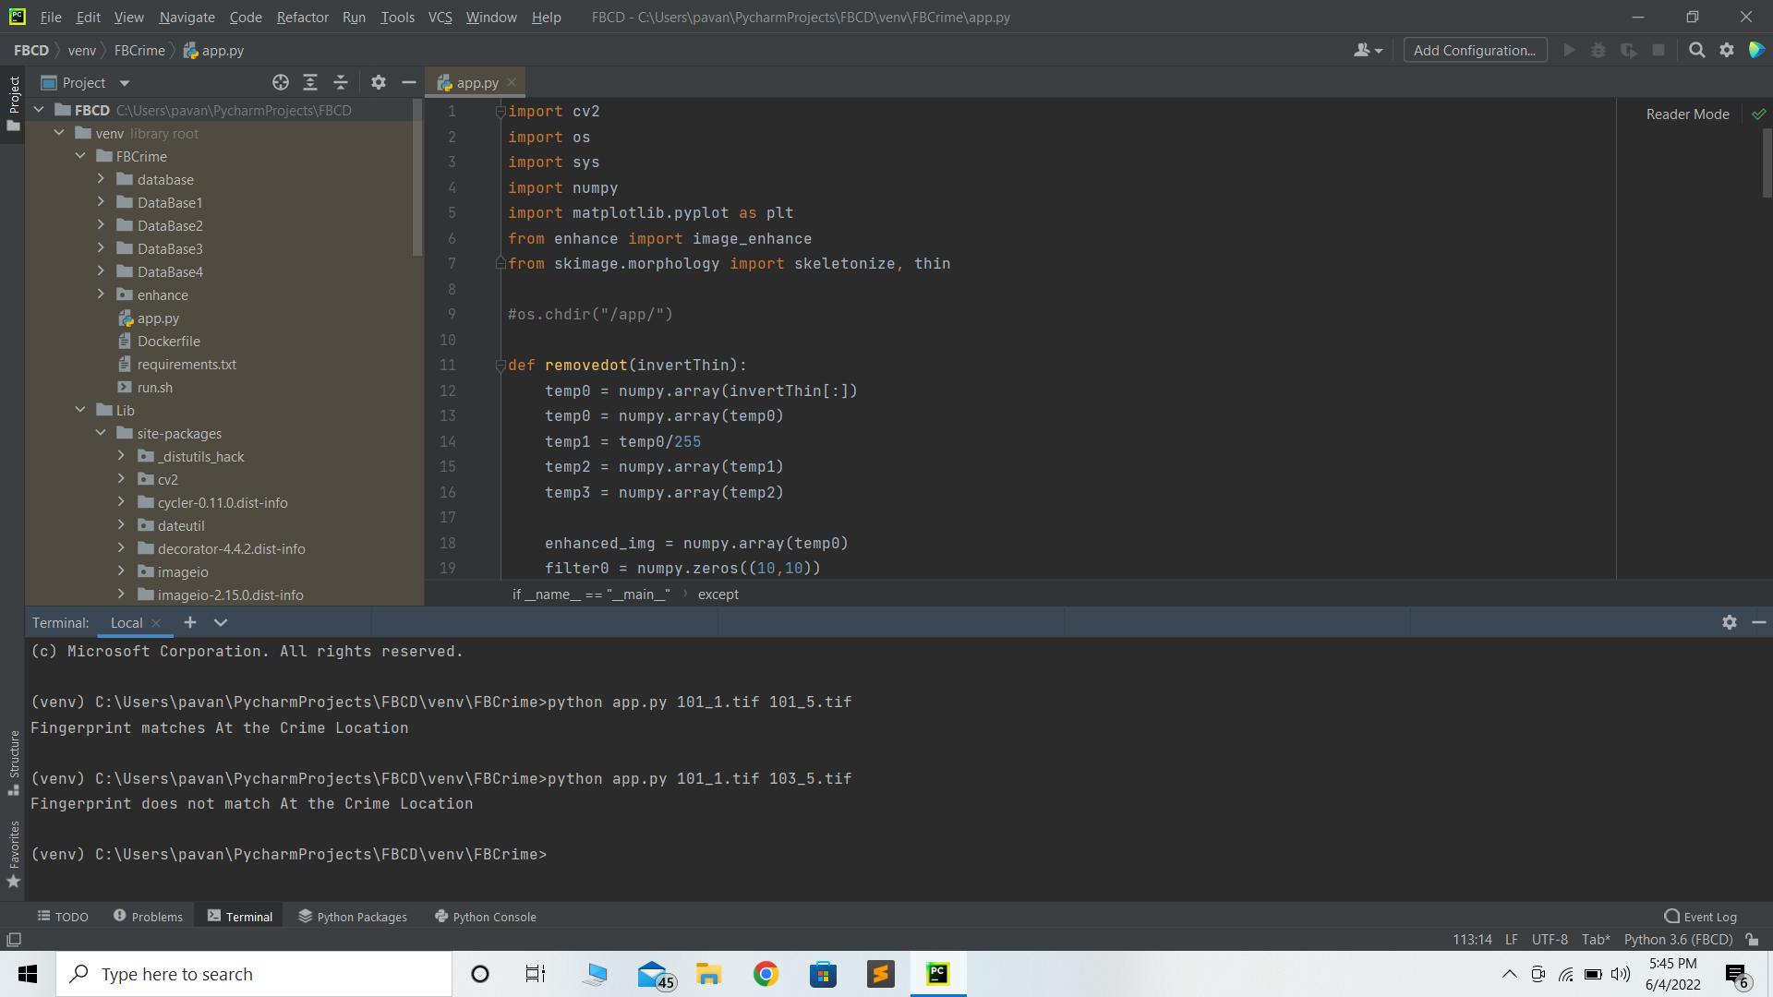
Contd…
The below screenshot is the output of our project:

Slide 25
Conclusion
Fingerprint identification system used to identify the given fingerprint as a crime person or non-crime person. The Harris corner detector used in Computer Vision to extract the corners and infer features of an image. The identification of fingerprints is a significant technique for various types of security authentication.
The Experimental results compared with previous methods validate that our algorithm has better performance even for low quality images. Hence, we have advanced outlines to make the identification process simpler and accurate using Harris Corner detector. The experimental output clearly says that, as compared to other methods, this method gives better performance.

Slide 26
References
[1]. “Anil K. Jain, and Jianjiang Feng”, “Latent Fingerprint Matching” | IEEE Transactions On Pattern Analysis And Machine Intelligence, VOL. 33, NO. 1, JANUARY 2011.
[2]. “Mohammad Mogharen Askarin , KokSheik Wong and Raphael C-W Phan”, “Reduced Contact Lifting of Latent Fingerprint” | Proceedings of APSIPA Annual Summit and Conference 2017, 12-15 December 2017, Malaysia.
[3]. “Pavithra. R and K.V. Suresh”, “ Fingerprint Image Identification For Crime Detection” | International Conference on Communication and Signal Processing, April 4-6, 2019, India.
Reference Link: Kaggle.com

Slide 27
Thank You!!!

