Slide 1


K.RAMAKRISHNAN COLLEGE OF TECHNOLOGY
(AUTONOMOUS), TRICHY.
AIRLINE RESERVATION SYSTEM
PRESENTED
M Divya Dharshini
2303811710422034
SUPERVISOR
Mr. M. Saravanan, M.E.,
AP/CSE.

Slide 2
PRESENTATION OVERVIEW
Objective
Project Introduction
Problem Statement
Methodologies (Programming concepts relevant to problem statement)
Architecture of the proposed system
List of Modules
Merits
Results and Discussion
Queries

Slide 3
OBJECTIVE
Simplify the booking interface with intuitive navigation, fewer steps, and clear instructions.
Implement responsive design and test the system on multiple devices to ensure consistency.
Enhance search functionality with advanced filters (e.g., time, price, stopovers) and dynamic suggestions.
Integrate real-time data feeds for flight schedules, availability, and prices.
Implement chatbots, FAQs, and 24/7 support to improve responsiveness and self-service options

Slide 4
PROJECT INTRODUCTION
The Airline Reservation System is a software solution designed to simplify and automate the booking and management of flight tickets.
It allows customers to search for flights, book tickets, and manage their reservations with ease.
The system also supports functionalities for seat selection, payment processing, and real-time updates on flight availability.
For airline staff, it provides tools to manage flight schedules, track bookings, and handle customer data efficiently.
By integrating these processes, the system aims to enhance the user experience, reduce manual errors, and streamline airline operations.

Slide 5
PROBLEM STATEMENT
Customers often find the booking process complicated, leading to frustration and booking abandonment.
The system may not be optimized for mobile or tablet devices, leading to a poor user experience.
Users struggle to find suitable flights due to limited search and filter options.
Users receive outdated flight information, causing inconvenience and confusion.
Customers face delays in getting assistance for booking issues or inquiries.

Slide 6
METHODOLOGIES
Object-Oriented Programming (OOPS)
Data Structures
File Handling
Graphical User Interface (GUI)
Exception Handling
Control Flow
Java Collections Framework

Slide 7
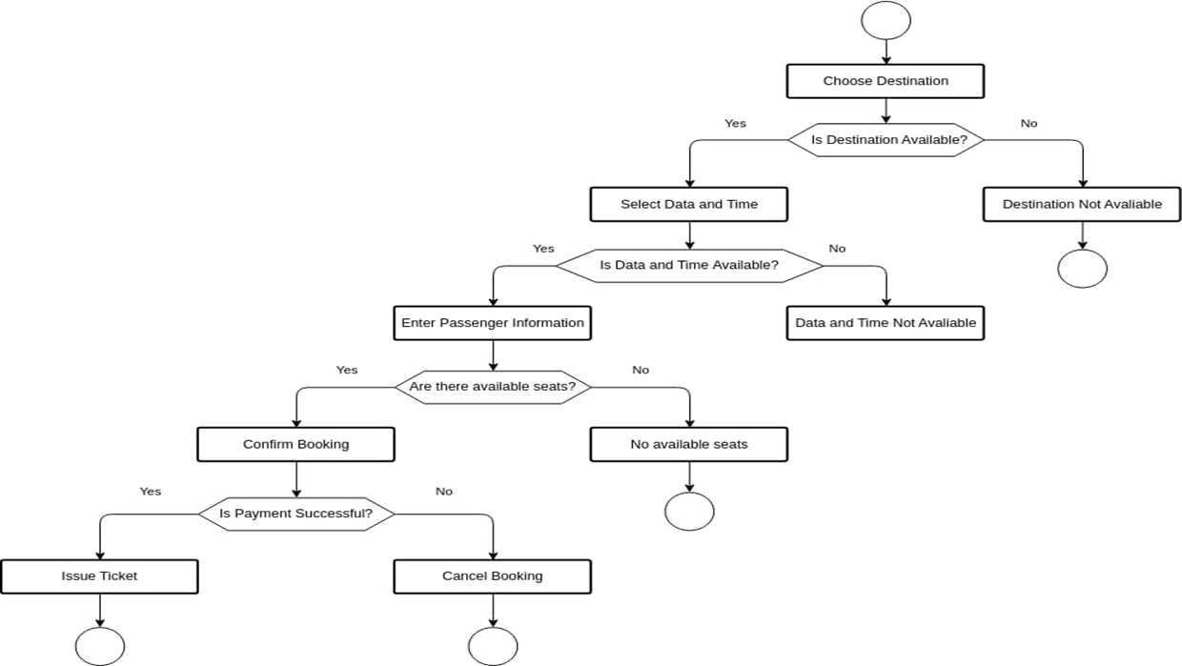
ARCHITECTURE OF THE PROPOSED SYSTEM

Slide 8
LIST OF MODULES
1. USER INTERFACE (GUI) MODULE:
The GUI module provides a user-friendly interface for interacting with the system, enabling users to:
Search for flights and make bookings.
Display flight details, availability, and booking statuses.
Simplify interactions for users with minimal technical knowledge.
Enhance user experience through a clear, intuitive design.

Slide 9
LIST OF MODULES
2. EVENT HANDLING MODULE:
The Event Handling Module manages user interactions by capturing actions like clicks and keystrokes. Its purpose is to:
Capture User Inputs: Detect actions like button clicks and form submissions.
Trigger Actions: Execute system functions such as searching flights or booking tickets.
Provide Feedback: Respond to user actions with real-time updates or error messages.
Maintain Flow: Ensure smooth navigation through the application.
Enhance UX: Create an interactive and responsive user experience.

Slide 10
LIST OF MODULES
3. DATA STORAGE AND MANAGEMENT MODULE:
The Data Storage and Management Module is responsible for:
Storing Data: Flight schedules, booking details, and user information.
Ensuring Data Integrity: Maintaining accurate and consistent records.
Supporting Queries: Enabling quick retrieval of data for searches and bookings.
Handling Updates: Managing real-time updates, cancellations, and changes.

Slide 11
LIST OF MODULES
4. BUSINESS LOGIC MODULE:
The Business Logic Module:
Processes Requests: Handles flight searches, bookings, and cancellations.
Applies Rules: Ensures seat availability, pricing, and booking limits.
Coordinates Data: Interacts with the data storage to fetch and update information.
Ensures Integrity: Validates inputs and confirms bookings and payments.

Slide 12
LIST OF MODULES
5. ERROR HANDLING MODULE:
The Error Handling Module:
Detects Errors: Catches issues like invalid input or system failures.
Provides Feedback: Displays clear error messages to users.
Prevents Crashes: Ensures the system runs smoothly even with errors.
Logs Errors: Records issues for debugging.
Maintains Data Integrity: Prevents data corruption during errors.

Slide 13
MERITS
Platform Independence: Runs on any system with a Java Virtual Machine (JVM).
Object-Oriented: Promotes modularity, reusability, and maintainability.
Rich Libraries: Provides libraries like Swing, JavaFX, and JDBC for faster development.
Security: Built-in features for secure data handling.
Multithreading: Handles multiple user requests simultaneously.
Scalability: Easily handles increased traffic and users.
Database Connectivity: Seamless integration with various databases.
Cost-Effective: Free to use and has a large pool of developers.
Error Handling: Robust mechanisms for detecting and resolving issues.
Rich UI: Easy creation of interactive user interfaces.
Maintainability: Clear syntax and modular design for easier maintenance.

Slide 14
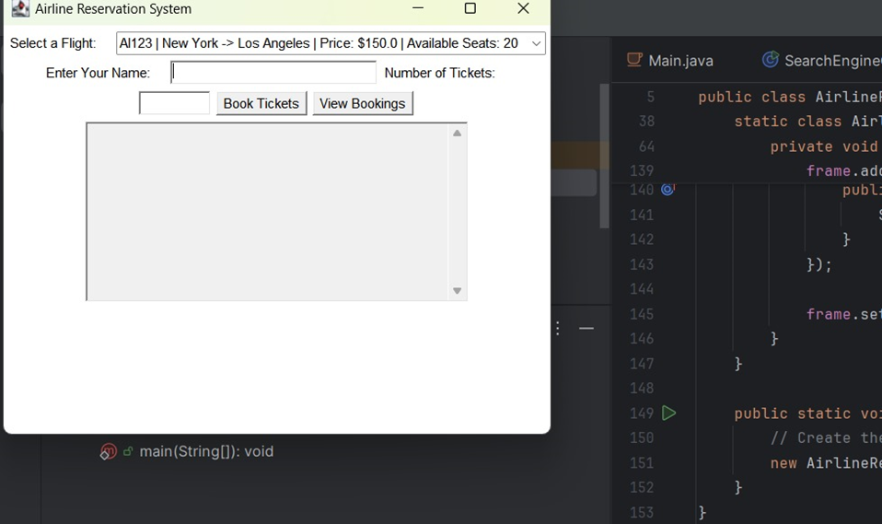
RESULTS AND DISCUSSION

Slide 15
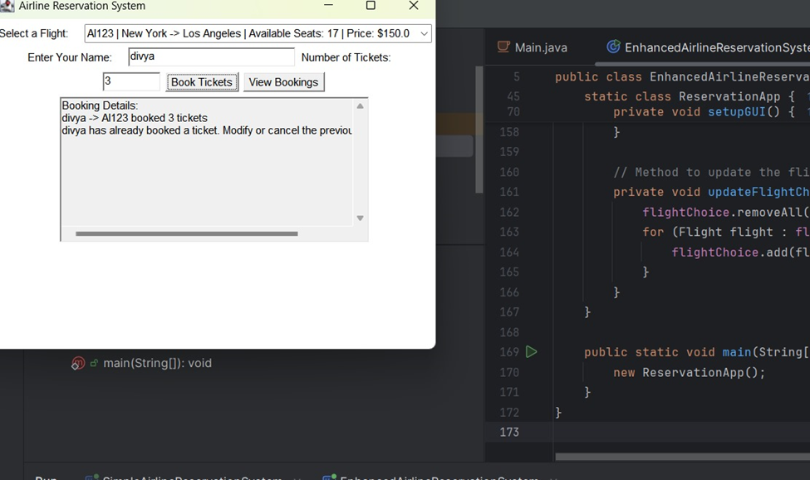
RESULTS AND DISCUSSION

Slide 16
QUERIES ?

