Slide 1
Full Stack Development
Team Name: FRONT END FUSION
ASHMITA ARUN KURDEKAR | 4SF23IS025
DIVYA K | 4SF23IS041
FATHIMA SHAZNEEN | 4SF23IS043
SHRAVYA | 4SF23IS095

Slide 2
Introduction
Objective: Build a responsive and user-friendly website for a food business using React.js.
Customer Features:
Browse menu along with different sections
Customize and place orders.
Provide feedback with a star rating system.
Contact the firm if any query
Admin Features:
Manage the menu dynamically.
Handle orders efficiently.
Tech Stack: HTML, CSS, JavaScript, React.js.
Goal: Streamline food business operations and enhance customer experience.

Slide 3
Problem Statement
Design and develop a frontend, responsive, and user-friendly website for a food business. The platform should allow customers to browse the menu, place and customize orders, and provide feedback. Administrators should be able to manage the menu, handle orders, and can perform CRUD operations effectively using React.Js.

Slide 4
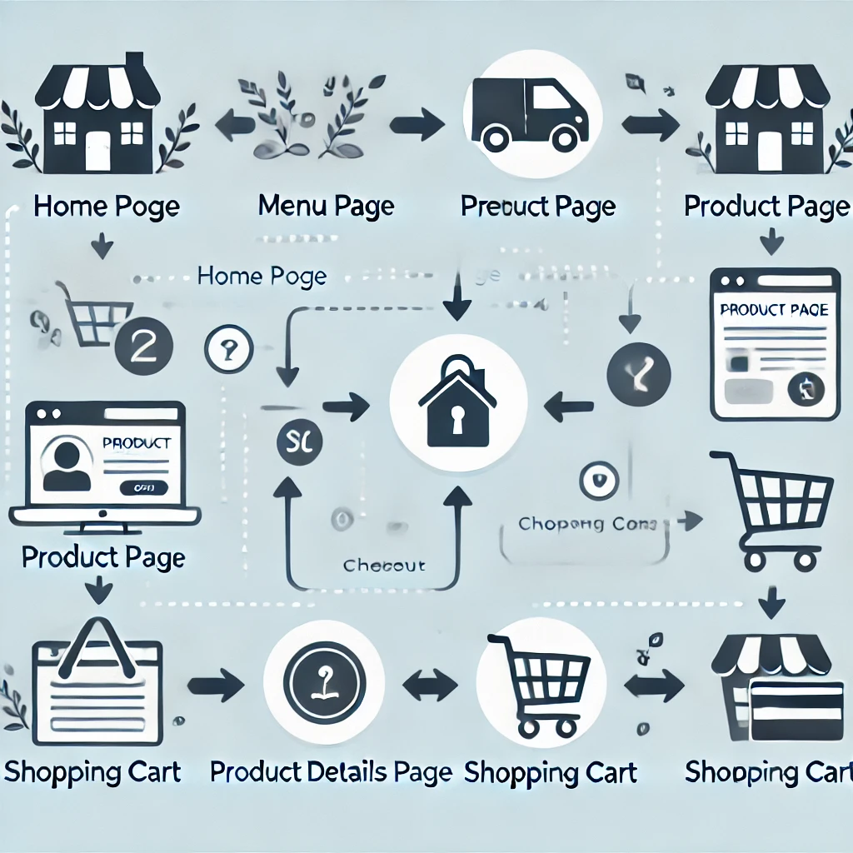
Solution
System requirements for the project
1. Framework/Library: React.JS
2. Routing: Router
3. Styling: CSS Modules
4. Debugging Tools: React Developer Tools
5. Package Management: npm
6. Code Editor: Visual Studio Code
Flowchart

Slide 5
Frontend
The frontend is built using React.js, CSS,JavaScript and HTML to create a dynamic and responsive user interface. React.js is used to develop reusable components (e.g., Header, Footer, MenuCard), manage page navigation with React Router, for features like the cart and user interactions. CSS is utilized for styling and responsive design, with custom styles ensuring a visually appealing layout. HTML structures the content within React components, while animations and interactive elements are added using CSS transitions for enhanced user experience. This approach ensures a clean, maintainable, and user-friendly frontend.

Slide 6
Conclusion
This website helps streamline food business operations by providing a responsive and user-friendly platform. Customers can easily browse the menu, customize and place orders, and provide feedback, enhancing their overall experience. For administrators, it simplifies menu management and order handling with efficient tools for CRUD operations. Built with React.js, CSS, and HTML, the website ensures a smooth, interactive, and modern interface that improves business efficiency and customer satisfaction.
https://drive.google.com/file/d/1NRrPQOkaSYq7_RjNrJh_W-N-QR016rJB/view?usp=sharing

Slide 7
References
https://youtu.be/M9C9b1hYu9M?si=cYm5Zs8C5GzROtOY
https://radixweb.com/blog/react-js-for-frontend-development-features-benefits

Slide 8
Thank You

