Slide 1
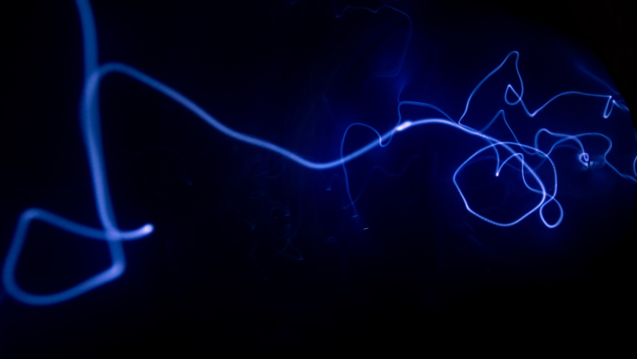
Image Validation & Species Identification with AI
Divya Jyoti
28/06/2025
AI/ML for Industry
Continuing Education Programme
Indian Institute of Technology Delhi

Slide 2
Background
Animal Image Validation & Species Identification
Part of Livestock Registration App
Used by farmers to register animals
Domesticated animals like cattle, buffalo, goat, sheep

Slide 3
Problem Statement
Farmers often upload:
Cropped images (only legs/ears)
Blurry images
Irrelevant pictures (like surroundings or people)
Leads to data inconsistency

Slide 4
Project Objectives
✅ Validate: Is this an animal?
✅ Identify: What species is this? (Cattle, Buffalo, Sheep, etc.)
🔮 Future Scope: Detect the breed (e.g., Sahiwal, Dheer)

Slide 5
Methodology, Datasets, and Tools used
Prefer Real App Data (Pending approval)
Backup: Use Open-Source Datasets
Kaggle, Freepik, shutterstock
https://www.freepik.com/search?ai=excluded&format=search&last_filter=ai&last_value=excluded&query=Gir+Cow
https://www.shutterstock.com/search/cow-of-gir-breed?image_type=photo

Slide 6
Methodology, Datasets, and Tools used
Framework: PyTorch
Model: MobileVNet2
Steps:
Image Preprocessing
CNN-based classification
Lightweight deployment

Slide 7
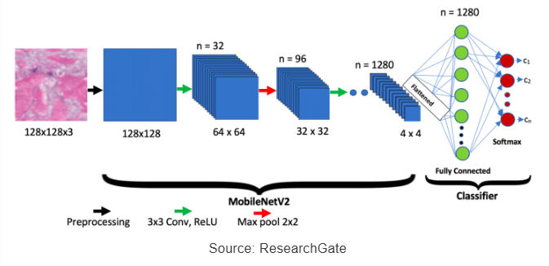
Mobilenetv2 architecture
Depthwise Separable Convolutions
Inverted Residual Blocks
Linear Bottleneck

Slide 8
Evaluation Metrics
Accuracy
Precision/Recall (for detecting blurry or invalid images)
Confusion Matrix (for species classification)

Slide 9
Conclusions
Validating animal image uploads improves system accuracy
Species classification brings automation
MobileVNet2 enables lightweight edge deployment

Slide 10
References
https://www.sciencedirect.com/topics/computer-science/mobilenetv2
https://www.analyticsvidhya.com/blog/2023/12/what-is-mobilenetv2/
https://arxiv.org/pdf/1801.04381
https://www.researchgate.net/publication/350152088_Deep_Learning_Classification_of_Systemic_Sclerosis_Skin_Using_the_MobileNetV2_Model?_tp=eyJjb250ZXh0Ijp7ImZpcnN0UGFnZSI6Il9kaXJlY3QiLCJwYWdlIjoiX2RpcmVjdCJ9fQ
Thank You

