Slide 1
OBJECTIVE
To calculate Road load power and Kinematic power of each drive cycle using this data calculating total vehicle wheel power and vehicle demand energy for the corresponding drive cycles.
To understand the behavior of above calculated quantities by plotting
Kinematic power(hp) vs Time(minutes)
Road load power(hp) vs Vehicle speed(Km/h)
Vehicle demand energy(MJ/mile) vs different drive cycles
Vehicle wheel power vs Time(minutes)

Slide 2
INPUTS
input variables | vehicle 1
Kerb weight(lb) | 4750
pay load(lb)
A(lbf) | 27.15
B(lbf/mph) | 0.2778
C(lbf/mph)^2 | 0.02345
DRIVE CYCLES DATAS
Federal Test Procedure (FTP)
Highway Fuel Economy Driving Schedule (HWFET)
US06
SC03

Slide 3
HOW DID YOU DO THAT ?
In EXCEL
Copy paste the drive cycle data in excel sheet.
In excel sheet the data(velocity(mph) and time(sec)) is copied in a single column and those data splitted into two column using text to column
Copy the velocity(mph) and time(sec) data of different drive cycles.
Using equation calculated kinematic and road load power of each drive cycle separately.
Then calculated total vehicle wheel power and vehicle energy demand

Slide 4
MATLAB
Imported drive cycle data to MATLAB
By taking excel data as reference created code of each equations after checking the correctness of that code next code is generated.
Evaluate the pieces of code and correct the error.
Done the entire calculation code for one drive cycle and after correction applied it to other drive cycles just by changing drive cycle data

Slide 5
By checking line build the entire code.
Incase of confusion calculated values my self randomly.

Slide 6
RESULTS
Kinematic power vs time plot for different drive cycles

Slide 8
Road load power vs velocity plot

Slide 10
Total Vehicle wheel power vs Time

Slide 18
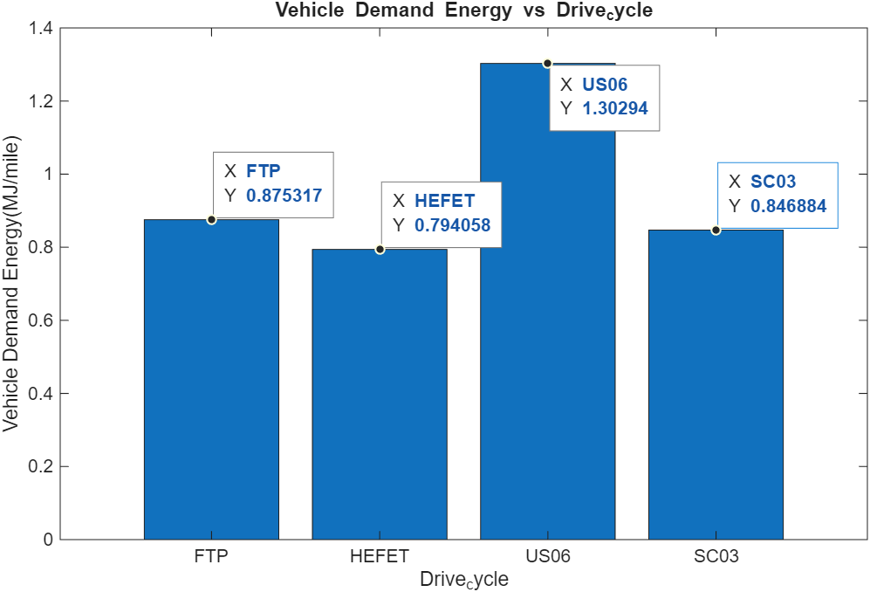

Slide 19
REFERENCES
Drive cycle data:
https://www.epa.gov/vehicle-and-fuel-emissions-testing/dynamometer-drive-schedules
https://www.epa.gov/sites/default/files/2015-10/ftpcol.txt
https://www.epa.gov/sites/default/files/2015-10/hwycol.txt
https://www.epa.gov/sites/default/files/2015-10/us06col.txt
https://www.epa.gov/sites/default/files/2015-10/sc03col.txt
https://in.mathworks.com/help/symbolic/sym.max.html
https://www.mathworks.com/help/matlab/ref/bar.html

Slide 20
CONCLUSION
Kinematic power vs time plot is same in both excel and MATLAB so it is correct the up and down variation is due to the effect of acceleration.
Road load power vs velocity got different in Excel and MATLAB but by sorting the plot in excel both plots matches so it is also correct.
Total vehicle wheel power vs time graphs is same in both excel and MATLAB .It shows the variation of force according to the effect of acceleration .
Vehicle demand energy and vehicle wheel power vs veloc
In the context of four-wheelers, common driving cycles used for testing and emissions certification include the WLTP (Worldwide Harmonized Light Vehicles Test Cycle), NEDC (New European Driving Cycle), and the Modified Indian Driving Cycle (m-IDC)ity graph has similar shape that got from theoretical method so it looks correct .
I am satisfied with the plot I had got.

Slide 21
If any four-wheeler using IDC ?
Indian Driving cycle is a short cycle (108 seconds) designed to represent low-speed, low-load city driving conditions in India.
Modified Indian Driving Cycle (MIDC) is used for four-wheeler certification in India, while the Indian Driving Cycle (IDC) is used for two/three-wheelers.
Maximum Speed: The MIDC cycle has a maximum speed of 90 km/h, while the IDC has a maximum speed of 42 km/h
MIDC is the standard driving cycle used for testing four-wheelers in India
In the context of four-wheelers, common driving cycles used for testing and emissions certification include the WLTP (Worldwide Harmonized Light Vehicles Test Cycle), NEDC (New European Driving Cycle), and the Modified Indian Driving Cycle (m-IDC).
The most common driving cycles for driving conditions are the WLTP, NEDC, SORDS and the FTP-75,

Slide 22
END

