Slide 1

St. Xavier’s College, Ahmedabad
(Department of Physics & Electronics)
STUDY AND COMPARISON OF LST, NDVI & NDBI BETWEEN THE OLD AHMEDABAD CITY AND THE NEW AHMEDABAD CITY USING THE LANDSAT-8 SATELLITE
NAME : Divyakumar A. Kotia
ROLL NO. : 19-PH-0380

Slide 2
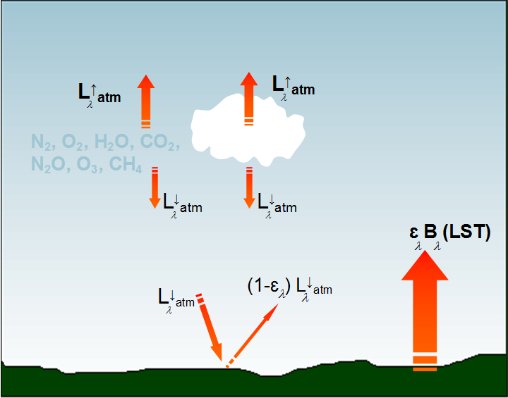
INTRODUCTION:
LST: The radiative skin temperature of the land derived from solar radiation.
Image courtesy: http://eumetrain.org/

Slide 3
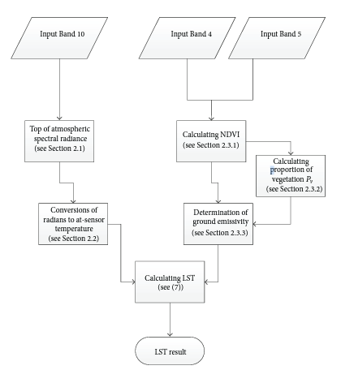
Methodology:
NDVI, NDBI & LST were obtained from the LANDSAT-8 Surface reflactance dataset by using the Google earth engine (GEE) for the Ahmedabad city for the year 2020 (whole city, new city & old city).
LST from TERRA(MOD11A1 V6) & AQUA (MYD11A1 V6) satellites was also obtained using GEE for validation of LST obtained from LANDSAT-8.
LST Maps for winter, pre monsoon, monsoon, post monsoon & for the whole 2020 year were obtained.
The mean values of the LST, NDBI & NDVI for the new city and old city were compared each other.
Relationship among LST, NDBI and NDVI was studied.
Algorithm for Automated Mapping of Land Surface Temperature Using LANDSAT 8 Satellite Data – Ugur Avdan and Gordana Jovanovska

Slide 4
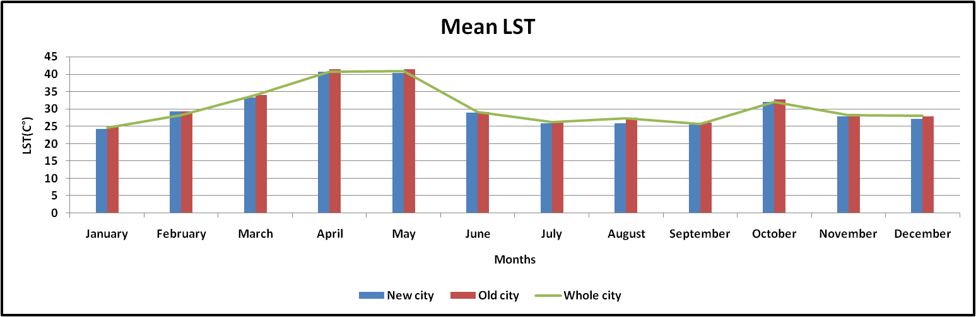
Results:
Mean LST 2020:
New city: 29.91
Old city: 30.46
Whole city: 30.15
Difference: 0.55 (~ 1.80 %)

Slide 5
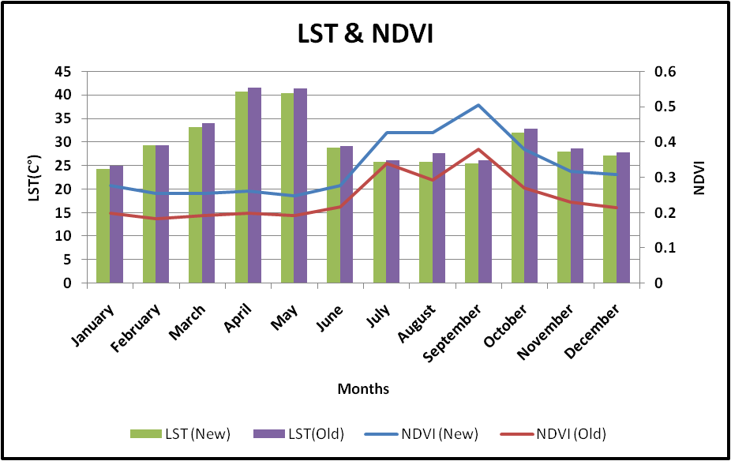
Mean NDVI 2020:
New city: 0.316
Old city: 0.228
Whole city: 0.269
Difference: -0.087 (~ -27.53 %)

Slide 6
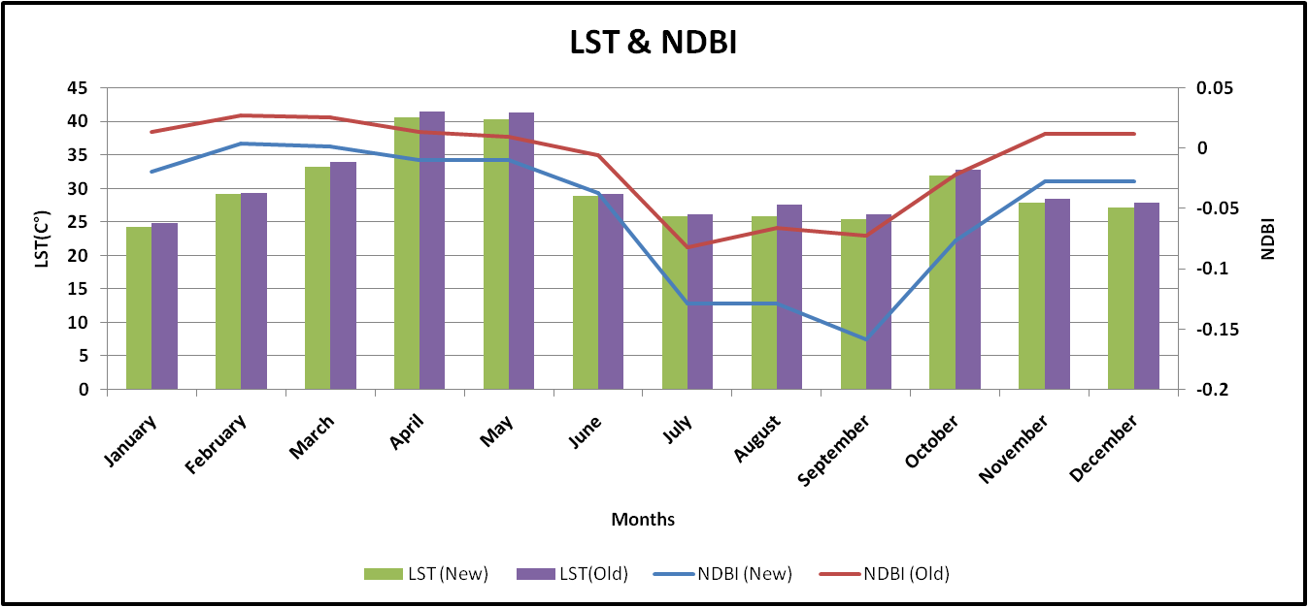
Mean NDBI 2020:
New city: -0.04
Old city: -0.002
Whole city: -0.021
Difference: 0.038 ( ~ 95 %)

Slide 7
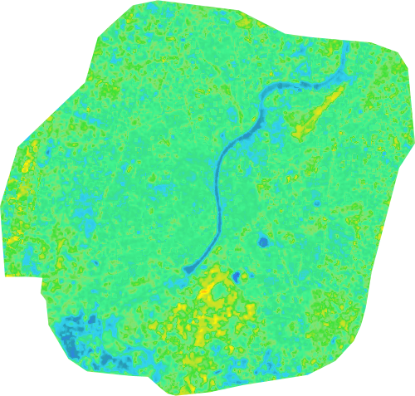
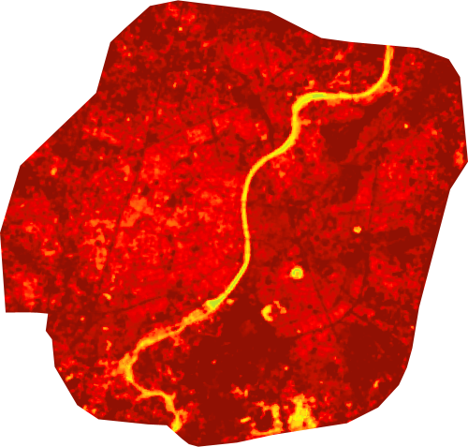
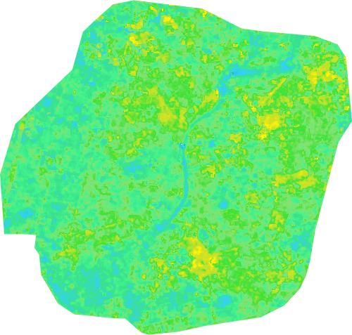
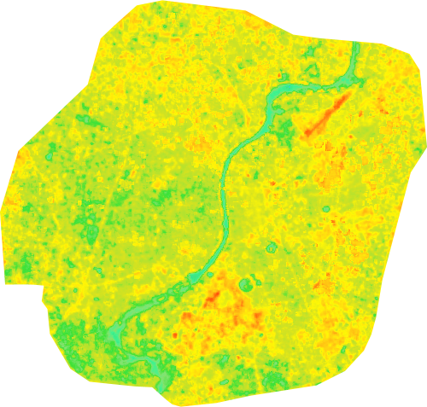
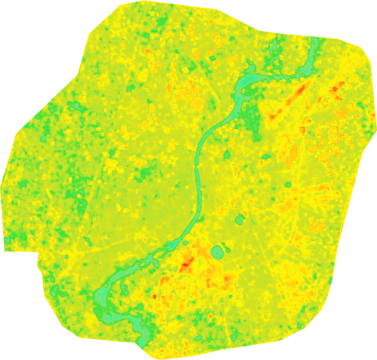
Variation of LST over Ahmedabad during the year 2020:
Winter
Pre monsoon
Monsoon
Post monsoon
Year 2020

Slide 8
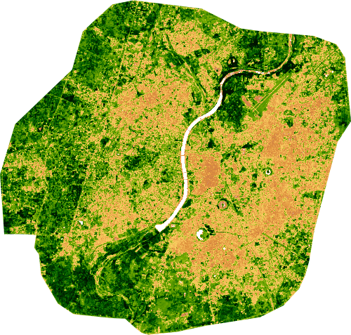
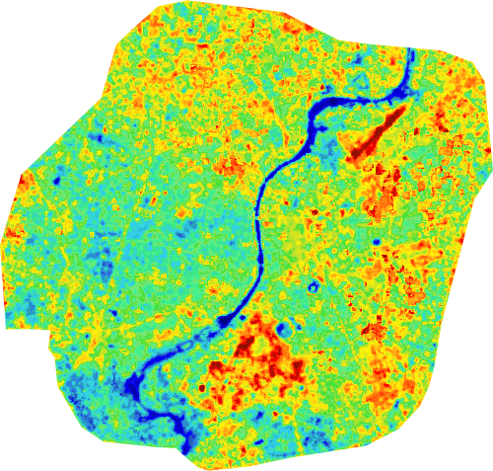
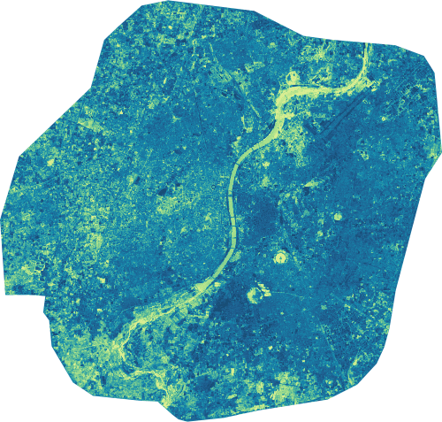
Relationship among LST, NDVI & NDBI
NDVI
LST
NDBI
Correlation coefficient (r) (2020):
LST-NDVI: -0.503
LST-NDBI: 0.502
NDVI-NDBI: -0.970

Slide 9
Conclusions:
It can be concluded that the old Ahmedabad city is having more built up land and less vegetation land as compared to the new Ahmedabad city.
LST of old city is also higher than the new city.
LST-NDVI, LST-NDBI & NDVI-NDBI over the Ahmedabad for 2020 were found to be having negative, positive and highly positive regression respectively.
During the monsoon season, NDVI & NDBI were found to be increasing and decreasing respectively which results in the decrease in the value of LST.

Slide 10
REFERENCES:
http://www.eumetrain.org/
Algorithm for Automated Mapping of Land Surface Temperature Using LANDSAT 8 Satellite Data – Ugur Avdan and Gordana Jovanovska
Advanced remote sensing terrestrial information extraction and applications by Liang, Shunlin Wang, Jindi
https://gis.stackexchange.com/
https://developers.google.com/earth-engine
Subhanil Guha, Himanshu Govil, Prabhat Diwan, “Analytical study of seasonal variability in land surface temperature with normalized difference vegetation index, normalized difference water index, normalized difference built-up index, and normalized multiband drought index,” J. Appl. Remote Sens. 13(2), 024518 (2019), doi: 10.1117/1.JRS.13.024518.

Slide 11
Corellation between LST and indexes:
Seasons | LST-NDVI | LST-NDBI | LST-NDWI | NDVI-NDBI
Winter | -0.806797917 | 0.952795754 | 0.916077964 | -0.944153439
Premonsoon | 0.525146853 | -0.654585138 | -0.531031042 | -0.159867323
Monsoon | -0.472094133 | 0.60687577 | 0.334898558 | -0.940734069
Post monsoon | 0.803876241 | -0.735990544 | -0.890373674 | -0.967954366
Year 2020 | -0.502907654 | 0.502580595 | 0.412159582 | -0.970174969

Slide 12
THANK YOU

