Slide 1

Utility Equipment Analysis

Slide 2
Best Time to sell off an Equipment?
Keep the vehicle till:
MC_{old} ≤ E(ATC_{new})
MC_{old} : Marginal cost per unit of service for existing machine
ATC_{new} : Average lifetime cost per unit of service expected from new machine
Buy a new one as soon as it equals each other.
Assumptions about Lifetime?
Assumptions about Service?
Data Integrity?

Slide 3
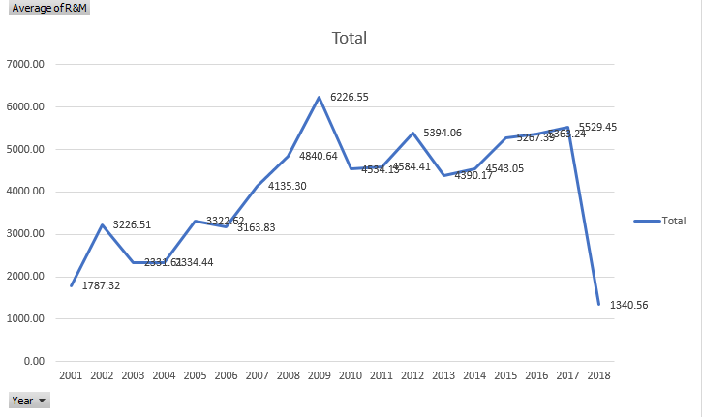
Problem: Average Aerial R&M Costs are Increasing
Notes:
$ 4390 in 2013- $ 5056 in 2017
Percenetage of vehicles of age
Bubble plot,

Slide 4
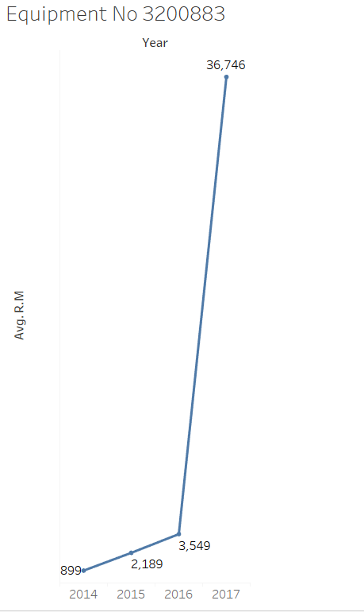
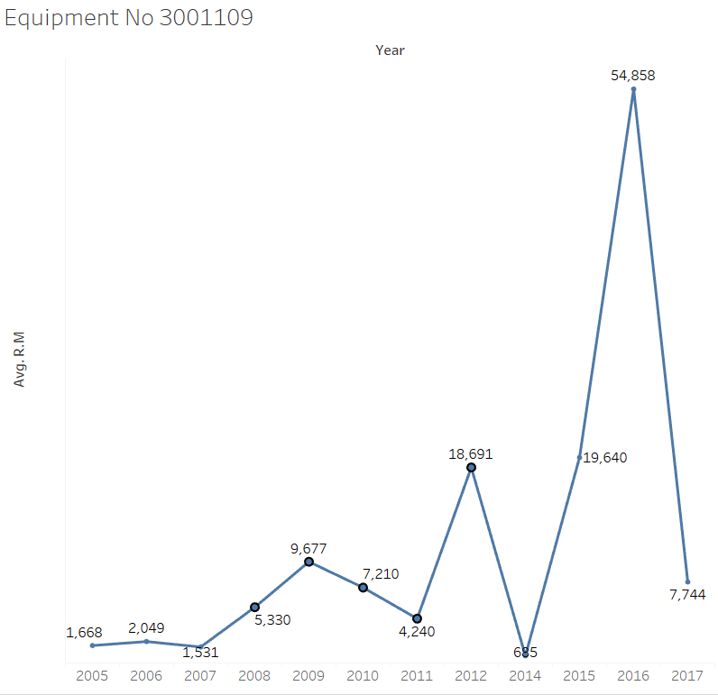
High variability in R&M Costs($): 37% of the Aerials have R&M costs above average
Notes:
3200883-Cummins, Freightliner coorp
3001109-Caterpillar, Ford
$5.21 M above the average(Amt which can be saved)

Slide 5
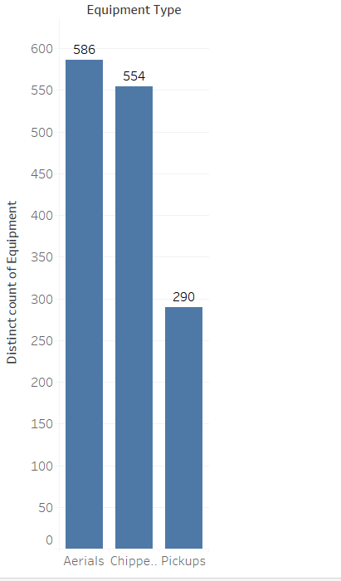
Data Overview
Years: 2001-2017
Variables chosen: Tower type, Trans type, Wheels driven by,
Vehicle manufacturer, Installed Location, Apportioned,
Engine Manufacturer, Engine model, Engine configuration,
Ownership code, Age, Year, LID, Fuel,Purchase Price,Billing hours
Total number of CAPs: 1430
Missing percentage:
23% in complete data
11% in Aerials
33% in chippers
23% in Pickups

Slide 6
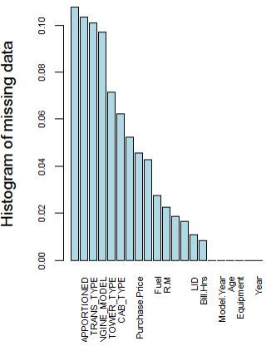
AERIALS: Missing Variable Values Replacement
Deleted the rows with > 50% missing
Categorical:
Deleted the columns with >10% missing
Replaced with Most frequent value
Numerical:
Deleted the columns with >50% missing
Deleted the rows with R&M costs =$0
Replaced with Median

Slide 7
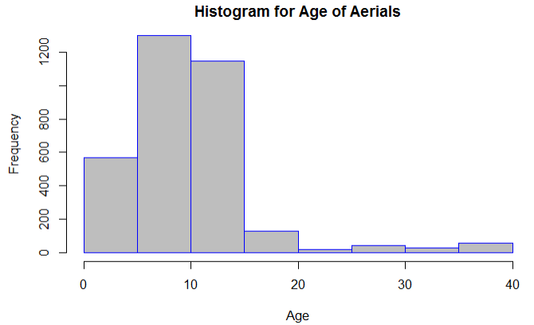

Slide 8
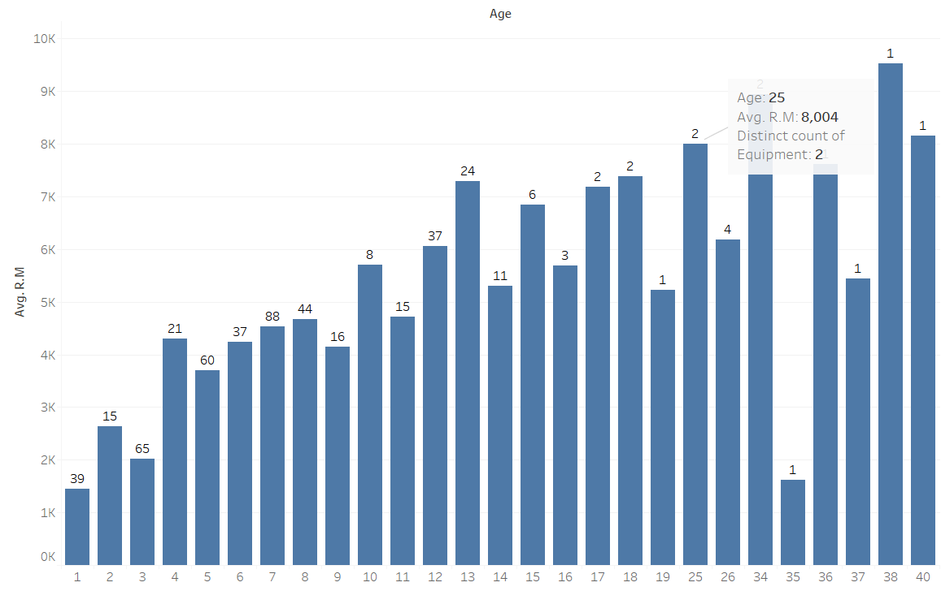
Age and R&M Costs(Aerials)
Notes:
Do not have date for Equipment 3800184, has only 3 years data

Slide 9
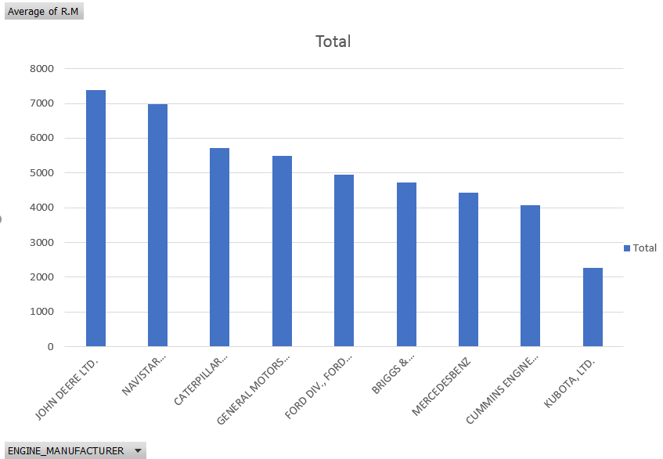
Average R&M Costs By Engine Mfg ($)

Slide 10
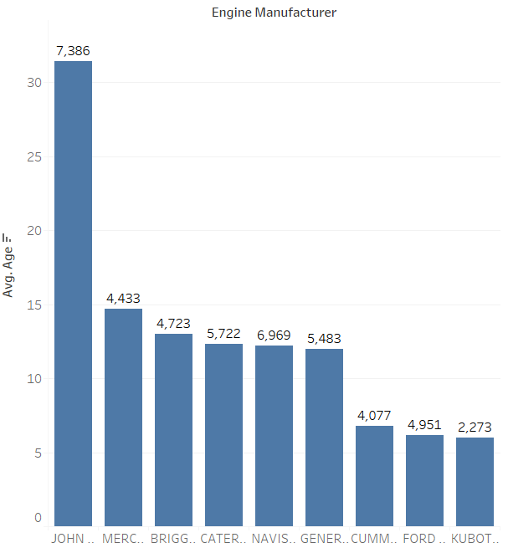
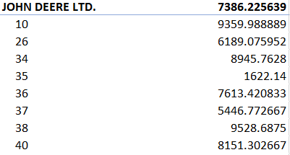
Average age By Engine Mfg (Years)
Notes:
Costs at top

Slide 11
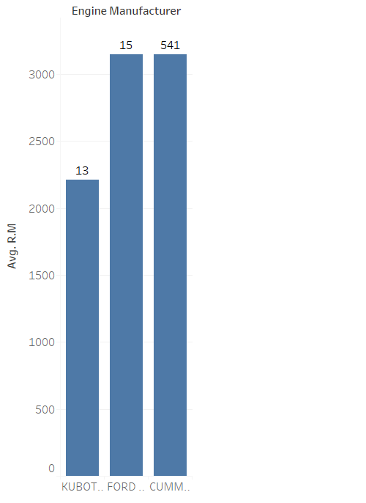
Avg R&M for 5 year old vehicles by Engine Mfg

Slide 12
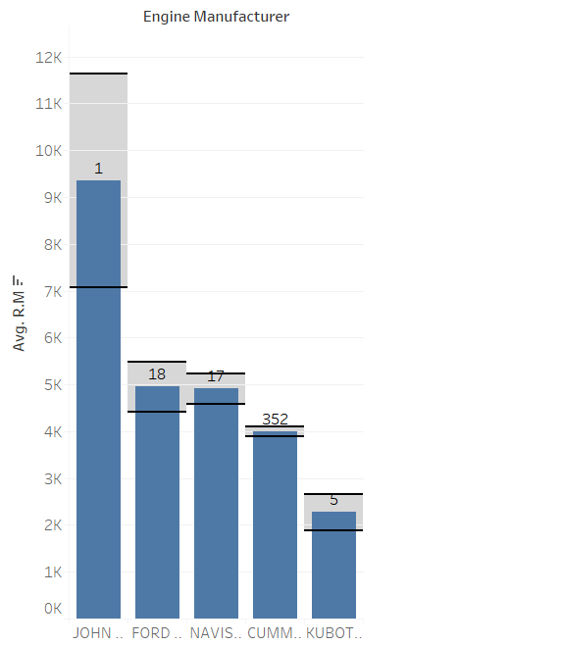
Avg R&M for 10 year old vehicles by Engine Mfg
Notes:
Plot error bars

Slide 13
Variables removed for Model
Age: Highly correlated to Model year and year and was same for an equipment for all years
Equipment : Unique identifier
Tower serial: Unique identifier
Billing hours : Removed only for Prediction for 2018
Fuel : Removed only for Prediction for 2018
LID : Removed only for Prediction for 2018 as there is no defined method of finding LID
ENGINE_MODEL was highly correlated to Engine manufacturer
Vehicle manufacturer(Correlated with Engine manufacturer)
Notes:
Altec as VM, then Cummins as EM
John Deere as VM has John Deere as EM
Remove age

Slide 14
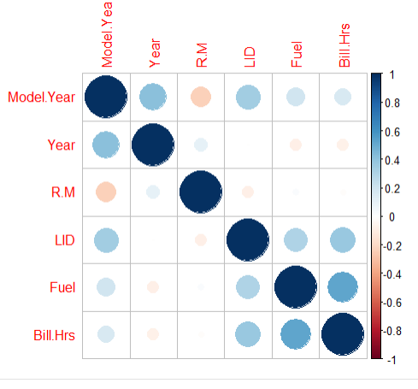

Correlation & Model for Aerials
Model year and R&M: negative
R square of 44% on Training data
R square of 32% on Test data
R square is 31.8% without LID,Bill.Hrs and Fuel on training
R square is 21% without LID,Bill.Hrs and Fuel on test

Slide 15
Effect of Different Attributes on R&M
Age:0.13
Bill Hours: 0.10 times
LID : 0.44 times
ENGINE_CONFIGURATIONV 8 CYL. 1.47 times
ENGINE_CONFIGURATION 6 CYL. (INLINE) 1.32 times
ENGINE_MANUFACTURERJOHN DEERE LTD -1.22 times
Purchase.Price -0.17 times
Ownership Lease -0.84 times
Wheels_By_Drive 4*4 0.24 times
Fuel 0.07 times
Notes:
exp(0.19)=1.21-1= 21% increase

Slide 16
Effect of Location Attributes on R&M
Peabody Municipal Power Plant: -3.96
Florida Public Utilities Northeast:-1.35
OUC Production: -0.73
Jones Onslow: -1.26
PSEGDistribution Firm Bid : -0.97
FirstEnergy JCPL Firm Bid: -0.88
DTE Unit Maintenance Work: -0.66
NIPSCO T&M:-0.92
NIPSCO: -0.79
Ohio Cooperatives: -0.68
National Grid New England:0.08
City of Cuyahoga Falls: -1.22

Slide 17
Most important Predictors
LID
Year
Installed location
Engine manufacturer
Ownership code(Own,lease,Chng)
Model year
Bill hours
Tower type
Engine Configuration
Drive Train Type (4x4, 4x2)
Fuel

Slide 18
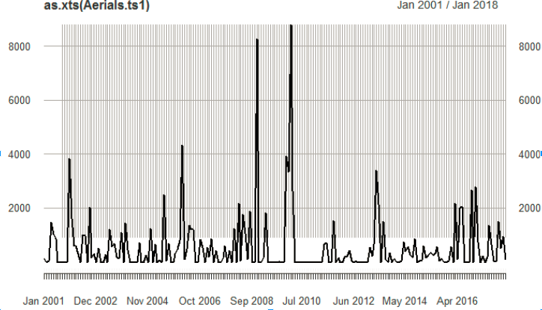
Time series Jan 2001-Jan 2018

Slide 19
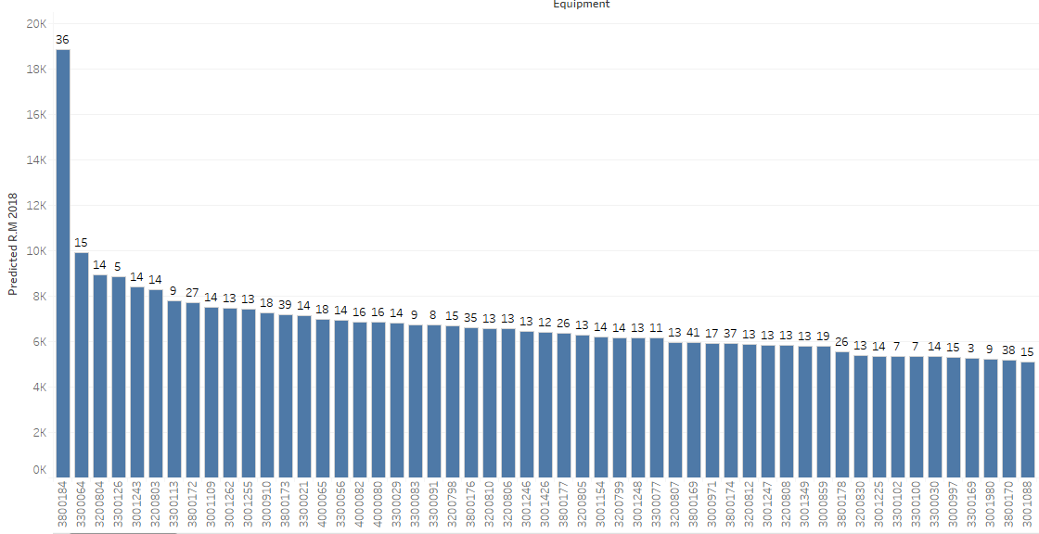
Predicted Repair & Maintenance costs 2018 (Aerials)

Slide 20
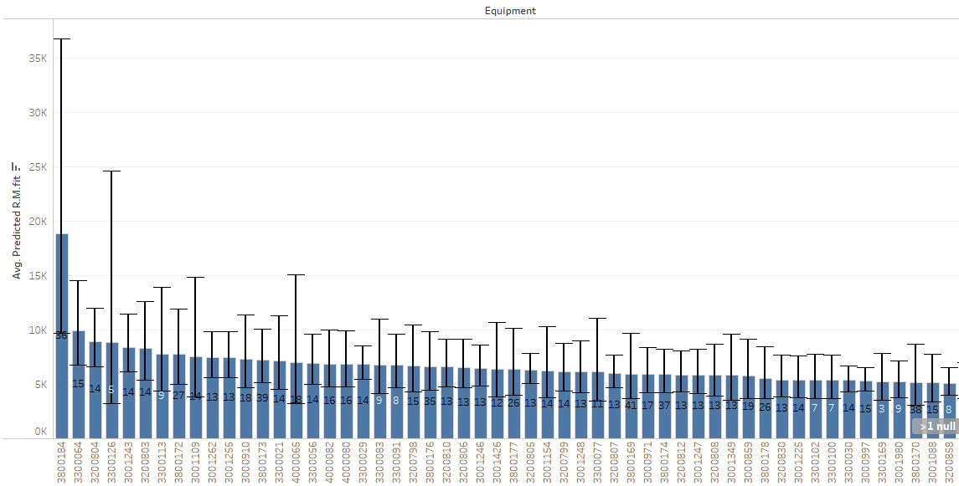
Predicted Ranges of Repair & Maintenance Costs (Aerials)

Slide 21
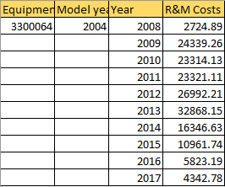
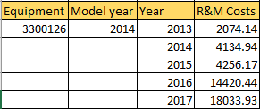
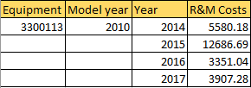
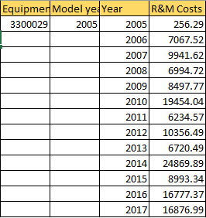

Slide 22
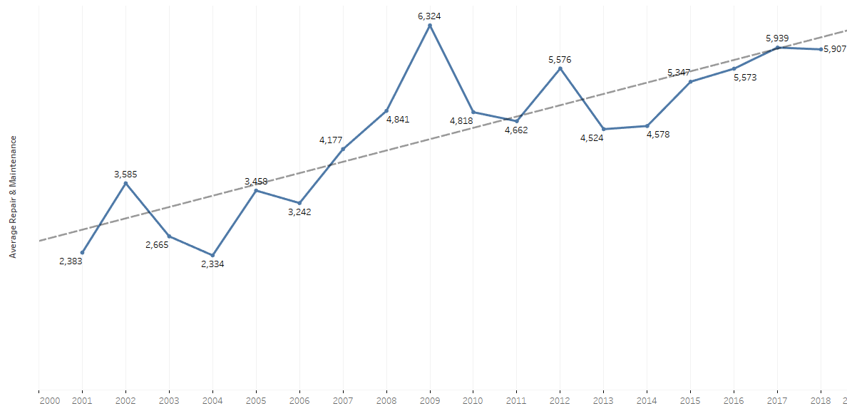
Predicted Average Repair & Maintenance Costs Trends 2018 (Aerials)

Slide 23
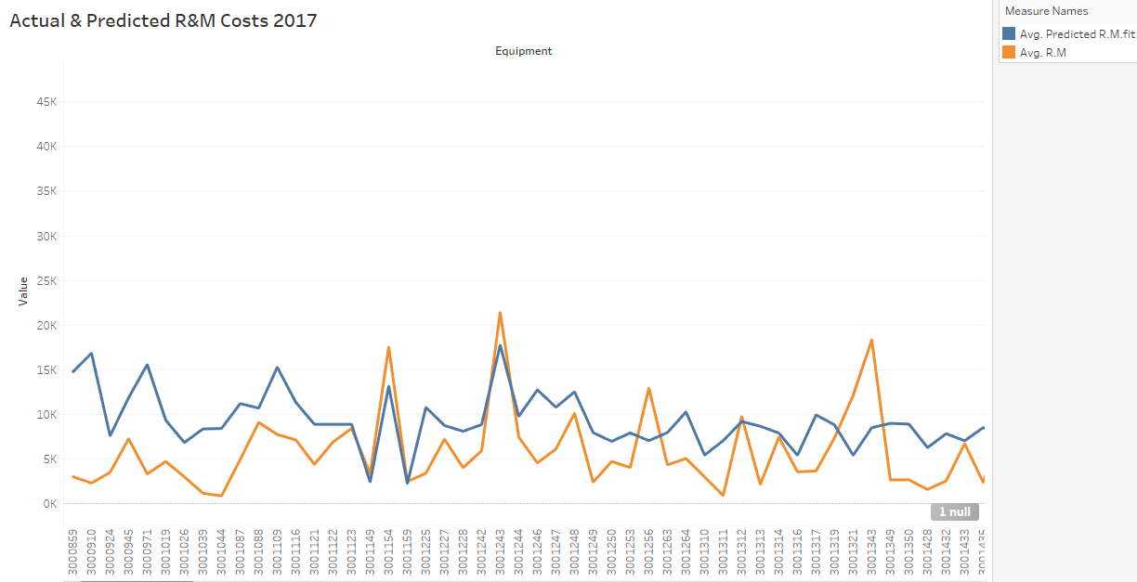

Slide 24
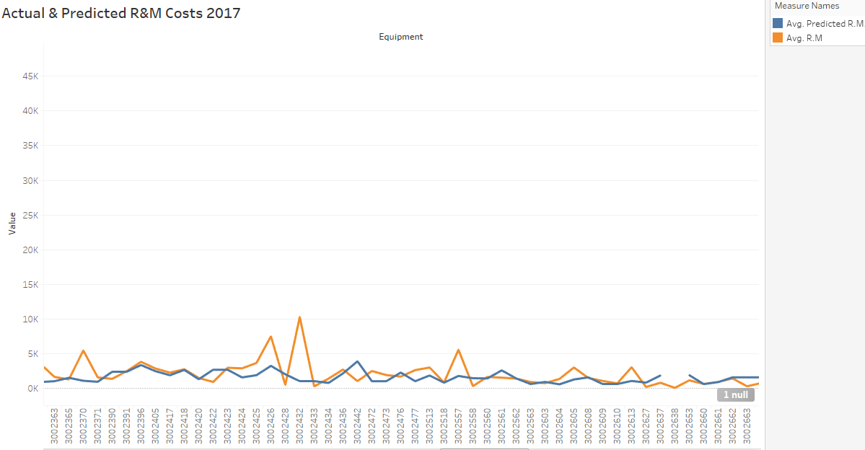

Slide 25
Challenges
Data Collection (combined columns, Pay Card transactions)
Data Integrity (Mileage, Engine manufacturer, kubota)
Missing values
Data spread all across (SAP, Equipment Team, wex, Telogis)

Slide 26
Insights
1 year increase, leads to an increase of 21% increase in R&M costs
Random values of p-card transaction would not make a difference in the model
Location, Engine configuration and wheels by drive does make a difference in R & M costs
Knowing the R&M costs of next year will act as an important deciding factor.
To filter down the Equipments which are expected to have a higher R&M and analyze the Trajectory the Equipment follows.

Slide 27
Future Possibilities
Have separate fields for Repair and maintenance.
Have separate fields for Licence, Insurance, Tax and Depreciation.
Repairs through Pay card are added into the same GL account and are not mapped to unit numbers
Predicting resale values/residual values of active vehicles
Telematics for real time data collection and failure prediction
Planned Maintenance to Predictive maintenance(Mean time before failure)
Notes:
Train and test

Slide 28
Thank you!

