Slide 1
Airbnb New York Data Analysis
Data Science Project Fall 2018
Divya Natolana Ganapathy

Slide 2
Objectives
Customer Point of view:
What is it that makes the price of one listing different from another
Host Point of view:
How to become a successful host on Airbnb

Slide 3
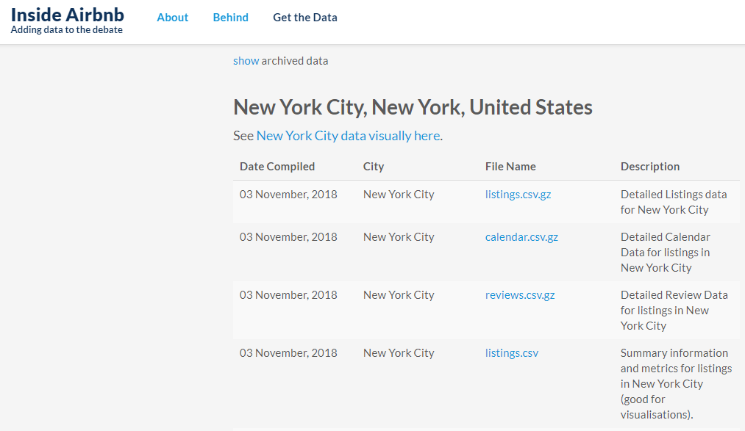
Data Source

Slide 4
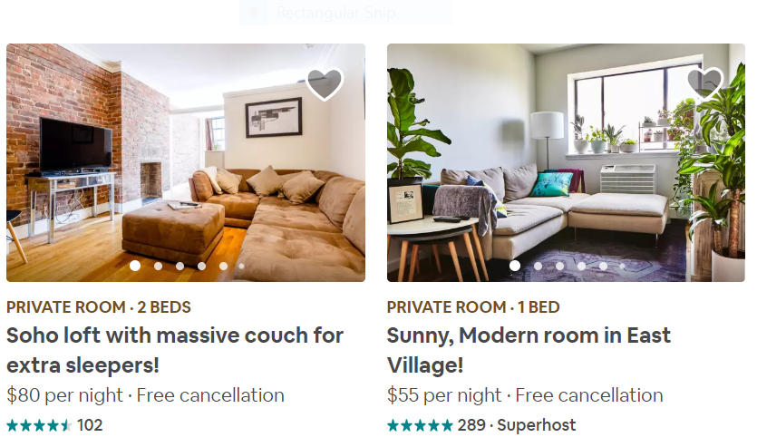
Customer Point of View

Slide 5
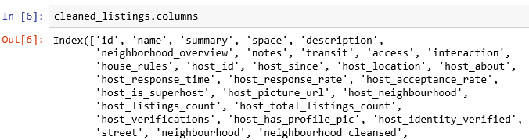


Listings.csv:
Reviews.csv:

Slide 6
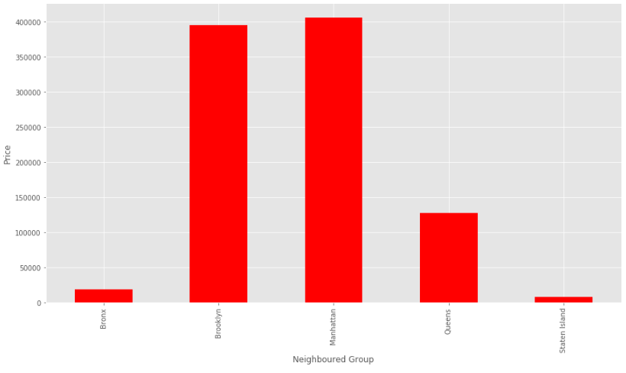
Price vs Neighbourhood Group

Slide 7
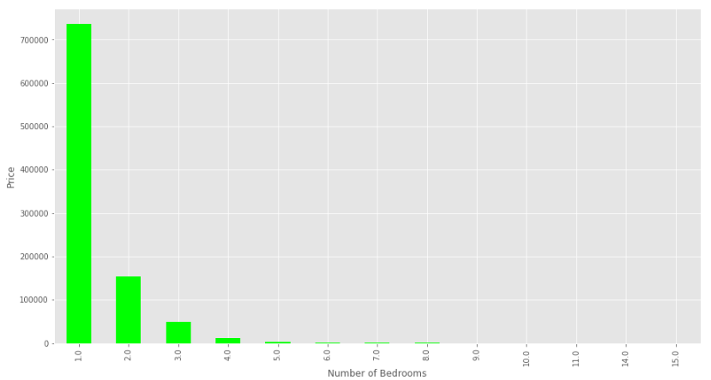
Price vs Number of Bedrooms

Slide 8
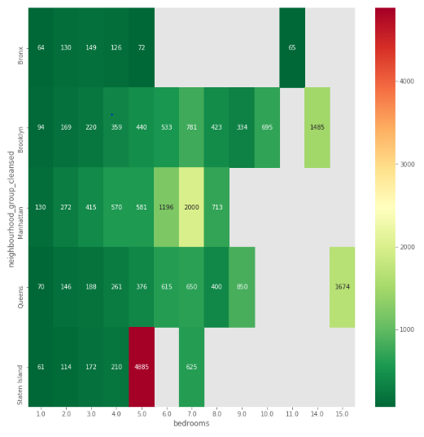
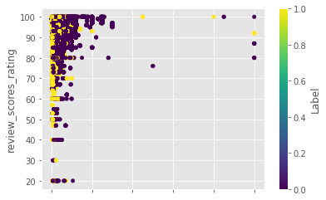
Neighbourhood Group vs Bedrooms

Slide 9
Words that affect price
Walking distance
Bedroom
Bed Size
Coffee maker
Queen Size
Hudson River
Clean
Easy

Slide 10
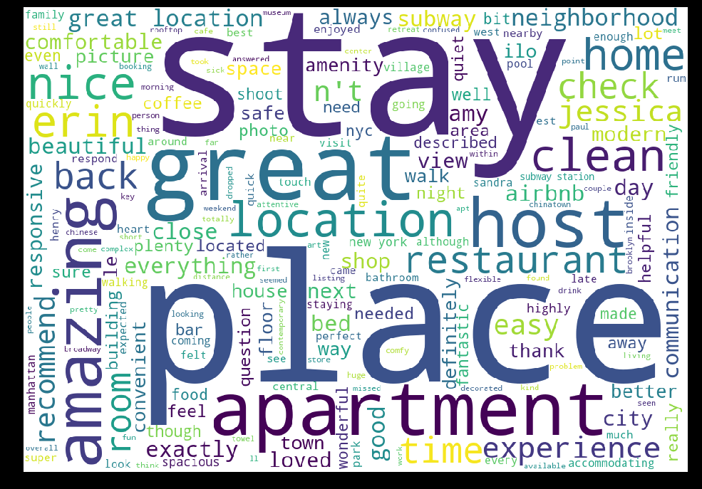

Slide 11
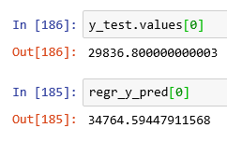
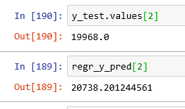
Host Point of View
Calculated the total revenue of each listings:
Linear Regression-->0.33 (r2-score)
Random Forest Regressor-->0.49 (r2-score)
LDA (Latent Dirichlet Allocation) on Description of Listings: Top 3 topics (Luxury, Location,Budget)

Slide 12
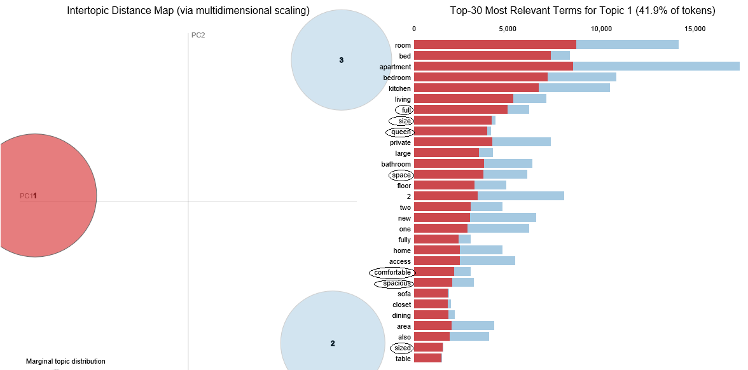
Topic 1 (Luxury) :Appeal to travellers who value Luxury.

Slide 13
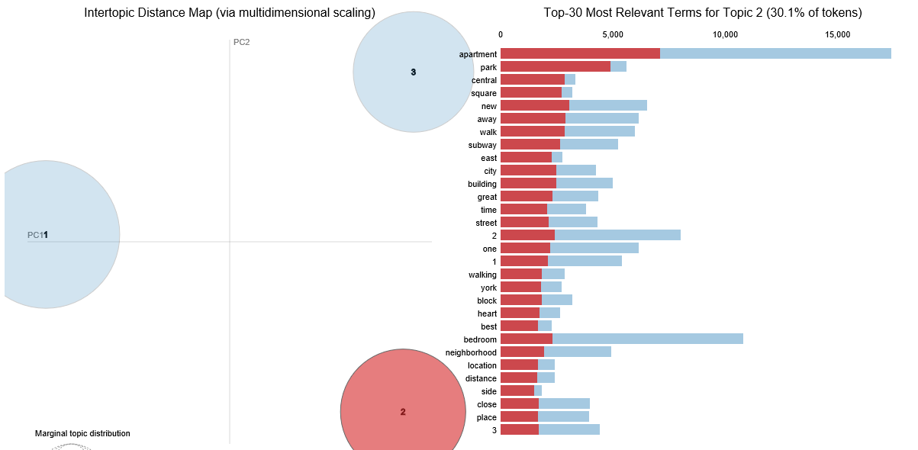
Topic 2 (Budget): Appeal to budget travellers.

Slide 14
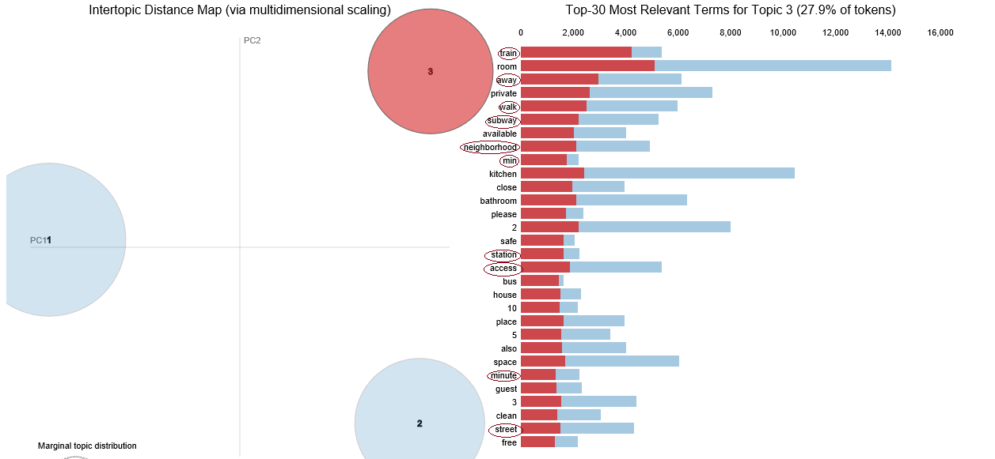
Topic 3 (Location): Appeal to traveller who value convenience and proximity.

Slide 15
Conclusion
Price is dependent on the following attributes :
Location.
Type of rooms.
Number of rooms .
Keywords used in the description and comments.
The host could become successful by targeting three types of customer groups.
We predicted the pricing of a new listing and also were able to suggest keywords that should be used for success in their description.

Slide 16
Failures and Improvements
Plot of price against the neighbourhood did not give us too much insight.
The predicted price vs actual price of a listing has some variance.
To improve the accuracy we need to add more features.
We can use important keywords extracted from comments and descriptions as feature to the model.

Slide 17
Thank You!

