Slide 1


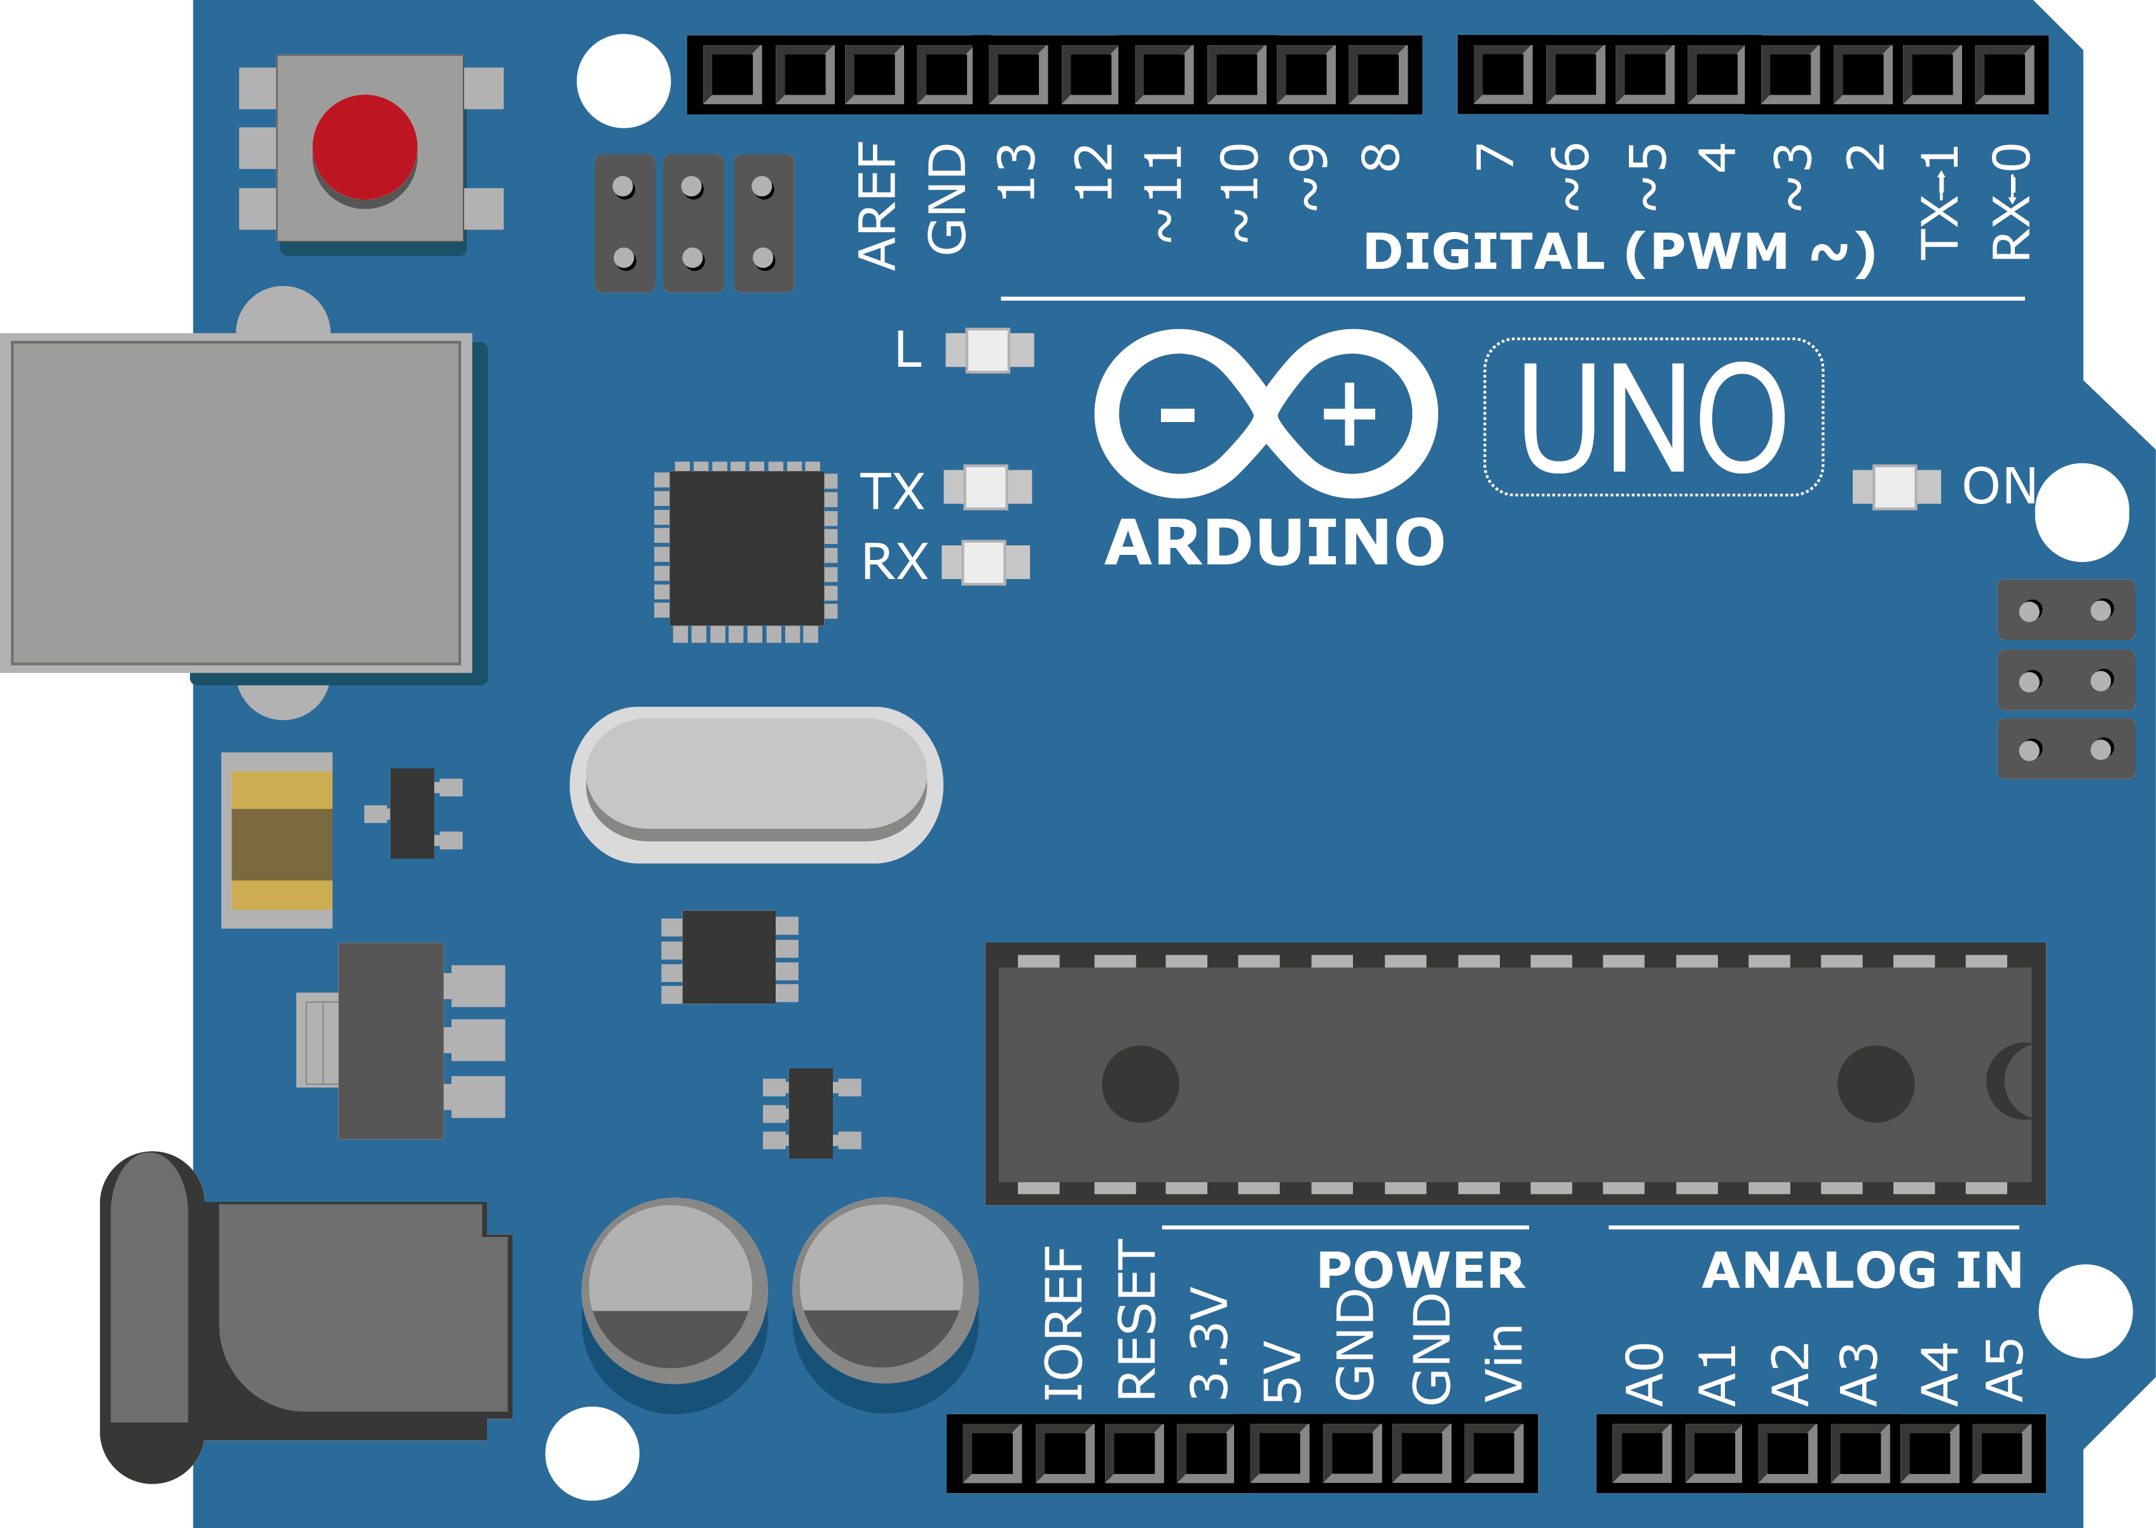
ARDUINO MASTER CLASS
DAY - 30
Data Transmission using LiFi Technology

Slide 2
DAY – 30 AGENDA
02
03
01
LiFi
Data Transmission using LiFi
Interview questions & News

Slide 3
LiFi - Light Fidelity
LiFi (light fidelity) is a bidirectional wireless system that transmits data via LED or infrared light.
It was first unveiled in 2011 and, unlike Wi-Fi, which uses radio frequency, LiFi technology only needs a light source with a chip to transmit an internet signal through light waves.
LiFi multiplies the speed and bandwidth of Wi-Fi, 3G and 4G
With LiFi, however, its band frequency of 200,000 GHz, versus the maximum 5 GHz of the Wi-Fi, is 100 times faster and can transmit much more information per second.
A 2017 study by the University of Eindhoven obtained a download rate of 42.8 Gbit/s with infrared light with a radius of 2.5 meters, when the best Wi-Fi would barely reach 300 Mbit/s.

Slide 4


Slide 5

INTERVIEW QUESTIONS – DAY 30
Why 50 Hz, 230 Volts AC in India & 60 Hz, 110 volts AC in Abroad
What is the frequency of electricity in India?
Advantage of 50 Hz Power system over 60 Hz power system?
Both the power system has advantages and disadvantages, but 50 Hz power system have some extra advantage over 60 Hz power system.
Reducing loss
Reducing Variable loss
Size of the conductor
Increases power generation
Insulation cost
50.0 Hz

Slide 6

This AI is playing an infinite bass solo on YouTube
TECHNOLOGY NEWS– DAY 30
2020
The project shows how AI‘s role in music can move from a gimmick to a powerful creative tool. Alternatively, it could produce an endless stream of original music with relatively little human effort.

Slide 7

THANKS!
www.pantechsolutions.net

