Slide 1
Title: Driver’s Fault Prediction
BY
Divya Sri Nunety – DP50052
FALL 2024 SEMESTER
UNDER CHAOJI WANG SUPERVISION

Slide 2
Introduction
Background:
Analyzing traffic accidents is critical for improving road safety by identifying factors contributing to driver fault.
Objective:
This project aims to predict whether a driver is at fault in traffic accidents using machine learning models, focusing on key accident characteristics.

Slide 3
Dataset
Data Sources:
The dataset used in this project is sourced from the Automated Crash Reporting System (ACRS) (Crash Reporting - Drivers Data) maintained by the Maryland State Police.
Data Size: 82 MB
Data Shape:
Rows: 157,841
Columns: 43
Time Period: 2006-2024

Slide 4
Key Variables
Crash Details:
ACRS Report Type, Collision Type, Weather, Surface Condition, Light Condition, Injury Severity
Driver and Vehicle Information:
Speed Limit, Driver Substance Abuse, Vehicle Body Type, Driver At Fault
Target Variables
Crash_Severity
Driver_Fault

Slide 5
Data Preprocessing
Initial Data Loading: Loaded the dataset using pandas.read_csv("Drivers_Data.csv").
Data Structure: Used .shape() and .info() to assess the dataset’s structure, including the number of rows and columns.
Handling Missing Values: Identified missing data in several columns and dropped irrelevant or redundant columns (Report Number, Municipality, Related Non-Motorist, etc.).
Dropping Rows with Missing Values: Dropped the rows containing missing values, which left me with only complete data for further analysis.

Slide 6
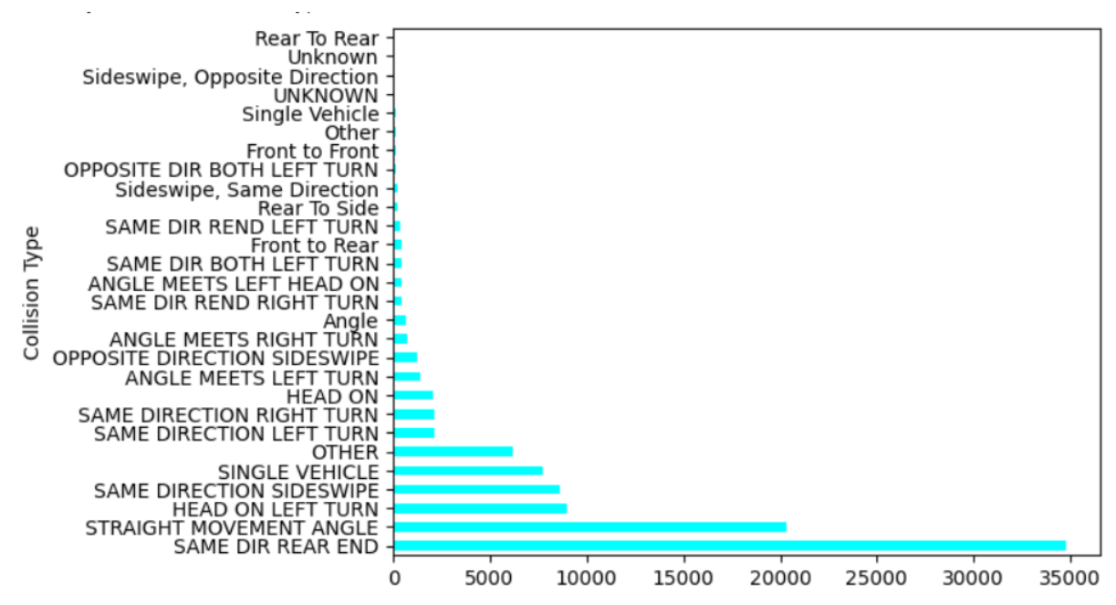
Exploratory Data Analysis (EDA) - Collision Types
Rear-End and Side-Impact collisions are most common; this insight helps in understanding typical accident scenarios and can inform model predictions.

Slide 7
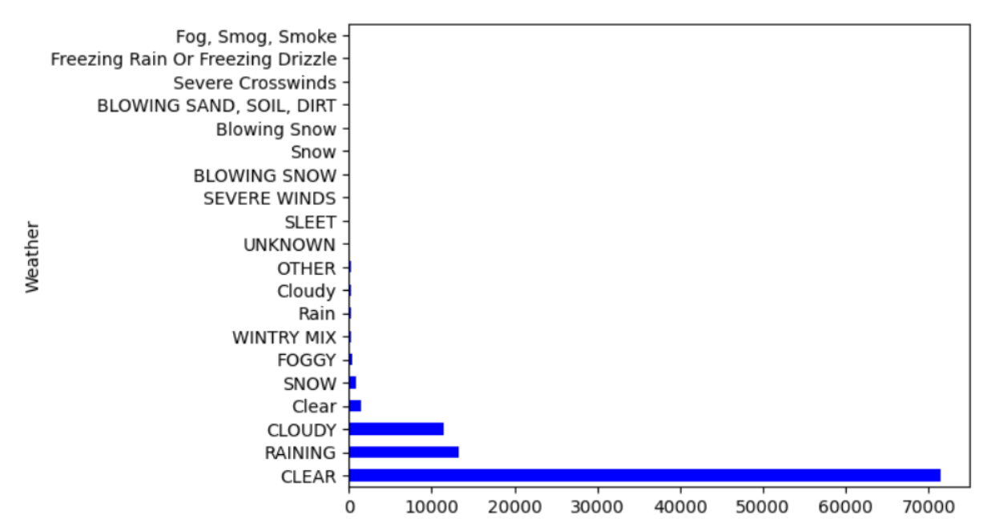
Exploratory Data Analysis (EDA) - Weather Conditions
Clear weather conditions account for most accidents, indicating factors beyond weather may play a role in determining fault.

Slide 8
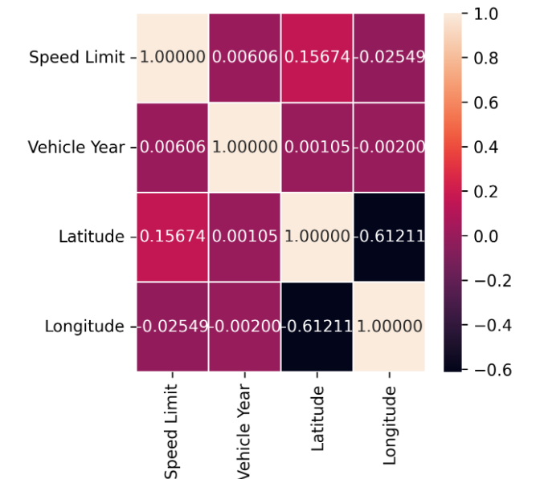
Exploratory Data Analysis (EDA) – Correlation Analysis
Heatmap to visualize the correlations between features such as Injury Severity, Speed Limit, and Vehicle Damage Extent, helping me understand how these features interact.

Slide 9
Feature Selection
Selected Features: ACRS Report Type, Collision Type, Weather, Surface Condition, Light, Driver Substance Abuse, Injury Severity, Speed Limit, Vehicle Damage Extent, Vehicle Body Type.
Target Variable: Driver At Fault column into Driver_At_Fault_encoded using LabelEncoder.
Encoding Categorical Variables:
Applied LabelEncoder to convert categorical variables like Collision Type, Weather, and Injury Severity into numeric format for use in the machine learning model.

Slide 10
Model Selection
Models for Prediction:
Logistic Regression: Simple, interpretable baseline for binary classification.
Random Forest: Ensemble model to handle complex interactions and enhance accuracy.
Support Vector Machine (SVM): Effective for higher-dimensional data with clear margins.
Baseline Model:
Started with Logistic Regression for interpretability and to establish a baseline.
Alternative Models:
Experimented with more complex models like Random Forest and SVM to improve predictive accuracy.

Slide 11
Model Training
Training Process:
Data Splitting: 80/20 split for train vs. test to ensure enough data for both training and evaluation
Cross-Validation: Using k-fold (e.g., 10-fold) cross-validation for more reliable performance estimates.
Note: These steps maximize model accuracy and prevent overfitting.

Slide 12
Model Evaluation: Predictive Analytics Approach
Python Packages:
scikit-learn: Primary library for model building, tuning, and evaluation.
pandas and numpy: For data manipulation and preprocessing.
matplotlib and seaborn: For data visualization and insight generation.
Development Environments:
Google Colab: For cloud-based development with GPU access.
Performance Measurement:
Accuracy: Percentage of correct predictions.
Model | Accuracy
Logistic Regression | 78.77
Random Forest | 74.22
SVM | 72.06

Slide 13
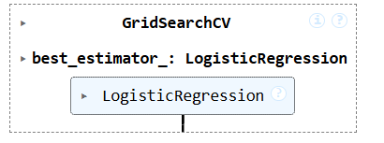
Driver At Fault Prediction
Objective: To predict if a driver is 'At Fault' or 'Not at Fault' based on accident-related features.
Model Used: Logistic Regression was selected as the final model due to its high accuracy and ability to handle complex interactions between features.
Prediction Process: The model takes key features as input, such as:
Collision Type
Weather
Driver Substance Abuse
Injury Severity
Vehicle Damage Extent
at fault or not."

Slide 14
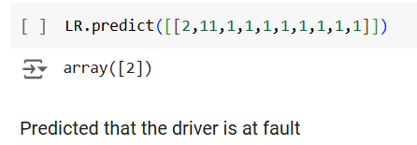
Driver At Fault Prediction
Prediction Accuracy: With tuning, the Logistic Regression model achieved a prediction accuracy of 75%, making it a reliable tool for identifying driver fault in accident scenarios.
Example Prediction: For an accident with adverse weather, high injury severity, and substance abuse by the driver, the model would likely predict 'At Fault'.

Slide 15
User Input Interface (Streamlit)
Purpose of Interface: Interactive interface where users select accident conditions to predict fault likelihood.
Inputs:
ACRS Report Type, Collision Type, Weather, Surface Condition, Light Condition, Injury Severity, Speed Limit, Driver Substance Abuse, Vehicle Body Type, Driver At Fault

Slide 16
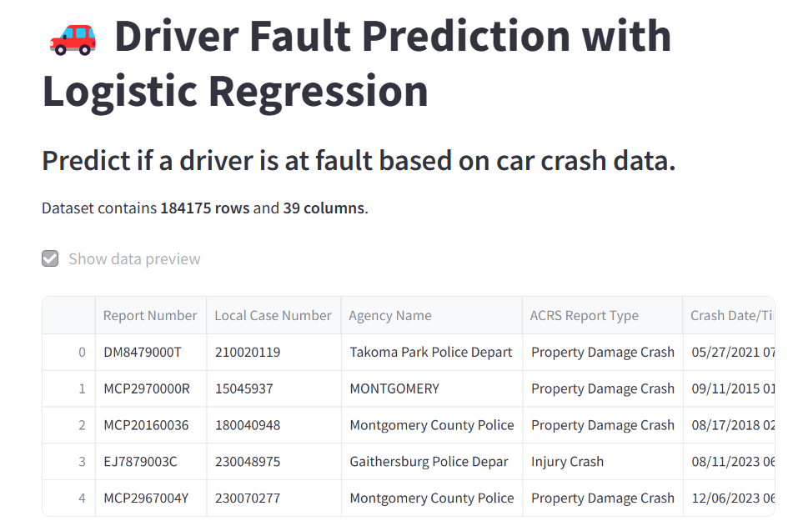

Slide 17
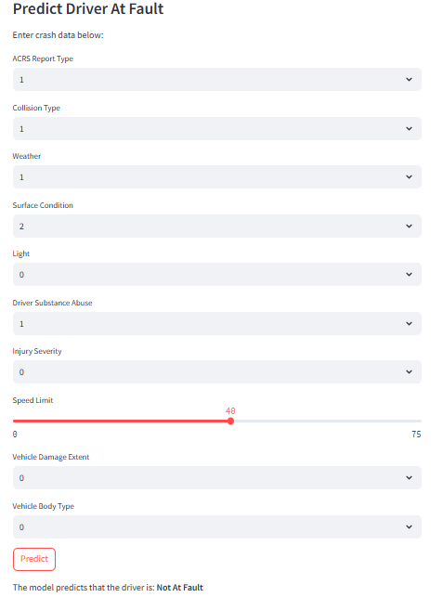

Slide 18
Conclusion
Key Findings:
Collision type, injury severity, and light conditions significantly impact driver fault predictions.
Logistic Regression model achieved the highest accuracy.
The project successfully predicts driver fault in car crashes, highlighting critical risk factors such as substance abuse and collision type
Limitations:
Limited to available variables; results may improve with additional data sources
Future Work:
Explore other models and incorporate real-time data (e.g., traffic flow, weather updates).

Slide 19
THANK YOU!

