Slide 1
GYM MANAGEMENT SYSTEM
Presented by:
Id here

Slide 2
GYM MANAGEMENT SYSTEM
Admin can add and edit instructors and members details and can able to see the details of all the applied members with specific workout plan and instructor.
Instructors create the workout plan with plan name, details and price.
Instructors can able to make changes to the existing workout plan whenever they need through the portal.
Members will register first in order to access the workout plans and select a particular plan with the instructor and applies for that workout plan.

Slide 3
Technologies:
Python(flask framework)
Html, CSS
MongoDB
IDE:
Visual Studio Code

Slide 4
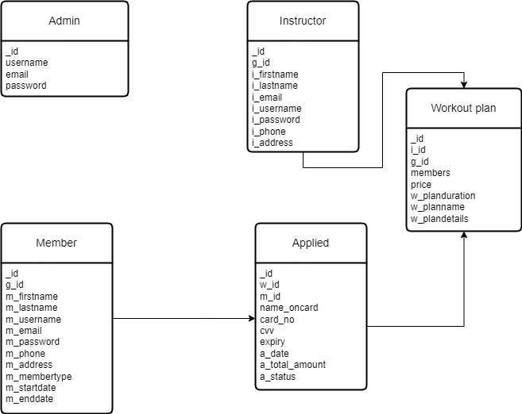
ER Diagram:

Slide 5
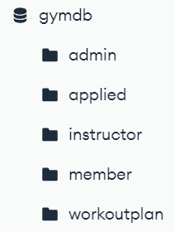
Collections

Slide 6
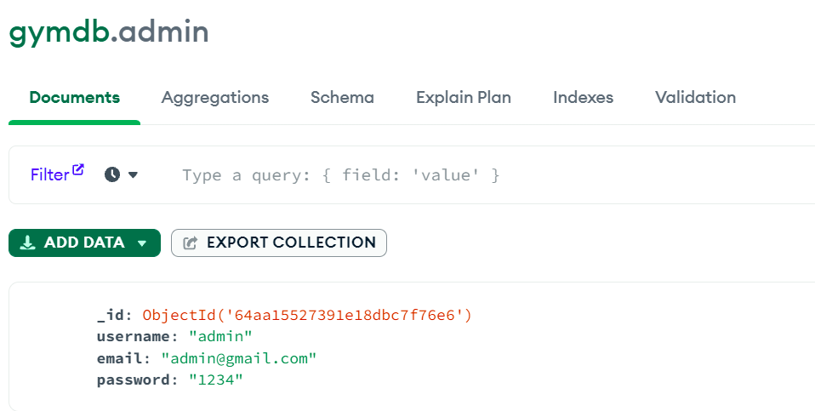
Admin

Slide 7
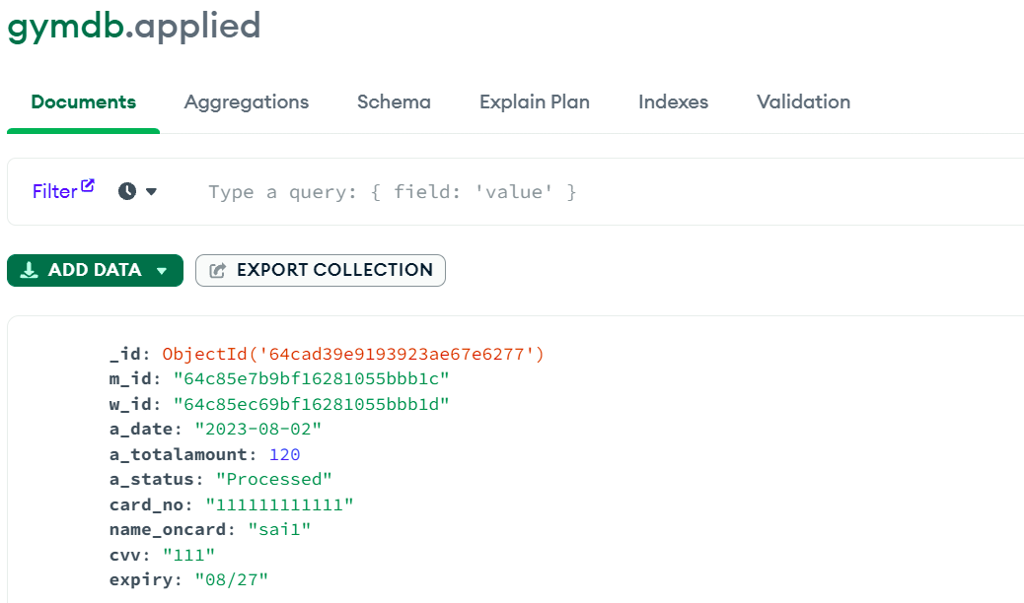
Applied

Slide 8
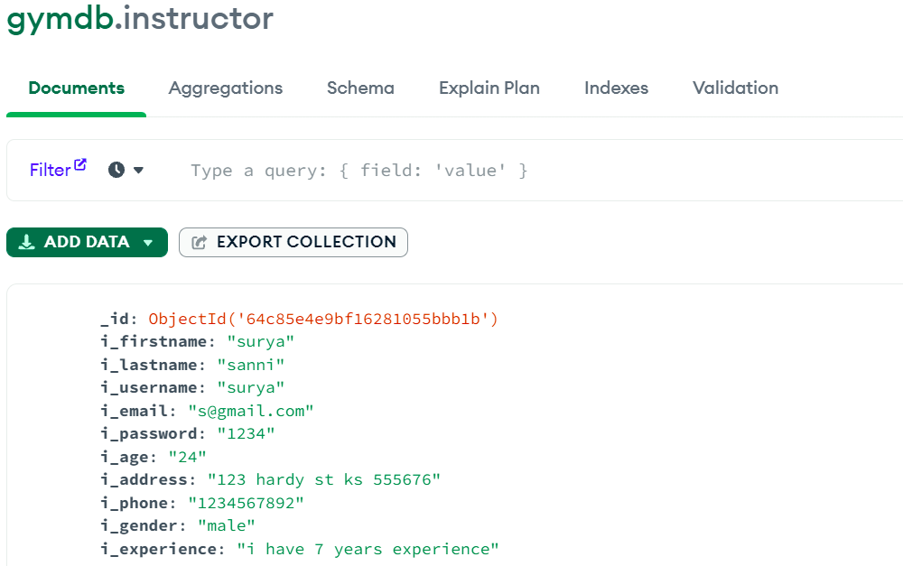
Instructor

Slide 9
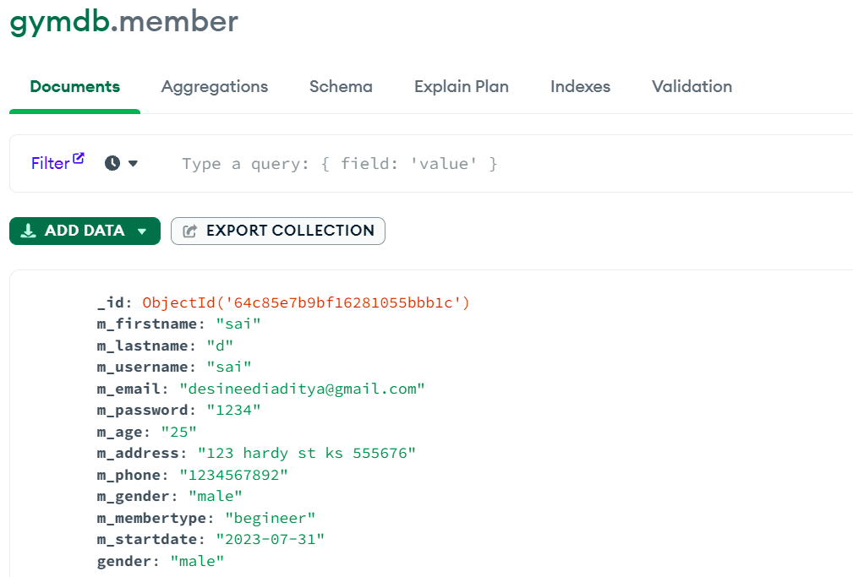
Member

Slide 10
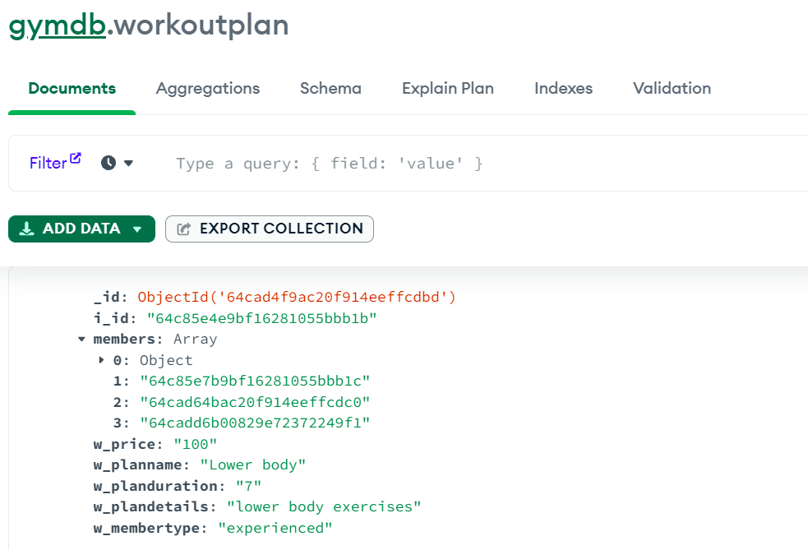
Workoutplan

Slide 11
Ready for Demo ?

Slide 12


