Slide 1

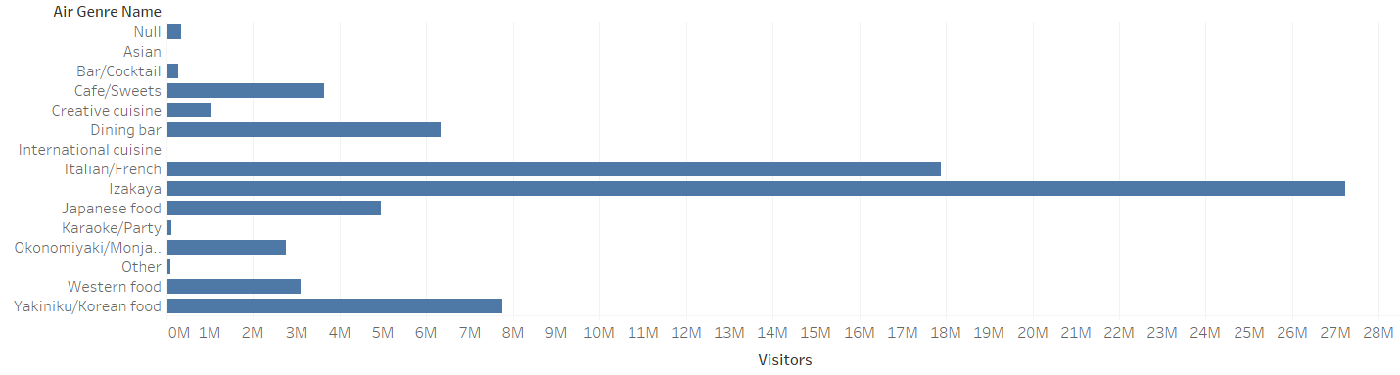
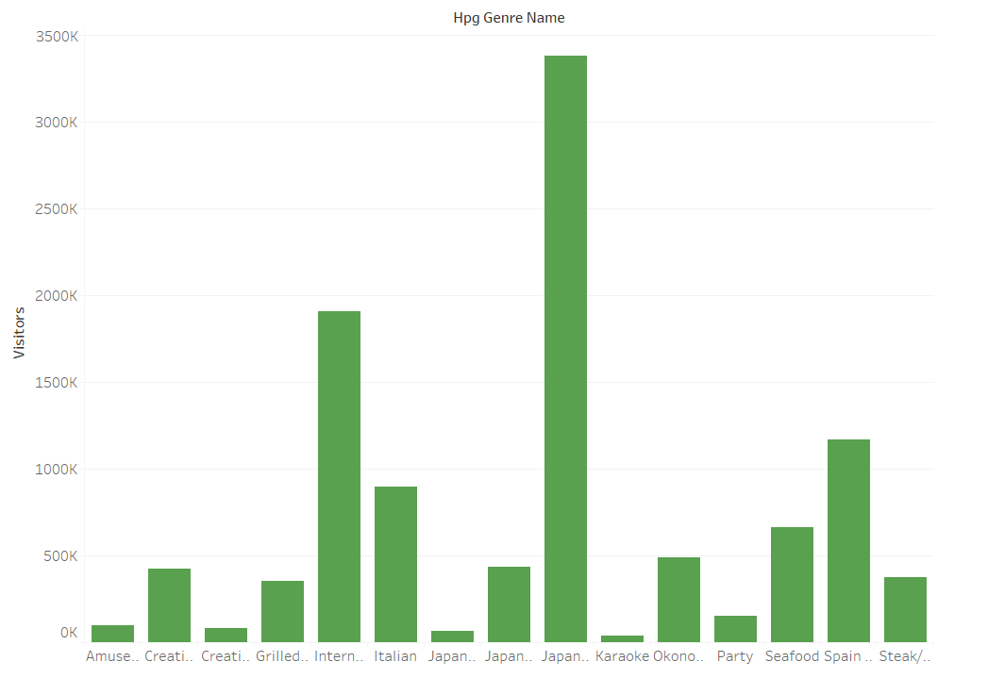
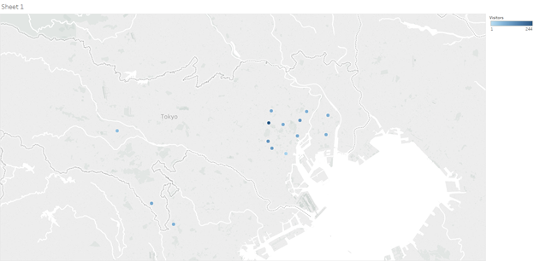
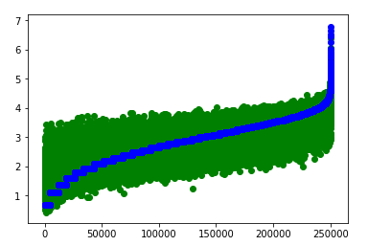
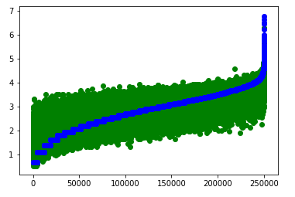
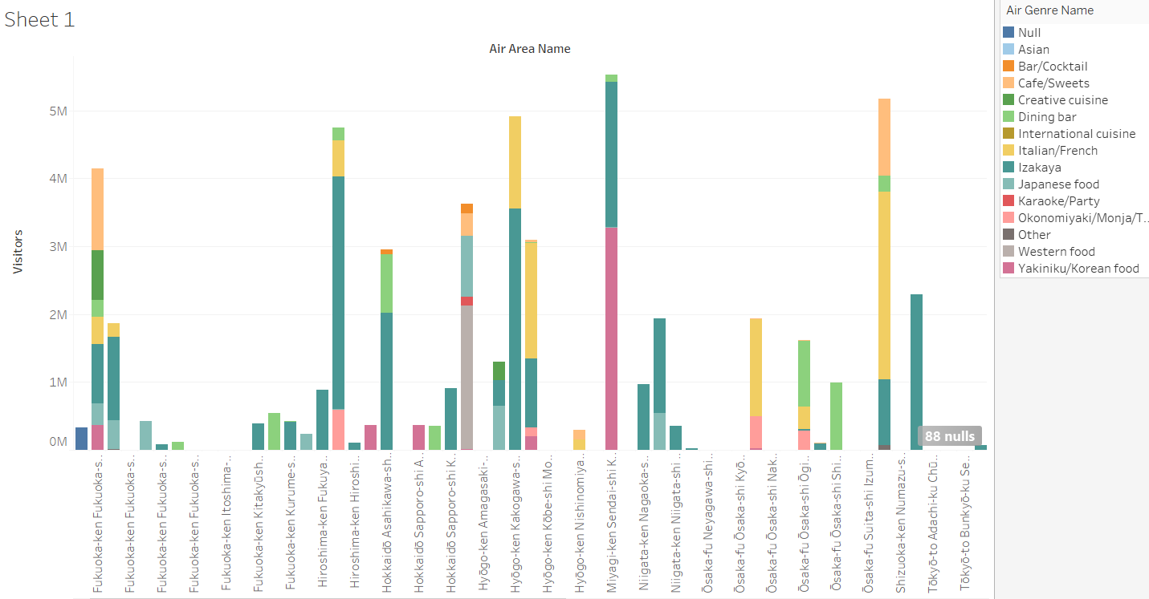
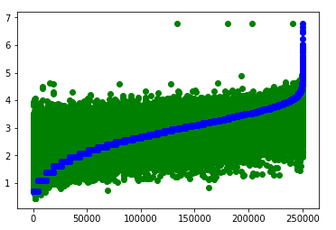
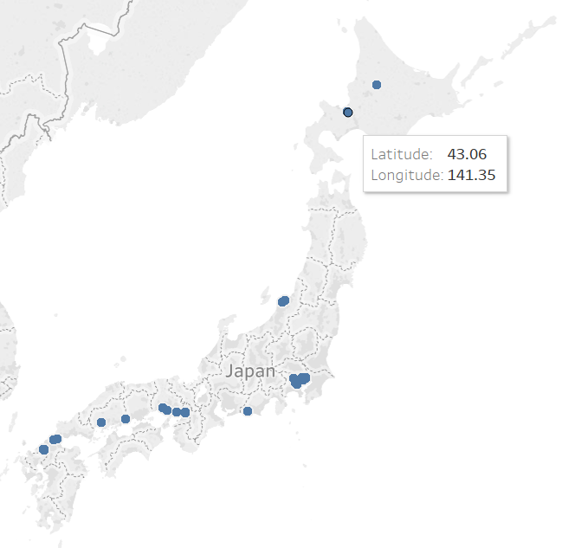
RESTAURANT VISITOR FORECASTING DATA ANALYTICS USING DATA MINING TECHNIQUES
Divya Samragni Nadakuditi
Department of Computer Science and Engineering
University of Bridgeport, Bridgeport, CT
Abstract
Data Visualization of Predicted visitors
With the enormous amount of increase in Data, there is a need for analysis of data and to know more information about it. This leads to a scope of Data Analytics and Data Mining Techniques.
In this project, we selected Restaurant Visitor Forecasting data to predict the number of visitors in future dates using Data Mining Techniques
Which is the most visited Cusine for visitors reserved using AirREGI site.
Which is the most visited Cusine for visitors reserved using Hot Pepper Gourmet site.
Introduction
Data Set provides the historical reservations, historical visitors, restaurant information
Problem: To predict the number of visitors in Future Dates
Methodology: Gradient Boosting Regressor, XBGRegressor, Neural Networks.
Performance Measure: Using Root Mean Square Error(RMSE)
Location of Restaurants with respect to Number of Visitors.
Performance Of Chosen Models
Below is the Comparison of Actual and Predicted visitors for all the 3 models.
Gradient Boosting : XBGRegressor:
RMSE- 0.3635 RMSE-0.3502
Which is the most visited Cuisine based on areas & visitors reserved using Hot Pepper Gourmet site.
Neural Networks:
RMSE- 0.4861
Restaurants Available Locations
The XGBRegressor has the least Root Mean Square Error.
Conclusion
We have predicted future number of visitors and analyzed the data using XGBRegressor and compared it with other models.
CPSC 552 – Data Mining

