Slide 1

SHRI VISHNU ENGINEERING COLLEGE FOR WOMEN (Autonomous) :: Bhimavaram Department of Computer Science and Engineering
Date : 02-07-2021
SUPPORT HUB
PROJECT GUIDE:
Mr. P.Sunil
Assistant Professor
PROJECT MEMBERS: N .Shanthi sri(17B01A05C1)
N.Kavya sri(17B01A05A9)
M.Divya sarada(17B01A0596)
N.Anupama rani(17B01A05A7)

Slide 2
Contents
Proposed system
Problem statement identification
Domain Knowledge
Objectives
Problems in existing system
Feasibility study and requirement analysis
Design
Functionalities
Modules
Implementation
Testing

Slide 3
Proposed system
The goal of the project is to provide a medium between students and faculty to raise and clarify their doubts through online portal.
In this project we are going to create a web application which enable students raise their doubts as tickets.
When a student asks a doubt, faculty can address the doubt
Answers will be displayed on the student portal

Slide 4
System Design Improvements
We implemented a two-step verification in the first step, a mail is sent to the user to check whether the given mail id is valid or not. In the second step, admin takes the role for validating and allowing users who belong to the college only.
When more than one faculty answers the question, then they are appended on student's page, with the name of the faculty.
We also maintain the list of number of questions asked by each student and number of questions answered by each faculty in admin module.

Slide 5
Problem statement Identification
The problem comes when students are interacted manually for asking doubts or raising complaints.
When these are done manually it becomes very difficult to keep a track of all the details under one person.

Slide 6
Domain Knowledge
We are using web development in order to create a portal which helps students to interact with faculty.
To achieve this, with high amount of responsiveness we use the following:
Front end- React js, HTML, CSS, Bootstrap
Back end- Node js, Socket
Database- MongoDB
Hoisting- Github, Heroku

Slide 7

Objectives
The main objective of the proposed system is to provide Interaction between faculty and students
To provide compatibility
It is a real time application

Slide 8

Problems in existing system
Manual working.
Involves risk due to the increment in chances of errors.
Takes lots of time and labor.
Not feasible to handle too many students at one time.

Slide 9
Feasibility Study and Requirement Analysis
Software requirements
VS code editor
Github
Heroku
MongoDB
Mongoose

Slide 10
Hardware requirements
Processor: I3
Ram:4GB
Hard disk space-512gb

Slide 11
Design
Admin
Accepting all user information
Web Server
Registering all users
Store and retrieval
Authorise Admin
Process all user queries
Database
End user

Slide 12
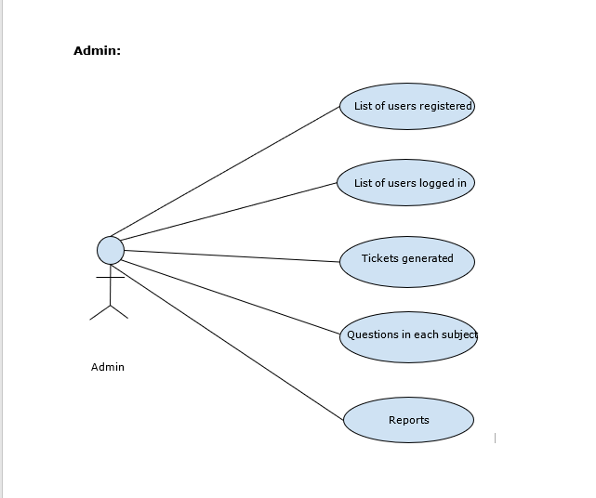

Slide 13
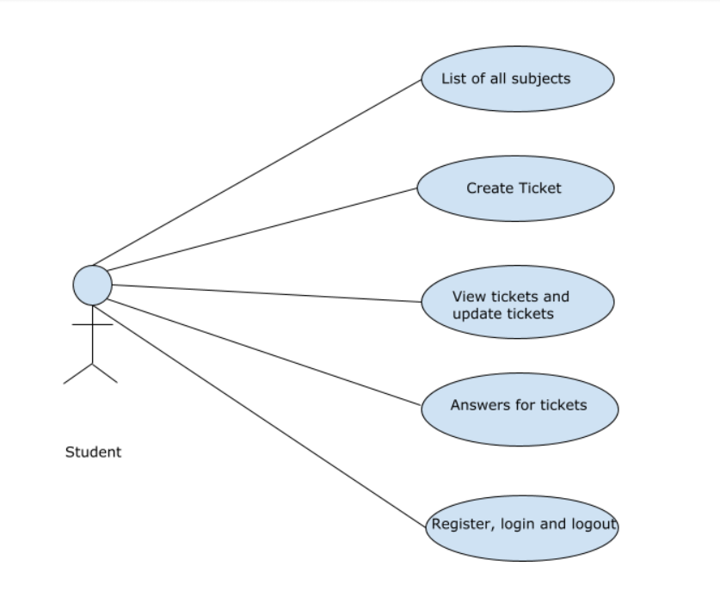

Slide 14
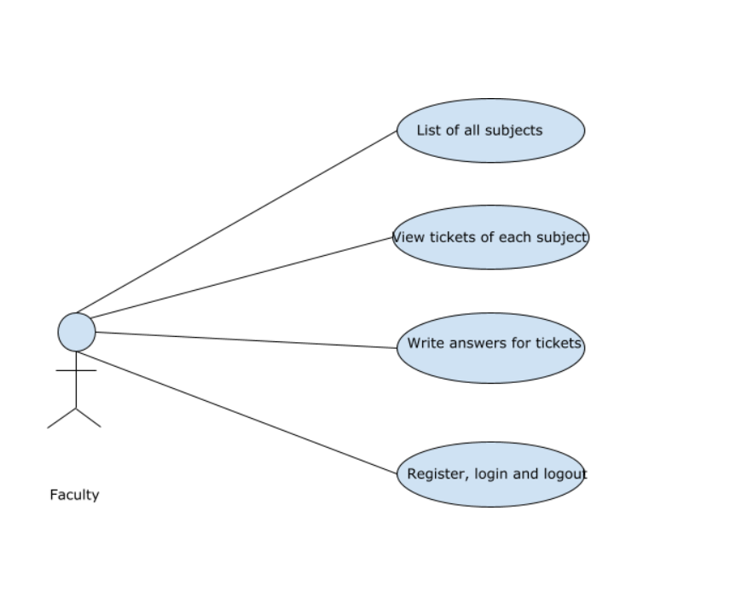

Slide 15
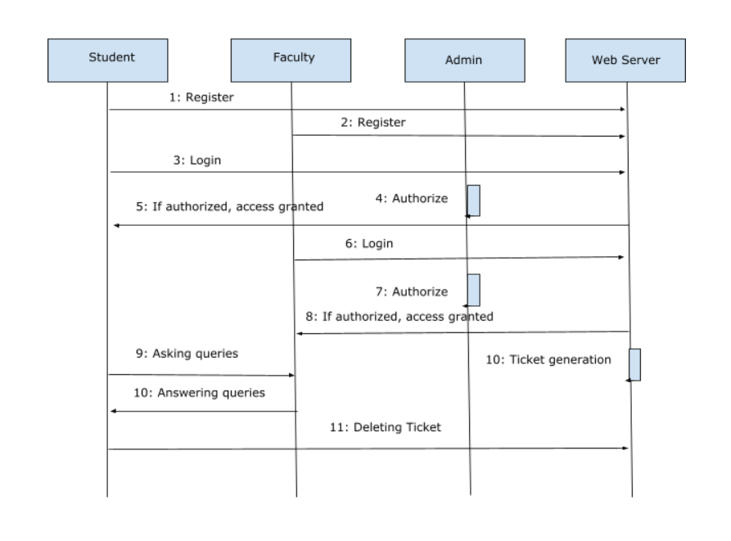

Slide 16
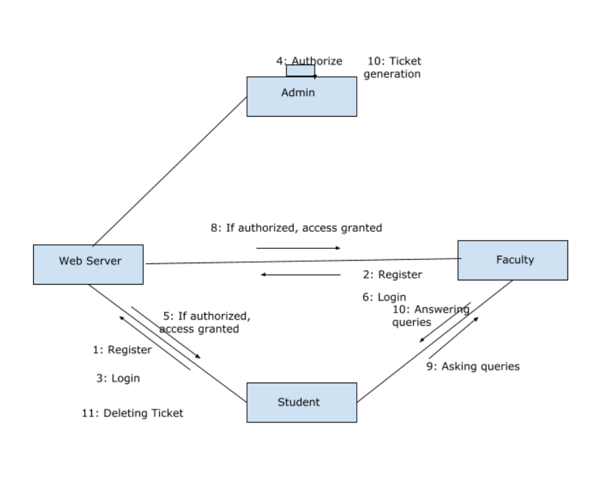

Slide 17
Design alternatives and Comparisions
Generally, structures of the applications are designed by using only Html and java script
By using only Html and java script web applications cannot be single page applications.
In order to achieve this we are using React.
React is component based with which we can achieve reusability.

Slide 18
Functionalities
This system will raise the ticket when the student raise the doubt.
Doubt clarification can be done by faculty
This student deletes the ticket when the doubt is clarified.
This system is designed in such a way where data is updated instantaneously.
This system also provides compatibility.

Slide 19
Student Module
Student module consists of student registration, login in students web portal
Students initially register in the web portal, there after login into the portal. When a student is logged into the portal then his/her data is stored in the database.
Then for each other login, students are granted permission regarding the credentials in the database.

Slide 20
Student Module
Student module consists of student registration, login in students web Student portal consists of the details where ticket creation and tickets generated are shown. Apart from that, students are also provided with a dropdown where all the related subjects are displayed.
Students need to pick the subject in which he/she has a doubt. After doubt is clarified then the student also has the option of deleting the ticket generated.

Slide 21
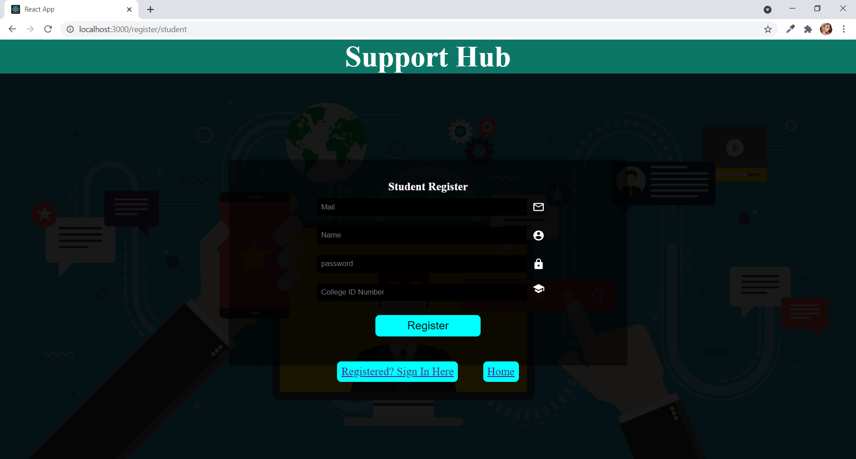

Slide 22
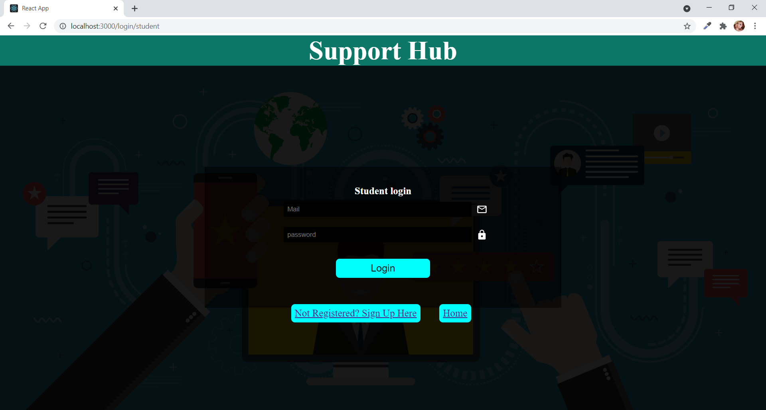

Slide 23
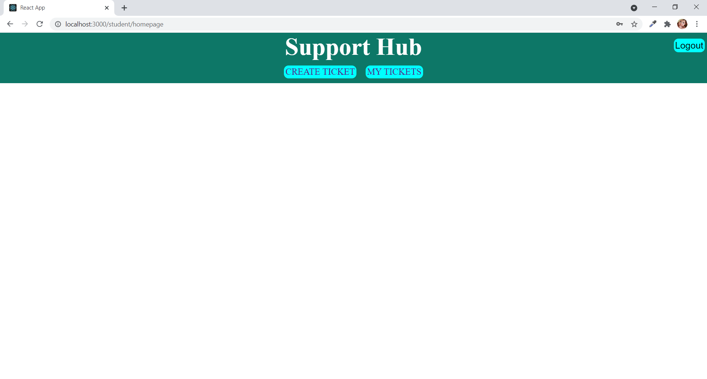

Slide 24
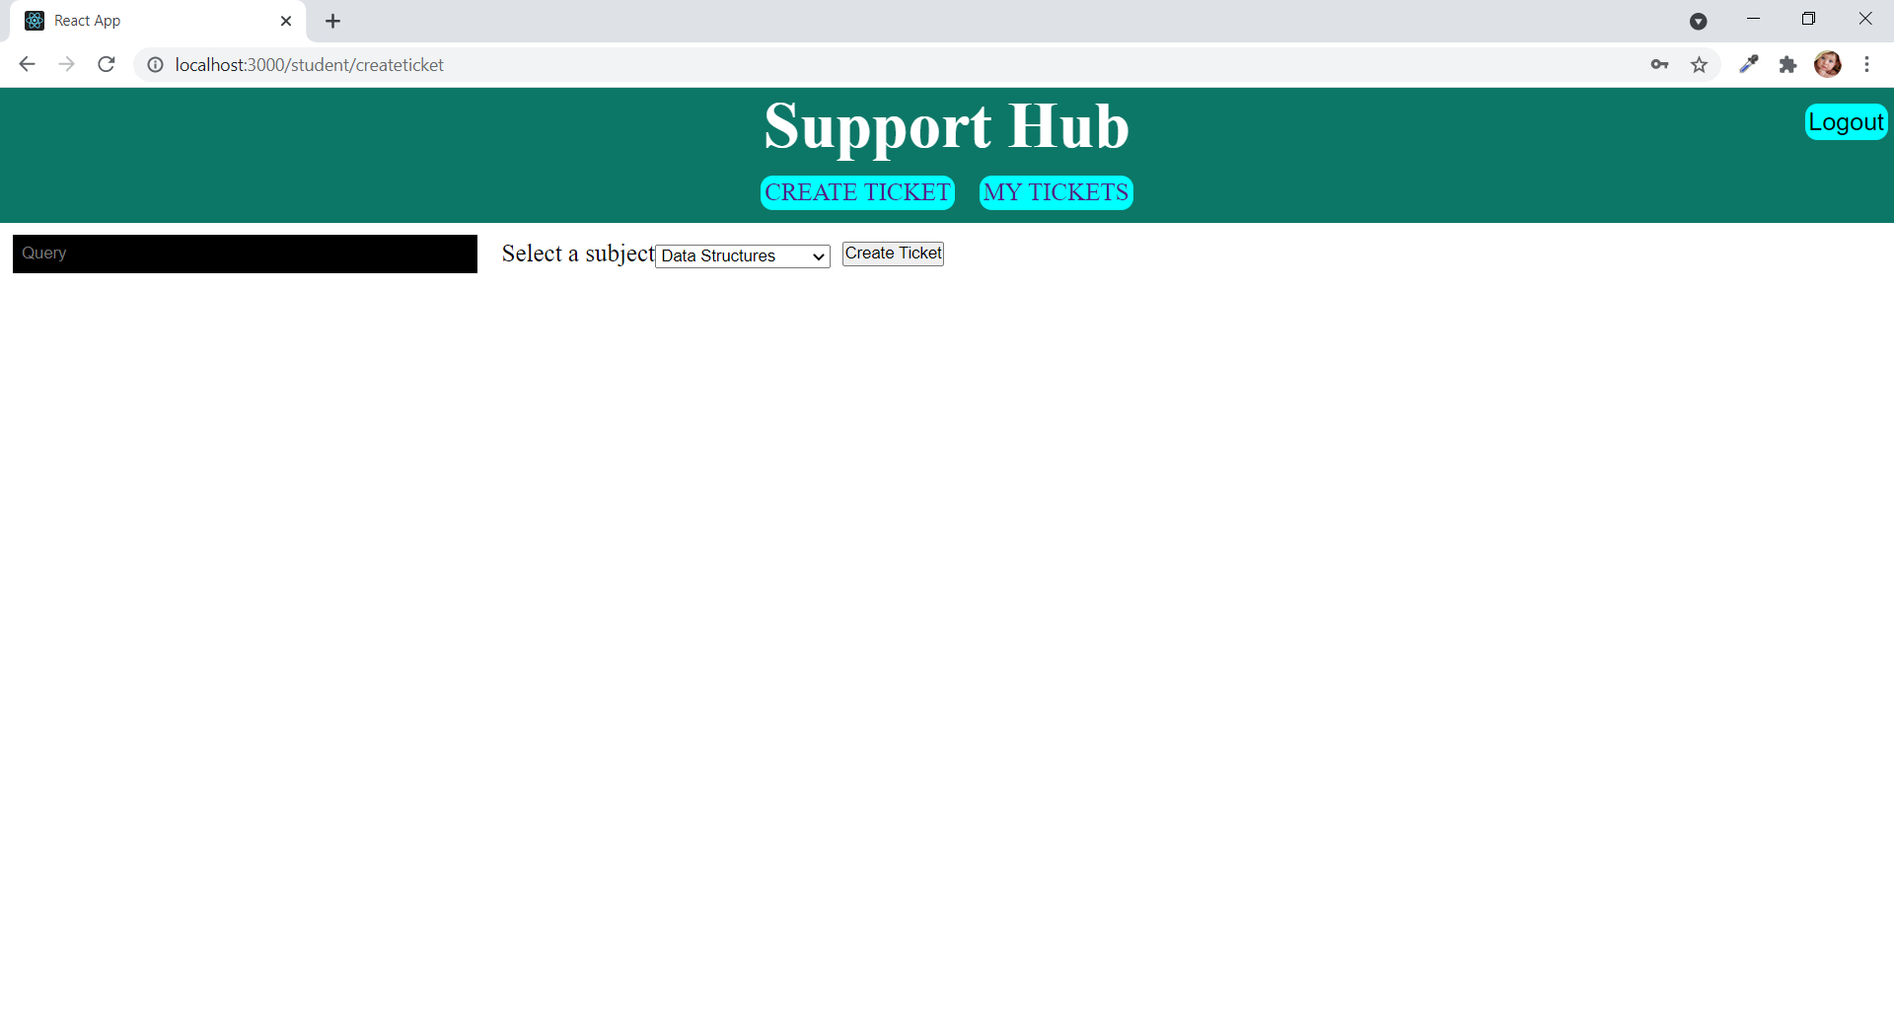

Slide 25
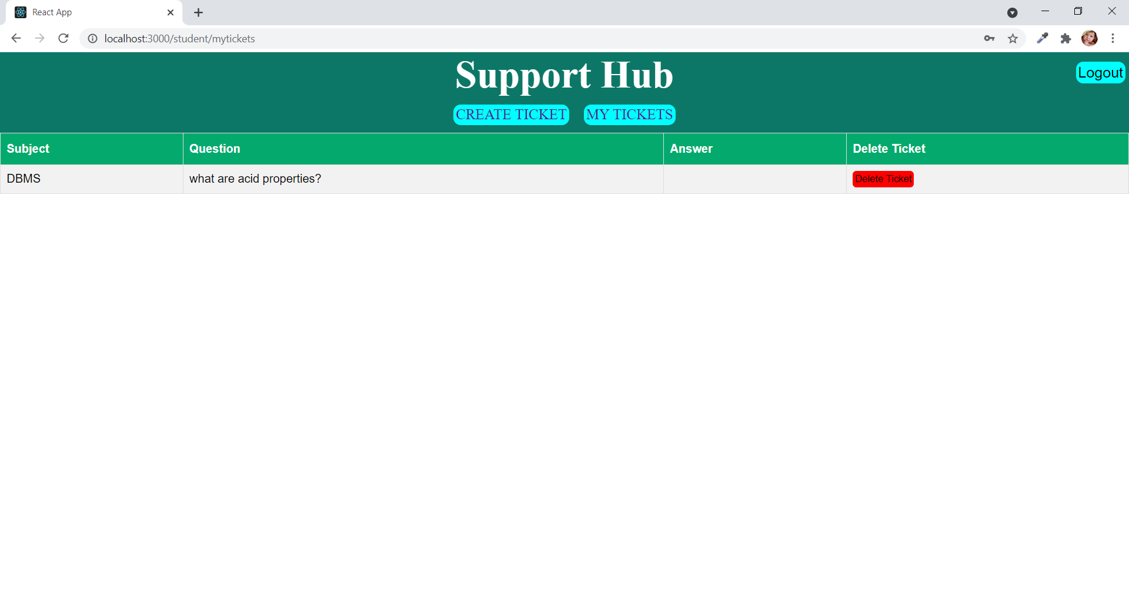

Slide 26
Faculty Module
Faculty also follows the same authentication procedure as that of the students.
The only difference will be the tickets.
Faculty are provided the subjects in which they want to solve the doubts, then can choose any of them.
Then doubts generated related to that subject are displayed on the faculty portal.
Faculty can address the doubts of the students by typing their answer in the text field.

Slide 27
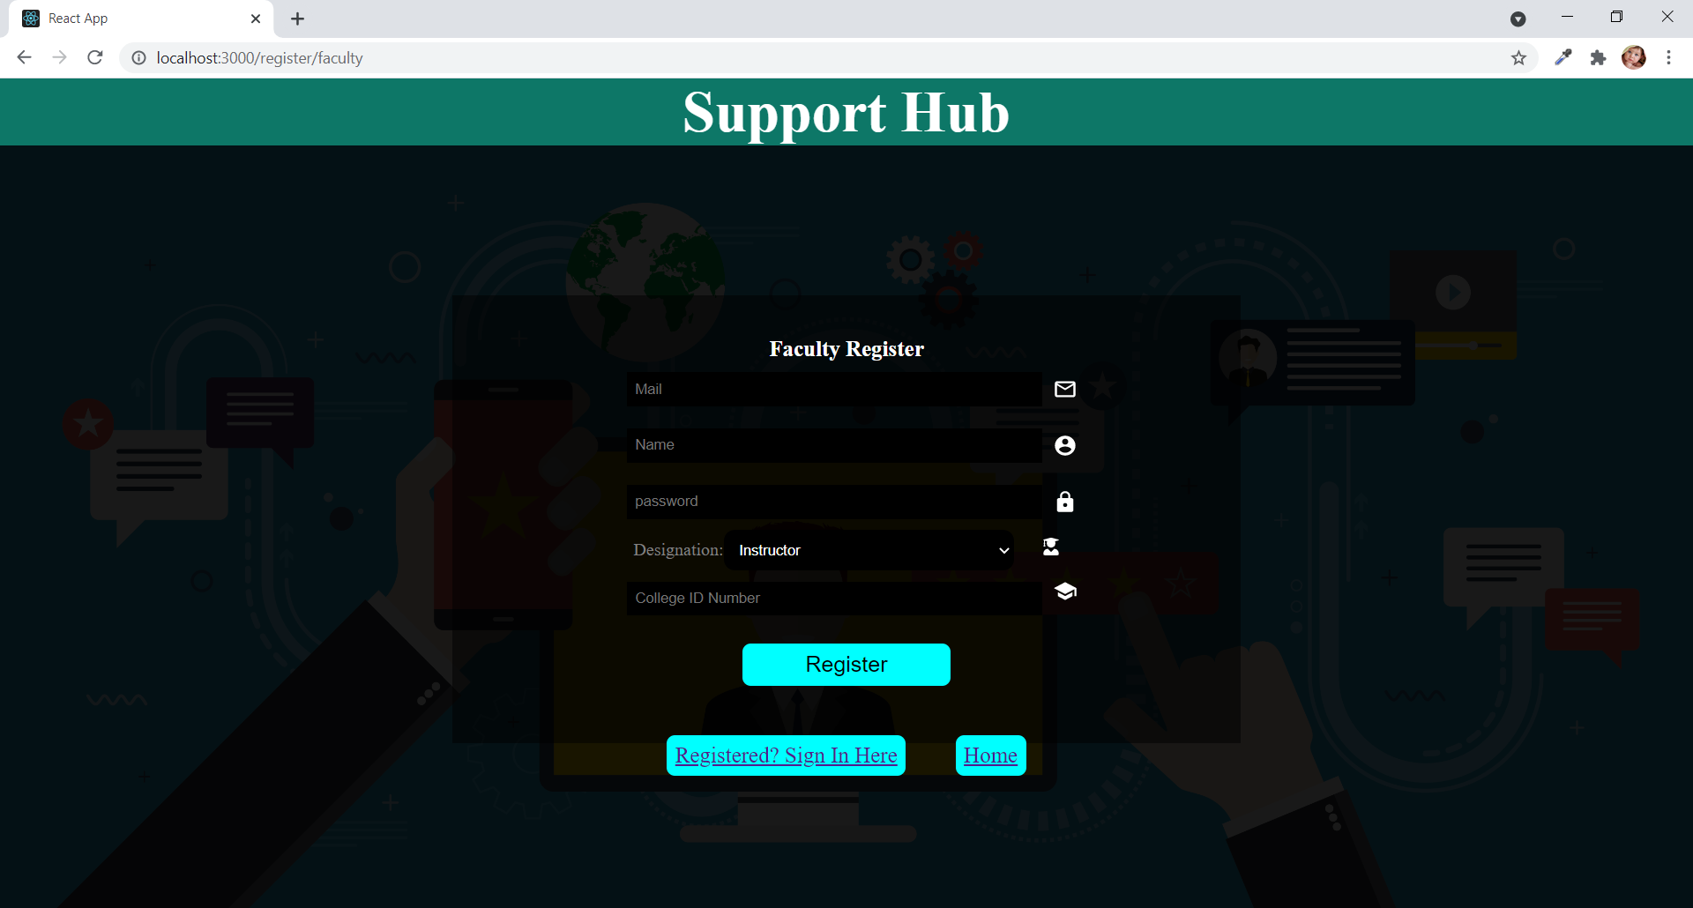

Slide 28
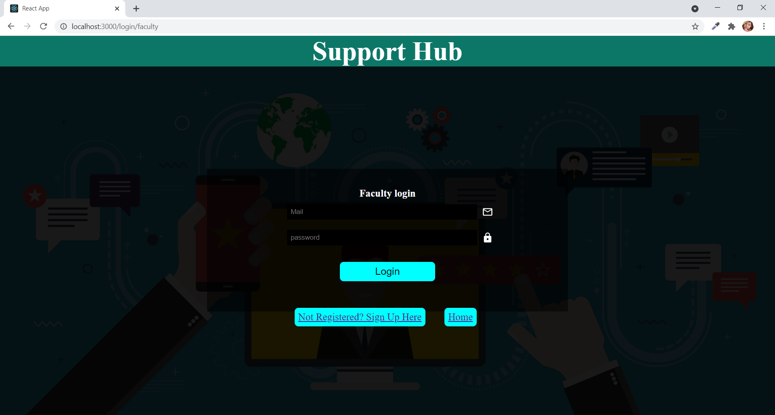

Slide 29
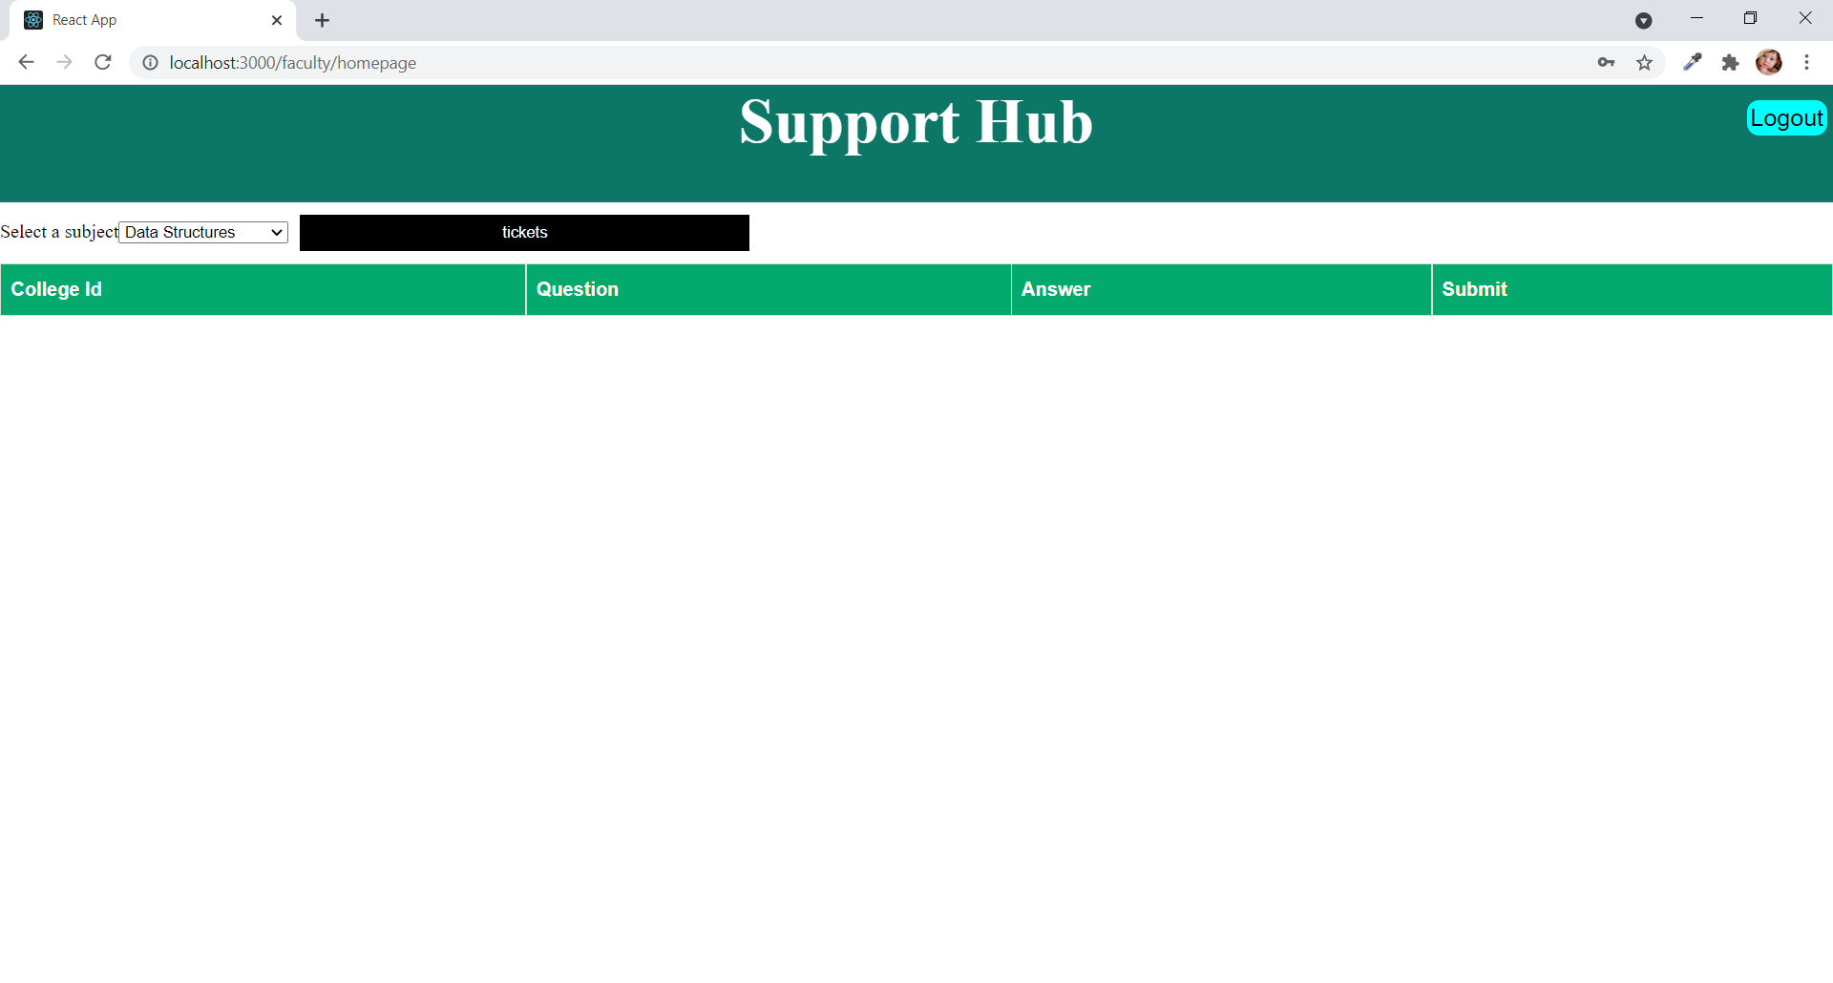

Slide 30
Admin Module
Admin module consists of admin login which consists of username and password. Admin has the right of validating the users who are registered. Since we are taking two-step verification, the second step takes place at the admin module.
In this module admin has the right to approve or deny the users registered in the website. Admin also consists of the actions performed in websites like - questions asked by each student, answers given by each faculty etc.

Slide 31
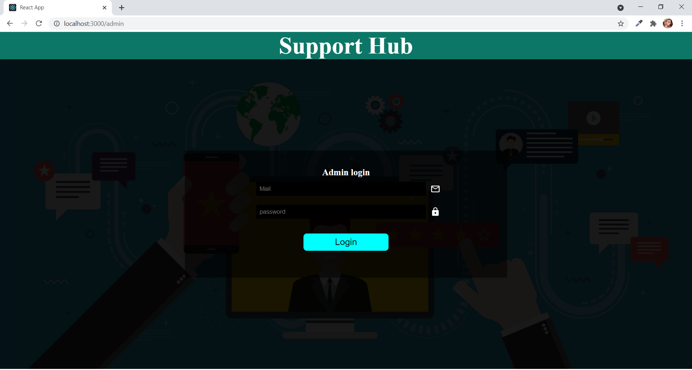

Slide 32
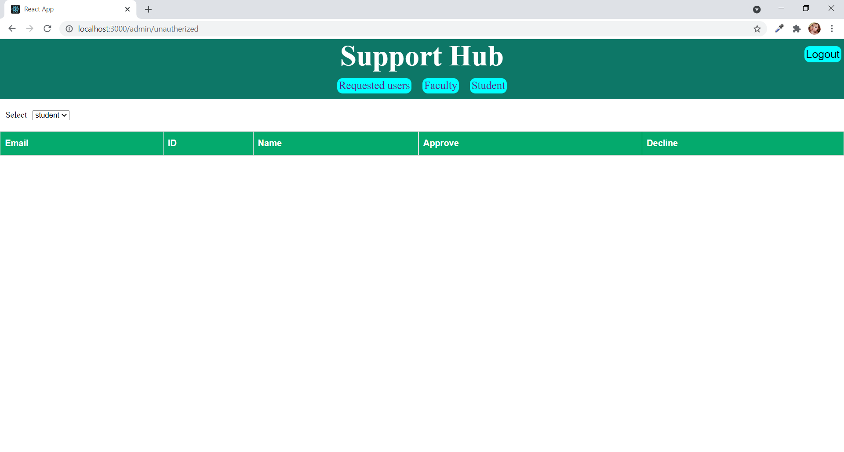

Slide 33
Implementation

Slide 36
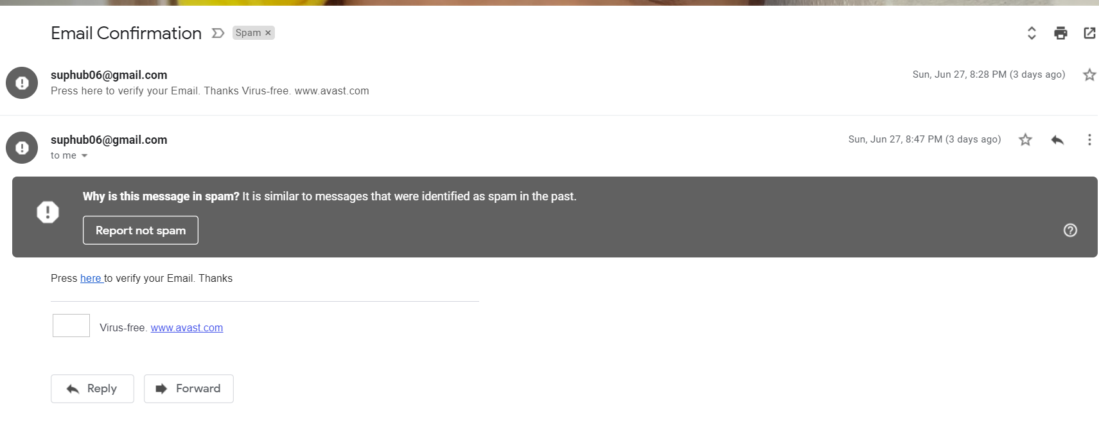
Testing

Slide 37
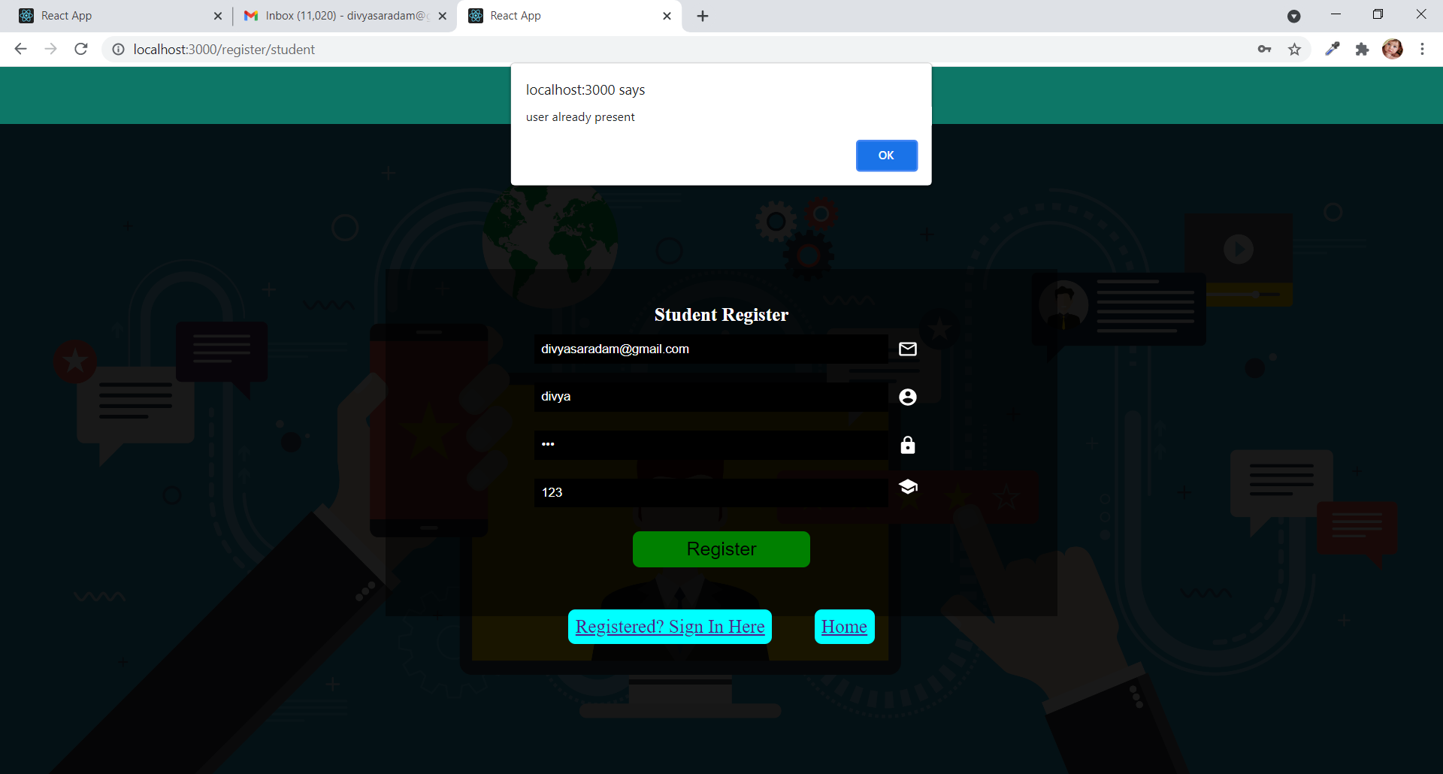

Slide 38
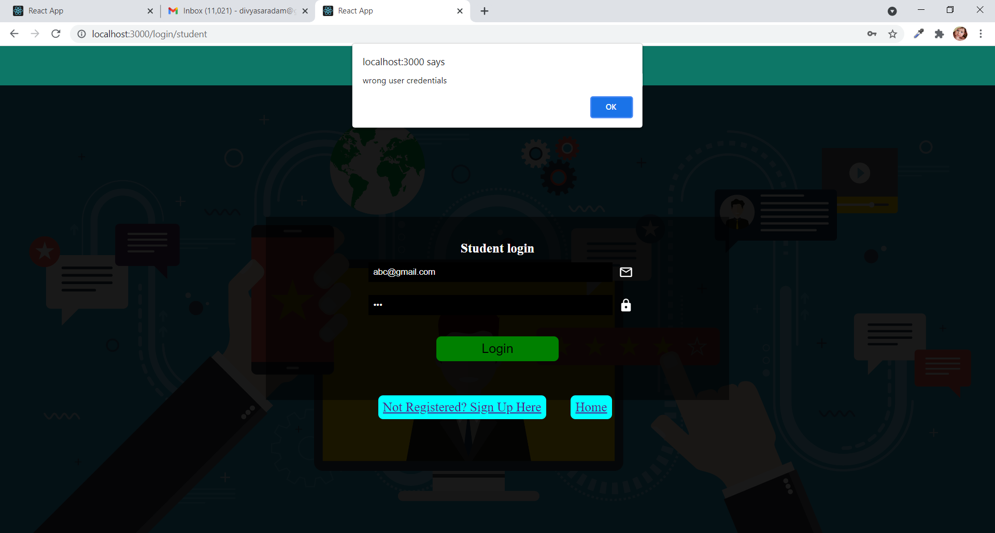

Slide 39
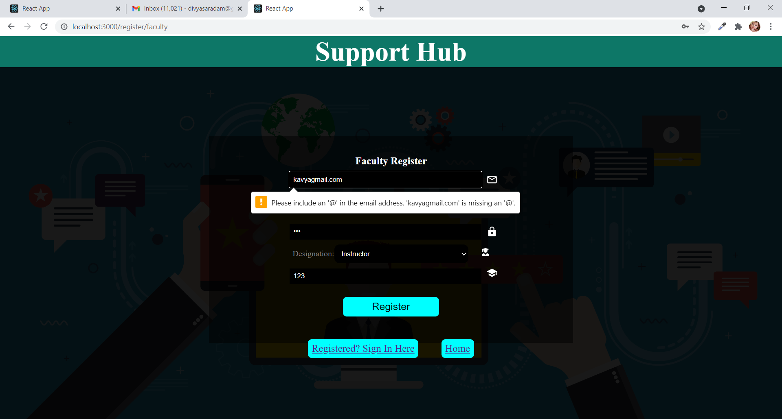

Slide 40


Slide 41
Future scope
The main aim of this project is to solve doubts of the students
The future scope is since this is a real time project and we want to implement this in our college, which will make it very useful and handy.

Slide 42
Results..

Slide 43
THANK YOU

