Slide 1


Consumer Goods Analysis

Slide 2

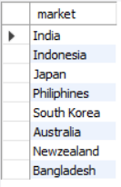

Request 1: Provide the list of markets in which customer "AtliQ Exclusive" operates its business in the APAC region.
Insight –
AtliQ Exclusive operates in eight countries within the APAC region, demonstrating a significant regional market presence

Slide 3
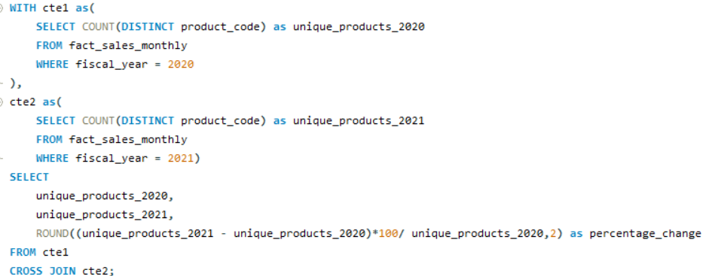

Request 2: What is the percentage of unique product increase in 2021 vs. 2020?
Insight –
1. The number of unique products grew from 245 in 2020 to 334 in 2021, marking a 36.33% increase.
2. This significant increase highlights the company's commitment to innovation & diverse customer needs.

Slide 4
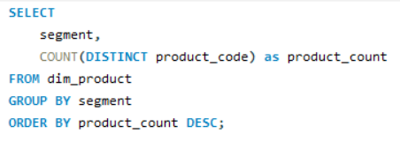
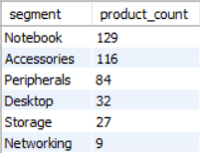
Request 3: Provide a report with all the unique product counts for each segment and sort them in descending order of product counts.
Insight –
1. AtliQ shines in Notebooks, Accessories, and Peripherals segment, accounting for a whopping 82.87% of product variety.
2. Desktops, Storage, and Networking currently hold a minor share (17.13%) of AtliQ’s product portfolio.
3. In Desktops, Storage, and Networking segment AtliQ should focus on products, current customer trends and industry demands,

Slide 5
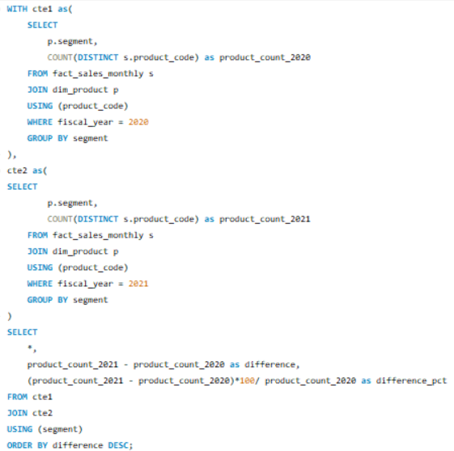
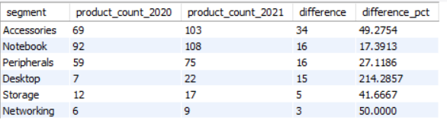
Request 4: Which segment had the most increase in unique products in 2021 vs 2020?
Insights:
1. Accessories have the most increased products from 2020 to 2021, with an increase of 34 new products.
2. Desktop products production increased drastically by approximately 214%
3. Storage and Networking segments are producing the least new products from 2021 to 2020.

Slide 6
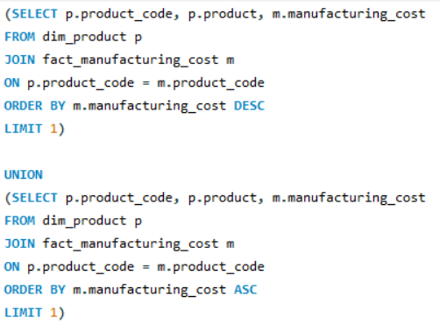

Request 5: Get the products that have the highest and lowest manufacturing costs.

Slide 7
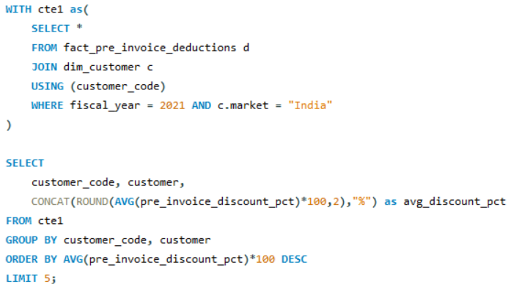
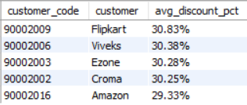
Request 6: Generate a report which contains the top 5 customers who received an average high pre_invoice_discount_pct for the fiscal year 2021 and in the Indian market.
Insights:
1. Flipkart leads the list with the highest average discount percentage at 30.83%.
2. AtliQ has provided relatively uniform discount percentages to its top 5 customer range of discounts

Slide 8
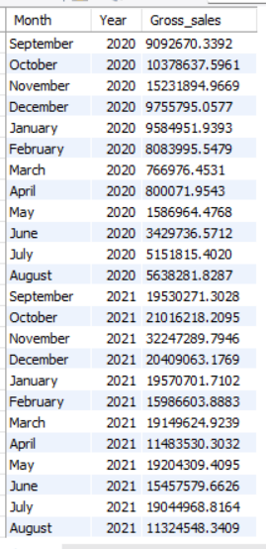
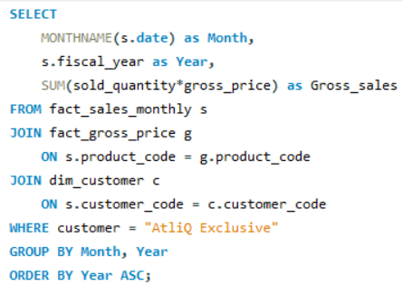
Request 7: Get the complete report of the Gross sales amount for the customer “Atliq Exclusive” for each month
Insights:
1. March, April, May recorded the lowest sales in 2020, likely due to the COVID-19 pandemic. Sales began to recover after June 2020.
2. generated the highest sales for 2020, with around 15.23 million.
3. Sales figures in 2021 show significant growth compared to 2020.

Slide 9
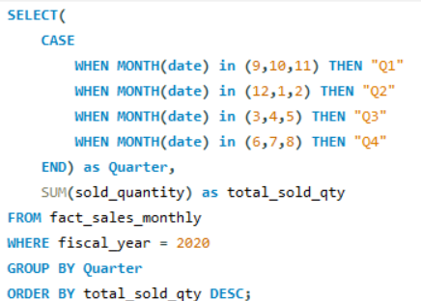
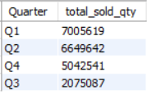
Request 8: In which quarter of 2020, got the maximum total_sold_quantity?
Insights:
1. Q1 (2020) saw the highest sales volume, reaching around 7 million units, indicating strong performance early in the year.
2. AtliQ experienced a significant decline in sales during Q3 (March, April, May) the COVID 19 pandemic, reflecting challenging market conditions and shifting preferences

Slide 10
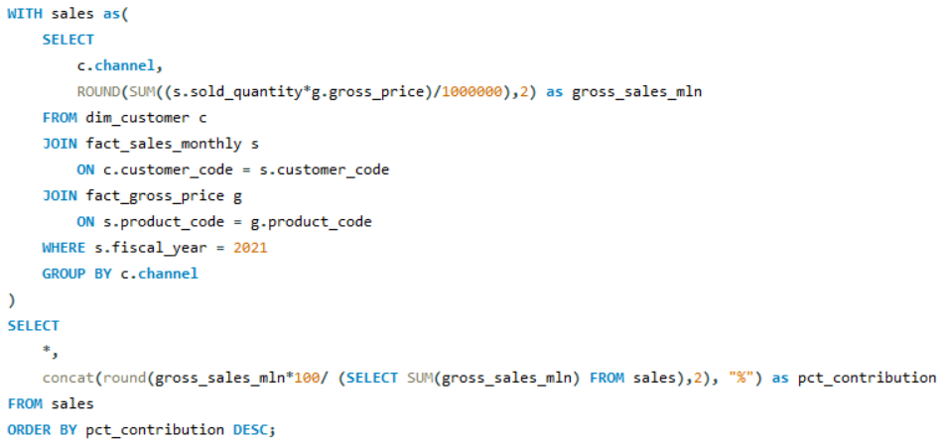

Request 9: Which channel helped to bring more gross sales in the fiscal year 2021 and the percentage of contribution?
Insights:
1. The majority of AtliQ's sales come from retailers, accounting for a substantial 73.22% of the total gross sales.
2. Direct and distributor channel together contributes only 26.79% of the total gross sales.

Slide 11
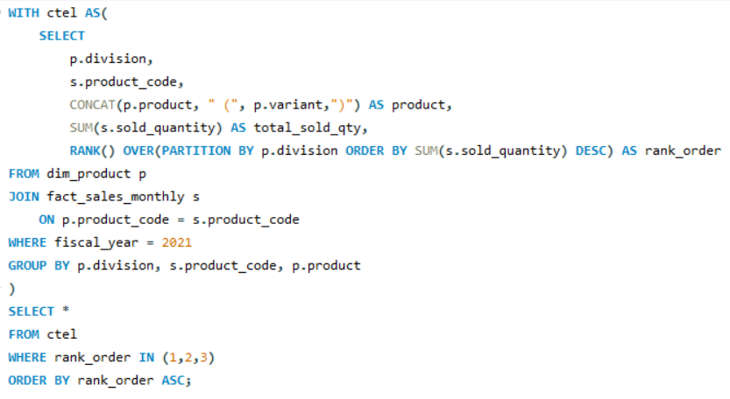
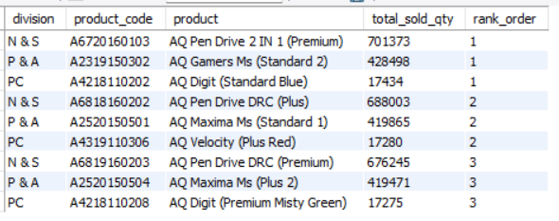
Request 10: Get the Top 3 products in each division that have a high total_sold_quantity in the fiscal_year 2021?
Insights:
1. In the N & S division, pen drives dominate the top three spots, showcasing their popularity and high sales performance.
2. The P & A division's top three products are exclusively mouse
3. The PC division's bestsellers are all personal laptops.

Slide 12
Recommendations
Focus on desktops, Storage, and Networking segment
Emphasizes multi-channel marketing
Combine pricing strategies with attractive promotions.
Continuously improve based on customer feedback.
Invest in sales team training for improved performance

Slide 13
THANK YOU

