Slide 1
Predicting Movie Revenue and Strategic Clustering for Marketing and Content Optimization
---Harnessing data-driven insights to decode what makes a film successful
Divya Sree Kuntamalla

Slide 2
INTRODUCTION
Attention-Grabbing Statistic
The global movie industry generated over $40 billion in box office revenue in 2022.
Streaming platforms now account for over 60% of global movie consumption.
Why Predicting Movie Success Matter?
Predicting movie revenue helps studios allocate resources effectively and reduce risks.
Optimizing marketing strategies ensures that campaigns target the right audiences, improving audience engagement and profitability.
Who it Benefits?
Film Makers & Studios
Marketers & Distributors
Streaming Platforms
Audiences

Slide 3

Research Goals
Predicting Movie Revenue:
The primary goal is to develop a predictive framework that uses early indicators, such as budget, cast popularity, genre, and audience ratings.
Strategic Clustering for Marketing:
These clusters will help marketers create tailored campaigns, distributors implement region-specific strategies, and streaming platforms curate content.
Enhancing Audience Engagement:
The project seeks to uncover insights into audience preferences and trends, enabling filmmakers and content creators to develop stories.
Bridging Creativity and Analytics:
The project aims to integrate data-driven insights into creative decision-making processes, ensuring that artistic vision is aligned with market demands.

Slide 4
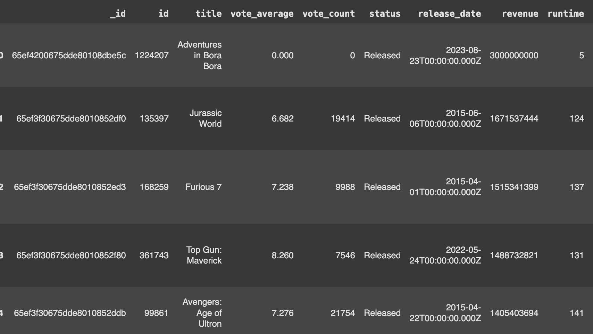
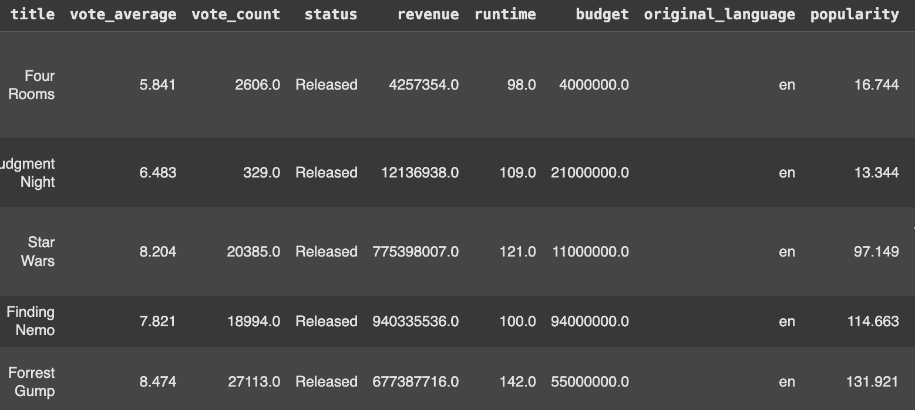
Raw & Cleaned Data
DataSet : RapidAPI
Shape : (110000,24)
Cleaning Methods : Handled missing values, Dropped uneccesary columns, Removed outliers
CLEANED DATASET
Shape : (11053, 17)
Columns Like : Vote_average, Budget, Revenue, Popularity….

Slide 5

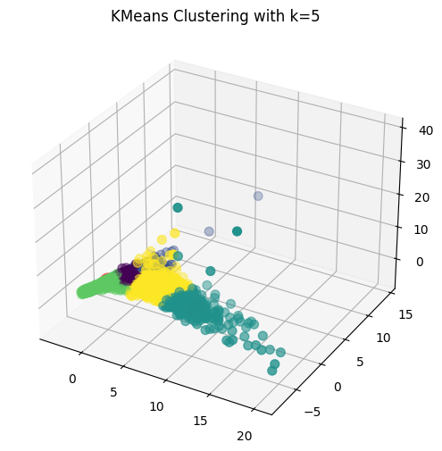
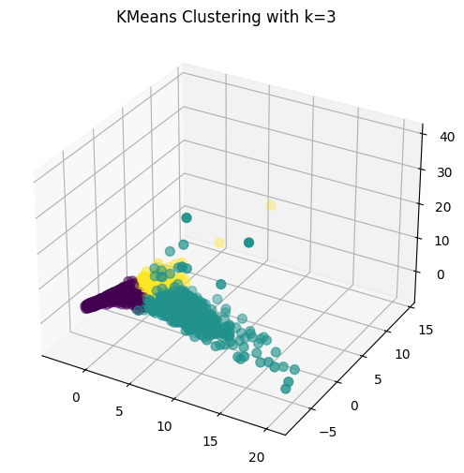
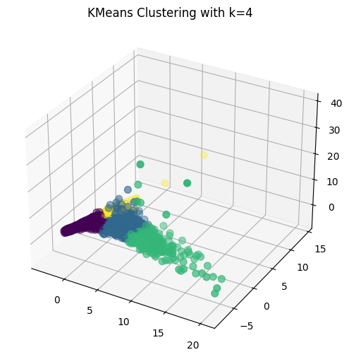
Key Insights from KMeans Clustering
K-Means clustering was used to group movies based on early indicators like budget, popularity, and audience ratings, helping to identify distinct patterns and trends.
For k=3, the clusters revealed one dominant group with two smaller clusters, indicating broad segmentation.
At k=4 and k=5, the clustering became more granular, identifying niche groups such as high-budget blockbusters or unique outliers.
These clusters provide valuable insights for creating targeted marketing strategies and optimizing content to maximize audience engagement and revenue.

Slide 6
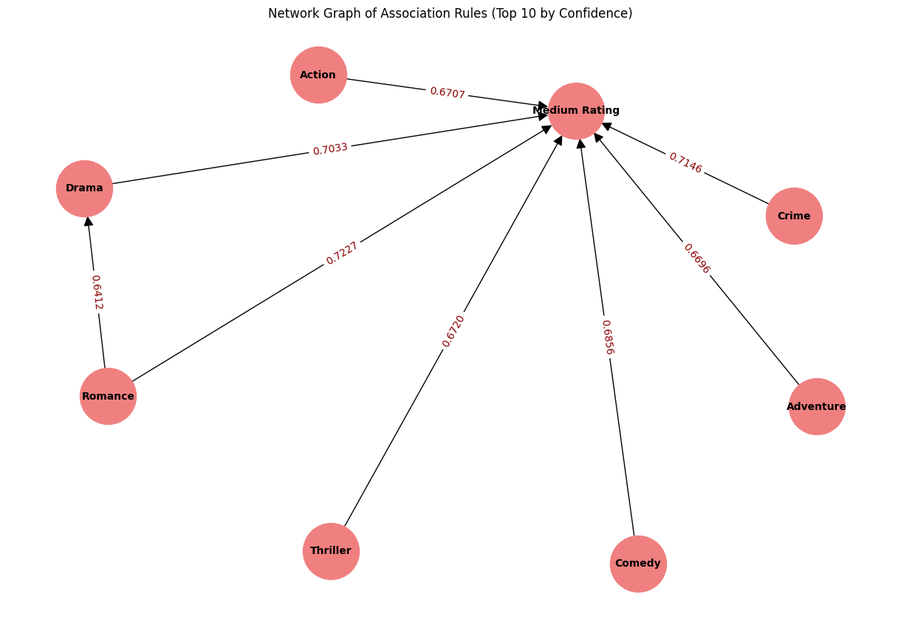
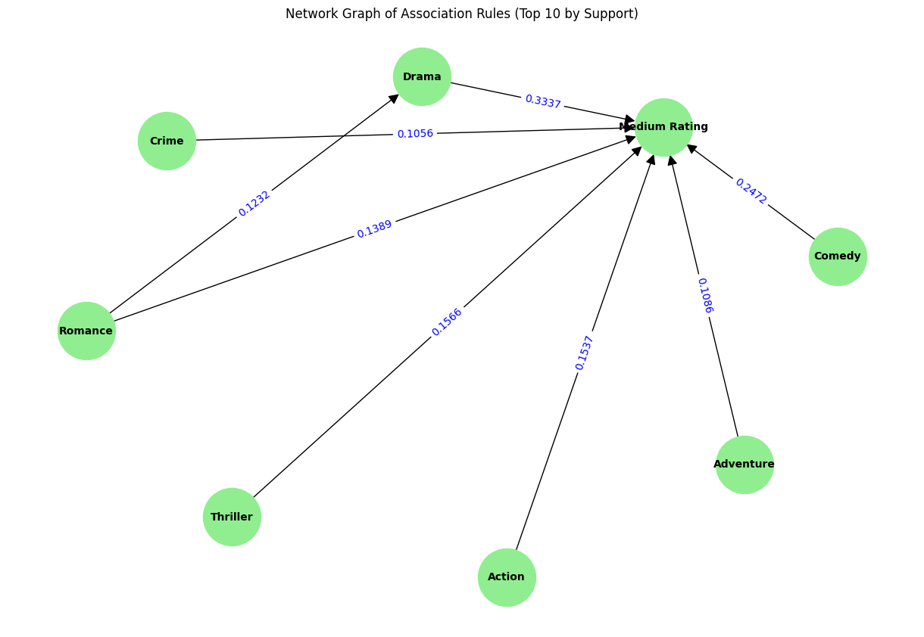
About Association Rule Mining
Drama and Romance genres show strong associations with medium ratings, indicating they consistently appeal to a broad audience.
The high lift value (1.35) for Romance → Drama highlights their frequent overlap, reflecting shared themes that attract similar viewers.
Action and Crime genres show weaker associations with medium ratings, suggesting these genres evoke more extreme audience responses, either highly positive or negative.
These insights can guide marketers and filmmakers in tailoring content and campaigns to meet audience expectations, ensuring better engagement and revenue optimization.

Slide 7
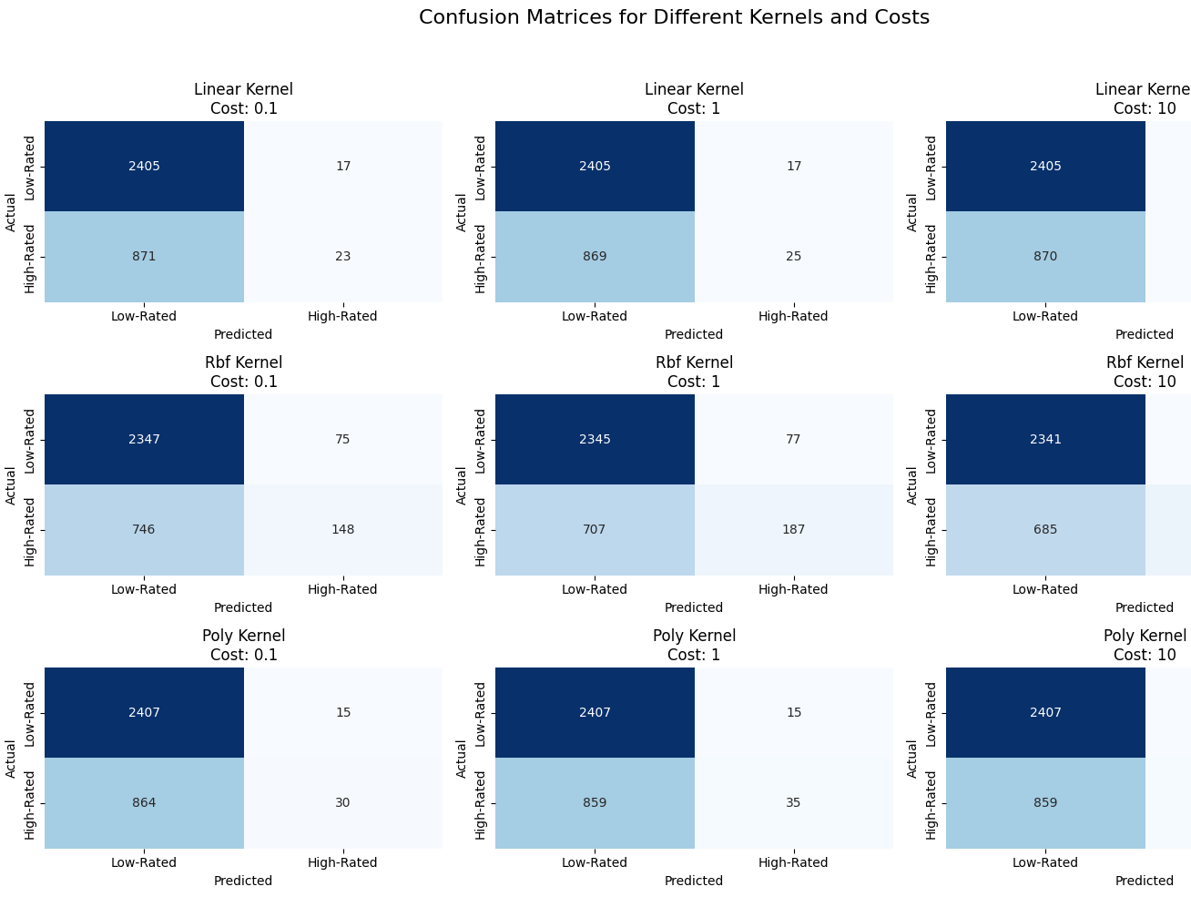
Findings in Support Vector Machine
The Linear kernel, achieved an accuracy of 73%, performing reliably for linearly separable data.
The RBF kernel, at C=10, achieved the highest accuracy of 77%, showcasing its ability to model non-linear relationships.
The Polynomial kernel, with a best cost at C=1, attained an accuracy of 74%.
These accuracies underline the RBF kernel’s advantage in handling the complex patterns in the data.

Slide 8
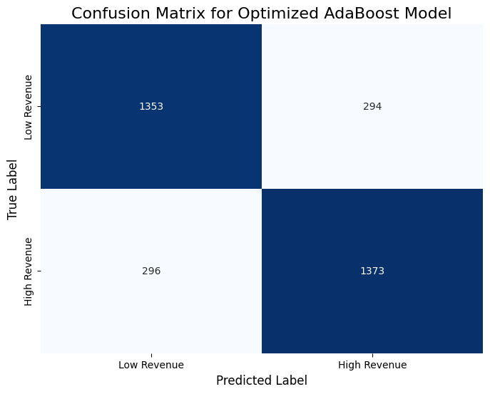
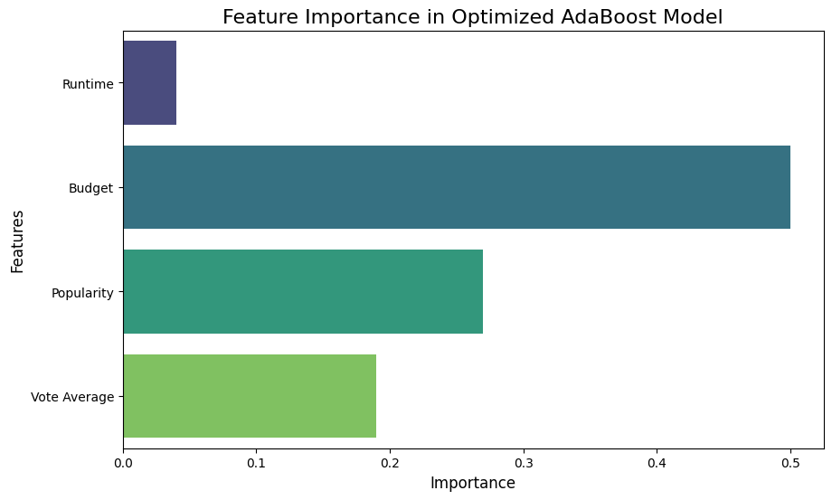
AdaBoost – Ensemble Learning
The AdaBoost model achieved an accuracy of 82%, showcasing its balanced ability to correctly classify both low and high-revenue films.
Precision, recall, and F1-scores around 0.82 for both categories.
Budget emerged as the most influential feature, followed by popularity and vote average.
The analysis highlights the role of resource allocation, suggesting that enhancing marketing strategies to improve popularity.
Focusing budgets on high-impact areas can significantly boost a movie’s revenue potential.

Slide 9
Final Thoughts
Data-driven insights from early indicators, such as genre, budget, and cast popularity, assist forecast film success and optimize profits.
Clustering can be used to handle regional variations and audience preferences, allowing for more focused marketing tactics.
Filmmakers can improve production and marketing while maintaining their artistic vision by striking a balance between creativity and statistics.
By offering a decision-making roadmap for the entire film lifespan, these insights enhance both audience enjoyment and financial returns.
The film business can adjust to global trends and produce stories that inspire, bring people together, and amuse them by fusing data-driven tactics with conventional filmmaking.

Slide 10


