Slide 1
All hail ggplot2—The code powering all those excellent charts is 10 years old & Data Visualization: Pretty Pictures Ain't Analytics
Group 6:
REDDY, REDDY aBHINAV (rxr210062)
dHARANI maganti (DXM220031)
ANIRUDH Gunda (AXG210120)
DIVYA SRISHTI CHITTOOR MUPPALA (DXC220051)
SAIYANAND REDDY KOMATI REDDY (SXK220059)
SHIVANGI shastri (SXS220105)

Slide 2
Introduction to Data visualization and ggplot2
A picture is of thousand words. Explore, Detect, Make sense of Data and Communicate
Visualizations play an important role in decision-making after analyzing relevant data. Graphical representation highlighting the interdependence of key elements affecting performance is important .
There are many libraries in Python and R which provide different options showing a variety of geometrical and pictorial visualizations which can be attractive and informative.
R supports a variety of functions and data visualization packages to build interactive visuals for exploratory data analysis. One such library available in R is ggplot2

Slide 3


All hail ggplot2—The code powering all those excellent charts is 10 years old.

Slide 4
Learning Objectives
To understand the tool ggplot2 and why it is most preferred among other open-source tools in the market.
To understand the evolution of the tool from ggplot to ggplot2.
Creating a visualization using ggplot2 for example - Creating a Bar chart.
To understand the disadvantages of ggplot2 compared to other visualization tools.

Slide 5
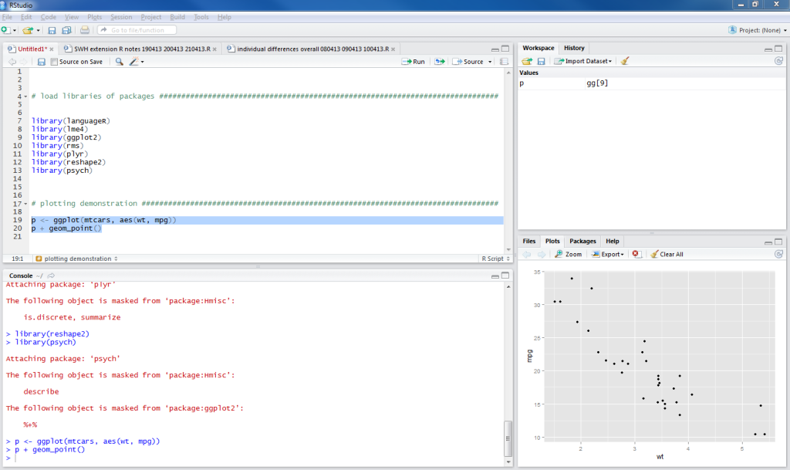
What is GGPLOT2?
ggplot2 in R is the latest version of the famous open-source data visualization tool ggplot for the statistical programming language R.
The term ggplot2 relates to the package’s name. We use the function ggplot() to produce the plots when using the package. Therefore, ggplot() is the command, and the whole package is called ggplot2.
It is a part of the R tidyverse, an ecosystem of packages designed with common APIs.
The "gg" in ggplot stands for "Grammar of Graphics".
https://www.tidyverse.org/packages/

Slide 6
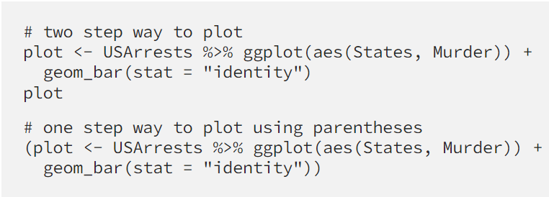
GGPLOT and GGPLOT2
R- language has 3 main packages for data visualization. One of these three is ggplot2(graphics, Lattice).
Ggplot2 was created by Hadley Wickham based on the Grammar of Graphics written by Leland Wilkinson.
On June 10, 2007, ggplot was officially released.
In 2009 ggplot2 was released which was a rewrite to ggplot with improvements and new features.
ggplot2 is used more than ggplot as it is more flexible, powerful, includes a wider range of graphical features and more customization options.
ggplot is still used when working with legacy code.

Slide 7
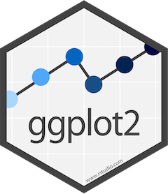
Why: ggplot2
Ggplot2 is based on the grammar of graphics, which provides a structured and intuitive framework for creating complex visualizations.
Despite being a very powerful tool, ggplot2 is relatively easy to use, even for beginners.
Ggplot2 is highly customizable, allowing users to control almost every aspect of the plot
It can handle a wide range of data types.
Ggplot2 supports faceting, which allows users to create small multiples of the plot based on a grouping variable.
It is actively developed and maintained by a large community of developers and users.

Slide 8
Creating a Bar chart using ggplot
Here is an example that uses ggplot2 to create a bar chart showing the average miles per gallon (mpg) for different types of cars in the built-in mtcars dataset:
Example:
library(ggplot2) # Load the mtcars dataset
data(mtcars) # Compute the average mpg by car type
mpg_data <- aggregate(mtcars$mpg, by=list(mtcars$cyl), FUN=mean) # Create a bar chart of the average mpg by car type
ggplot(mpg_data, aes(x=Group.1, y=x)) +
geom_bar(stat="identity", fill="steelblue") +
labs(title="Average MPG by Car Type", x="Number of Cylinders", y="Miles per Gallon")

Slide 9
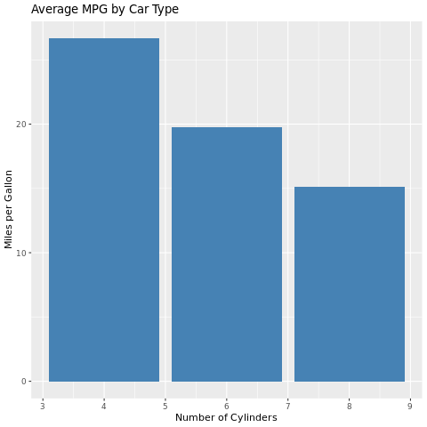
Result:

Slide 10
Cons of ggplot2
While ggplot2 is a powerful and popular data visualization package, there are some potential downsides to using it:
Steep learning curve:
Code verbosity:
Limited interactivity:
Performance issues:
Limited 3D support:

Slide 11
All hail ggplot2—The code powering all those excellent charts is 10 years old. Who passed this statement and why?
GGPLOT2 as a sentiment that has been expressed by many people in the data science and visualization communities. The statement is a recognition of the impact that ggplot2 has had on the field of data visualization since its release in 2007.
The statement "All hail ggplot2" is a celebratory and appreciative sentiment towards the package and its creator, Hadley Wickham, for providing a powerful and enduring tool for data visualization.
The statement highlights the fact that ggplot2 has become the go-to data visualization tool for many data scientists and researchers and has contributed significantly to the promotion of data visualization as an important tool for communicating data insights.

Slide 12
The "The code powering all those excellent charts is 10 years old" part of the statement is a recognition of the fact that ggplot2 has been around for over a decade and has been continuously improved and refined by its creator and the wider community. Despite being 10 years old, ggplot2 remains a popular and relevant tool for data visualization due to its versatility, flexibility, and ease of use.
For the past 10 years, ggplot2 has been widely used by data scientists, statisticians, and researchers for creating beautiful and informative visualizations. It is known for its elegant and versatile grammar of graphics, which allows users to create a wide range of plots, from simple scatterplots to complex faceted plots.

Slide 13
Over the years, ggplot2 has become the go-to data visualization tool for many data scientists and researchers. Its popularity can be seen in the numerous packages that have been developed to extend its capabilities, such as gganimate for creating animated plots, ggmap for mapping data, and ggforce for creating complex plots.
Back then, as a celebration of ggplot2's 10th anniversary, many realized that it is worth noting how much this package has contributed to the field of data visualization. It has not only made it easier for researchers and data scientists to communicate their findings but also helped to promote the importance of data visualization in data analysis.

Slide 14
Learning Outcomes
Ggplot2 is an open source and free tool for data visualization.
It is declaratively and efficient in creating data visualization based on The Grammar of Graphics.
Ggplot2 provides a structured and intuitive framework for creating complex visualizations.
Ggplot2 is a data visualization package for the statistical programming language R.
Ggplot2 is highly flexible as it allows us to build and customize visualizations by adding more layers.

Slide 15
Data Visualization: Pretty Pictures Ain't Analytics

Slide 16
LEARNING OBJECTIVES:
To learn what successful visualization actually is.
The purpose and value of analytics led decisions.
Using data as an asset and building a data-first future across industries.
Platform thinking.

Slide 17
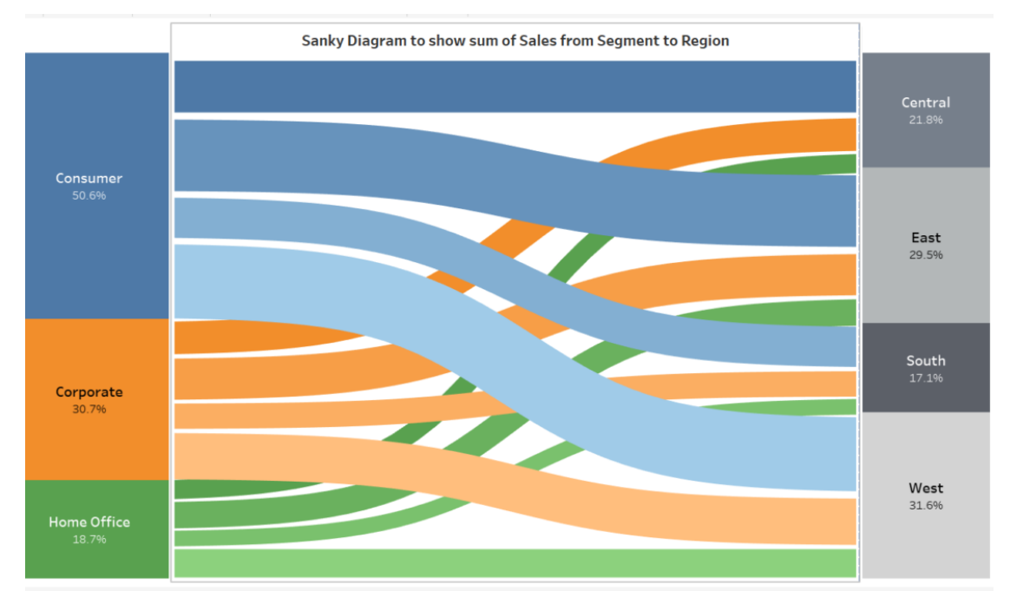
Sankey Diagram
Sankey Diagram shows the flow in the relationship between two different elements.
Flow of Sales between two different dimensions Segment and Region.

Slide 18
DISADVANTAGES
The main issue with using a Sankey diagram is that it’s not always going to be accurate. Since the purpose of the diagram is to illustrate the flow of data in a system, it’s important to not put in additional data that will skew the picture, which leads to the next point.
The purpose of this diagram is to illustrate the flow of data in a system and not depict the user experience. Therefore, it’s important to not include anything other than the information being input into the system.

Slide 19
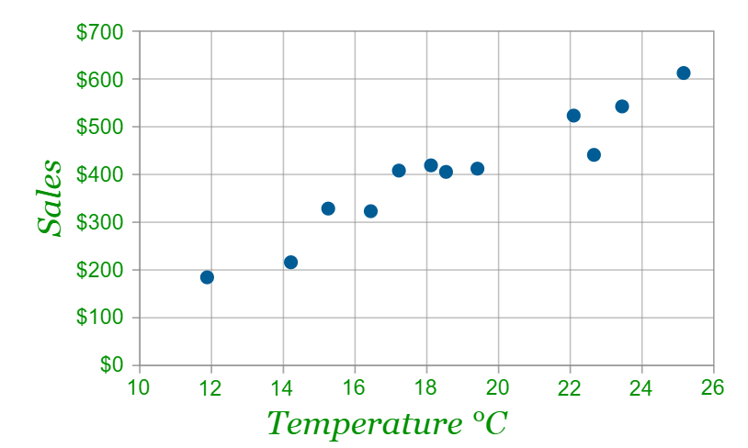
Scatter Diagram
The scatter diagram is also called a scatter plot chart, XY chart, and correlation chart. A scatter diagram is a two-dimensional graphical representation of a set of data. The scatter diagram graphs pairs numerical data with one variable on each axis to look for a relationship between them.
It shows that warmer weather leads to more sales, but the relationship is not perfect.

Slide 20
DISADVANTAGES
Reading scatter diagrams incorrectly may lead to false conclusions that one variable caused the other, when both may have been influenced by a third
A relationship in a scatter diagram may not be apparent because the data does not cover a wide enough range
Associations between more than two variables are not shown in scatter plots
Scatter diagrams cannot provide the precise extent of association
A scatter plot does not indicate the quantitative measure of the relationship between the two variables

Slide 21
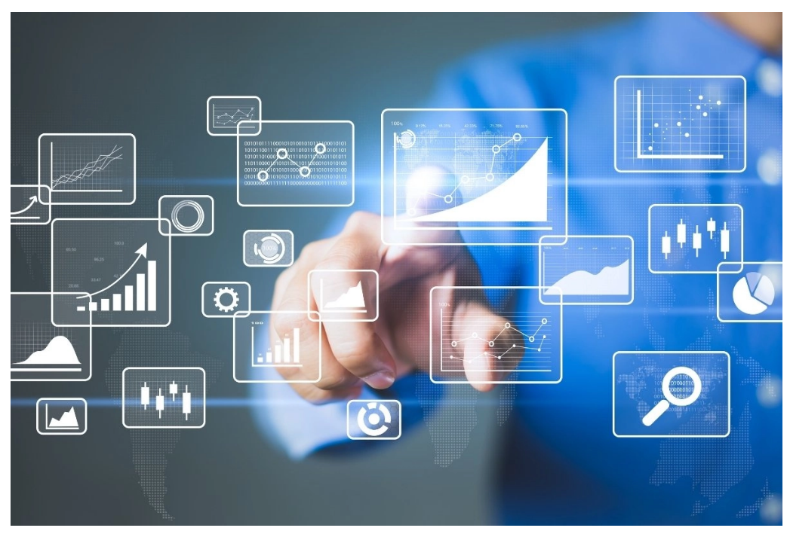
Using Data as an Asset
Data as an Asset’ model indicates the quality of your data and the enterprise’s maturity to handle DataOps and Data Governance. Organizations must turn data into actionable information, which will be a critical operation for businesses soon.
The organization that will transform data into a business asset would provide insights and clues into the business continuously to answer – Where it is? What happened, Why it happened, and most importantly, Where it could go?.
Data is no longer an enabler of the business, but Data is steering the business.

Slide 22
A Data-First Future Across Industries
Data is a light in the dark – determining how we best prepare for the future across all industries. Some industries as follows have already realized the power of data.
Telecommunications
Healthcare
Manufacturing

Slide 23
We can make the impossible possible with data.
Data has the potential to show us the way to make anything, and everything happen.
If business treats it as their most valuable asset, instilling urgency from the top to centralize it and invest in it accordingly, then data becomes a key to unlocking competitive advantages and realizing the future.

Slide 24
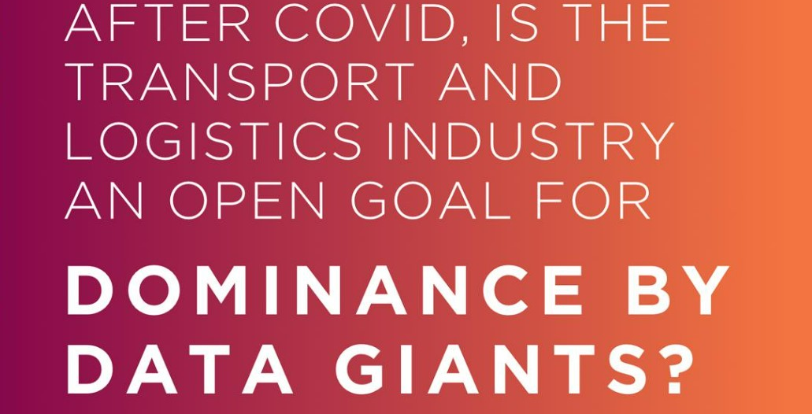

Slide 25
So far, logistics firms have mostly been using data to build forecasting models and event management algorithms that work absolutely fine; they’re built on the data of things that happened in years gone by, and can fairly accurately figure out what’s going to happen next.
As long as everything works in the way it’s expected to.
As long as, say, a global epidemic doesn’t come along and scatter expectations to the winds.
But that’s exactly what happened, and so it’s important to reflect on what uncertainty really means in logistics, and how things could be done better.

Slide 26
Renewal Of Its Thinking, Rather Than A Return To Old Habits?
The entire concept of data-its meaning, value and way the industry approaches working with it-needs to be decoupled from the tradition of "technology".
A logistics company's entire structure and outlook could be reset to zero, and every single movement built exclusively around the notion of data, It would perhaps be something like a brain, driving an elaborate, fully sensitive central nervous system.
An imperceptible sensation or change would cause ripple effects adjusting the way it thinks and reacts, in real time.
An imperceptible event would contribute to a slight alteration of the whole outlook. There's something else such a logistics company may look like, however: Big Tech.

Slide 27
If the future of logistics supply chains is data-led, it's pertinent to ask when a data-led company that thrives on next-day delivery may start trading up trucks and planes for cargo ships.
As well as seeing the logistics industry tighten up its existing game, the Covid-19 epidemic has seen online retail gains delivering many of their own packages, with an expectation this will continue to grow.
Big Tech is getting a feel for logistics, and the most prominent are already knocking on the docs of traditional shipping and logistics organizations—owing in no small part to dissatisfaction with the efficiency of using third-party logistics services.

Slide 28
Learning Outcomes:
How a picture is worth thousand words.
Sankey diagram is best way to show the flow of 2 set values.
Scatter diagram is shows the relation between 2 variables.
Renewing old habits with the help of logistics and technology.
Visualization should not just present the data but also give insight into actionable options which can be done as a result of the visualization.
Businesses should rely more on data and use a data-first approach moving forward.

