Slide 1
AUTOMATED EARLY DETECTION OF PLANT LEAF DISEASES
By,
Sree Divya Sudagoni
CSUN ID: 202617109

Slide 2
Project Goal
The primary objective of this project is to leverage the power of YOLO and Mask-RCNN object detection models, along with a trained CNN, to automate the detection and classification of plant leaf diseases.
By enabling early identification and intervention, the project aims to contribute to improved crop health monitoring and effective disease management practices.
I'm developing an application that allows users to upload images of plant leaves. The application will then provide the user with the name of the disease affecting the plant, along with a detailed description and the recommended cure. Additionally, the information will be displayed in the user's preferred language.

Slide 3
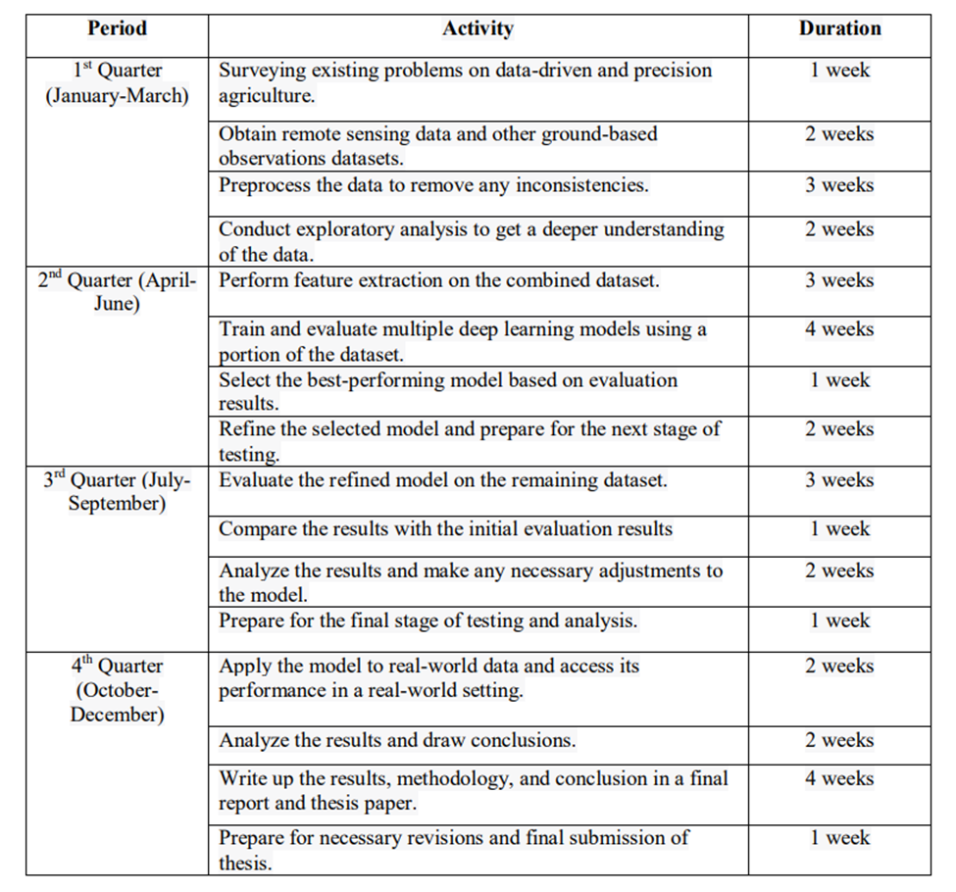
Project status
The overall project health is green
I planned to work on training the models and refining
them. Until the end of June. I am currently right on track.
Dataset - Plant Village data set
Algorithms - CNN, Mask-RCNN, YOLO.

Slide 4
Project status
The percentage of work that I expected to be completed by today is:
· Understand how YOLO (You Look Only Once), Mask RCNN and Convolutional Neural Networks work.
· Understand how to work with Image data
· Prepare the data according to each algorithm specification before training.
· Start training the models.

Slide 5
Work done
Convolutional Neural network
Used partial data set of 15 classes with 3 species (Potato, Tomato, Pepper)
Data preprocessing - Resizing, normalization
Converted all the images into numpy array format
Created a CNN model using 3 convolutional layers, 3 pooling layers, 1 Flatten layer and 1 dense layer and the output layer
Trained the model with a batch-size of 32 and for 5 epochs
The test accuracy achieved was 89%

Slide 6
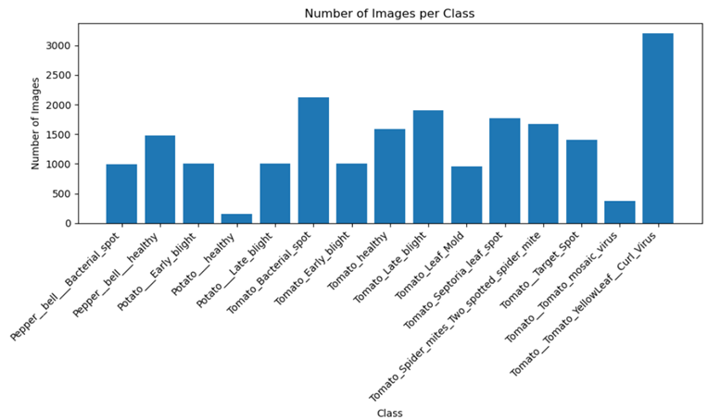
CNN

Slide 7
YOLO (You Look Only Once)
It is an object detection model which creates bounding boxes on images with the specific classification as a result.
It divides the input image into a grid and predicts class probabilities within each grid cell.
Internally it uses a CNN architecture
I am currently using the latest version which is YOLOv7
The official documentation and necessary files can be downloaded from the GitHub repository https://github.com/WongKinYiu/yolov7
Before training the model, annotated the images.

Slide 8
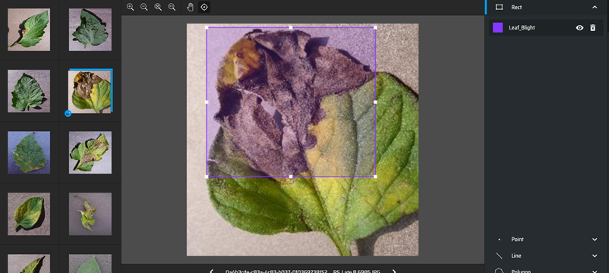
YOLO (You Look Only Once)
Annotated 200 images before training

Slide 9
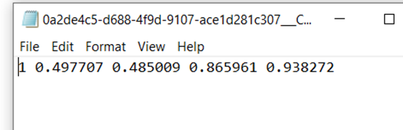
YOLO (You Look Only Once)
The result of this annotation leads to a txt file which contains the coordinate information of the image. One txt file is created for each image. I have created a folder called labels to save all the coordinate information

Slide 10
Mask - RCNN
Region based Convolutional Network, it is another object detection model with an additional feature called pixel-level segmentation.
It uses two-stage approach.
In first stage, it identifies potential areas of the object in an image using a technique called region proposals.
In the second stage, it creates a detailed outline or mask that shows the exact shape of the object.
The above classification is called instance segmentation.

Slide 11
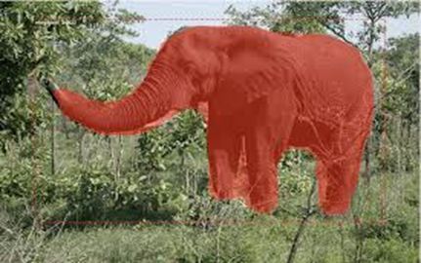
Mask - RCNN
The below is an example of instance segmentation

Slide 12
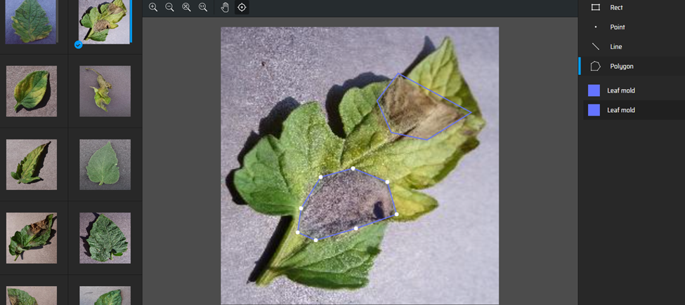
Mask - RCNN
In order to train this model, the images have to be annotated in polygon shape.

Slide 13
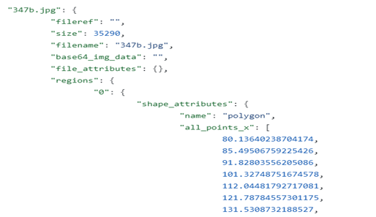
Mask - RCNN
The result of this annotation will be a json file which is the format accepted by Mask_RCNN.
One json file is created for all the images with coordinates of Each line in the polygon. I have annotated 200 images to train the Mask-RCNN algorithm

Slide 14
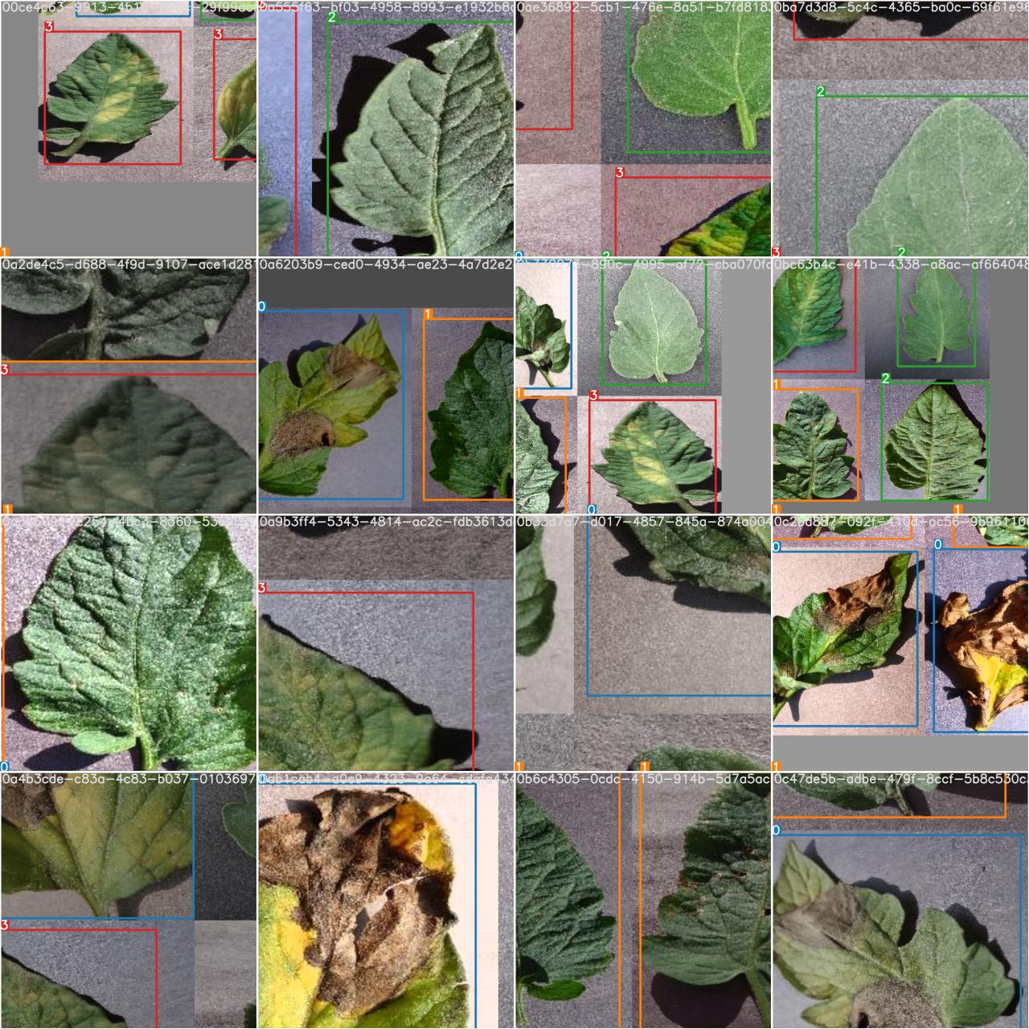
Blocking issues
One blocking issue: Failure of Object classification using YOLO
The YOLO algorithm successfully ran without any errors
The following is the training folder created after the training process is done.

Slide 15
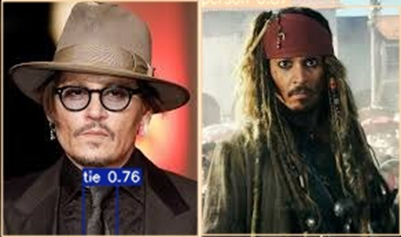
Blocking issues
Initially, suspected an error with the annotation process of training images, So I re-annotated them carefully, but still the output was not as desired.
To further investigate, I decided to use a different dataset of jack sparrow images.
I performed a preliminary check before training the model with my desired bounding boxes. I just uploaded one image to directly make use of detecting code to check if the underlying algorithm is working fine.

Slide 16
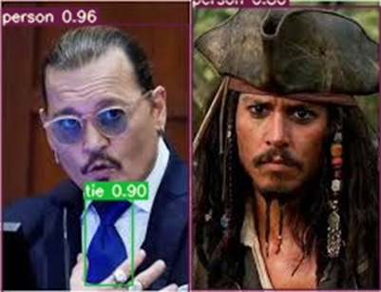
Blocking issues
Later, I proceeded to train the model using my own bounding boxes, specifically targeting the person’s face as the object, with an expectation of detecting jack sparrow.
It still detected the tie and recognized the face as a person, but it failed to identify it as jack sparrow.

Slide 17
Blocking issues
In order to resolve the above issue, I am currently going through the documentation from official GitHub repository of YOLOv7 to train the images.
I am trying to understand how the directory structure and annotation effects the training process.

Slide 18
Normal issues
Prior to training the Mask - RCNN model, I proceeded to download the required files from the GitHub repository of Mask - RCNN https://github.com/matterport/Mask_RCNN
I was unable to install all the necessary libraries, as the python library versions that I have are different.
I figured out that to able to work more effectively, I need to create a separate python virtual environment for each algorithm.
I was also trying to work on scripts in anaconda prompt but I need to make use of a GPU either from Kaggle or Google colab.

Slide 19
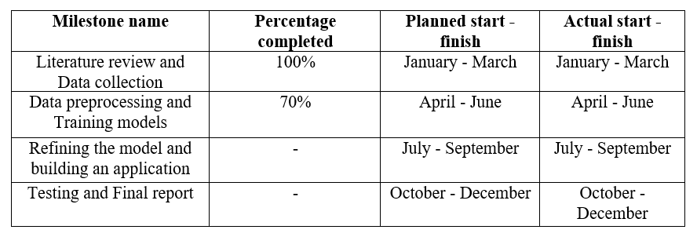
Milestone review

Slide 20
Expected results
I am currently in the process of training the object detection models.
Following this, I will proceed to develop an application that enables users to upload leaf pictures to get more information on what is the disease.
Once, I resolve the issues that I mentioned earlier, I will finish my second milestone.
By the end of June, I will have 3 working models to detect plant leaf diseases.
The CNN will be able to classify the disease if the leaf.
YOLO and Mask - RCNN will create the respective bounding boxes for the diseased leaf and classify it.

Slide 21
Thank you

