Slide 1

Smart SDLC – AI Enhanced Software Development
Life Cycle

Slide 2

What is SDLC ?
The Software Development Life Cycle (SDLC) is a structured framework used by software development teams to design, develop, test, and maintain high-quality software. It provides a systematic approach to software creation, ensuring that the final product meets user requirements, is cost-effective, and is delivered within a specified timeline.

Slide 3
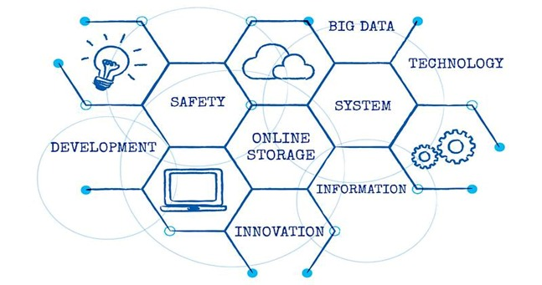
Need for AI in software
development

Slide 4
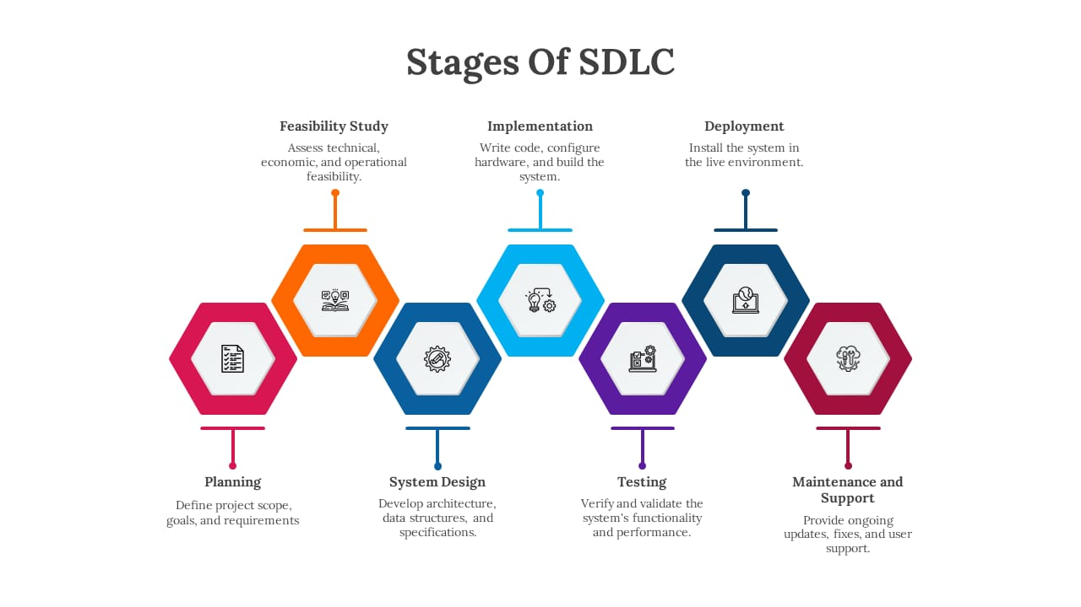

Slide 5
PLANNING :
In the Software Development Life Cycle (SDLC), planning is the initial phase where the project's purpose, scope, and goals are established. This stage involves gathering requirements from stakeholders, performing feasibility studies (technical, financial, and operational), analyzing risks, and creating high-level project plans.

Slide 6

SYSTEM DESIGN :
System design in the Software Development Life Cycle (SDLC) is the crucial design phase that translates user requirements into a detailed technical plan and architecture. This phase creates a blueprint for the software, defining its overall structure (High-Level Design) and the specifics of individual components (Detailed Design) like interfaces, databases, and algorithms.

Slide 7
IMPLEMENTATION :
In the Software Development Life Cycle (SDLC), implementation is the phase where developers translate the software design into a fully functional application by writing the actual code. This involves adhering to coding standards, using version control, and collaborating with the team to build, test, and integrate the system into a tangible product that meets the defined requirements.

Slide 8

DEPLOYMENT :
Deployment in the SDLC is the crucial, final phase where a tested software product is released and made available to end-users in a real-world production environment. This involves transferring the software from a development setting to the production environment, where it's installed, configured, and supported.

Slide 9
TESTING :
Testing is a crucial phase within the Software Development Life Cycle (SDLC) (SDLC) that focuses on verifying and validating software against requirements, identifying defects, and ensuring quality. It involves various activities like test planning, test case development, and execution of unit, integration, and system testing to ensure the software functions as expected and meets user needs before deployment.

Slide 10

MAINTENANCE :
In SDLC, maintenance is the final phase, focusing on keeping the software functional, reliable, and relevant after deployment through corrective, adaptive, preventive, and perfective updates. It involves fixing bugs, adapting to new environments like operating systems, improving the software based on user feedback, and ensuring long-term viability as market conditions and organizational needs change.

Slide 11

THANK YOU

