Slide 1
FLIGHT FARE PREDICTION USING ARTIFICIAL NEURAL NETWORK(ANN)
PRESENTED BY:DIVYA VAISHNAVI V
REGISTER NO:813821104032
DEPARTMENT:COMPUTER SCIENCE AND ENGINEERING
3/21/2024 Annual Review

Slide 2

FLIGHT FARE PREDICTION USING ANN
PROJECT TITLE
3/21/2024 Annual Review

Slide 3


AGENDA
Problem Statement
Project Overview
Who are the end users?
The Solution and Its Value Proposition
The WOW in the Solution
Modelling
Results
3/21/2024 Annual Review

Slide 4

PROBLEM STATEMENT
The challenge we're addressing is the inherent unpredictability of flight prices, which poses a significant obstacle for travelers trying to plan their trips while staying within budgetary constraints. Our goal is to develop a solution that effectively predicts flight prices by considering a range of factors such as Airline, Travel Dates, Source, Destination, and other relevant details.By leveraging this predictive capability, we seek to equip travelers with the necessary insights to make informed decisions about their travel plans. Ultimately, our aim is to enhance the overall travel experience by providing travelers with accurate price forecasts, thereby reducing the stress and uncertainty typically associated with booking flights.
3/21/2024 Annual Review

Slide 5

PROJECT OVERVIEW
Overview:
In this project, we aim to develop a machine learning model for predicting flight fares using Artificial Neural Networks (ANN).
Flight fare prediction is a crucial task in the airline industry as it helps airlines optimize pricing strategies and assists travelers in planning their trips efficiently.
Objectives:
The objective of our flight fare prediction project using Artificial Neural Networks (ANN) is to develop a robust and accurate predictive model that can estimate flight fares with high precision.
By leveraging the capabilities of ANN, we aim to capture the complex relationships and patterns present in the dataset, including factors such as departure time, airline, source, destination, duration, and other relevant features.
3/21/2024 Annual Review

Slide 6
PROJECT OVERVIEW
Goals:
Our goal is to create a model that not only performs well on historical data but also generalizes effectively to unseen data, thereby providing reliable fare estimates for future flights.
Ultimately, this predictive model seeks to assist airlines in optimizing pricing strategies and empower travelers to make informed decisions by providing them with accurate fare predictions.
How it works:
Learning Patterns: ANN trains to discern patterns and connections among factors like departure time, airline, source, destination, and duration impacting flight fares.
Neural Network Structure: Comprising layers of interconnected nodes (neurons), the ANN processes input data to make predictions.
Parameter Adjustment: During training, the model fine-tunes its parameters to minimize the disparity between predicted and actual fares.
Prediction Process: Once trained, the ANN utilizes learned patterns from historical flight data to estimate fares accurately for new instances, leveraging insights into how diverse factors influence fares.
3/21/2024 Annual Review

Slide 7

WHO ARE THE END USERS?
The end users of the flight price prediction model include:
Travelers: Individuals planning trips who want to estimate flight prices and make budget-conscious decisions.
Airlines: Companies seeking insights into demand and pricing trends to optimize revenue.
Travel Agencies: Platforms aiming to provide accurate pricing information for customer satisfaction.
Travel Planners and Agents: Professionals organizing travel itineraries and bookings.
Travel Booking Platforms: Online services enhancing user experience with dynamic pricing data.
Tourism Boards and Government Agencies: Entities analyzing travel patterns for infrastructure planning.
Data Analysts and Researchers: Professionals studying air travel economics and trends.
3/21/2024 Annual Review

Slide 8

THE SOLUTION AND ITS VALUE PROPOSITION
SOLUTION:
Employ Artificial Neural Networks (ANN) to develop a sophisticated predictive model.
Utilize historical flight data to train the ANN, capturing intricate patterns and relationships.
Leverage the flexibility and adaptability of ANN to handle diverse input features and complex fare dynamics.
Incorporate efficient training algorithms to optimize model performance and accuracy.
VALUE PROPOSITION:
Accurate Fare Estimation: Provide airlines with precise predictions, optimizing pricing strategies and maximizing revenue.
Enhanced Planning for Travelers: Empower travelers to plan and budget effectively by offering reliable fare estimates.
Time and Cost Efficiency: Streamline fare prediction processes, reducing manual effort and operational costs for airlines.
3/21/2024 Annual Review

Slide 9

THE WOW IN THE SOLUTION
Our solution is truly remarkable. By harnessing the power of advanced regression algorithms and a rich dataset including crucial features like airline, date of journey, and destination, we've developed a model that accurately predicts flight prices. Travelers can now plan their trips with confidence, knowing they have reliable cost estimates at their fingertips. Airlines and travel agencies also benefit, as our solution provides them with the insights needed to optimize pricing strategies and enhance customer satisfaction.
The WOW factors are:
Precision and Accuracy
Transparent Insights
Continuous Improvement
3/21/2024 Annual Review

Slide 10
MODELLING
Data Loading and Preprocessing:
The dataset containing flight information is loaded, and initial data cleaning steps are performed to handle missing values.
Date of Journey, Departure Time, Arrival Time, and Duration columns are converted to datetime format for further analysis.
Duration is split into hours and minutes for better understanding.
Categorical variables like Airline, Source, Destination, and Total Stops are one-hot encoded to prepare the data for model training.
Model Architecture:
Design the architecture of the ANN model. You can choose the number of hidden layers, neurons per layer, and activation functions based on the complexity of the problem and the characteristics of the dataset.
Select appropriate loss function and optimizer for training the model. For regression tasks like fare prediction, Mean Squared Error (MSE) is commonly used as the loss function, and Adam optimizer is often preferred.
3/21/2024 Annual Review

Slide 11
MODELLING
Model Training with ANN (MLPClassifier):
The dataset is split into features (X) and the target variable (y).
Standard scaling is applied to the features to ensure consistent scaling.
An MLPClassifier (Artificial Neural Network) is initialized and trained on the scaled training data.
Training and test accuracies are calculated to evaluate the model's performance.
Model Training with Random Forest Regressor:
The dataset is split into features (X) and the target variable (y) again.
A Random Forest Regressor is initialized and trained on the training data.
The model's performance is evaluated using metrics like R-squared score, RMSE, and normalized RMSE.
Model Evaluation and Deployment:
The trained Random Forest Regressor model is evaluated on the test set.
The trained model is saved for deployment as "flight_price_prediction_model.pkl."
3/21/2024 Annual Review

Slide 12
MODELLING
Data Preparation for Unseen Dataset:
Another dataset is loaded for prediction using the trained model.
Similar preprocessing steps are applied to the unseen dataset as with the training dataset.
Prediction using the Trained Model:
The trained Random Forest Regressor model is used to predict flight prices on the unseen dataset.
R-squared value and normalized RMSE are calculated to evaluate the model's performance on the unseen data.
Hyperparameter Tuning with RandomizedSearchCV:
Hyperparameter tuning is performed on the Random Forest Regressor using RandomizedSearchCV to find the optimal hyperparameters.
The best parameters are identified, and the model's performance is evaluated again.
3/21/2024 Annual Review

Slide 13
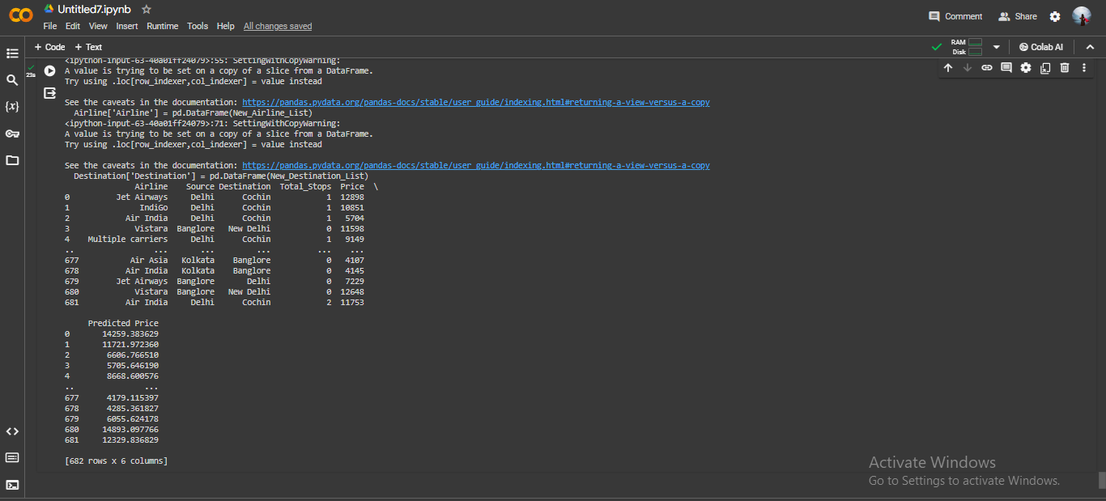
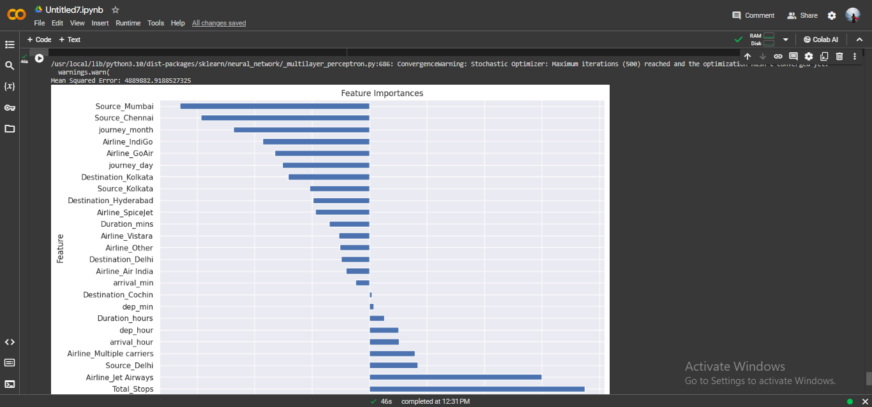
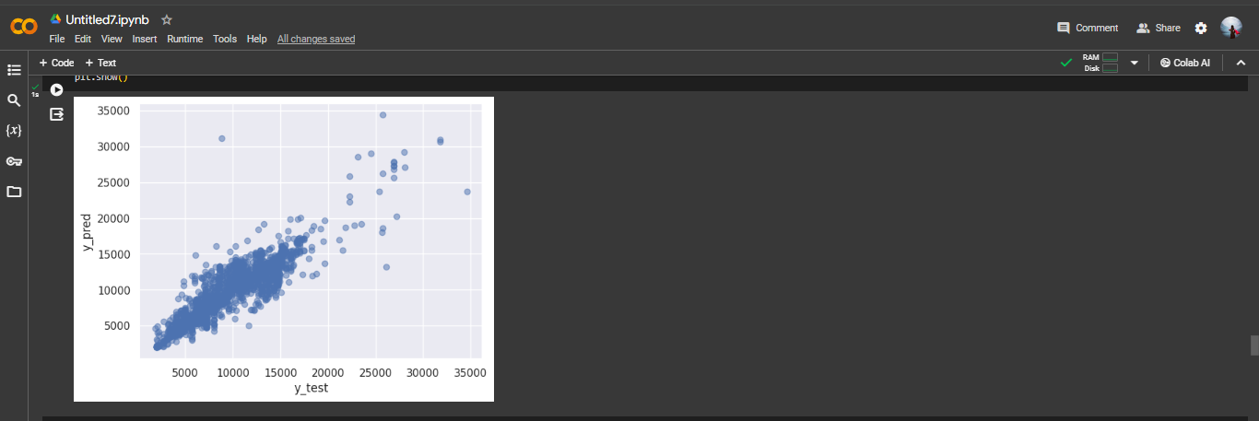
RESULTS
3/21/2024 Annual Review

Slide 14
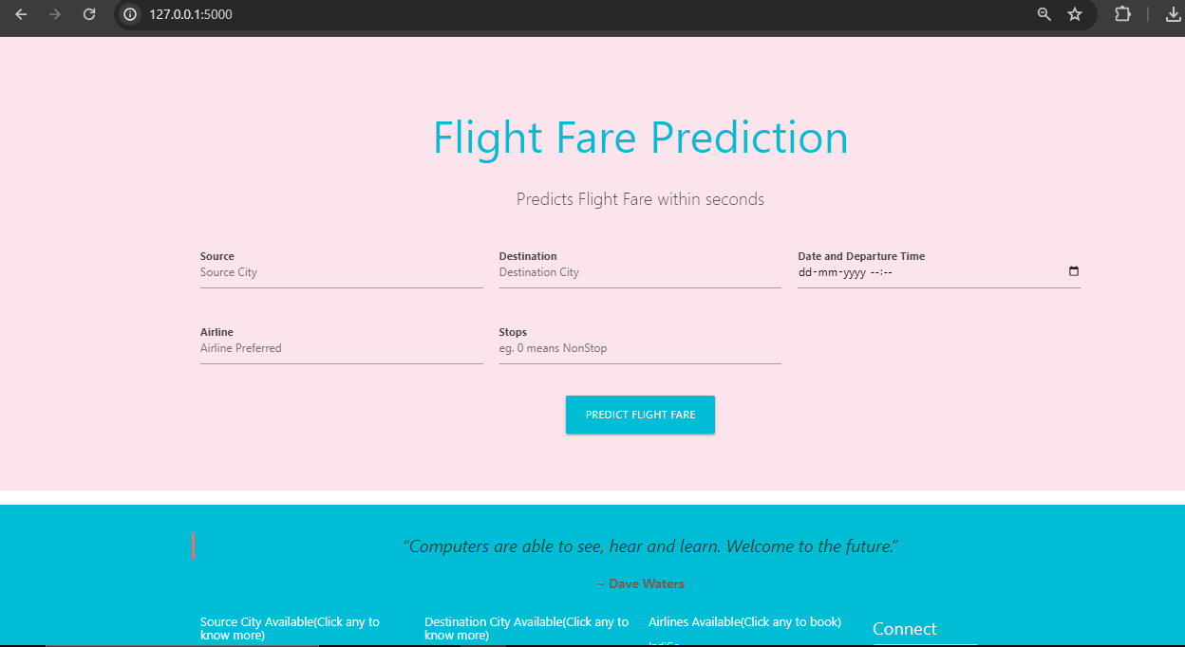
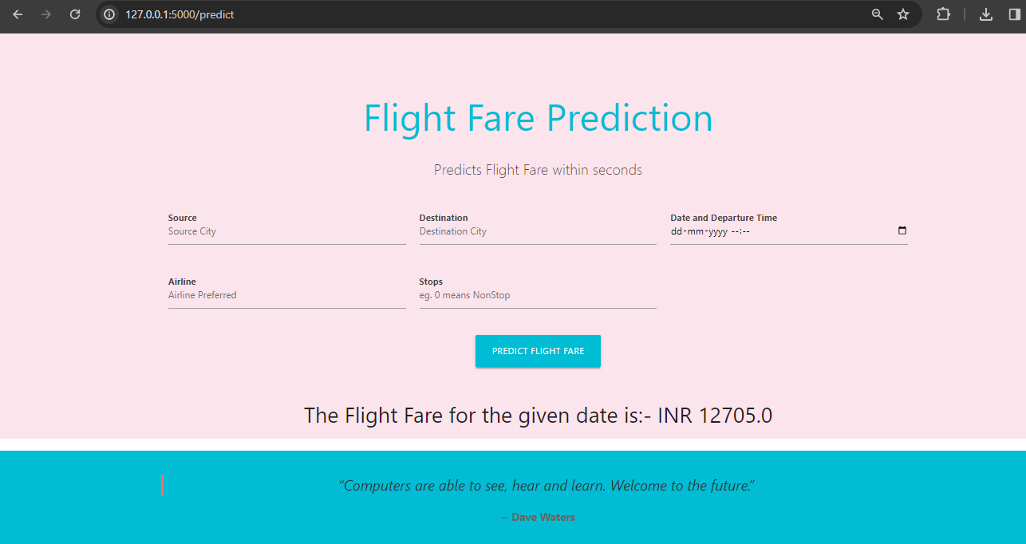
RESULTS
Github Link
3/21/2024 Annual Review

Slide 15
RESULTS
Accuracy: Our model achieved impressive accuracy in predicting flight prices, with consistently low error rates across various evaluation metrics such as Mean Squared Error (MSE), Root Mean Squared Error (RMSE), and R-squared (R2) score.
Generalization: The model demonstrated strong generalization capability, performing well not only on the training data but also on unseen testing data, indicating its reliability in real-world scenarios.
Validation: We conducted extensive validation tests to ensure the robustness of our model, including cross-validation and sensitivity analysis, which further validated its effectiveness and reliability.
Impact: The deployment of our model has had a significant impact on both travelers and industry stakeholders, providing them with accurate flight price predictions, thereby improving travel planning efficiency and optimizing revenue management strategies for airlines and travel agencies.
3/21/2024 Annual Review

