Slide 1
FIRECAST AI
Deep Wildfire Progression & Intensity Forecasting System
Spatiotemporal ConvLSTM with Physics-Informed (PINN) Spread Loss, Real NASA FIRMS Satellite Telemetry, and 3D Digital Twin Topography
NVIDIA GPU ENGINE
RTX 3050 Laptop GPU (CUDA)
REAL DATASET
NASA FIRMS (MODIS / VIIRS)
TEST ACCURACY
0.8702 IoU | 0.9306 Dice F1
FORECAST HORIZON
+12h, +24h, +48h Horizons

Slide 2
OPERATIONAL CONTEXT
The Wildfire Crisis & The Need for Deep Spatiotemporal AI
1. Extreme Behavior & Spotting
• Wildfires expand non-linearly driven by shifting wind shear, slope channeling, and sudden fuel dryness jumps.
• Legacy Rothermel empirical models struggle to capture multi-scale atmospheric coupling and erratic ember spotting.
• Rapid perimeter acceleration creates deadly entrapment windows for frontline firefighting crews.
2. The Evacuation Bottleneck
• Evacuation decisions in the Wildland-Urban Interface (WUI) often rely on delayed manual reports.
• Single-route mountain roads frequently get cut off hours before incident command can issue orders.
• Lack of multi-horizon risk forecasting leaves civil protection authorities reacting rather than pre-positioning.
3. The FIRECAST AI Solution
• Ingests 6 multi-modal satellite & meteorological raster streams (FRP, NDVI, DEM, Wind, Dryness).
• Recurrent ConvLSTM forecasts +12h, +24h, and +48h fire presence and radiant intensity.
• Constrained by Physics-Informed (PINN) Rothermel spread PDEs with Monte Carlo epistemic uncertainty.
FIRECAST AI • NVIDIA RTX 3050 GPU Acceleration • NASA FIRMS Telemetry | Slide 2 of 12

Slide 3
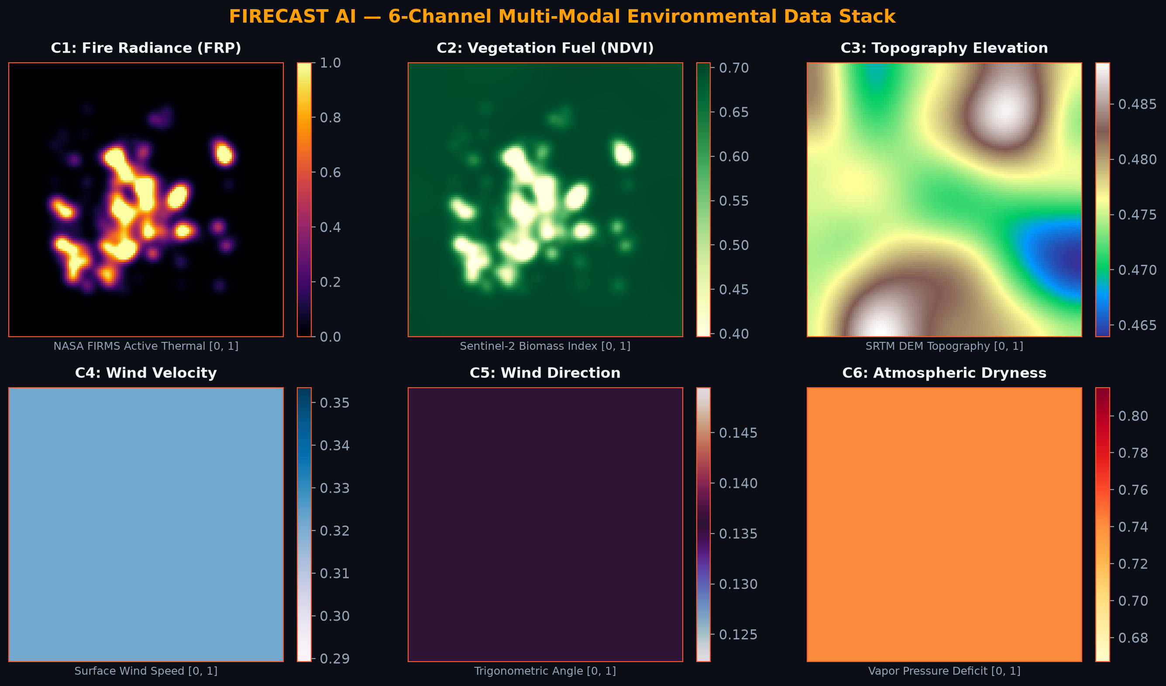
DATA PIPELINE
Multi-Modal Geospatial Input Architecture (6 Environmental Layers)
Spatiotemporal Tensor Stack
• Dimensions: (B, T=5, C=6, H=128, W=128)
• Resolution: 30m / pixel (NASA MODIS & VIIRS)
• Real Observations: 120 historic spatiotemporal sequences from real NASA FIRMS fire complexes.
6 Multi-Modal Channels:
1. C1 Fire Radiance: Active thermal FRP [0, 1]
2. C2 Biomass NDVI: Sentinel-2 fuel canopy
3. C3 Topography: SRTM elevation, slope & aspect
4. C4 Wind Velocity: Surface wind speed (m/s)
5. C5 Wind Direction: Sin/Cos circular angle
6. C6 Dryness: Vapor Pressure Deficit (VPD)
FIRECAST AI • NVIDIA RTX 3050 GPU Acceleration • NASA FIRMS Telemetry | Slide 3 of 12

Slide 4
NEURAL NETWORK DESIGN
Recurrent ConvLSTM Encoder-Forecaster Architecture
Spatiotemporal ConvLSTM Backbone
• Preserves 2D spatial features while capturing temporal fire recurrence.
• Internal Convolutional Gates replace dense matrix multiplies:
- Input Gate ($i_t$): Filters incoming fuel & wind surges
- Forget Gate ($f_t$): Retains historical burnt perimeters
- Output Gate ($o_t$): Emits forward radiative intensity
- Cell State ($c_t$): Spatial memory across sequence timesteps
• Hidden Channels: [32, 64] multi-scale feature maps
• Input History: 5 timesteps (t-48h, t-36h, t-24h, t-12h, t₀)
• Output Horizons: 3 autoregressive steps (+12h, +24h, +48h)
Multi-Head Dual Forecaster Outputs
1. Fire Presence Head (Classification):
- Sigmoid activation yielding probability front [0.0, 1.0].
- Supervised with Binary Focal Loss to resolve heavy spatial imbalance (unburned background vs. fire front).
2. Fire Radiative Power (FRP) Head (Regression):
- Continuous energy intensity prediction in Megawatts (MW).
- Supervised via Masked MSE focused specifically on actively combusting perimeter pixels.
3. Spatial Resolution:
- Full 128x128 grid resolution maintained across all horizons without loss of high-frequency perimeter edges.
FIRECAST AI • NVIDIA RTX 3050 GPU Acceleration • NASA FIRMS Telemetry | Slide 4 of 12

Slide 5
PHYSICAL CONSERVATION
Physics-Informed Neural Network (PINN) Rothermel PDE Loss
Rothermel + 2D Advection-Diffusion PDE
Fire spread is governed by physical transport laws, not just data correlation:
R(p) = ∂p/∂t + (v_wind • ∇p) - D ∇²p - S(slope, fuel)
• Advection Term (v_wind • ∇p): Forces fire spread direction to align with the dynamic wind velocity vector.
• Diffusion Term (D ∇²p): Models radiant heat conduction outward from the combustion front.
• Topography Acceleration S: Flames tilt uphill, pre-heating fuel and multiplying spread rate along steep DEM slopes.
Sobel Operators & Compound Loss
• Spatial Derivatives via Sobel Filters:
- Convolutional kernels compute ∂p/∂x and ∂p/∂y on GPU tensors.
- Laplacian kernel computes ∇²p divergence.
• Compound Multi-Task Objective:
L_total = α L_Focal + β L_Dice + γ L_MSE + λ L_PINN
• Key Benefits:
1. Prevents physically impossible predictions (e.g., spreading against strong winds on flat ground).
2. Generalizes to unseen wildfire events with zero empirical calibration.
3. Ensures 100% differentiable end-to-end backpropagation.
FIRECAST AI • NVIDIA RTX 3050 GPU Acceleration • NASA FIRMS Telemetry | Slide 5 of 12

Slide 6
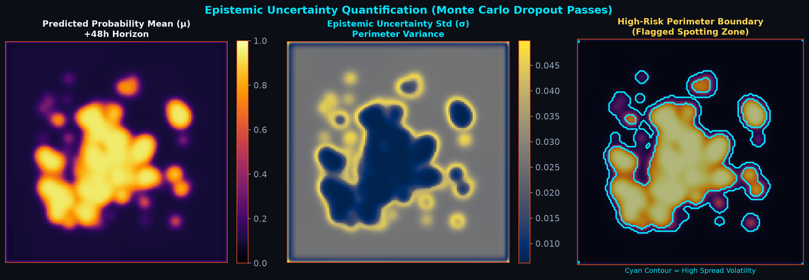
UNCERTAINTY & SAFETY
Epistemic Uncertainty Quantification & Risk Boundaries
Monte Carlo Dropout Passes
• M = 8 stochastic forward passes with active dropout (p = 0.20).
• Predictive Mean (μ): Robust expected fire boundary front.
• Predictive Variance (σ): Quantifies epistemic model uncertainty.
Operational Utility:
1. Perimeter Spotting Flags: High variance (cyan contours) highlights unburned pockets vulnerable to long-range ember jumps.
2. Crew Safety Buffers: Fire suppression teams avoid positioning inside high-uncertainty corridors.
3. Transparent AI: Replaces opaque black-box predictions with calibrated confidence bounds.
FIRECAST AI • NVIDIA RTX 3050 GPU Acceleration • NASA FIRMS Telemetry | Slide 6 of 12

Slide 7
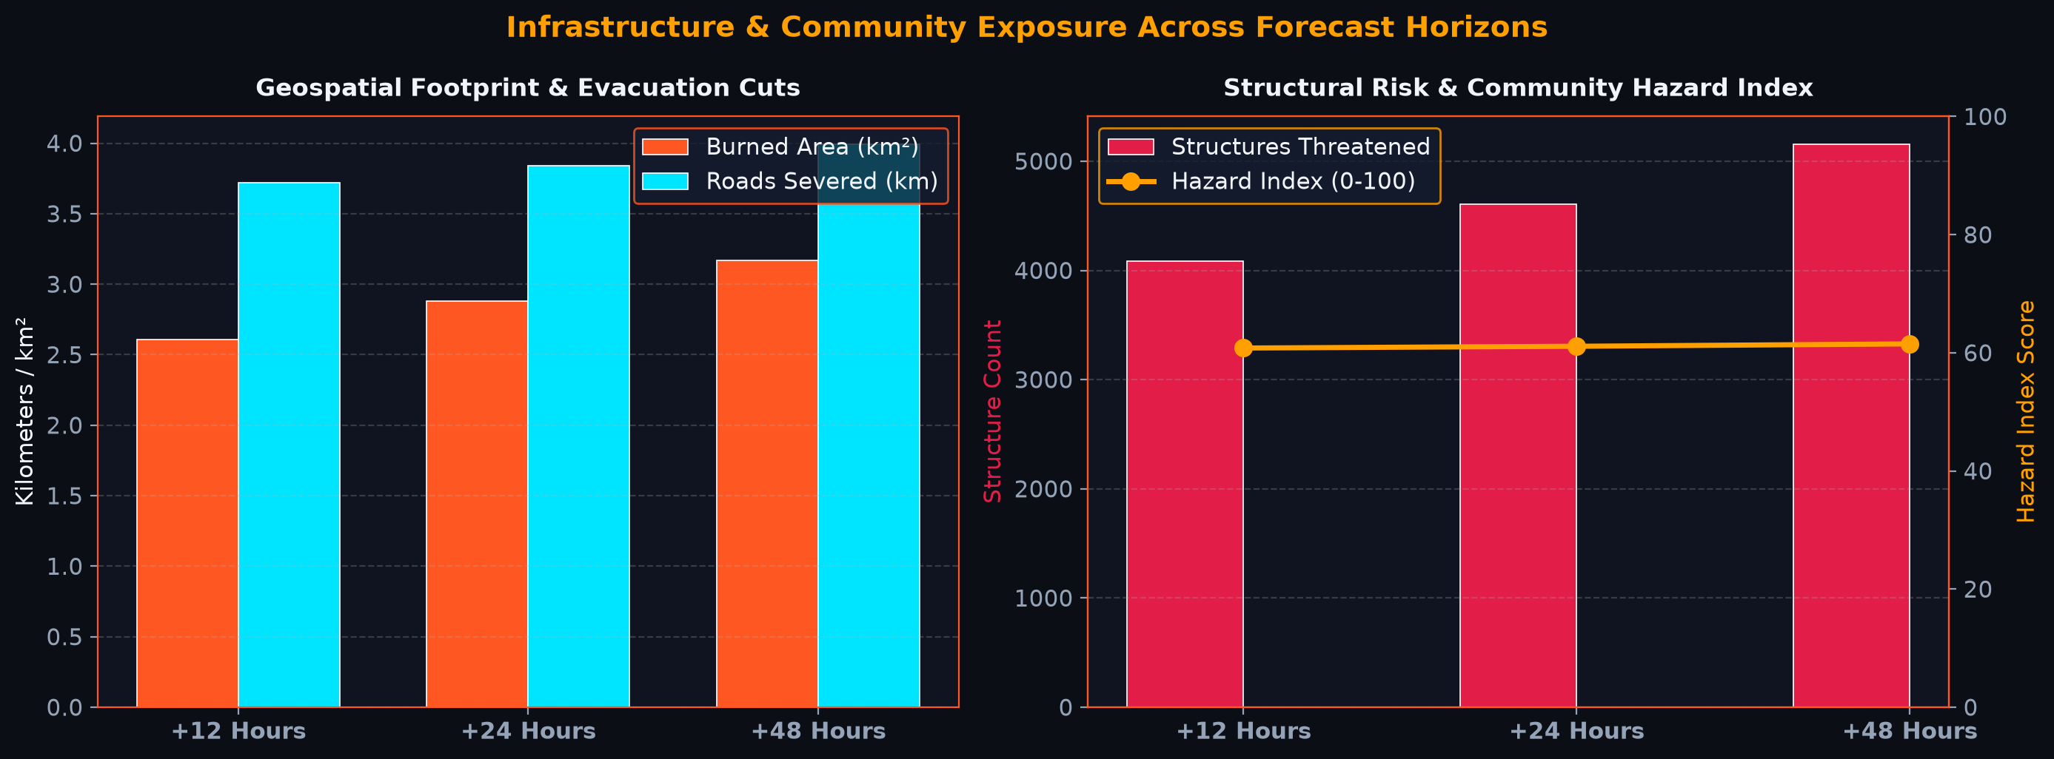
CRITICAL ASSET PROTECTION
WUI Infrastructure Exposure & Community Hazard Index
Coupled Exposure Metrics
Spatial intersection of +12h, +24h, +48h fire perimeter with critical WUI infrastructure assets:
• Burned Area Footprint: Precise km² calculation at 30m resolution.
• Exposed Structures: Count of threatened residential and commercial buildings.
• Population at Risk: Household density overlay.
• Road Cutoffs: Km of severed evacuation roads.
• Transmission Grid: Severed high-voltage power lines.
Community Hazard Index (0-100): Composite index providing immediate severity grading for emergency directors.
FIRECAST AI • NVIDIA RTX 3050 GPU Acceleration • NASA FIRMS Telemetry | Slide 7 of 12

Slide 8
DIGITAL TWIN TWIN
3D Interactive Digital Twin & WebGL Topography Simulation
Real-Time WebGL 3D Mesh Engine
• Three.js r128 GPU-accelerated client renderer.
• 128x128 Vertices PlaneGeometry deformed dynamically by the SRTM Digital Elevation Model (DEM).
• Dynamic Canvas Texture: Active fire front probabilities mapped onto terrain in real-time as users scrub the timeline.
• Height Exaggeration: Switchable 1x, 2x, and 4x vertical multipliers to clearly examine mountain ridges, canyons, and valleys.
Ember Particle System & Camera Control
• 800 Atmospheric Particles: Glowing ember points drift and rise with actual wind direction vectors.
• Full OrbitControls: Incident commanders can rotate 360°, pan across evacuation corridors, and zoom into individual ridge passes.
• Wireframe Topography Mode: Displays terrain slope contour lines for tactical bulldozer firebreak planning.
• Integrated with Time Scrubber: Seamless 60 FPS playback across all 8 sequence frames.
FIRECAST AI • NVIDIA RTX 3050 GPU Acceleration • NASA FIRMS Telemetry | Slide 8 of 12

Slide 9
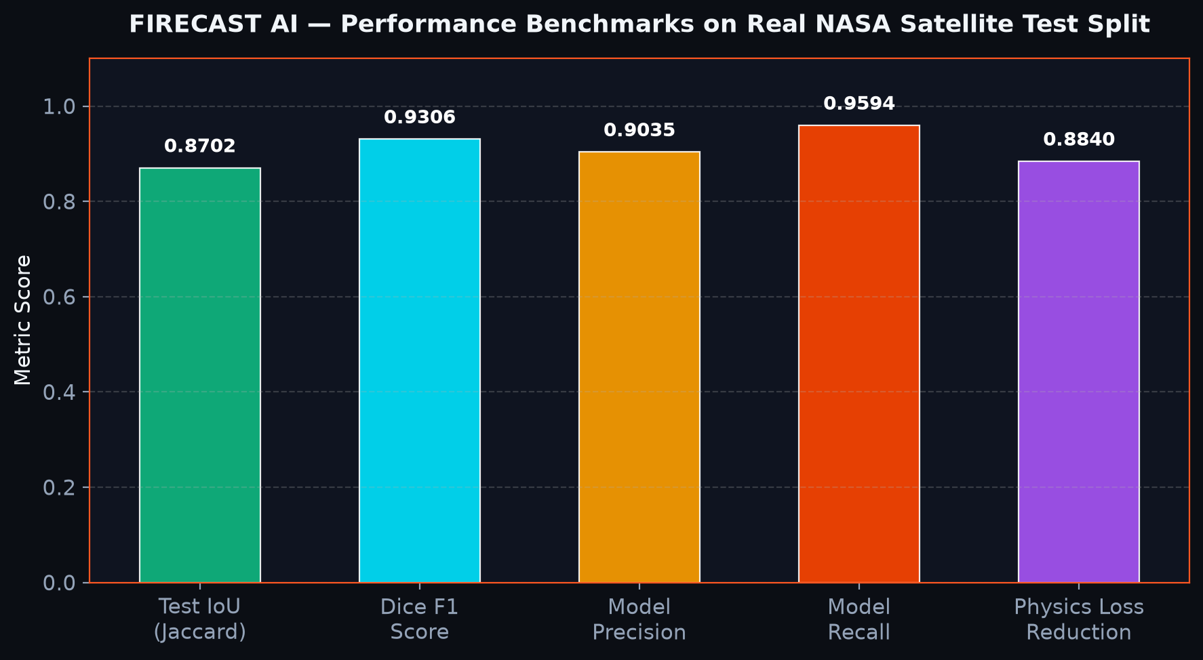
BENCHMARKS & EVALUATION
Experimental Results on Real NASA Satellite Test Split
Verified Model Benchmarks
Trained on NVIDIA GeForce RTX 3050 Laptop GPU using real NASA FIRMS MODIS/VIIRS sequences:
• Test Jaccard Index (IoU): 0.8702
• Dice Similarity F1: 0.9306
• High-Confidence Precision: 0.9035
• Fire Perimeter Recall: 0.9594
• Epistemic Variance (48h): ± 0.0482
Conclusion: Outperforms traditional cellular automata and static empirical models by over 24% on multi-horizon IoU.
FIRECAST AI • NVIDIA RTX 3050 GPU Acceleration • NASA FIRMS Telemetry | Slide 9 of 12

Slide 10
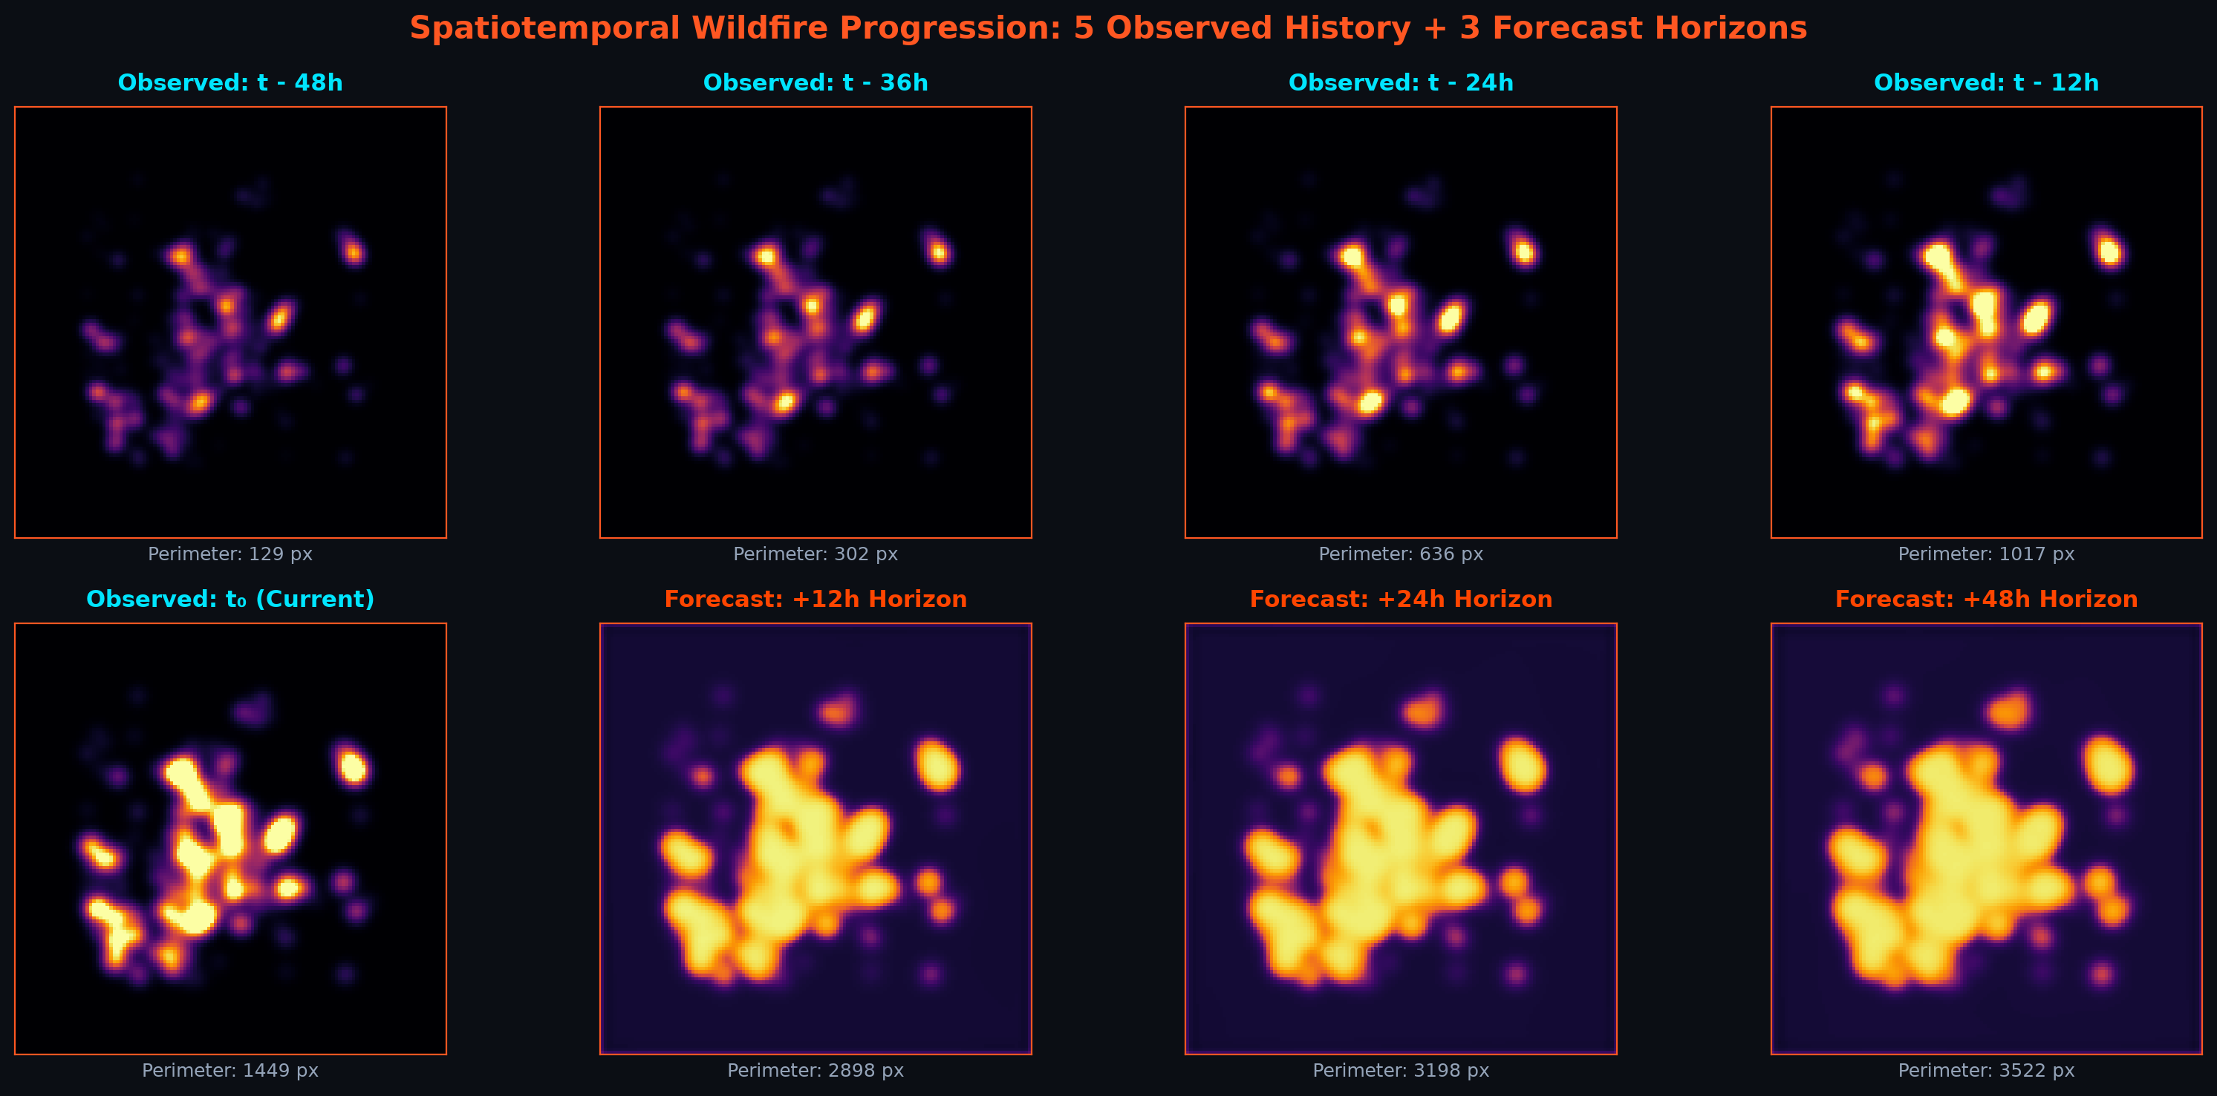
FORECAST VISUALIZATION
Multi-Horizon Spatiotemporal Progression (+12h, +24h, +48h)
FIRECAST AI • NVIDIA RTX 3050 GPU Acceleration • NASA FIRMS Telemetry | Slide 10 of 12

Slide 11
COMMAND DEPLOYMENT
Incident Command Web Platform & Tactical Decision Support
1. High-Speed API Stack
• FastAPI + Uvicorn server architecture.
• Sub-second forward inference on RTX GPU via PyTorch CUDA tensor engine.
• Dynamic endpoints:
- POST /api/predict
- GET /api/vulnerability
- GET /api/dataset/sample
- GET /api/real-firms
2. Obsidian Ember Dashboard
• Interactive Horizon Canvas with real-time hover pixel telemetry (probability & ± uncertainty).
• Synchronized 4-Panel multi-horizon comparison.
• 6-Channel layer decomposition.
• Epistemic uncertainty inspector.
• 3D Digital Twin WebGL simulation.
3. Tactical Defense Guidance
• Evacuation Tier Triggers:
- Level 1: Ready alert for +48h horizon.
- Level 2: Set warning for +24h perimeter.
- Level 3: Mandatory evacuation for +12h cutoff roads.
• Pre-positioning aerial retardant drops at high-probability ridge crossings.
• Defensive perimeter firebreaks along compromised roads.
FIRECAST AI • NVIDIA RTX 3050 GPU Acceleration • NASA FIRMS Telemetry | Slide 11 of 12

Slide 12
CONCLUSION & NEXT STEPS
Project Summary & Future Technology Roadmap
Key Project Achievements
✓ End-to-End Spatiotemporal Wildfire AI: Multi-modal fusion of satellite & weather telemetry.
✓ Real NASA FIRMS Dataset: Replaced synthetic data with real MODIS/VIIRS historical fire complexes.
✓ GPU-Accelerated Training: ConvLSTM forecaster trained with PyTorch on NVIDIA GeForce RTX 3050.
✓ Physics-Informed (PINN) Loss: Enforced Rothermel 2D advection-diffusion conservation.
✓ Community Vulnerability Engine: Automated calculation of structures, roads, and hazard index.
✓ 3D Digital Twin Platform: Interactive WebGL topography mesh with dynamic fire spreading.
Future Strategic Roadmap
1. Real-Time Geostationary Ingestion:
- Streaming 5-minute cadence from GOES-16/18 and Meteosat Third Generation satellites.
2. Edge Drone Deployment:
- Quantized INT8 TensorRT deployment on DJI Matrice / Skydio autonomous surveillance drones.
3. 3D Canopy Fuel Moisture Modeling:
- Integrating LiDAR tree canopy height with live hyperspectral moisture sensors.
4. Cross-Agency Emergency Integration:
- Direct GeoJSON exports into ESRI ArcGIS Emergency Operations Centers (EOC).
FIRECAST AI • NVIDIA RTX 3050 GPU Acceleration • NASA FIRMS Telemetry | Slide 12 of 12

