Slide 1
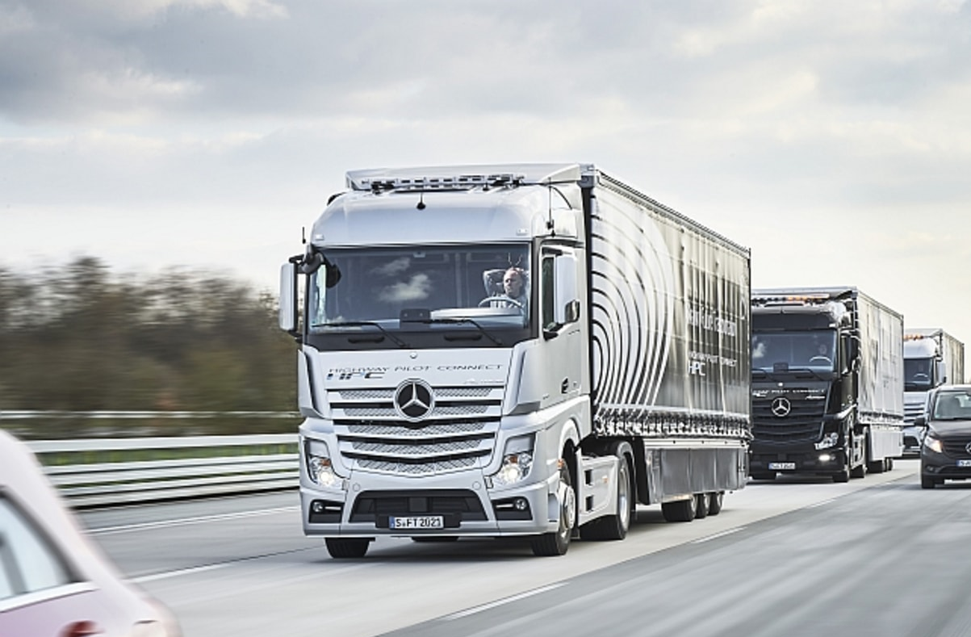
Truck
Platooning
DPS Semester Project
Team JBD
Sebastian Rudolph
Vasanth Kandiyathevan
Divya Bharti Sharma
Winter Semester 2023
Copyright Daimler

Slide 2
Table of Content
Introduction
Use case
Architecture
Base architecture
Networking computing model
Transmission control protocol
Implementation
State machine implementation
Threading in C++
Socket programming in C
Outcome
GPU computing

Slide 3
Introduction
Truck Platooning
Group of trucks in formation
Driving assistance systems
Communicating with each other
Less Drag = fewer emissions
Distributed System
Parallel Architecture
Use GPU computing
Notes:
What is a platoon in general?
What are the main tasks of the semester project?

Slide 4
Use case
Leading truck steered by human
Following trucks autonomous
Wireless communications
All trucks able to steer autonomously
Safety measurements in case of a communication failure
De-/Recoupeling in case of intruding vehicle

Slide 5
Base Architecture
Optimal: (semi centralized) peer-to-peer network (master peer) In this implementation: simple server/client communication
TCP protocol
Parallel execution with forks / threads
Statemachine (Platoon forming, coupeling, communication failure)
Notes:
TCP Divya will explain later on
Two seperate Statemachines for forming platoon / driving

Slide 6
Networking Computing model
Server / client architecture
Customer transmits request from network-enabled device.
The network server accepts and processes the user's request.
Lastly, the server sends the response to the client.

Slide 7
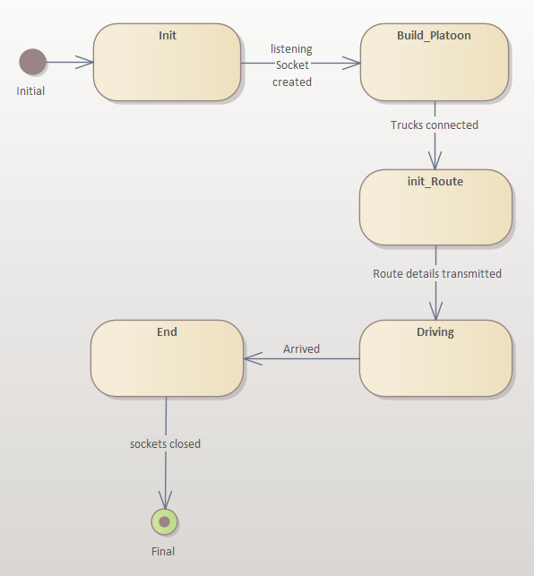
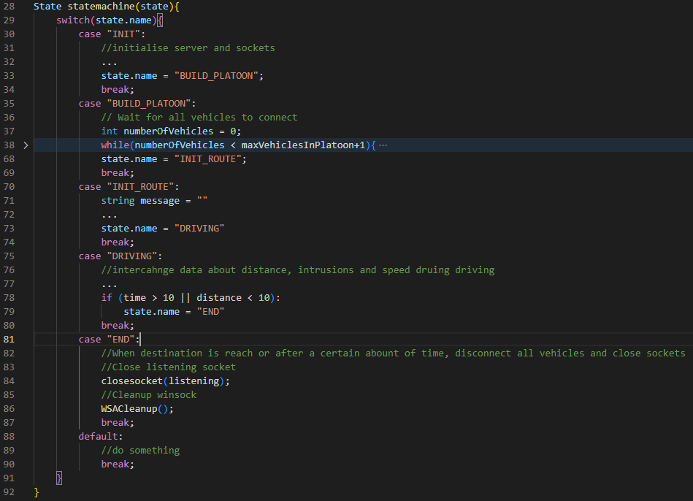
State Machine Implementation
Notes:
Init state opens listening socket
Build platoon waits for clients to connect
-> forms seperate thread for each client
Init_route shares general information
-> Position in Platoon
-> Route
-> other presets
Driving
Communicating
sharing up to time data
When arrived,
Close sockets
Clean up

Slide 8
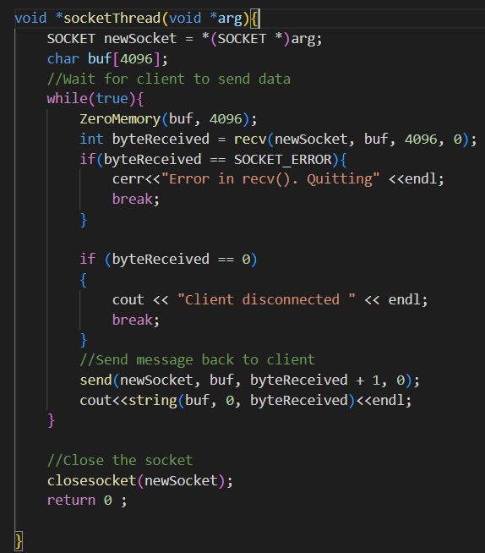
Threading in C++

Slide 9
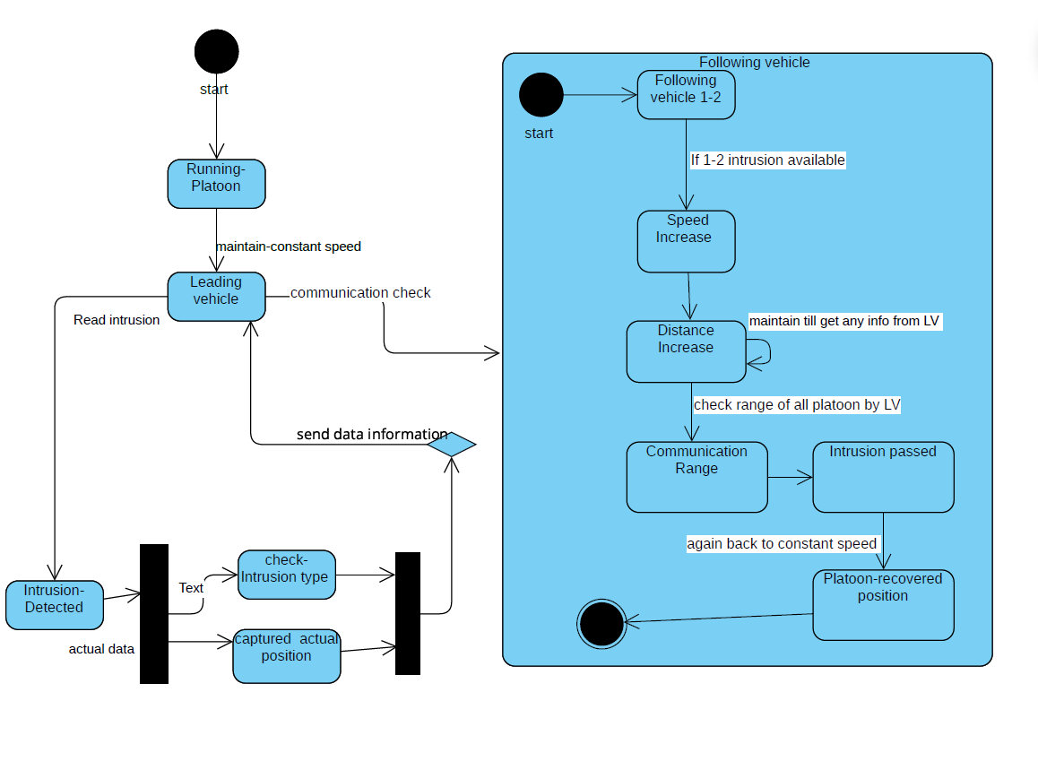
Intrusion State Machine
If another vehicle approaches between the two following trucks,
the leading platoon stabilizes the other following vehicles by offering guidance.
Maintain distance
Maintain speed

Slide 10

Transmission Control Protocol/Internet Protocol
Server-client distributed architecture using TCP/IP
Smooth transmission of data between devices
connection-based protocol with error-checking method:
If the client doesn’t respond with suitable connection, circuit is closed
both the server and client acknowledgement are satisfied

Slide 11
Socket Programming
Connecting two nodes in a network to communicate with each other.
Socket()
End point of two-way communication between programs which are running on network.
Bind()
Listen()
Accept()
Connect()
Send()/Recv()

Slide 12
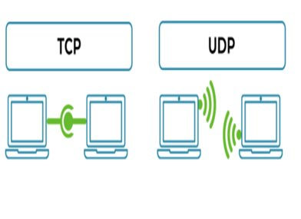
Socket Programming( contd.)
Two Sockets
Stream socket:
More reliable, fast, error checking is easy if any
packet is lost in between then it is lost in between
Then again sends the information to server.
Also, it is connection oriented between sender
And receiver.
2. Datagram Socket:
Connection free, lost packet are not send again
by sender.

Slide 13
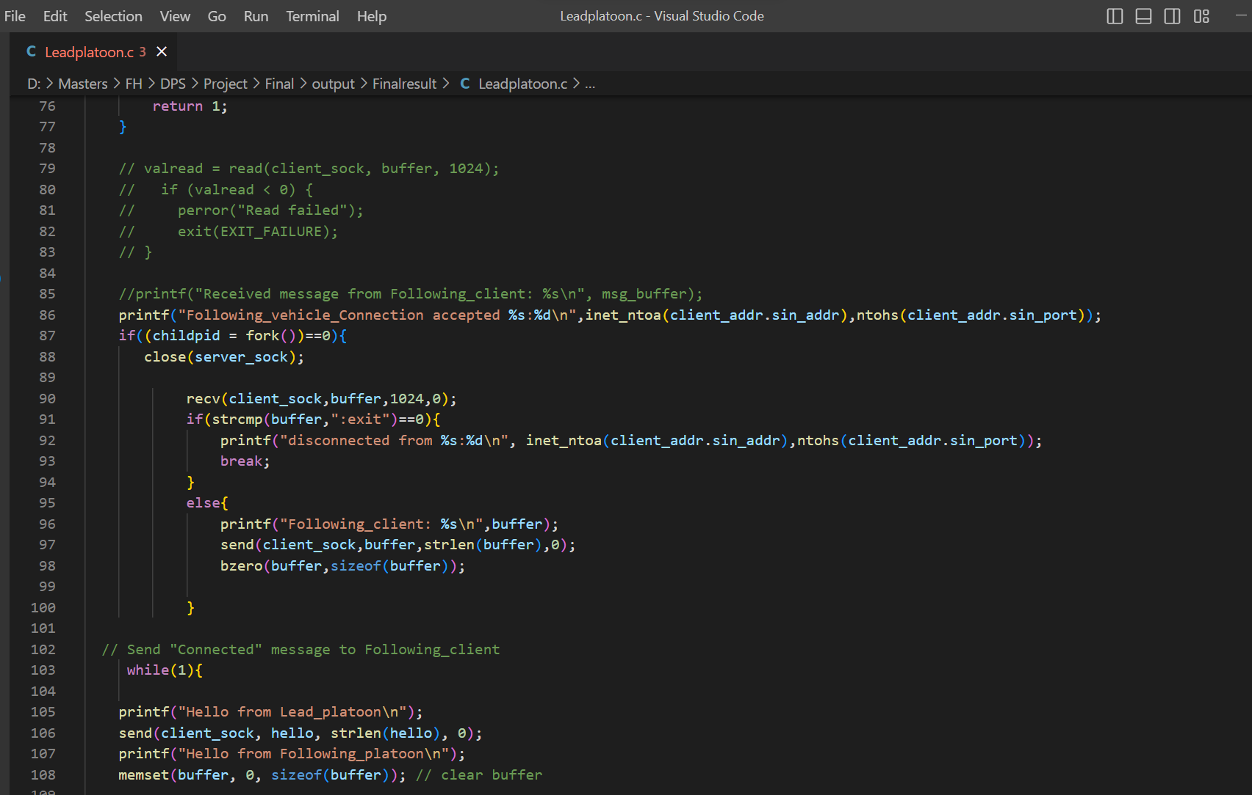
Socket Programming in C
Server (Lead-Vehicle)
Fork()
Creates a new child process with unique ID.
CODE:
https://github.com/Divyabhartisharma/Vehicle-Platooning/blob/main/Final/Leadplatoon.c

Slide 14
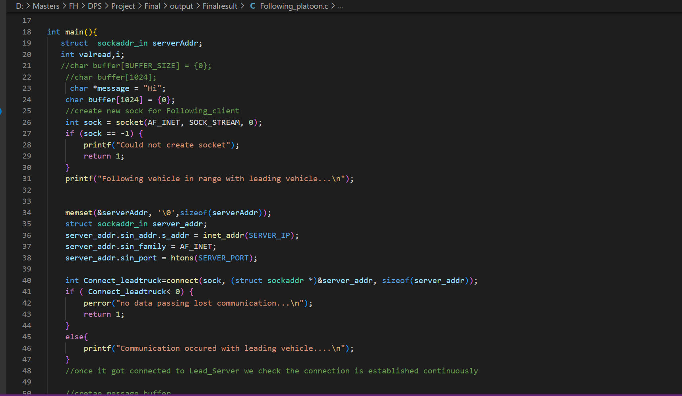
Socket Programming in C
Client (Following-Vehicle)
Data is being sent by defining buffer and with write and read.
CODE:
https://github.com/Divyabhartisharma/Vehicle-Platooning/blob/main/Final/Following_platoon.c

Slide 15
Outcome
Check_from_leading_vehicle...
Bind Successful with Lead vehicle.....8888
Listening to following vehicles...
Following_vehicle_Connection accepted 127.0.0.1:34294
Following_client: Hi
Hello from Lead_platoon
Hello from Following_platoon
Following_Client: Hi
constant speed sent: 60
Following_client: What is the speed?
constant Distance between sent trucks : 10
Following_client: What is the distance?
new_speed maintain until object there: 40
Following_client: intrusion
new_distance maintain until object there : 20
Following_vehicle_Connection accepted 127.0.0.1:59794
Following_client: HiHi
Hello from Lead_platoon
Hello from Following_platoon
Following_Client: What is the speed?
constant speed sent: 60
Following_client: What is the distance?
constant Distance between sent trucks : 10
Following_client: intrusion
new_speed maintain until object there: 40
Following_client: ok
new_distance maintain until object there : 20

Slide 16
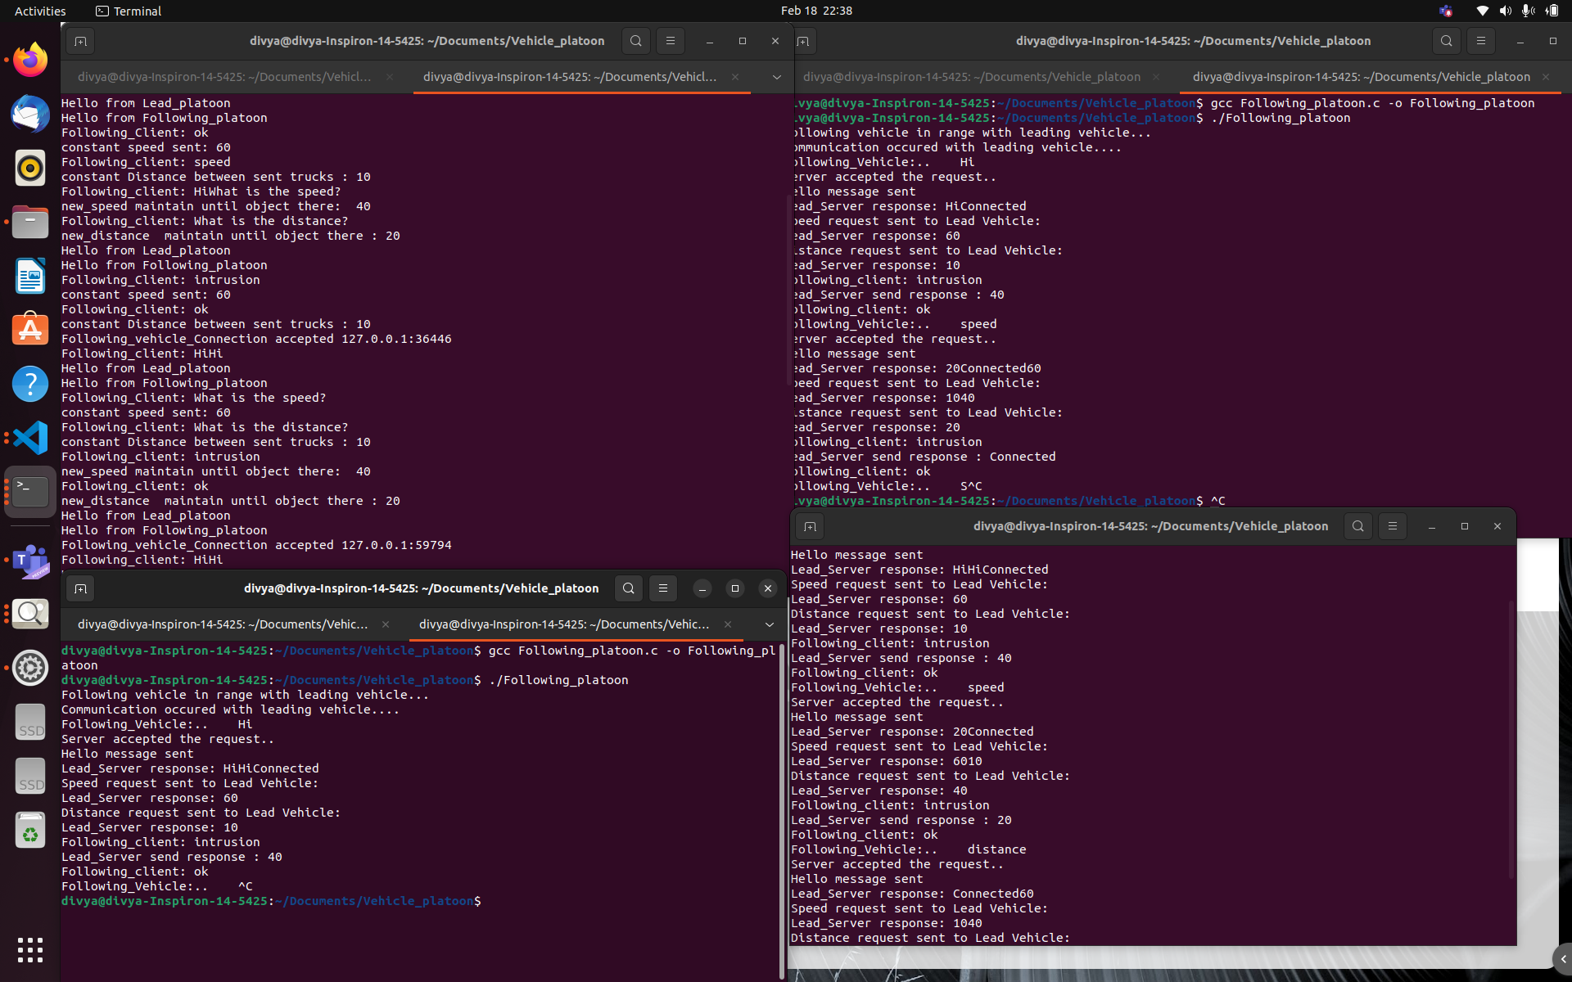
Outcome

Slide 17


Cloud GPU computing
Cloud GPU computing, refers to the use of remote graphics processing units (GPUs) to perform computations in the cloud.
GPU computing has become increasingly popular for applications that require high-performance computing.
We have used Google Colab for GPU computing.
Notes:
Online GPU computing, also known as cloud GPU computing, refers to the use of remote graphics processing units (GPUs) to perform computations in the cloud. GPU computing has become increasingly popular for applications that require high-performance computing. We have used Google Colab for the GPU computing.
Google Colab
Google Colab provides two types of GPU: Tesla K80 and Tesla T4. Tesla T4 is the more powerful of the two, offering up to 16 GB of GPU memory compared to the Tesla K80's 12 GB.

Slide 18
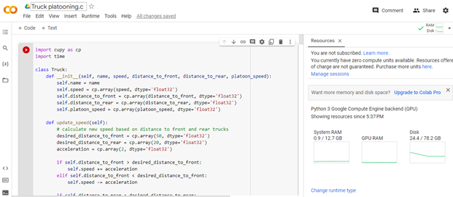
GPU computing using Google Colab
Notes:
For executing C/C++ in Google Colab we need to enable the CUDA environment which will take a good amount of time whereas Python could be implemented directly in Jupyter for GPU computing. So we have converted the C code which we have implemented in the Colab to python.
We implemented a platoon of three trucks and simulated their movement based on their speed and distance from other trucks in the platoon. This simulation is based on a model that does not take into account factors such as traffic, road conditions, weather, and the actions of other drivers on the road

Slide 19
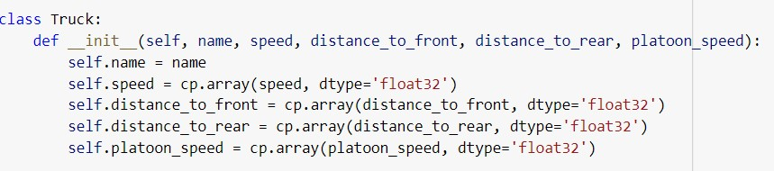
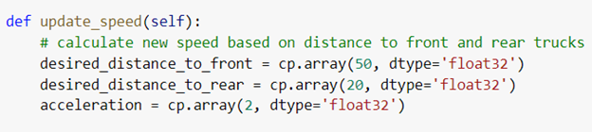
GPU computing code
Truck properties declaration
Update Speed function
Notes:
The Truck class represents each truck in the platoon. The __init__ method initializes each truck's properties, including its name, speed, distance to the front and rear trucks, and the platoon speed. The update_speed method updates each truck's speed based on the distance to the front and rear trucks, and the desired distance to maintain between them.
In the Truck class, the name attribute is declared as an instance variable using self.name = name. This means that each instance of the Truck class will have its own name attribute, which can be accessed and modified using the instance's name property.

Slide 20
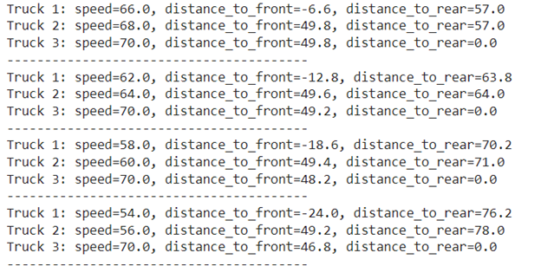
GPU computing output
Notes:
In the first output, the speed is 68kmph, distance to the rear truck is 57 feet which can be seen and for truck 2 and truck 3 have the same distance to the front truck of 49.8 feet. In the next output sequence, it can be seen the speed of truck 1 and truck 2 have decreased to 62 kmph and 64 kmph respectively as the distance to the rear truck has increased which will be intimidated by the update_distance() function. While truck 3 speed remains at the same speed of 70 kmph to remain in the platoon
(): calculates a new speed for the truck based on its current distance to the front and rear trucks and the platoon speed limit.

Slide 21
Conclusion
Inconclusive about language (C / C++)
GPU computing worked separately
Got threading only working in C++
State machine + threading did not work properly
Final step of combining efforts was not achieved

