Slide 1
INTRODUCTION HTM,CSS, JAVASCRIPT
PRESENTED BY-
D.DIVYA
24524U18024
KARAN ARTS AND SCIENCES COLLEGE
TIRUVANNAMALAI

Slide 2
INTRODUCTION
This presentation covers the basics of web development with a focus on HTML, CSS, and JavaScript. Learn how these technologies create the structure, style, and interactivity of websites.

Slide 3
OVERVIEW OF WEB DEVELOPMENT
Web Development = building and maintaining websites.
Uses HTML (structure), CSS (style), JavaScript (interactivity).

Slide 4
HTML (Hypertext MarkUP Language)
HTML is the lingua franca for publishing hypertext on the World Wide Web
Define tags <html><body> <head>….etc
Allow to embed other scripting languages to manipulate design layout, text and graphics
Platform independent
Current version is 4.x and in February W3C released the first draft of a test
suite 4.01
For more info: http://www.w3.org/MarkUp

Slide 5
HTML (Hypertext Markup Language)
Example HTML code:
<HTML>
<head>
<title>Hello World</title>
</head>
<body bgcolor = “#000000”>
<font color = “#ffffff ”>
<H1>Hello World</H1>
</font>
</body>
</HTML>

Slide 6
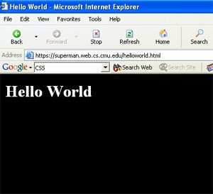
HTML (Hypertext Markup Language)
An HTML document starts with a doctype declaration and contains nested elements like head and body that organize content logically.

Slide 7
CSS (Cascading Style Sheet)
Controls format:
▶ Font, color, spacing
▶ Alignment
▶ User override of styles
▶ Aural CSS (non sighted user and voice-browser)
▶ Layers
▶ Layout
▶ User Interface

Slide 8
CSS OF EXAMPLE
Client’s browser dependable
Example code:
p,h1,h2 {
margin-top:0px;
margin-bottom:100px;padding:20px 40px 0px 40px;
}

Slide 9
CSS (COADING)
<HTML>
<head>
<title>Hello World</title>
<style type=“text/css”> p,h1,h2 {
margin-top:0px;
margin-bottom:100px;padding:40px 40px 0px 40px;
}
</style>
</head>
<body bgcolor = “#000000”>
<font color = “#ffffff ”>
<h1>Hello World<h1>
</font>
</body>
</HTML>

Slide 10
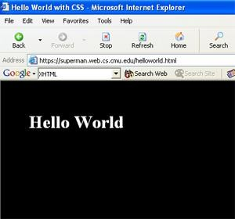
CSS (STYLING AND LAYOUT PRINCIPLES)
CSS manages site appearance including colors, fonts, spacing, and layout to create visually appealing and usable webpages.

Slide 11
RESPONSIVE DESIGN TECHNIQUES
Responsive design uses flexible grids, images, and media queries to ensure websites adapt smoothly to different screen sizes and devices.

Slide 12
BASICS OF JAVASCRIPT
Compact object-based scripting language
Code be embedded into HTML file
HTML tag
<script language=“javascript”>CODE</script>
Also be in a separate file FILENAME.js
HTML tag
<SCRIPT LANGUAGE="JavaScript" SRC=“FILENAME.js"></SCRIPT>

Slide 13
JAVASCRIPT
Main objectives:
User interface, CGI capabilities without involving server
Client side compilation
Server provides no support
Security hazard for client’s computer
SCS websites JavaScript's Examples

Slide 14
CONCLUSION
Mastering HTML, CSS, and JavaScript provides the foundation for building modern, accessible, and engaging websites that meet today’s digital standards.

Slide 15
THANK YOU

