Slide 1
Digital Portfolio
STUDENT NAME: M.DIVYADHARSHINI
REGISTER NO AND NMID:FDA6BB6CFF3169BBBFF4C32DA0CBF425
DEPARTMENT: Bsc.Computer Science
COLLEGE: Krishnasamy College of science,arts and management for women

Slide 2
PROJECT TITLE
DIGITAL PORTFOLIO

Slide 3


AGENDA
Problem Statement
Project Overview
End Users
Tools and Technologies
Portfolio design and Layout
Features and Functionality
Results and Screenshots
Conclusion
Github Link
3/21/2024 Annual Review

Slide 4

PROBLEM STATEMENT
In today’s digital era, individuals are expected to showcase their skills, achievements, and
experiences in a manner that is accessible, professional, and engaging. Traditional paper-based
portfolios or static résumés are often limited in reach, interactivity, and adaptability. They fail to fully
demonstrate creativity, digital literacy, and the dynamic progression of an individual’s words.

Slide 5

PROJECT OVERVIEW
The Digital Portfolio Project aims to create an interactive online platform where individuals can showcase their skills, achievements, and personal growth in a
professional and visually appealing manner. Unlike traditional paper-based portfolios or résumés, this solution provides a dynamic, multimedia-driven space that
highlights the individuality and capabilities of its users.
The system will allow users to:
Create personalized profiles.
Upload and organize academic, professional, and creative work.
Integrate multimedia elements such as images, videos, and documents.
Customize the look and layout to reflect personal branding.

Slide 6

WHO ARE THE END USERS?
1. Students (School/University)
To showcase academic projects, assignments, certificates, and extracurricular activities.
Useful for admissions, internships, and scholarships.
2. Job Seekers / Fresh Graduates
To present résumés, skills, certifications, and sample work in a modern and interactive way.
Helps them stand out in competitive job markets.
3. Working Professionals
To build a personal brand and demonstrate career achievements, case studies, or creative portfolios.
Useful for promotions, networking, or freelance opportunities.
4. Creative Professionals (Designers, Photographers, Writers, Developers, etc.)
To display creative projects, code samples, artwork, photography, or published content.
Acts as an online showcase for clients or employers.
5. Educational Institutions
Teachers or universities can use digital portfolios to evaluate student progress and learning outcomes.
Helps in maintaining digital records for academic accreditation.
6. Employers / Recruiters (Indirect Users)
The benefit by easily accessing,reviewing, and. verifying candidates skills and work.

Slide 7

TOOLS AND TECHNIQUES
Tools: Figma (design), Canva (graphics), Notion (content organization)
Technologies: HTML, CSS, JavaScript, React, GitHub Pages (deployment)

Slide 8
POTFOLIO DESIGN AND LAYOUT
1. Homepage / Introduction
Clean, minimal landing page with a professional headshot or banner.
Brief introduction or tagline (who you are and what you do).
Navigation bar for easy access to different sections.
2. About Me Section
Personal background, career/academic goals, and philosophy.
Clear and concise narrative to make the portfolio personable.
3. Skills
Displayed using icons, progress bars, or interactive charts.
Categorized into technical skills, soft skills, and tools/software knowledge.
4. Projects
Grid or card-based layout showcasing projects, assignments, or case studies.
Each project includes:
Title and description
Role and tools used
Images, demos, or links (e.g., GitHub, Behance, live website)
Roles, achievements, and key contributions.
5.Contact Section
Page 07
Contact form and/or email.
Links to LinkedIn, GitHub, or social media (professional only).
8

Slide 9
FEATURES AND FUNCTIONALITY
Feature:
A characteristic or attribute of a product.
Example: A smartphone has a high-resolution camera.
Functionality:
The practical use or action that the feature enables.
Example: That high-resolution camera allows you to take 4k videos and capture details photos.

Slide 10
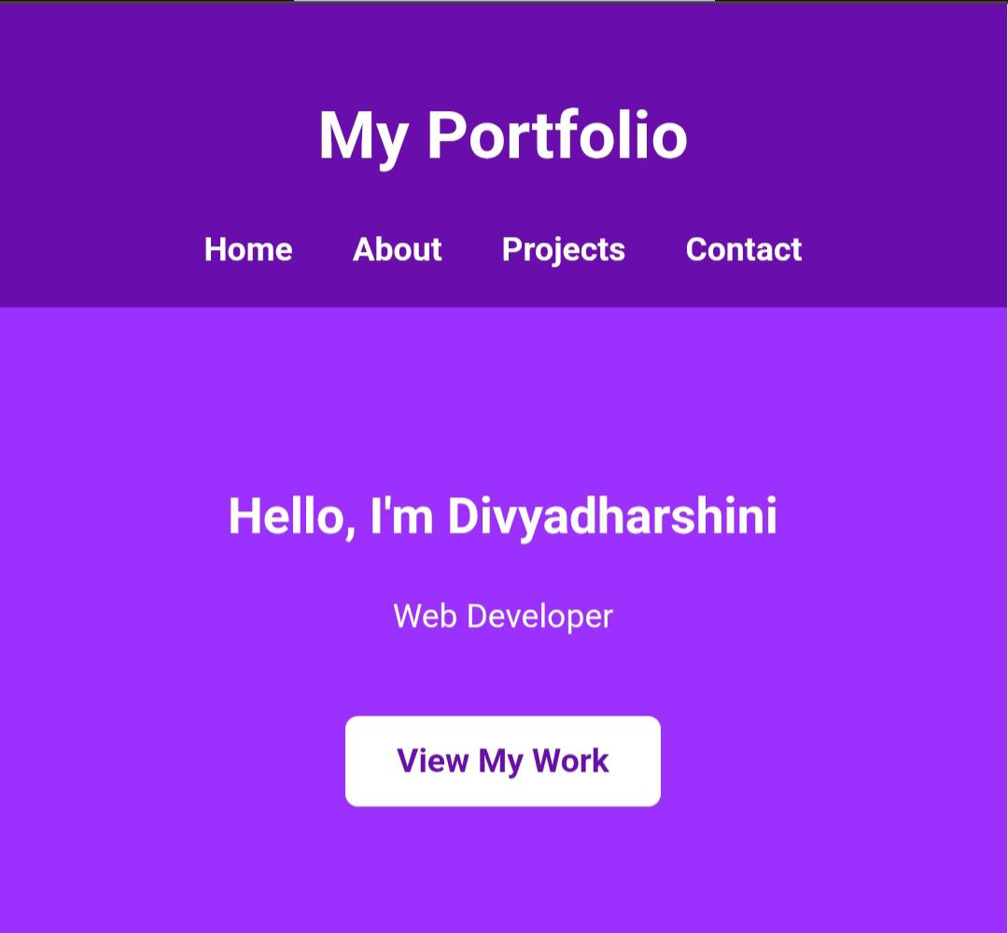

RESULTS AND SCREENSHOTS
3/21/2024 Annual Review
10

Slide 11
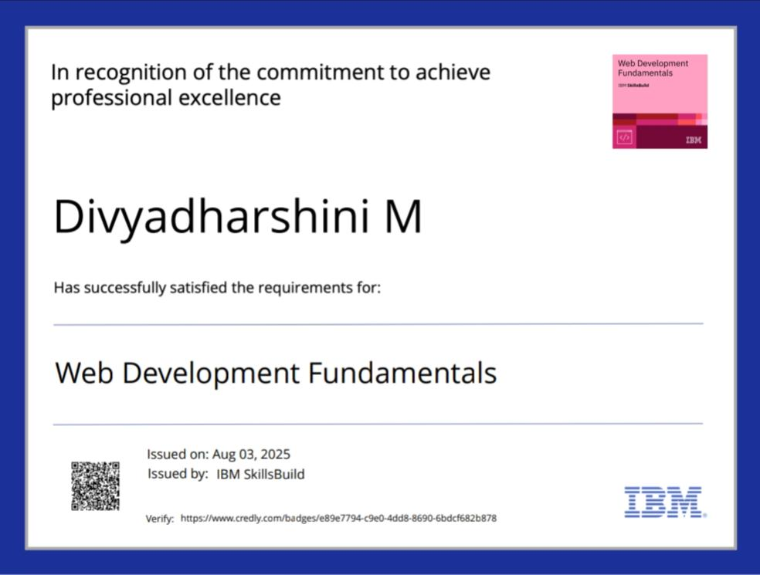
RESULTS AND SCREENSHOTS

Slide 12
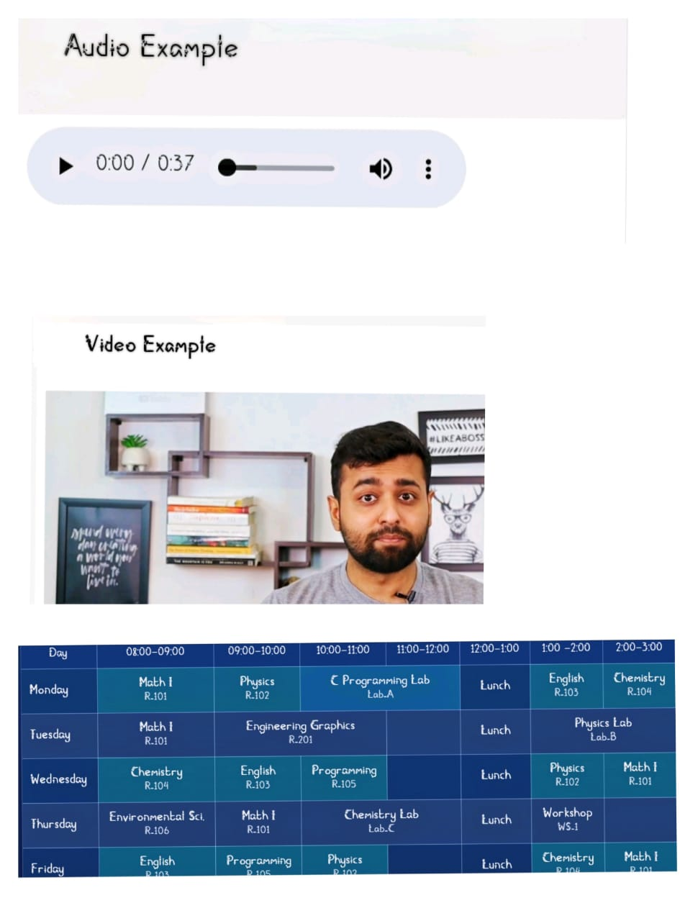
RESULTS AND SCREENSHOTS

Slide 13
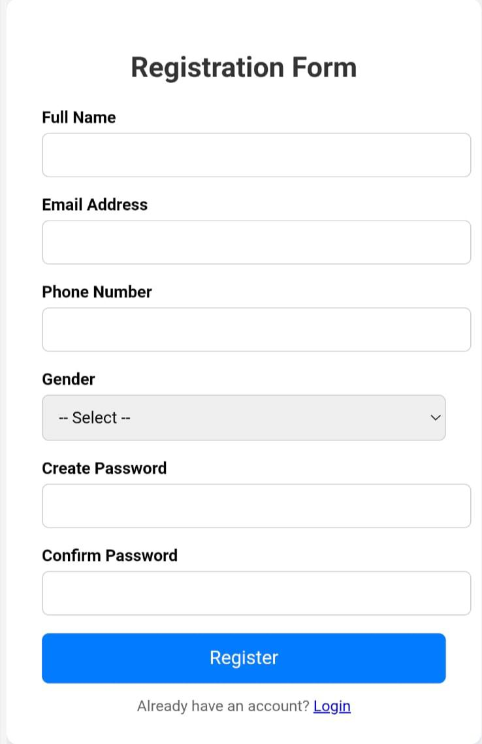
RESULTS AND SCREENSHOTS

Slide 14
CONCLUSION
“The digital portfolio serves as a professional
platform to showcase my skills, projects, and
achievements. It highlights my ability to presen
work clearly and creatively while providing easy
access for employers, clients, and collaborators
This project enhanced my technical and design
skills and will continue to evolve as I grow
Professionally”.
14

