Slide 1




NEXT GEN EMPLOYABILITY PROGRAM
Creating a future-ready workforce
MEMBER:
College Name
Student Name : Divyadharshni K V
Student ID :311121205018
LOYOLA ICAM COLLEGE OF ENGINEERING AND TECHNOLOGY

Slide 2

CAPSTONE PROJECT SHOWCASE
Project Title
Music Web Application using Django Framework
Abstract | Problem Statement | Project Overview | Proposed Solution | Technology Used | Modelling & Results | Conclusion

Slide 3
Abstract
In today's digital age, music has become an integral part of our lives, and the demand for online music streaming platforms is continuously growing. In response to this demand, this project aims to develop a music web application using the Django framework, a high-level Python web framework known for its simplicity and scalability.
The proposed web application will provide users with the ability to discover, listen to, and organize their favorite music tracks conveniently. Key features of the application include user authentication, a vast music library, playlist creation, search functionality, and a seamless listening experience across various devices.
Overall, the music web application developed using the Django framework aims to provide users with a seamless and enjoyable music streaming experience while showcasing the power and versatility of Django in web development.
Source :

Slide 4
Problem Statement
Developing a Django-based music streaming web application to provide users with a personalized, feature-rich, and secure platform for discovering, organizing, and streaming music seamlessly.
Source :

Slide 5
Project Overview
The project involves developing a music streaming web application using the Django framework, focusing on user authentication, a comprehensive music library, playlist management, search functionality, responsive UI, seamless streaming, external API integration, scalability, security, documentation, and testing to deliver a personalized, feature-rich, and secure platform for users to discover, organize, and enjoy music seamlessly across devices.
By incorporating these features and adhering to best practices in web development, the project aims to deliver a high-quality music streaming platform that offers users a seamless and enjoyable listening experience while showcasing the capabilities of the Django framework.
Source :

Slide 6
Proposed Solution
.
The proposed solution involves developing a robust music streaming web application using the Django framework, encompassing essential features such as user authentication, playlist management, comprehensive music library, responsive UI, and seamless streaming. Through Django's built-in authentication system, users will be able to securely sign up, log in, and manage their profiles, while a sophisticated backend system will facilitate efficient organization and retrieval of music tracks and albums. Integration with external APIs like Spotify will enrich the music library with metadata and cover art, enhancing the user experience. The frontend will be designed with responsiveness in mind, ensuring a seamless experience across devices. Additionally, stringent security measures and thorough documentation will be implemented to safeguard user data and facilitate easy deployment and maintenance.
By leveraging Django's capabilities and adhering to best practices in web development, the proposed solution aims to deliver a user-friendly, feature-rich music streaming platform that caters to the evolving needs of music enthusiasts while prioritizing security, scalability, and seamless user experience.
Source :

Slide 7


Technology Used
Front-end
Back-end
Source :

Slide 8
Modelling & Results
In modeling the music streaming web application, a relational database schema will be designed using Django's ORM to represent entities such as users, music tracks, playlists, and user interactions. User authentication and profile management will be modeled to store user credentials securely and manage user preferences and playlists. The music library will include tables for artists, albums, and tracks, with relationships established to allow efficient querying and retrieval of music content. Additionally, metadata from external APIs can be stored to enrich the music database further.
Furthermore, the frontend model will focus on creating responsive and intuitive user interfaces using HTML, CSS, and JavaScript frameworks like Bootstrap or React. Model views will be designed to interact seamlessly with the backend, facilitating actions such as playlist creation, music playback, and search functionality. AJAX techniques can be employed to enable asynchronous communication between the frontend and backend, enhancing user interactivity and experience. Overall, the modeling approach aims to create a well-structured and efficient system that delivers a cohesive and engaging music streaming platform.
Source :

Slide 9
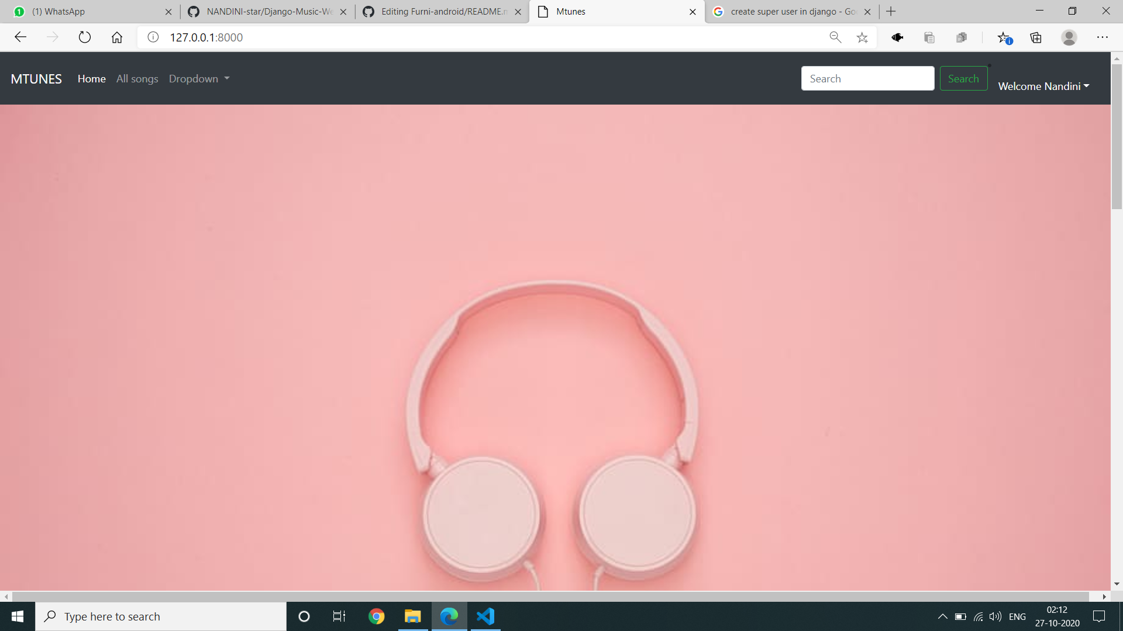
Homepage

Slide 10
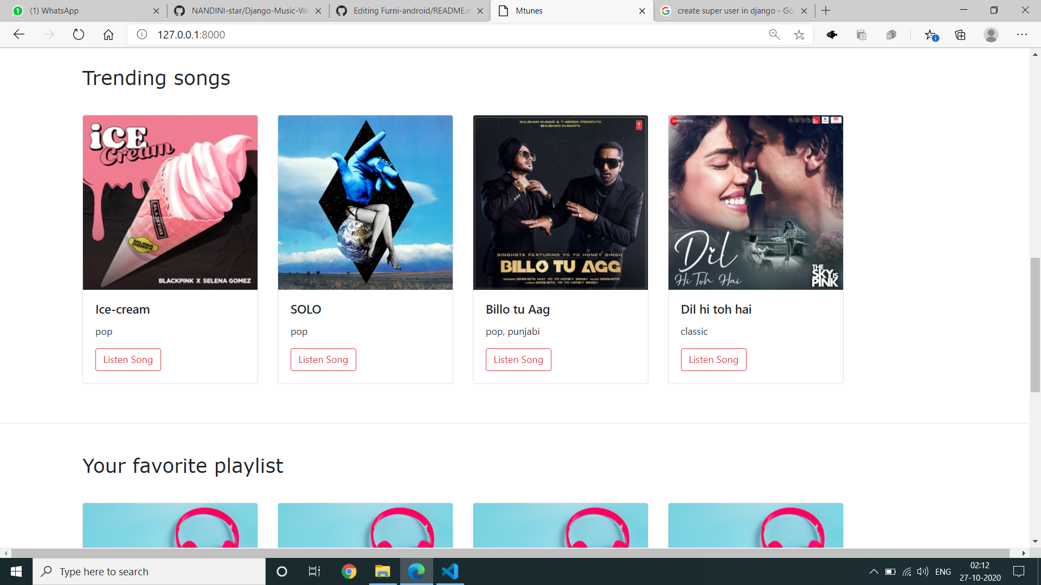
About-Us-Page

Slide 11
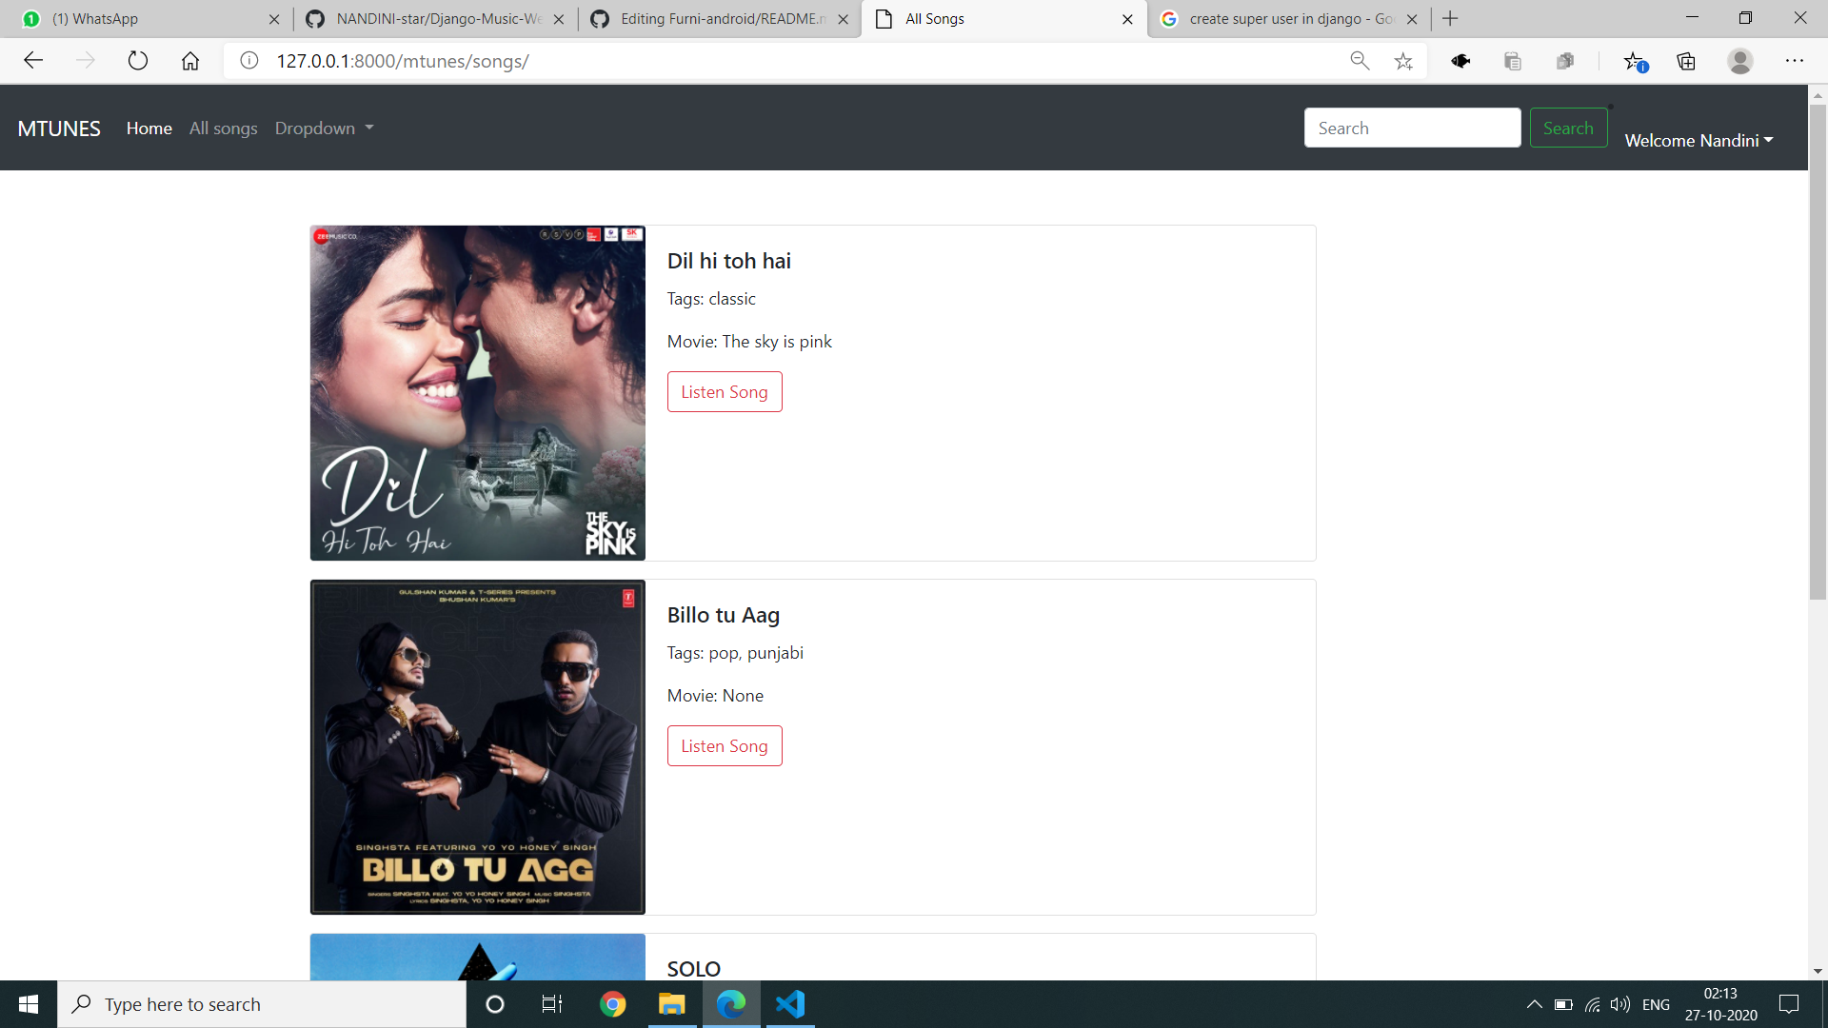
All songs page

Slide 12
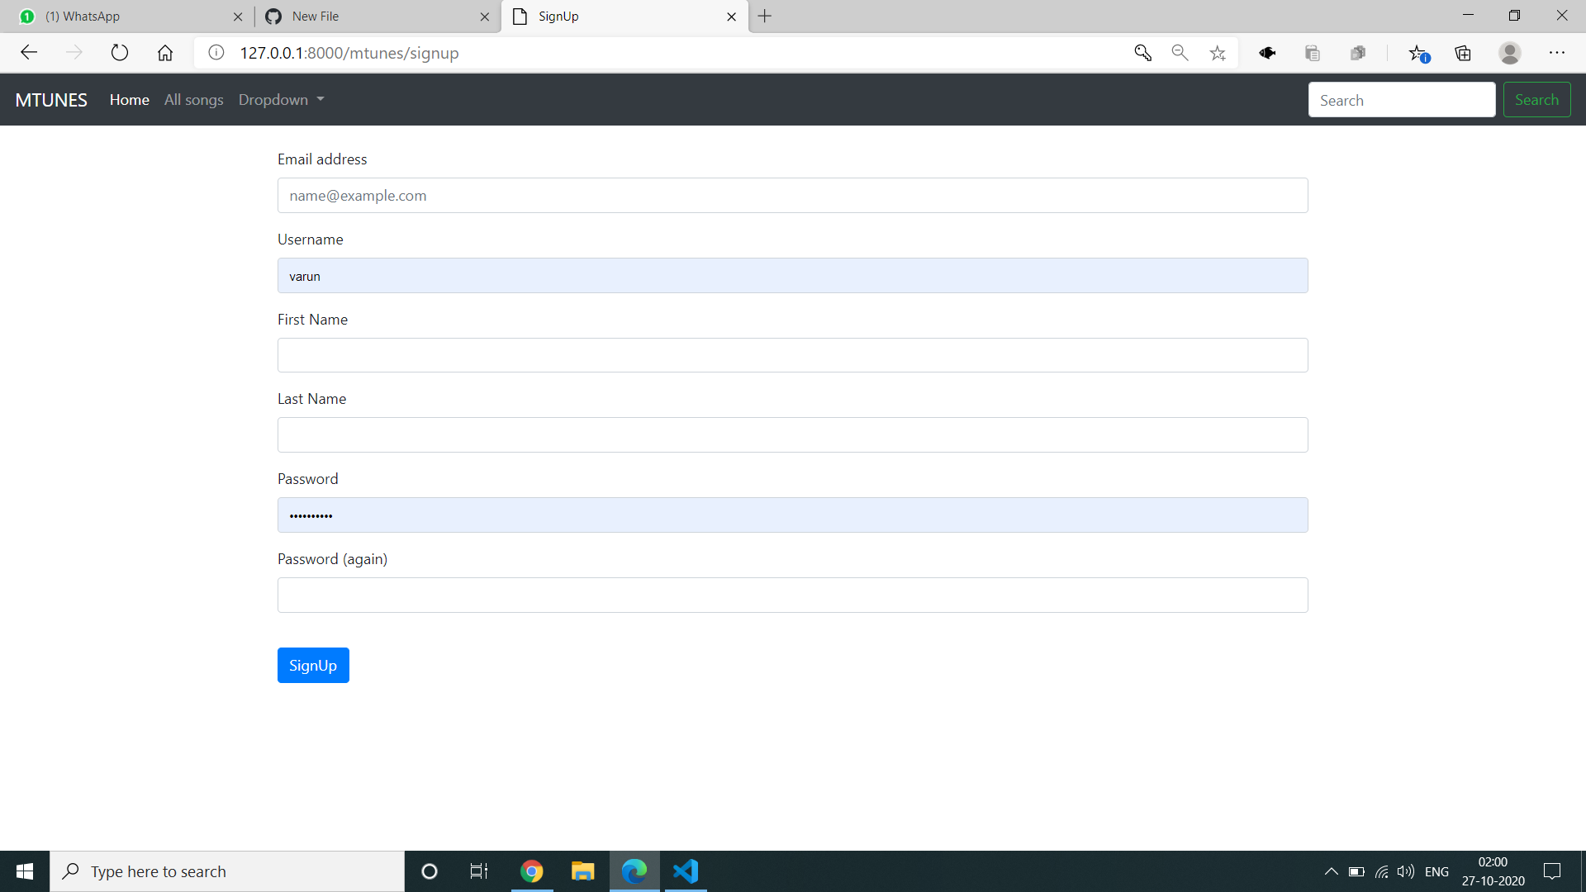
Sign up page

Slide 13
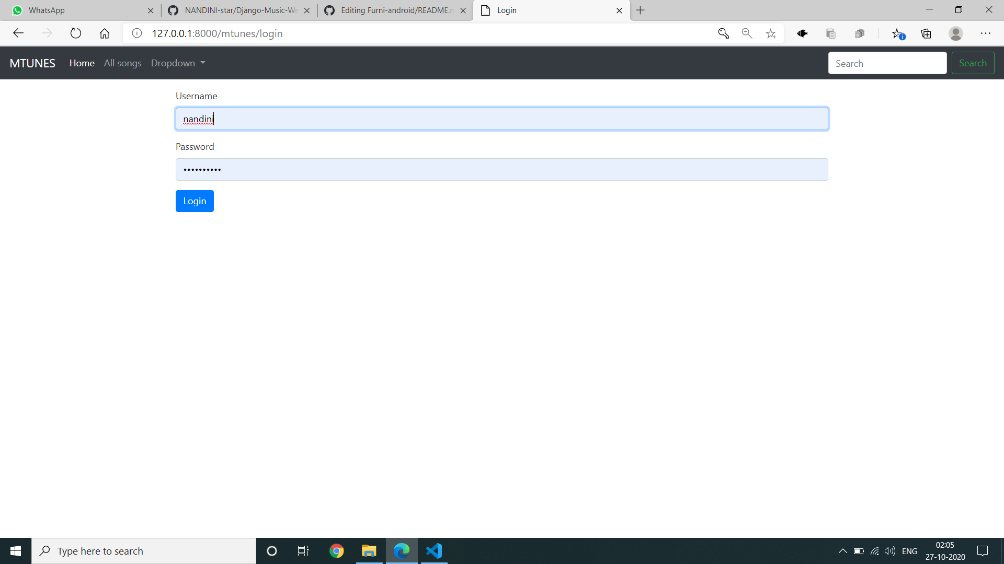
Login page

Slide 14
Future Enhancements:
In future iterations, the music streaming web application could introduce features like social integration, allowing users to follow friends, share playlists, and engage in discussions about music.
Additionally, personalized recommendation systems could be implemented, leveraging machine learning algorithms to suggest music based on individual listening habits and preferences.
Furthermore, the application could expand its content offerings to include podcasts and audiobooks, catering to a wider range of audio enthusiasts.
Enhancements such as offline playback for mobile devices and multi-language support would also enhance accessibility and user experience, ensuring the platform remains competitive and adaptable to diverse user needs and preferences.

Slide 15
Conclusion
In conclusion, using the Django framework for mobile web development offers numerous benefits.
Django provides a robust and scalable backend infrastructure, allowing for efficient data management and processing.
Its built-in security features help safeguard sensitive information, ensuring a secure user experience.
Additionally, Django's extensive documentation and vibrant community support facilitate rapid development and troubleshooting.
By leveraging Django's versatility and flexibility, developers can create dynamic and responsive mobile web applications tailored to meet the demands of modern users.
Overall, Django emerges as a powerful tool for mobile web development, enabling developers to deliver high-quality solutions efficiently.
our music web application project, Harmony Hub, represents a significant step towards revolutionizing the way users interact with music online. Through the integration of Django technology and advanced recommendation algorithms, we have created a platform that offers personalized music exploration and discovery tailored to individual preferences. The emphasis on social interaction fosters a sense of community among users, facilitating the sharing of playlists and collaborative music discovery. Harmony Hub's responsive design ensures a seamless experience across devices, further enhancing user satisfaction and engagement.
Source :

Slide 16
Thank You!
Notes:
Thank You !!

