Slide 1
CUSTOMER SEGMENATATION USING MACHINE LEARNING IN R
By
Name: Divyagandh Pokala
College Name: Gayatri Vidya Parishad College of Engineering
Education Stream: B.Tech, Computer Science and Engineering
EmailId: divyagandh08@gmail.com

Slide 2
INTRODUCTION
To the solution of reaching out customers and Understanding customer sentiments about products is of utmost priority for any product company including HP.
Consumers give feedbacks on social meadia platfroms as they are engaged with those platform.
It also helps the organization reach customers easily and get to know consumer sentiments first-hand so that it can make better products with great user experience and resolve customer issue faster. We need a one stop knowledge store, which can store reviews.
To get one stop store my idea is to make customer segmentation according to their complaints appreciantiosn, user experience defects and all.

Slide 3
PROPOSED WORK
Creating clusters with more data quality which is more cost effective.
It is based in quality grouping.
Here we are using k means algorithm to cluster the consumers or customers.
Advantages of our Proposed Work
Implementing customer segmentation leads to plenty of new business opportunities.
You can do a lot of optimization in:
Budgeting
product design
Promotion
Marketing
customer satisfaction

Slide 4
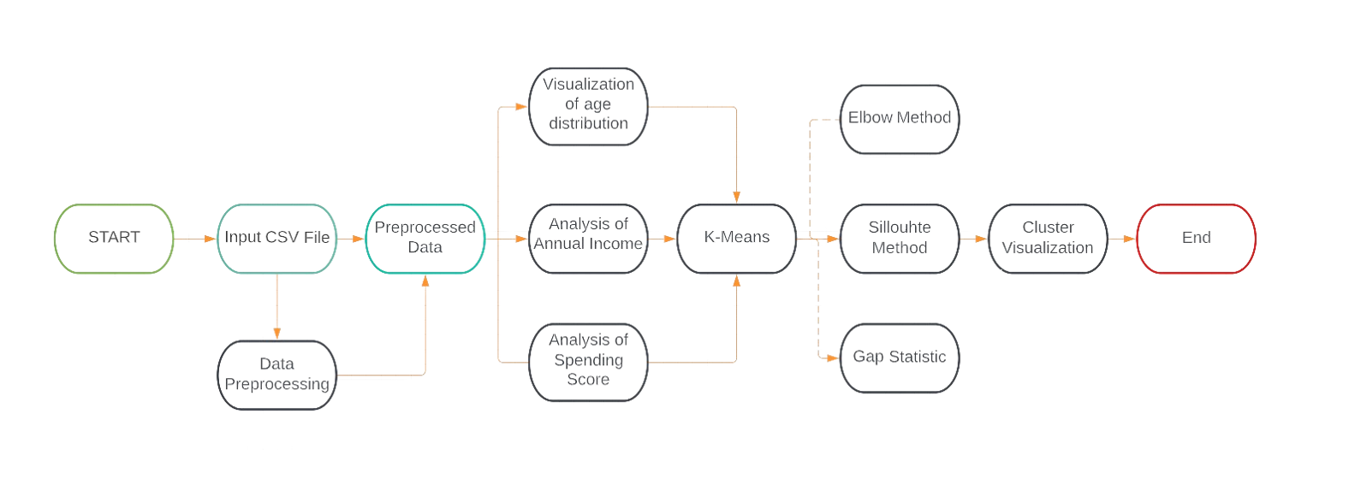
DATA FLOW DIAGRAM
Flow of the algorithm

Slide 5
SOLUTION
The solution is attached outside I have done analysis and visualization of the FLIPKART CUSTOMER DATA.
In this we can make analysis and plots. By using those data we can try to improve the product of certain section of people.

Slide 6
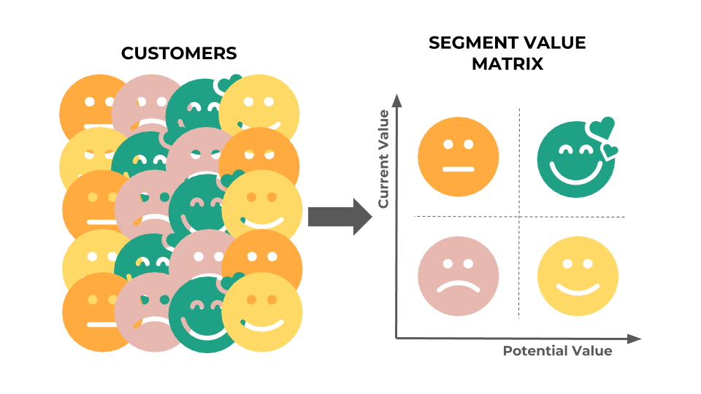
RESULTS
Input Must be given in a pre-formatted Excel File
When Compared with all the three algorithms in K-means which are Elbow method, silhouette and Gap statistic the silhouette has more accuracy
The Analysed Data will be Represented in the form of Various Clusters based on their segmentation

Slide 7
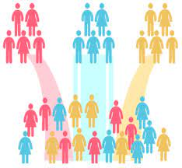
CONCLUSION
In this data science project, we went through the customer segmentation model. We developed this using a class of machine learning known as unsupervised learning. Specifically, we made use of a clustering algorithm called K-means clustering. We analyzed and visualized the data and then proceeded to implement our algorithm.

Slide 8
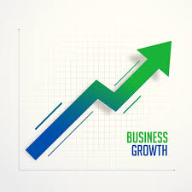
FUTURE SCOPE
In Future if required the project can be integrated to a website to develop and make the service available for anyone so that though a web page the csv file can be taken as an input and Directly display the clusters which is nothing but the segmented customers as per the given data.

Slide 9
THANK YOU

