Slide 1

BRAIN TUMOUR DETECTION
Final Evaluation
Presenter Humaira Gani (2020A1R124)
DEPARTMENT OF COMPUTER SCIENCE AND ENGINEERING
MIET(Autonomous), JAMMU

Slide 2
Contents
Problem Statement
Solution
Need
Objective
Workﬂow
Survey
Demonstration
2

Slide 3
PROBLEM STATEMENT
Automated defect detection in medical imaging has become an emergent ﬁeld in several medical diagnostic applications. The conventional method for defect detection in magnetic resonance brain images is human inspection. This method is impractical due to a large amount of data and sometimes took a long while due to unavailability of the respective doctor. In this project, it is proposed with machine learning algorithms to overcome the drawbacks from any source where tumor is detected in brain MRI using machine learning algorithms.

Slide 4
Solution
Let’s have a look over the solution part :
D We have created a system which will be detecting that if the reports are tumour positive or not through the images of the tests.
D ML techniques are having a strong hold in detecting, predicting and diagnosing any disease.
D With the recent advancement in technology, it is possible to automatically detect the tumor from images such as Magnetic Resonance imaging (MRI).

Slide 5
OBJECTIVE
As we know, brain tumor occurs because of anomalous development of cells.
It is one of the major reasons of death in adults around the globe. Millions of deaths can be prevented through early detection of brain tumor.
Earlier brain tumor detection using Magnetic Resonance Imaging (MRI) may increase patient's survival rate.
In MRI, tumor is shown more clearly that helps in the process of further treatment.
Our project's aim is to detect tumor at an early phase.

Slide 6
WORKFLOW

Slide 7
Load Modules
Load and prepare data
Testing
Examine the result
Data Analysis
Prediction
Predict test dataset
Data Visualization
Trainin
g
Split Data
Evaluation
Testing
Feature Scaling
Model Training
using SVM (Support Vector Machine)

Slide 8
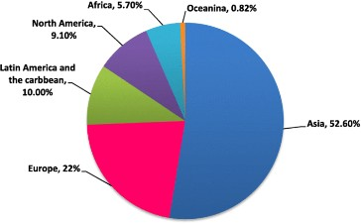
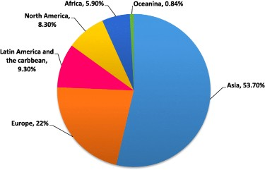
Survey of New Cases & Deaths By Brain Tumour
a) New Cases
b) Death Caused

Slide 9
REFERENCES
https://www.kaggle.com/
https://docs.python.org/3/tutorial/ https://www.python.org/ https://www.javatpoint.com/python-oops-concepts
https://www.tutorialsteacher.com/python/python-version-history https://www.w3schools.com/python/

Slide 10
DEMONSTRATION

Slide 11
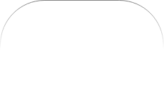
THANK YOU

